Slide 1

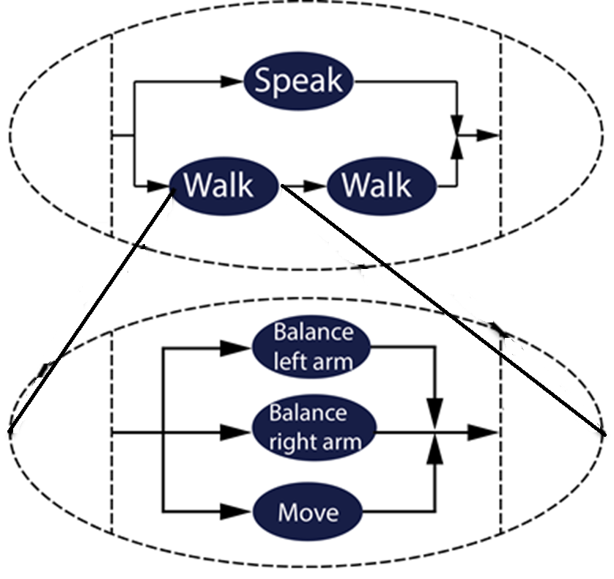
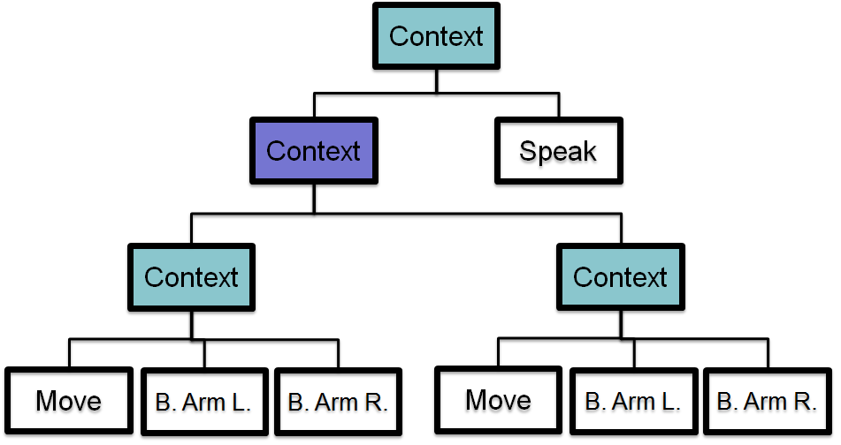
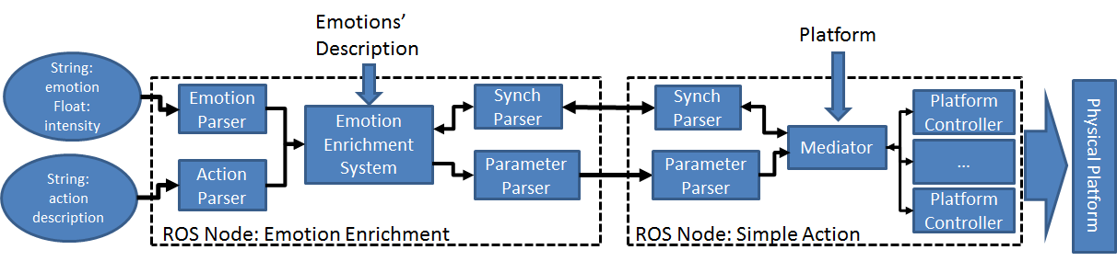
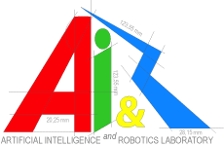


Towards Enriching Robot’s Actions
with Affective Movements
Julián M. Angel-Fernandez (*) (+)
Andrea Bonarini (*)
(*) Politecnico di Milano, Department of Electronics, Information and Bioengineering
(+) Technical University of Wien, Automation and Control Institute
{julianmauricio.angel,andrea.bonarini}@polimi.it
Angel-Fernandez@acin.tuwien.ac.at
Problem Definition
Contributions
Acceptance of social robotics could be increased if they convey emotions
Works studying emotions expression in robotics create specific solutions to convey emotions
Link to the platform or specific features
Pre-programmed movements
An emotional enrichment system could:
Reduce the time on introducing emotion expression
Enable reuse of emotional parameters
Use on different platforms
Emotional enrichment system emotional system that:
Could be used in different platforms
New platforms could be included
Could be extended to express through diverse features (e.g. movement and voice)
Emotions description are described in external files
Easy modification
Independent of decision systems (e.g. action and emotion)
The System
Concepts
Simple Action are actions that are considered as primitives or building blocks.
Compound Action are actions that are created from simple actions.
Action Message establishes the structure of the message to describe any kind of action
Emotional Parameters describe how the emotional enrichment should be done to convey an emotion in a specific simple action
Emotional Execution Tree is a computational representation of desired actions that should be executed
Simple Action and Compound Actions
Emotional Execution Tree
Implementation
airlab.ws.dei.polimi.it
www.polimi.it
http://www.tuwien.ac.at

