Slide 1
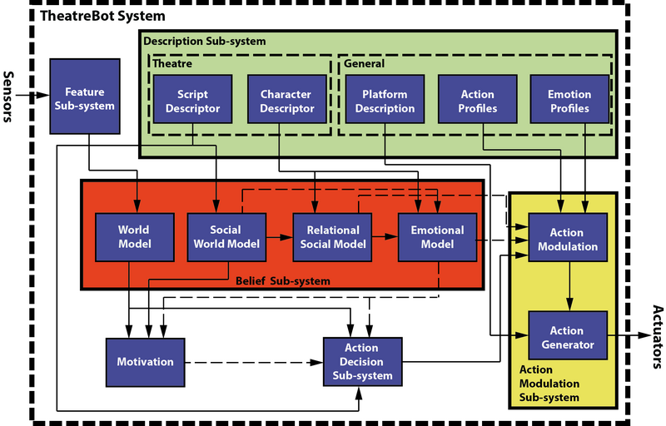

Slide 2
Changes
Notes:
*The blue line from world model is to close the pid controller necessary to correctly move
*The red line is the failure signal, which informs if the action could be perform or not, or if during the performing it was a problem

Slide 3
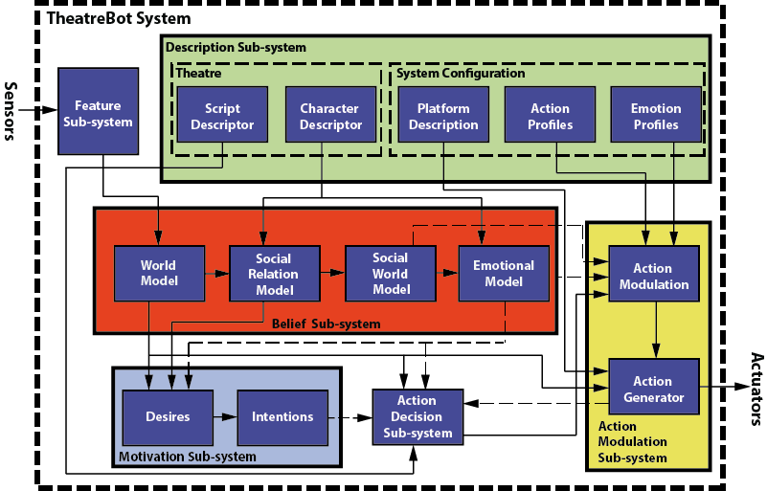
2.0

Slide 4
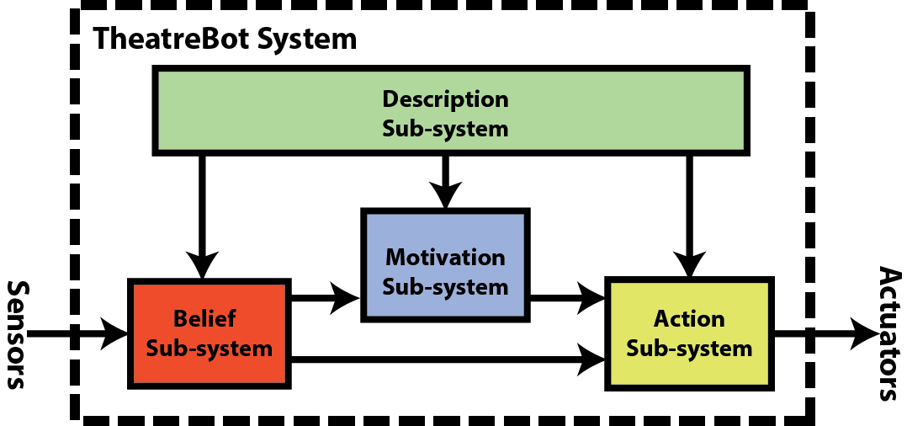
General Architecture

Slide 5
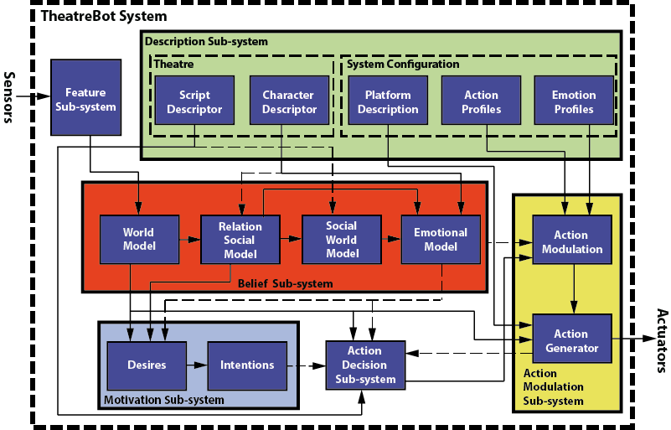
2.01

Slide 6
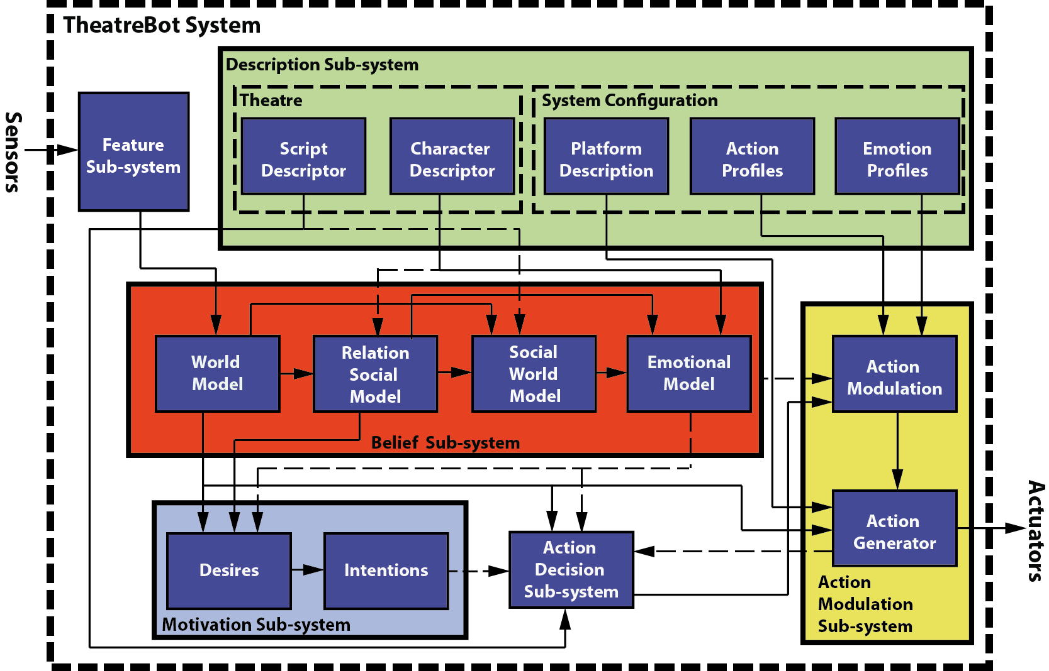
2,02

Slide 7
List of boxes
Action Generation
Action Modulation
Emotion Profiles
Action Profiles
Platform Description
Character Descriptor
Script Descriptor
World Model
Social World Model
Relational Social Model
Emotional Model
Motivation

Slide 8
Relational Social Model
Description:
This module is in charge of:
Upgrade the emotion that a place, person, role and situation make feel the character

Slide 9
Relational Social Model
Input
World Model: own pose and motion, free space, and metal model of others.
Character descriptor: gives the basic information about how the character relates with other roles.
Output
People and roles that are present in the environment

Slide 10
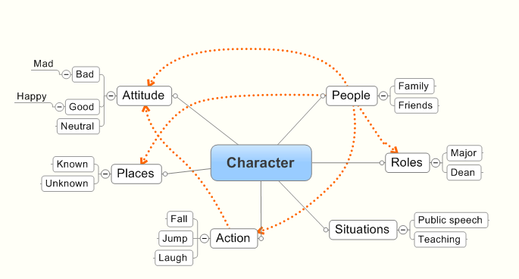
Relational Social Model: Example

Slide 11
Social World Model
Description:
This module is in charge of:
Recognize social situation
Calculates the emotional state of others

Slide 12
Social World Model
Input
World model
People and roles present in the environmnet
Output
Situation awareness
Emotional state of people in the environment

Slide 13
Emotional Model
Description:
This module evaluates the current situation and update the current emotional state

Slide 14
Emotional Model
Input
Character descriptor: attitude and social behavior
Social world model: gives the information about the current situation, and the possible emotional state of the people present on it.
Relational social model: gives the information about the people, role, etc. that is present in the environment and how the characters feels when this person is around
Output
Emotional state: <emotion, intensity>

Slide 15
Emotional Model
Failure signal
Specific controllers
Platform description
Translational
Wheel motors
Emotional Actions
Action Filter
Actions
Action Controller
Torso movement
Torso motors
Arm movements
Arm motors
World model

Slide 16
Action Generation
Description:
This module is in charge to:
Decide which actions could be performed by the platform
Execute and control each action that should be done

Slide 17
Action Generation
Input
Platform descriptor (1): this describes the capabilities of the platform, and it is use to select which actions could be perform
Emotional Actions (m): primitive actions that should be perform
Output
Electronic signal (n): this to control each actuator
Failure signal(1): this signal informs if the actions could or not be perform

Slide 18
Action Generation
Failure signal
Specific controllers
Platform description
Translational
Wheel motors
Emotional Actions
Action Filter
Actions
Action Controller
Torso movement
Torso motors
Arm movements
Arm motors
World model

Slide 19
Action Generation
Action Filter
Action Controller
Specific Action Controllers
Translational
Torso movement
…

Slide 20
Translational controller
Description:
This controller drives the robot from point A to point B given the information. This controller is the traditional controller used in current robotic systems.

Slide 21
Translational controller
Inputs
World model: this model specifies the position of the objects that are around the robot.
Initial point: position of the robot at the moment that this command was called.
Final point: position that the robot must be reach
Outputs

Slide 22
Advance Translational controller
Description:
This controller introduces the option to modify the optimal trajectory and add new features to project emotions while is moving.

Slide 23
Action Controller
Description:
This module decides which actions should be executed given the current actions that have performed by the robot. This module communicates with a specific module, which knows how to perform the action. This module knows which actions are executing and solve the problems of precedence and importance.

Slide 24
Action Controller
Input
Actions (m): primitive actions that should be perform. Action description.
Failure signals(k): these signals inform that an action could not been performed
Output
Commands: each command is given to the corresponded module
Failure signal(1): this signal informs if the actions could or not be performed

Slide 25
Action Controller
Actions
Commands
Failure signals
Failure signal

Slide 26
Action Filter
Description
This module filter the possible actions that could be perform due the constrains of the platform, and it makes any necessary change to the action to be correct performed by the platform (e.g. Constrains of movement)

Slide 27
Action Filter
Input
Platform descriptor (1): this gives describes the capabilities of the platform, and it is use to select which actions could be perform
Emotional Actions (m): primitive actions that should be perform. Action description. The format of the action should be specify.
Output
Emotional Actions (n): primitive actions that could be performed by the platform. Action description .The format of the action should be specify.

Slide 28
Action Filter
Platform description
Emotional Actions
Emotional Actions

Slide 29
Action Description
Description
This part is missing

Slide 30
Action Modulation
Description
This module gets the emotional state and the action(s) to generate emotive actions, which includes adding new actions and modifying parameters of the current. To do this module add new actions regarding the platform

Slide 31
Action Modulation
Input
Emotional state (1): it is the emotion and its intensity, with the modification of social awarness. For example <happy, 1>
Abstract Actions (m): actions that should be perform, these actions do not include emotional part.
Action Profiles (n): described actions that are compounded by other actions. For example the action walk could be decomposed in move arms, legs and torso.
Emotion Profiles (k): these describes the actions that should be added, and the actions and parameters that should be change to show an specific emotion.
Output
Emotional Actions (l): actions with emotional changes (parameters changed and actions added)
Failure signal: to inform the action decision sub-system that one of the actions could not be performed.

Slide 32
Action Modulation
Emotional state
Emotion modified
Emotion profiles
Action Addition
Actions
Action Modification
Emotional Actions
Action profiles
Simple Actions
Action Decrypt
Abstract actions

Slide 33
Action Modification
Description
This module is in charge to change the parameters of all the actions given the emotion.

Slide 34
Action Modification
Input
Actions (l): actions with emotional changes (parameters changed and actions added)
Emotion Profiles (k): these describes the actions that should be added, and the actions and parameters that should be change to show an specific emotion.
Intensity modified (1): is the new intensity given the social awareness.
Output
Emotional action (l): all the necessary action to express emotions (addition and modification of emotions)

Slide 35
Action Addition
Description
This module is in charge to add the necessary movements to express the emotion. If the action is already, it does not do anything.

Slide 36
Action Addition
Input
Emotion Profiles (k): these describes the actions that should be added, and the actions and parameters that should be change to show an specific emotion.
Emotion modified (1): is the emotions given that we have to act in a different way if we are interacting with our boss than our family.
Simple Actions (k): actions that are used to construct compound actions.
Output
Actions (l): actions with emotional changes (parameters changed and actions added)

Slide 37
Action Decrypt
Description
This module take a compound or simple. If the action is simple, it does not do anything. But if the action is compound, it resolved the action until arrived to simple actions.

Slide 38
Action Decrypt
Inputs
Compound Actions (m): actions that should be perform, these actions do not include emotional part.
Action Profiles (n): described actions that are compounded by other actions. For example the action walk could be decomposed in move arms, legs and torso.
Outputs
Simple Actions (k): actions that are used to construct compound actions.

Slide 39
Emotion Profiles
Description

Slide 40
Emotion Profiles
Input
Output

Slide 41
Emotion Profiles
(emotion: happiness
(Move (parameter: Velocity: fast))
(WaveMove (parameter: Velocity: fast )
(parameter: MaximumAngle: medium))
(WaveShoulder (parameter: movement: asymmetric)
(parameter: MaximumAngel: medium))
)

Slide 42
Emotion Profiles
(emotion: angry
(Move (parameter: Velocity: fast))
(WaveMove (parameter: Velocity: small)
(parameter: MaximumAngle: verysmall))
(WaveShoulder (parameter: movement: asymmetric)
(parameter: MaximumAngel: medium))
)

Slide 43
Action Profiles
Description

Slide 44
Simple Actions
Move(finalPosition, Velocity, angularPosition)
WaveMove(Velocity,MaximumAngle)
RotateTorso(Angle)
RotateTorso(Angle,Velocity)
WaveTorso(Velocity,MaximumAngle)
Grasp(Object)
RotateHead(AngleTheta,AngleBeta)
RotateHead(AngleTheta,AngleBeta,VelocityTheta, VelocityBeta)
RotateShoulder(Idshoulder,AngleBeta,AngleTheta,AngleOmega)
WaveShoulder(Idshoulder,Idshoulder,AngleBeta,AngleTheta,type)

Slide 45
Platform Description
Description:
It is given from the simple actions
(platform: triskar
(basicActions: move, wavemove, RotateShoulde
)

Slide 46
Platform Description
Format
Example

Slide 47
World Model
Description
this model specifies the position of the objects that are around the robot.
Current position of the robot
Position of the objects surrounding the robot
Mental model of others

