Slide 1

MIDNIGHT HACKATHON
m402
Private agentic payments on Midnight.
x402, with no payer attached to the payment.
Link to the site
·
01 / 13

Slide 2
THE PROBLEM
An agent that pays per call publishes its entire behaviour.
157.4M
$41.1M
$0.26
x402 payments settled to date
stablecoin volume moved across 7 chains
average payment — a per-call meter, not a purchase
cumulative, jul 2026 · agenteconomy.to · every one of them public
PAYER
AMOUNT
COUNTERPARTY
FREQUENCY
Which wallet made the call
Exactly what each call cost
Which service was called
How often, and at what hour
Every x402 payment is signed by an address, so the calls link to each other. What comes out is a public, ordered record of what an agent does — which is its strategy.
02 / 13

Slide 3
STARTING POINT
x402 already solved the handshake. We kept it.
402
RETRY
200
Merchant answers Payment Required with a price
→
Agent repeats the request carrying payment
→
Merchant serves the response
m402 changes nothing about that exchange. The client sees the same status codes and the same header. What changes is what settles on-chain underneath it.
03 / 13

Slide 4
WHAT IS PROVED
The agent proves one sentence: someone holding a valid credit paid this price.
PRIVATE
PUBLIC
PUBLIC
The payer
The price and the merchant
That someone paid
pay takes no payer argument and reads no caller identity. Two payments cannot be linked.
Registered on-chain, listed in the explorer. A marketplace needs a price list.
A receipt hash lands in the on-chain set. No address appears anywhere in it.
The amount is public, because it equals the published price. m402 hides who paid, not how much — and who paid is what x402 leaks.
04 / 13

Slide 5
WHAT WE RUN
A marketplace for paid services, and services of our own on it.
M402 MARKETPLACE
X402 BRIDGE
Merchants publish their own endpoints
We publish x402 services too
Register a price, get paid per call, settle in mNight. 100% Midnight-native, private on the payment leg by default.
A USDC relayer pays the external service on its own chain and returns the resource. It is credited in the vault exactly like any other merchant, so the agent never leaves the private path.
We operate the relayer and its USDC float in this first step, and the relayable services are a curated list. The Midnight-native side needs no operator at all.
05 / 13

Slide 6
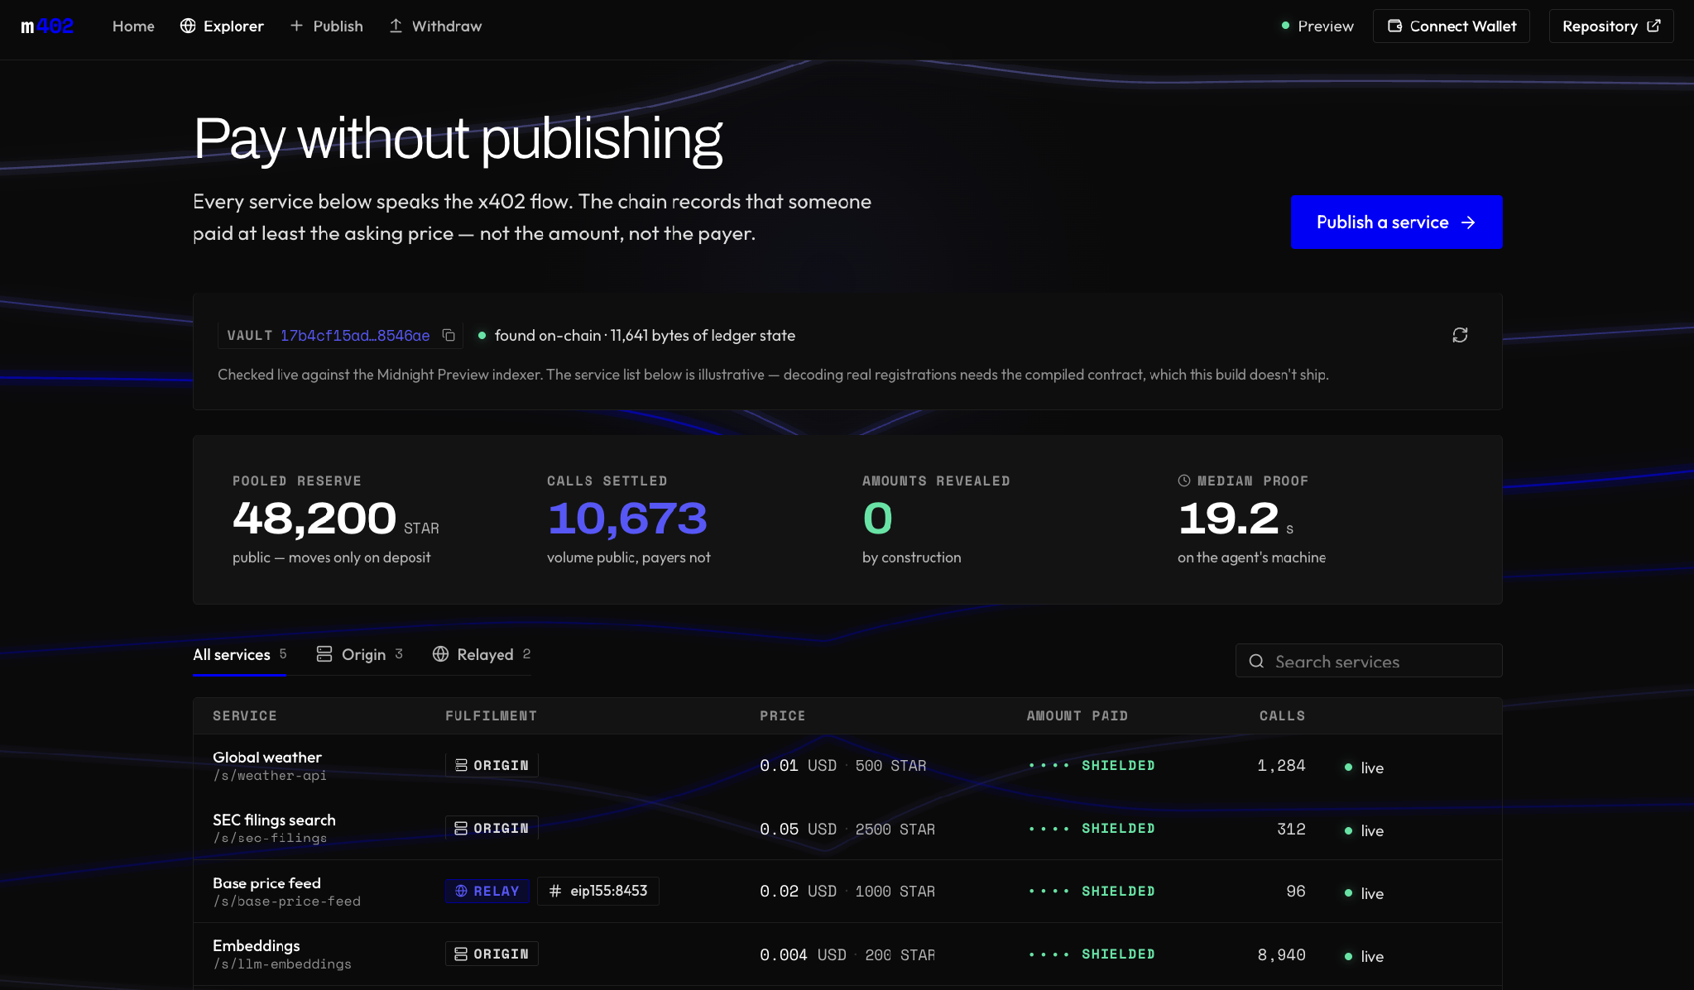
THE MARKETPLACE
Every listed service speaks x402. There is no payer column, because no payment carries one .
Prices and call volume are public — a marketplace needs a price list. Which agent bought what is not.
06 / 13

Slide 7
WHY MIDNIGHT
Selective disclosure is the ledger's own model, not a layer on top of it.
MNIGHT
NIGHT is unshielded, so spending it reveals the sender. The vault pools deposited NIGHT and mints mNight, a shielded credit, against it 1:1
On a transparent chain, hiding the payer means an off-chain operator standing between agent and merchant. On Midnight the proof does it, so nobody has to be trusted with the thing we are hiding.
COMPACT CIRCUIT
pay(serviceId) takes no payer argument. There is no msg.sender to read and none is added
Selective means the agent decides. If a payment has to be shown — for tax, accounting or an audit — it hands over that payment's receipt secret; the auditor recomputes the hash against the public ledger. One payment, and only that one.
WITNESS
Proving runs on the agent's machine. The credit coin and the receipt secret are inputs to the proof, never fields of a transaction
RECEIPT
Only hash(secret, serviceId) reaches the chain. The secret stays with the payer and is what claims the resource
07 / 13

Slide 8
ONE CALL, END TO END
01
Agent deposits into the vault
Unshielded NIGHT in, shielded mNight minted out. Deposit is public.
02
Gateway answers 402
Carrying the registered price — 0.01 USD · 500 STAR
03
Agent proves locally
No address enters the transaction. Private.
04
Retry with the receipt secret
Same request, one X-Payment header. The origin API is untouched
05
Gateway finds the receipt on-chain, serves 200
The gateway never holds funds, never signs, and cannot fake a payment
08 / 13

Slide 9
THE AGENT CLI
The whole flow is four commands.
$
m402 deposit 5000
COMPOSABLE
NIGHT in, mNight credit out
The resource body is written unchanged to stdout, timings to stderr — m402 call … | jq
$
m402 call http://…/s/<service-id>
402, prove, retry — the body lands on stdout
$
m402 call …/s/<service-id> --dry-run
NEVER PAYS TWICE
See the price before paying it
The receipt secret is written to disk before the transaction is built, so an interrupted call resumes instead of re-paying
$
m402 redeem 1000 --yes
Unspent credit back to the wallet's own address
LOCAL BY DEFAULT
Proving stays on loopback and redeem has no recipient argument to misdirect
09 / 13

Slide 10
GETTING OUT
mNight is a claim on NIGHT, and both sides can claim it back.
AGENT
MERCHANT
Redeem unspent credit
Withdraw earnings
Whatever mNight the agent did not spend goes back out of the vault as NIGHT. Deposits are not one-way.
withdraw pays the Lace address recorded at registration, out of the pooled NIGHT reserve. Merchants never handle mNight.
The private leg is the payment itself. Entering and leaving the vault are public NIGHT transfers, so the pool stays auditable — outstanding claims can never exceed the reserve.
10 / 13

Slide 11
WHERE IT STANDS
The happy path runs end to end. Everything else is named, not hidden.
WORKING
NOT YET
Vault contract: registerService, deposit, pay, redeem, withdraw
The amount is public — it equals the published price
Gateway proxy and indexer watcher
Payment and delivery are not atomic — no refund circuit yet
CLI: deposit, call, redeem
Privacy is bounded by the anonymity set, and the pool is small
Marketplace registration and explorer
The relayer is a trusted operator, and its services are curated
Midnight Preview only
11 / 13

Slide 12



TEAM
Three people who have shipped this kind of system before.
Julian Ariel Martinez
Martín Lecam
Sebastián Rosenberg
ENGINEERING LEAD
SYSTEMS ENGINEER
ACCOUNT & PROJECT MANAGER
Software engineer, 10+ years, 5+ of them in blockchain. Has built and led engineering on the official Bittensor TAO bridge, among several others.
Over ten years designing systems where failure is not an option, for global financial and energy institutions including JP Morgan and Chevron.
8 years in crypto, leading projects for the Arbitrum Foundation, Stacks Foundation and Rootstock, among others. Has secured 15+ grants across the space.
12 / 13

Slide 13

M402
The chain records that someone paid the price. It does not record who.
x402 keeps its flow. Midnight supplies the privacy. An agent can pay for what it uses without publishing what it does.
Link to the site
m402
·
·
13 / 13

