Slide 1
Data Visualization with R Shiny Apps
Juliana Spector
July22, 2019
Notes:
I participated in a datathon as part of the Water Data Symposium (put on by the SWAMP group) in early July.
Individuals from Water Boards, other state agencies within CalEPA, federal agencies, and general public participated.
I will demonstrate the R Shiny app that was developed from the datathon as well as another app that I have been working on that shows how plots produced from the ggplot package can be more interactive.

Slide 2
Water Datathon App Problem and Purpose
Select a location within PWS boundary and see current and past water sources
Notes:
The datathon project was sponsored by the Division of Drinking Water.
The State Water Board’s Division of Drinking Water (DDW) regulates approximately 7,500 public water systems (PWS) in California.
A PWS is defined as a system that provides drinking water for human consumption to 15 or more connections or regularly serves 25 or more people daily for at least 60 days out of the year.
The DDW allocates permits for PWS and collects an annual report from each system.

Slide 3
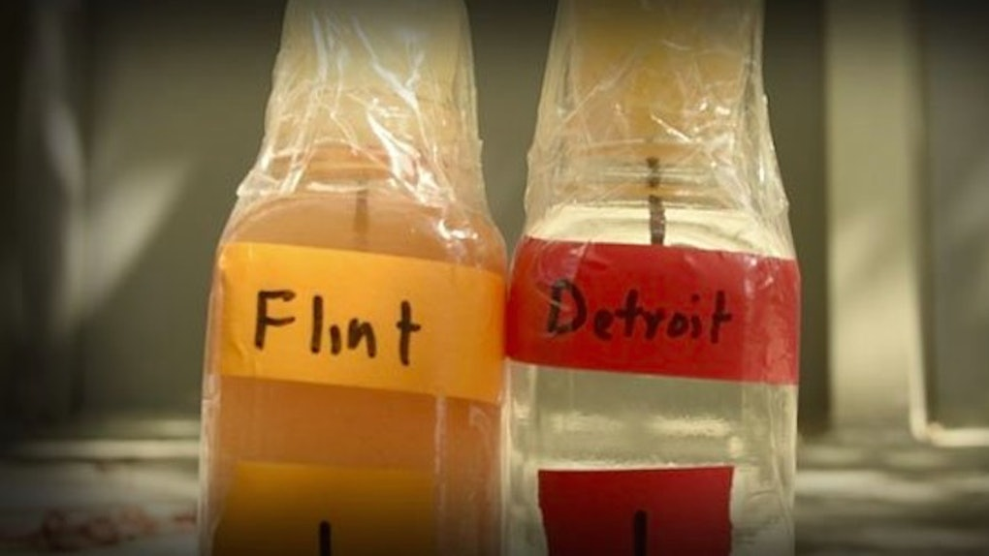
Motivation: Flint Drinking Water Crisis
Image Credit: Twitter
Notes:
This type of app could have been useful in the case of the drinking water crisis in Flint, Michigan. When the city of Flint switched the water source from Lake Huron (where Detroit gets its water) to the Flint River, residents began to notice issues with the smell, taste, and appearance of their water.

Slide 4
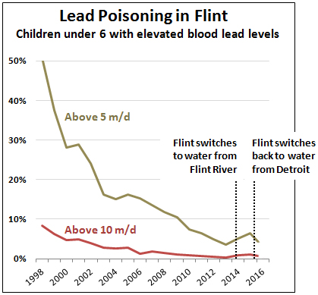
Motivation: Flint Drinking Water Crisis
Image Credit: Mother Jones
Notes:
This is a graph showing percentage of children in Flint with elevated lead blood levels.
What you see is very steady and impressive progress from 1998 to 2013, with the number of children showing elevated blood lead levels (above 5 micrograms per deciliter) declining from approximately 50 percent to 3.6 percent.
Then Flint stopped using Detroit water and switched to Flint River water, which corroded the scale on their lead pipes and allowed lead to leach into the water. The number of children with elevated lead levels rose to 5.1 percent and then 6.4 percent.

Slide 5
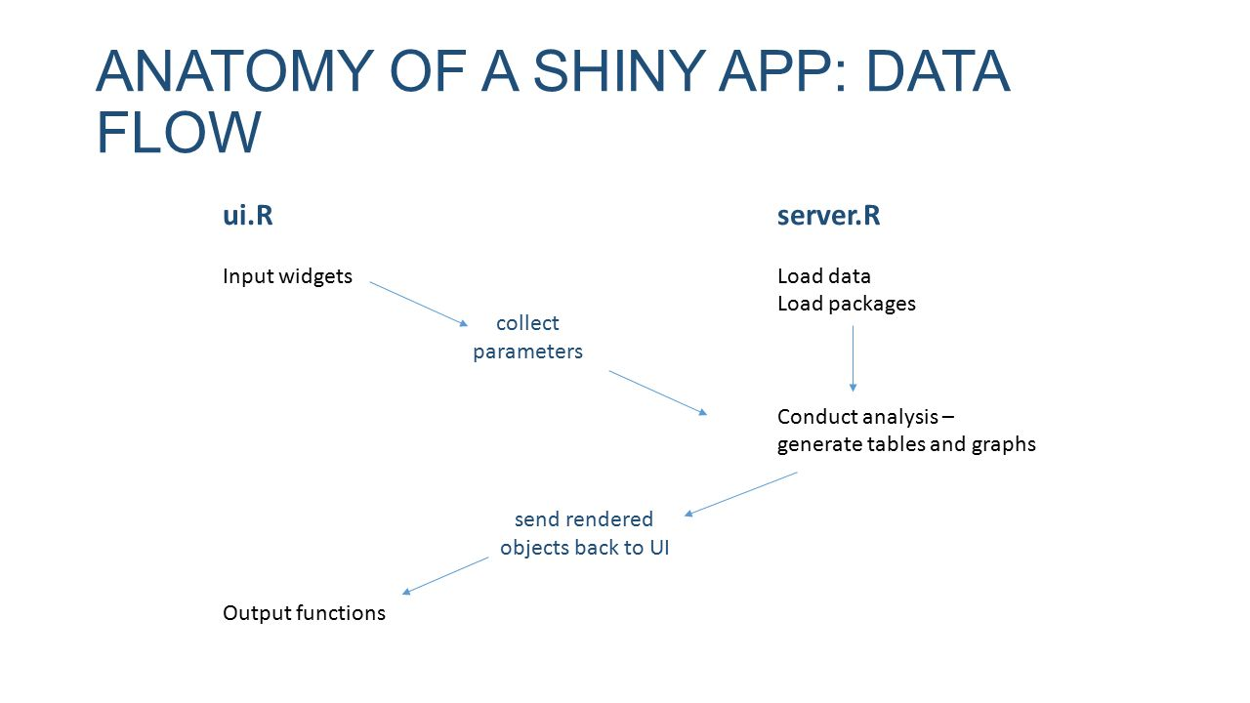
Platform: R Shiny App
Image Credit: datascience+
Notes:
The widgets collect input parameters through text boxes, drop down menus, or sliders for data between a range.
The server script loads data and packages and generates tables and graphs. The output from the graphics is rendered back to the UI script.

Slide 6
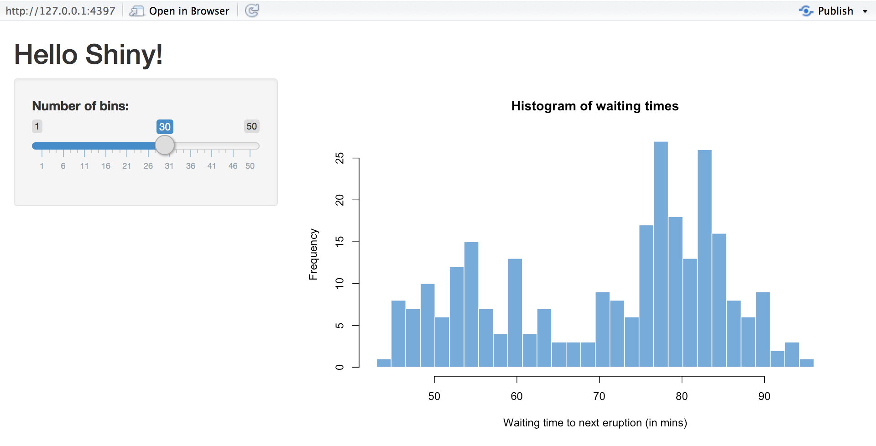
Platform: R Shiny App
Notes:
This is an example of a very simple Shiny app that R Studio for which R Studio provides the code so users can see how to build an app.
The number of bins can be adjusted with the slider and this controls the extent of the y axis which represents frequency.
The app shows the frequency of waiting times to see the Old Faithful geyser erupt in Yellowstone National Park.

Slide 7
Available Data Sources for Water Datathon App
PWS Boundaries
DDW Source Points
Electronic Annual Reports
Notes:
The Water Boundary Tracker Tool provides shapefiles of PWS boundaries that are finalized and complete.

Slide 8
Demonstration of Apps

