Slide 1
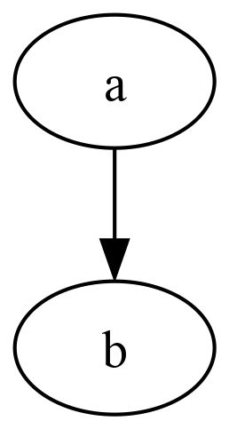
For reference: graphviz
Should be an image:

Slide 2

This works
Here is some text. Other column is image.

Slide 3

Still good
Here is some text. Next is the example for convert:

Slide 4

Still good
And then there is the example for montage:

Slide 5
This is where it should be
Text

Slide 6

This one doesn’t play nice
This is where the text is.

Slide 7

And this one also doesn’t
This is where the text is.

