Slide 1
This should become a (crappy) table
row 1, column 1 | row 1, column 2
row 2, column 1 | row 2, column 2
Text for test. Will ignore column width.

Slide 2
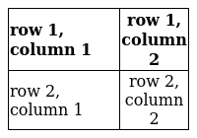
This is what the output should look like eventually
Table with text as text. Some stuff in bold. Low res for the purpose of this example. Code used to create the image:
bash render_table.sh table.yaml table.png -a l,c -w 2,1 -W 200

Slide 3
This should become an image
Table with text as text. Some stuff in bold.
- - **row 1, column 1**
- **row 1, column 2**
- - row 2, column 1
- row 2, column 2

