Slide 1
NexusAI
A multi-chain marketplace for AI model licences
Julian Calvo
AAI6850, Module 15 capstone
August 2026
Testnet project. Not independently audited. Not for mainnet or real value.
Notes:
Introduce the project in one line: a marketplace where a model can only be sold while an oracle says it still works.

Slide 2
The problem
A model vendor's accuracy claim is unverifiable before you pay.
Models decay, and nobody tells the buyer when the datasheet stops being true.
Licensing one is a procurement cycle, not a purchase.
Transacting on a public chain publishes who you are and what you paid.
Notes:
Four frictions. The first two are the interesting ones because they are information problems, not workflow problems.

Slide 3
What I built
10 Solidity contracts: token, staking, governance, marketplace, oracle, compliance, sealed-bid auction, cross-chain registry.
A phishing detection classifier in Python whose evaluation output feeds the oracle.
A provider posts a slashable bond and declares an accuracy floor.
The oracle committee measures the model on a secret holdout and publishes the median.
The marketplace refuses to sell a model below its own declared floor.
Notes:
The key structural point: the ML result is not decoration, it is what gates the sale.

Slide 4
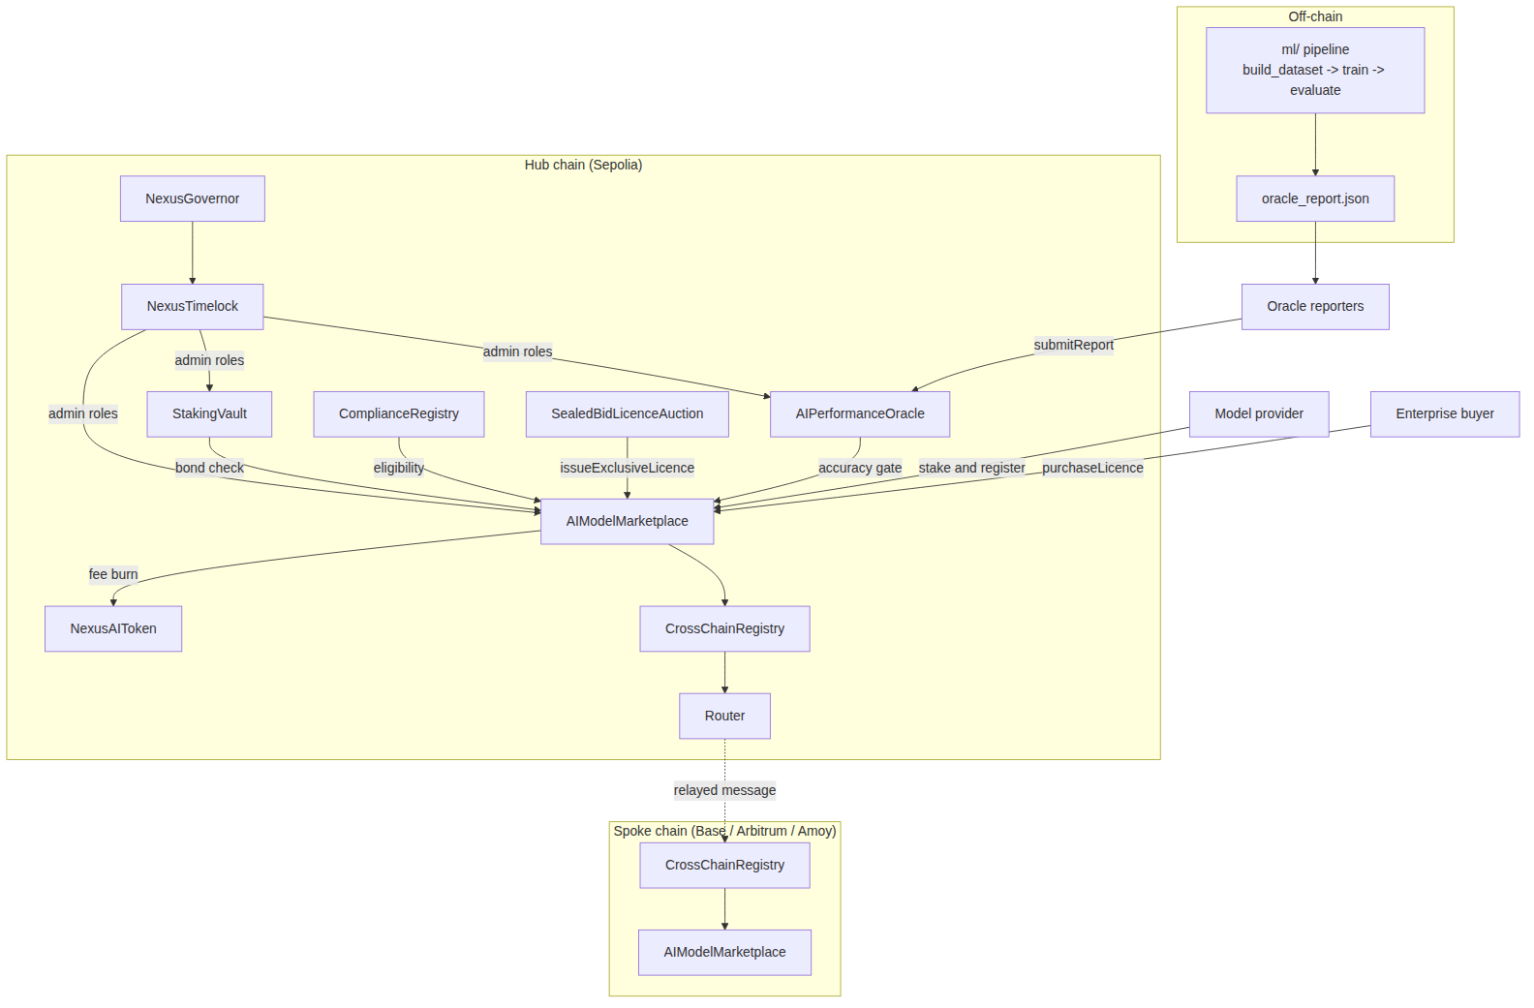
Architecture
Notes:
Hub chain has the full stack. Spokes get a marketplace, a compliance registry and a bridge registry. Off-chain ML feeds the oracle.

Slide 5
Tokenomics, staking, governance
NEXA: 1B hard cap, 400M genesis mint to the timelock, emissions rate-limited per 30-day epoch.
The epoch ceiling itself is capped by an immutable constant, so no vote can inflate past it.
Staking: four lock tiers, 1.0x to 2.2x, Synthetix reward accounting, slashing up to 30%.
Provider bonds live in the same vault and get slashed on a lost dispute.
Governor: 4% quorum, 1-day delay, 5-day vote, 2-day timelock. Snapshot voting, so flash-borrowed votes do not count.
Notes:
Mention that the fee is capped at 10% in the contract, so governance cannot tax the marketplace to death either.

Slide 6
The model
Phishing email classifier. Three feature families: TF-IDF text, 30 URL features, 22 header and authentication features.
Six-model ladder. Each step is a hypothesis, not a hyperparameter sweep.
Selected: soft vote over a gradient boosting model on dense features and a tuned logistic regression on all three families.
Test F1 0.960, precision 0.957, recall 0.963, ROC-AUC 0.981.
Threshold 0.272, chosen on expected cost with a false negative weighted 4x, not on F1.
Notes:
The surprising result: dropping the text entirely and using only URL and header features beat every text model. Most of the signal is in who sent it, not what it says.

Slide 7
Leakage control
Template-generated messages produce near-duplicate clusters.
A random split puts siblings of a test message in training and reports a meaningless score.
Split is StratifiedGroupKFold on group id. Group overlap between splits is zero, asserted in code.
Ran it both ways to measure the cost: random split test F1 0.9411, grouped 0.9358.
So a random split would have overstated F1 by 0.005 here, and by much more on a real corpus with campaign duplication.
Notes:
This is the slide to spend time on if anyone challenges the ML rigour.

Slide 8
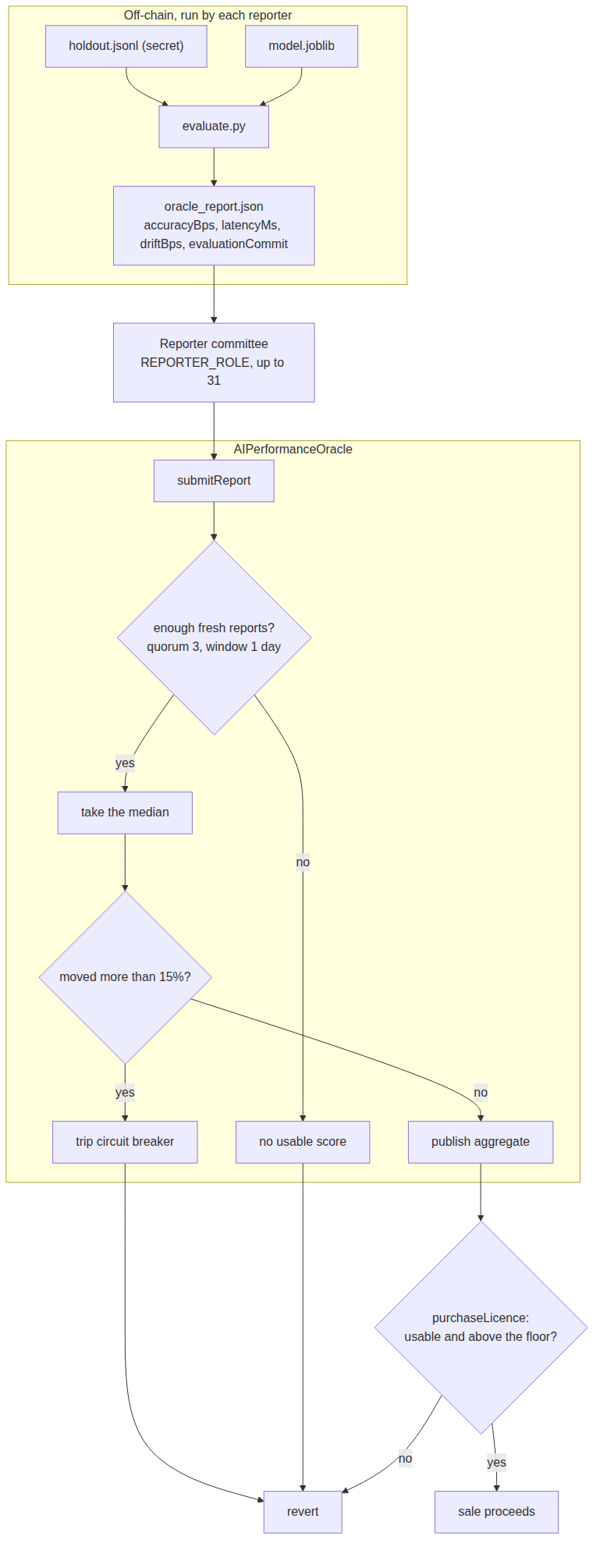
Oracle
Notes:
evaluate.py writes oracle_report.json, report-oracle.js submits it, the marketplace reads it on every purchase.

Slide 9
Oracle design
Reporters submit accuracy in basis points. Contract takes the median, not the mean, so one liar cannot move it.
Quorum of 3 fresh reports inside a 1-day staleness window, or there is no usable score at all.
A median that moves more than 15% trips a per-model circuit breaker and sales stop.
Reporters publish the score and a hash of the holdout manifest, never the holdout itself.
Every failure mode fails closed: no score means no sale.
Notes:
Demo step 9 shows the breaker firing when the model drops from 96 to 61 percent.

Slide 10
Privacy and compliance
Compliance registry stores a Merkle root, a country code and an expiry. Nothing else.
A buyer proving one attribute reveals exactly that one leaf. No name, no address, no other attributes.
Revocation is on-chain and immediate. Erasure is off-chain at the attester.
Sealed-bid auctions use commit-reveal with uniform collateral, so neither the bid nor the deposit leaks willingness to pay.
Commitments are bound to the bidder's address, so a copied commitment is useless.
Notes:
Be careful with the GDPR claim: the argument is that no personal data hits an immutable ledger. I am not a lawyer and this has not been reviewed by one.

Slide 11
Cross-chain
Hub and spoke. Two message types: model listing and licence entitlement.
Source emits, destination executes. The source never reaches into the destination.
The destination registry checks the router, the trusted remote and the nonce itself, without trusting the router.
expiresAt is an absolute timestamp, so a delayed message cannot extend an entitlement.
Payload carries no fee, escrow or bond state, so a compromised spoke cannot make claims about hub money.
Local demo uses a mock router. Production needs a real CCIP or LayerZero adapter behind the same interface.
Notes:
Demo step 8 shows a replayed message and a direct ccReceive call both rejected.

Slide 12
Security review
Slither 0.11.6 and Solhint over the full contract set. 45 results, all triaged. 0 Solhint errors.
13 manual findings, 12 fixed. No critical.
Both High findings were provider-bond problems that no tool detected: a bond withdrawable in the same block, and a minimum bond of zero.
M-05 is a compliance bypass I introduced while fixing M-01 and caught on a later pass.
Every fix has a named regression test. 195 tests, 13 of them attack simulations.
8 residual risks documented and accepted, not hidden.
Notes:
If asked whether a self-audit is worth anything: M-05 is the honest answer. It is exactly the failure mode independent review exists to catch.

Slide 13
Tests, coverage, CI
195 tests, 0 failing.
Coverage: 99.76% statements, 92.56% branches, 99.15% functions, 99.82% lines. Requirement was 90%.
CI runs 8 jobs with four hard gates: coverage below 90%, an unaccepted High Slither finding, a contract over the EIP-170 size limit, or model accuracy below 90% all fail the build.
Monitoring document maps every privileged event to a severity tier and a runbook action.
The monitoring is a specification. There is no deployed indexer or alerting stack.
Notes:
Do not overclaim the monitoring. It is written, not running, and standing it up is a named prerequisite before a first mainnet listing.

Slide 14
The demo
1-2. Provider bonds 50,000 NEXA for 180 days, lists the model at 1,000 NEXA with a 90% floor.
3. Three reporters publish. Median lands at 96.04%.
4-5. Buyer is attested, then purchases. 15 NEXA burned, 35 to treasury, 950 escrowed.
6-7. Listing and entitlement mirrored hub to spoke.
8. A replayed message and a direct ccReceive call are both rejected.
9. Model degrades to 61%. Circuit breaker trips. Sales blocked.
10. Buyer disputes, gets refunded, provider bond slashed 20%, model delisted.
Notes:
Run npm run demo:crosschain live. It prints real contract state at every step.

Slide 15
Business case
5% protocol fee, 30% burned, 70% to treasury. Contract ceiling is 10%.
Base case: year 3 GMV of 36M, net cash flow still negative at -1.49M.
NPV at 30% is +1.67M, but that is entirely terminal value. Strip it out and the five modelled years are -2.82M.
Sensitivity says volume, not pricing. Even at the 10% ceiling year three barely turns positive.
Buyer-side case is stronger: break-even is roughly a 2.2% reduction in expected phishing loss.
Notes:
Be straight about the terminal value point. Anyone reading the +1.67M as the answer has read the terminal assumption as the answer.

Slide 16
What is not done
No public testnet deployment. Four networks are configured, nothing is deployed, so no addresses or explorer links.
The bridge is a mock router, not a real adapter.
The security review is mine, not independent.
The ML corpus is synthetic, because the build machine cannot reach the public phishing datasets.
No cross-chain licence revocation. A refunded buyer keeps a mirrored licence on a spoke until it expires.
Monitoring is specified, not running.
Notes:
Say these before anyone asks. Every one of them is written down in the README and the audit report too.

Slide 17
Next
Cross-chain revocation with a monotonic per-holder watermark.
Real CCIP or LayerZero adapter, then redo the whole security review against it.
Independent audit and a public contest before any mainnet consideration.
Foundry invariant tests on the reward accumulator.
Re-run the ML pipeline on Nazario, SpamAssassin and PhishTank, and republish the model card.
Deploy across the four configured testnets and record the addresses.
Notes:
Close on the deployment gap, since that is the one assignment requirement not yet met.

