Slide 1
Phishing email detection
Julian Calvo
AAI6850 capstone, Module 15
August 2026
Notes:
Introduce the project in one sentence: a phishing email classifier, and the marketplace it plugs into.

Slide 2
The problem
Classify an email as phishing or benign from the subject, body, sender headers and any URLs.
The costs are not symmetric. A false negative puts a phishing message in an inbox.
A false positive quarantines legitimate business mail. Enough of those and the security team turns the filter off, which makes the false negatives worse too.
So: weight a false negative at 4x a false positive, and hold precision at 0.90 or better at whatever operating point I pick.
Notes:
The asymmetry is the reason the threshold gets chosen on cost rather than on F1 later.

Slide 3
Related work
Method | Year | Classifies | Approach | Reported
PILFER (Fette et al.) | 2007 | email | 10 structural features, random forest | 99.5% acc, 0.13% FP
CANTINA (Zhang et al.) | 2007 | web page | TF-IDF signature plus search result | 97% TP, 6% FP
CANTINA+ (Xiang et al.) | 2011 | web page | 15 URL, DOM and search features | 92.5% TP, 0.41% FP
Ma et al. | 2009 | URL | lexical plus WHOIS, DNS, AS | 0.9 to 3.0% error
PhishDef (Le et al.) | 2011 | URL | lexical only, online AROW | 96 to 98% acc
Fang et al. | 2019 | email | RCNN with attention, char and word | 99.85% acc, 0.04% FP
Atawneh, Aljehani | 2023 | email | BERT plus LSTM | 99.61% acc, 99.55% F1
Not comparable. Different tasks, corpora, eras and class balances. Full discussion in section 2 of the report.
Notes:
Three families: hand-crafted email features, page content plus search, and URL-only. Then the recent deep learning work.

Slide 4
What I took from the literature
PILFER's claim is that a small set of structural features beats a general spam filter. That is the result my model ladder ends up reproducing.
The URL-only work (Ma, PhishDef) shows how much signal sits in the link alone, with no page fetch. That motivated a separate URL feature family.
The 2019 and 2023 deep learning numbers are high, but on corpora whose class balance is either heavily imbalanced or not stated at all.
So I report a false positive rate at a stated operating point rather than a single accuracy number.

Slide 5
Data
The corpus is synthetic.
The machine I built this on can't reach the public phishing datasets, so build_dataset.py generates records from a seeded RNG (seed 6850) over 114 templates. Loaders for Nazario, SpamAssassin, PhishTank and UCI are written and get tried first. They have never run against real files here.
 | Records | Phishing | Benign | Groups
Corpus | 8,000 | 3,356 | 4,644 | 1,574
Holdout | 1,200 | 481 | 719 | 805
300 holdout records come from templates that appear nowhere in the corpus. 1.5% label noise is injected on purpose, so a perfect score would be a bug.
Notes:
Say the corpus is synthetic here rather than later. Every number after this is a result about the pipeline.

Slide 6
Leakage control
Templates produce near-duplicate messages. A random split puts siblings of a test message into training and reports a score that means nothing.
So the split is StratifiedGroupKFold on group_id, where a group is a near-duplicate cluster. Train 4,797, validation 1,603, test 1,600.
Group overlap between splits is zero, checked and asserted in code.
Split | Test F1
Random | 0.9411
Grouped | 0.9358
A random split would have overstated F1 by about 0.005 here. On real corpora with heavy campaign duplication it would be much larger.

Slide 7
Features
Text. TF-IDF over subject and body, word 1-2 grams plus char_wb 3-5 grams. Character n-grams catch deliberate misspellings ("acount", "ver1fy") and homoglyph domains that shatter into unseen tokens under word tokenisation.
URL and lexical, 30 features. URL count, HTTPS ratio, max and mean URL entropy, longest URL, risky TLDs, shortener hosts, brand lookalike distance, length and punctuation counts.
Header and authentication, 22 features. SPF, DKIM and DMARC results, sender domain shape, freemail sender, reply-to present, reply-to mismatch, display-name brand mismatch, received hop count, role account.
Notes:
Three families, all built in ml/src/features.py.

Slide 8
Model ladder
 | What changed | Val F1
M1 | Baseline. Word TF-IDF plus logistic regression | 0.7516
M2 | Add character n-grams | 0.7830
M3 | Drop text entirely. URL and header features only, HistGradientBoosting | 0.9705
M4 | All three families, calibrated LinearSVC | 0.9359
M5 | All three families, logistic regression, grouped GridSearchCV | 0.9463
M6 | Soft vote over M3 and M5 (selected) | 0.9682
Each step tests one idea rather than sweeping hyperparameters. Validation F1 at threshold 0.5.
Notes:
M3 is the interesting one. Throwing the text away beats every text model. Same conclusion PILFER reached in 2007.

Slide 9
Why the ensemble
M3 and M5 fail differently. M3 can't read the text at all. M5 can't model feature interactions like "SPF fails AND reply-to mismatches".
Averaging their probabilities trims both error modes. M6 is selected on validation PR-AUC (0.9753).
M4 scoring below M3 is the text block dragging down a model that already had the useful features.

Slide 10
Operating point
Threshold | Precision | Recall | F1 | Cost
0.272 (selected) | 0.9715 | 0.9657 | 0.9686 | 111
0.386 (F1-optimal) | 0.9831 | 0.9553 | 0.9690 | 131
0.500 (default) | 0.9846 | 0.9523 | 0.9682 | 138
Threshold chosen to minimise expected cost with a false negative weighted 4x, subject to precision staying above 0.90. F1 hardly moves across that range but cost moves 25%.
Notes:
F1 would not have distinguished these three. Cost does.

Slide 11
Test results
Metric | At 0.272 | At 0.500
Accuracy | 0.9663 | 0.9719
Precision | 0.9572 | 0.9816
Recall | 0.9629 | 0.9510
F1 | 0.9600 | 0.9660
ROC-AUC | 0.9813 | 0.9813
PR-AUC | 0.9740 | 0.9740
Held out until model and threshold were both frozen, then evaluated once. Test F1 0.960 against validation 0.969: a small drop is what you want. A test score above validation would suggest the split leaked.

Slide 12
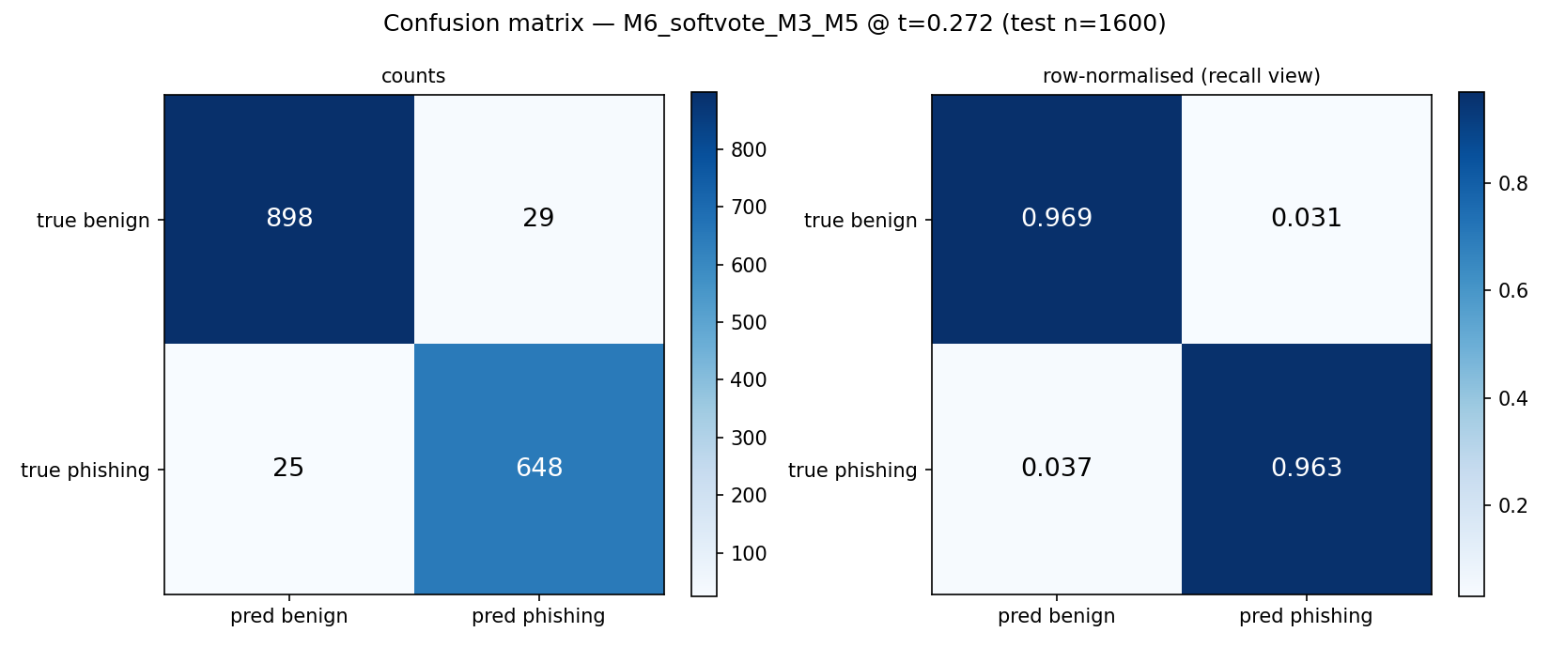
Confusion matrix

Slide 13
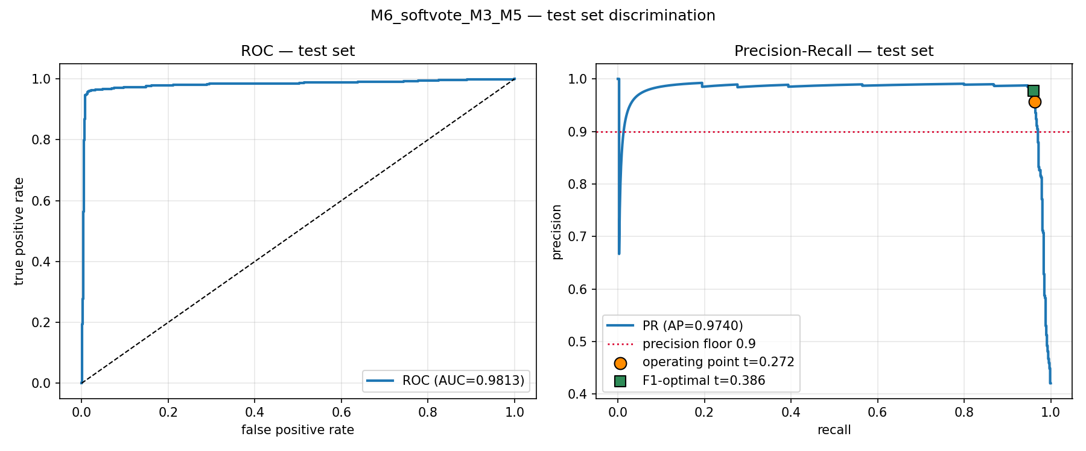
ROC and precision-recall curves

Slide 14
Error analysis
29 false positives and 25 false negatives on the test set. Of those, 21 FPs and 9 FNs are real model failures. The rest sit on records the noise process deliberately flipped, so the model was right and the label was wrong.
False negatives: 12 of 25 pass all three authentication checks. A phishing message from a genuinely authenticated domain defeats the strongest feature family the model has.
False positives: almost all are legitimate mail with no URLs. With no links to score, the URL family contributes zeros, and several of those zeros push toward phishing.
Fix: add an explicit "no URLs present" indicator so the model can tell "no links" from "bad links" instead of encoding both as zero.
Worked examples in ml/reports/error_examples.md.

Slide 15
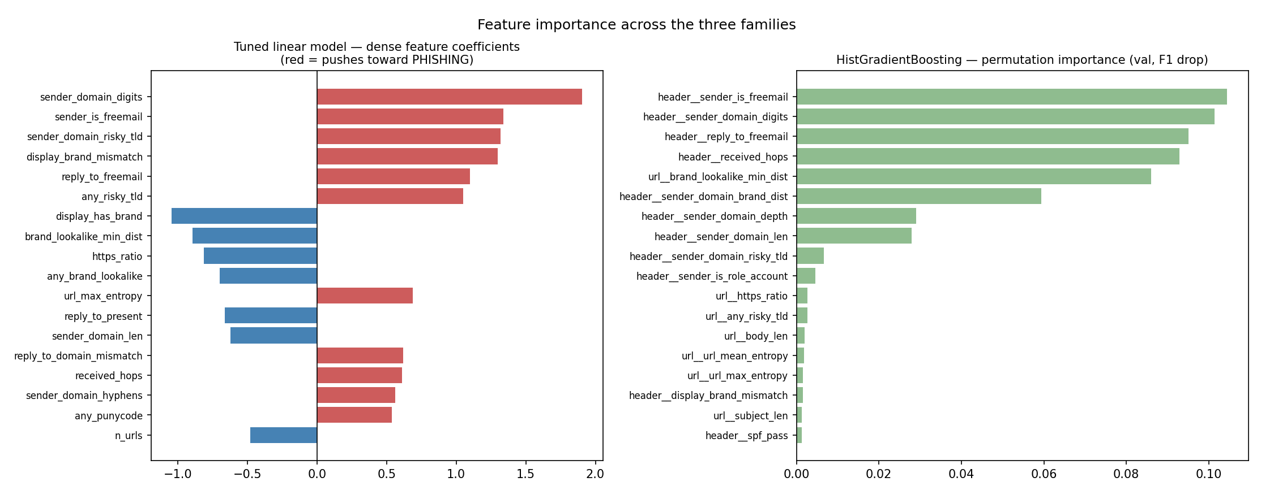
Feature importance
Notes:
Sender shape and authentication dominate. Permutation importance on M3 agrees with the dense model's coefficients.

Slide 16
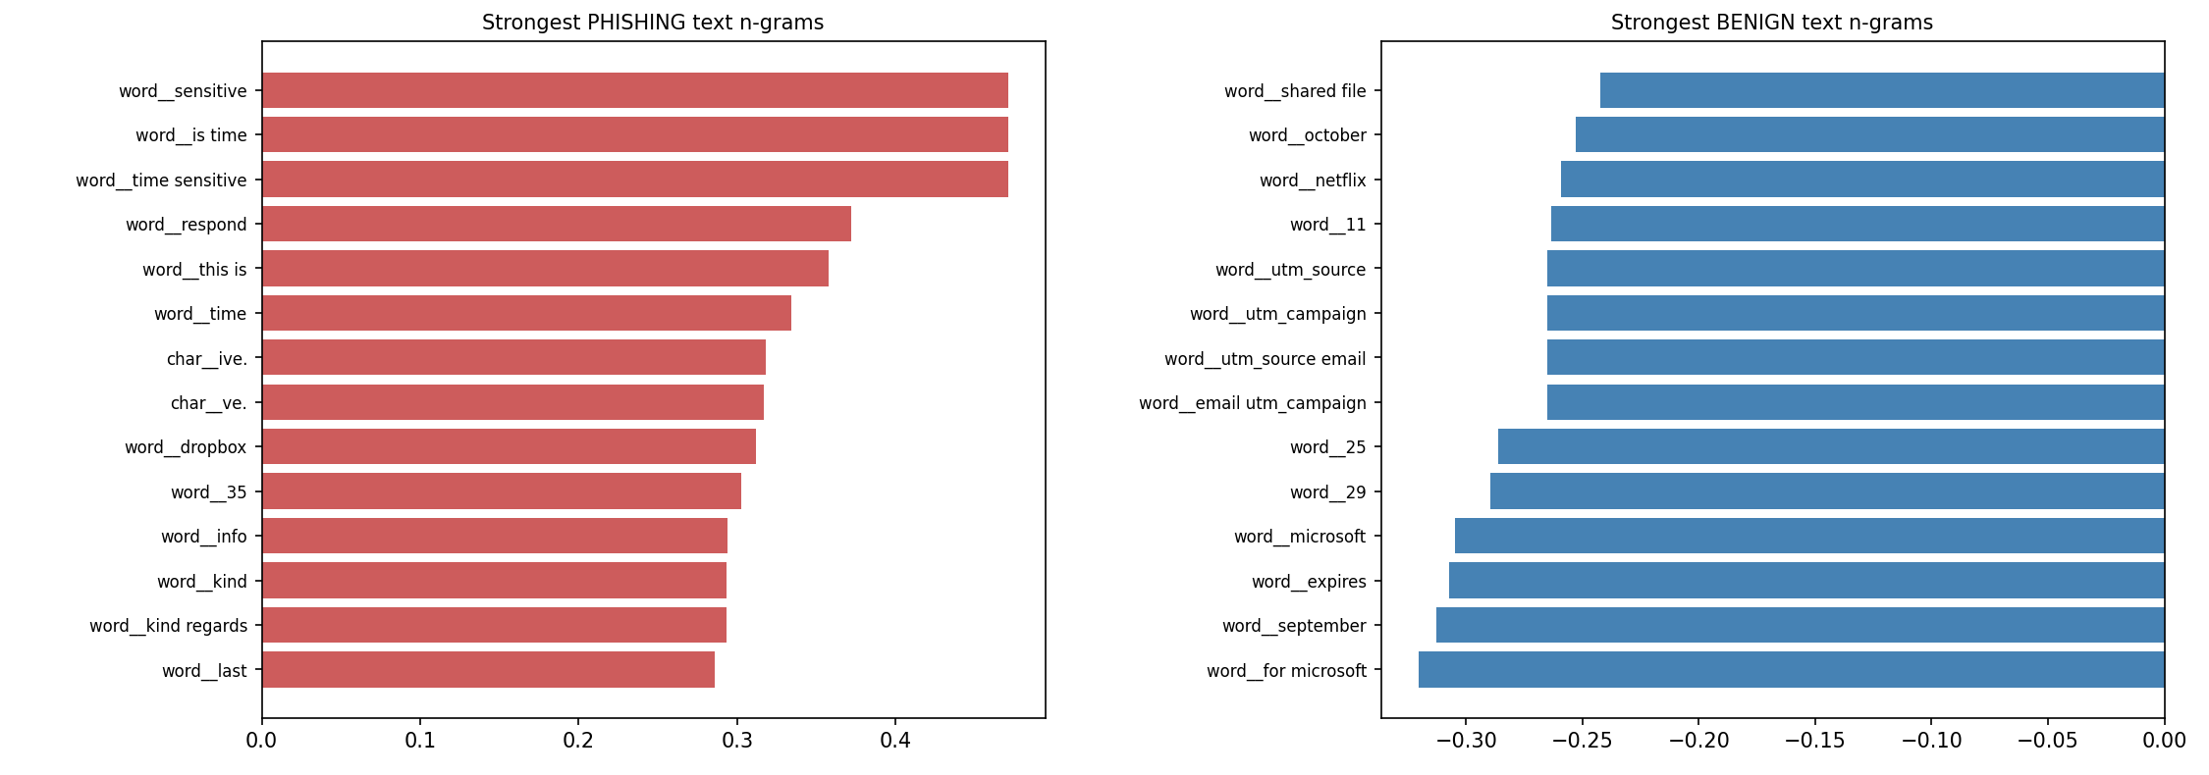
Strongest text n-grams
Notes:
Most of these are synthesiser artifacts. "time sensitive", "kind regards" and "dropbox" are template phrases, not phishing signal. Worth saying out loud.

Slide 17
Ethics
False positives hurt. Quarantined business mail costs time and, on a legal deadline or a customer escalation, money. A noisy filter also gets ignored, which makes false negatives worse. That is why precision has a floor rather than being traded off freely.
Privacy. The model reads email content. It should run inside the buyer's boundary, not as a service that sees their mail. Nothing in this pipeline ships email content anywhere.
Evasion. An attacker who knows the features can defeat them: a real domain with valid SPF, no digits or hyphens, a plausible display name. The header family is the strongest and the most gameable.
Bias. English-only, from a synthesiser I wrote. Freemail sender is a top phishing feature, and small businesses legitimately send from freemail addresses.

Slide 18
Reproducing this
pip install -r ml/requirements.txt
npm run ml:all
About 95 seconds end to end: build the corpus, train the ladder, evaluate once.
Seed 6850 throughout, so the corpus regenerates byte for byte. data/holdout_manifest.json carries the hash it should produce.
evaluate.py writes reports/oracle_report.json, carrying accuracy, latency, drift and the holdout manifest hash.
requirements.txt pins the Python side. Node 20 and Python 3.11.

Slide 19
The platform it plugs into
The classifier is the product being licensed on NexusAI, a multi-chain marketplace for AI model licences. Ten Solidity contracts, 195 tests, 99.8% statement coverage.
evaluate.py writes the oracle payload. An oracle committee submits it, the contract takes the median, and the marketplace refuses to sell the model if measured accuracy falls below the floor its provider declared.
Deployed live: hub on Ethereum Sepolia, spoke on Ethereum Hoodi, with the cross-chain workflow run across both in 14 transactions.
Details in the technical documentation, security review and business case.
Notes:
Keep this short. The rubric is about the model; this slide accounts for the marketplace half.

Slide 20
Limitations and next steps
The corpus is synthetic. That is the big one, and everything else is downstream of it.
English only. No attachment analysis, no HTML structure, no image content.
No temporal split. Real phishing evolves, and a chronological holdout would be a harder and more honest test.
The threshold was picked on one validation split, not bootstrapped, so there is no confidence interval on it.
Next: re-run on Nazario, SpamAssassin and PhishTank, add a temporal split, add the no-URL indicator, and try a transformer on the text block.

