Slide 1

How to access and consume the SAP Best Practices Content

Slide 2
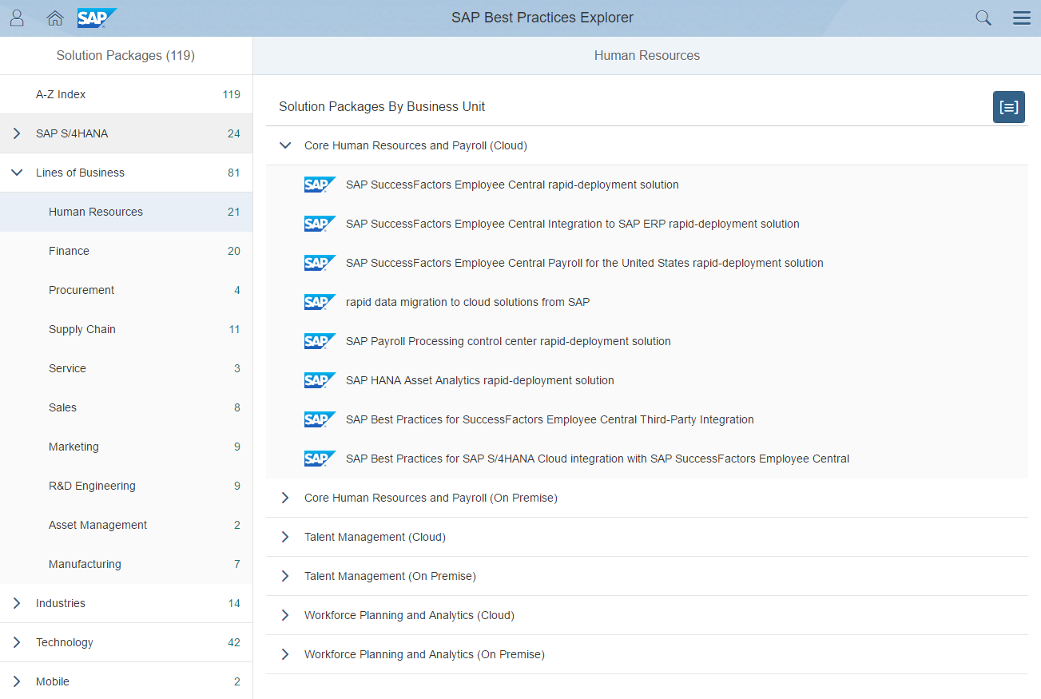
Accessing the SAP Best Practices Content via the SAP Best Practices Explorer
Visit the SAP Best Practices Explorer and navigate to your solution package by clicking on Complete Portfolio → Lines of Business → Human Resources.
Choose the solution package of your choice, for example SAP Best Practices for SAP SuccessFactors Employee Central

Slide 3
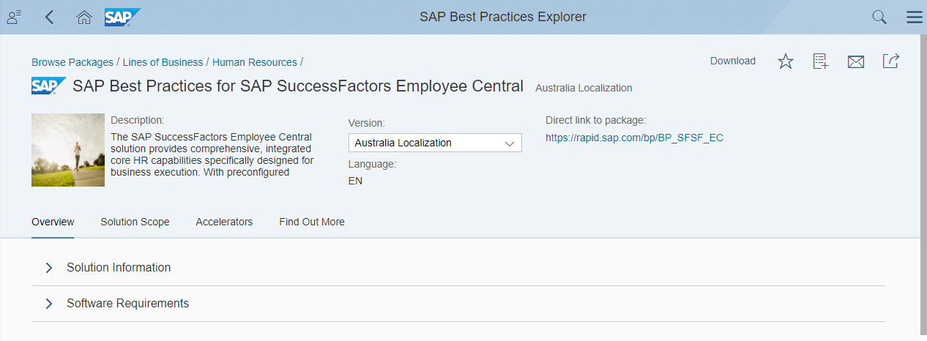
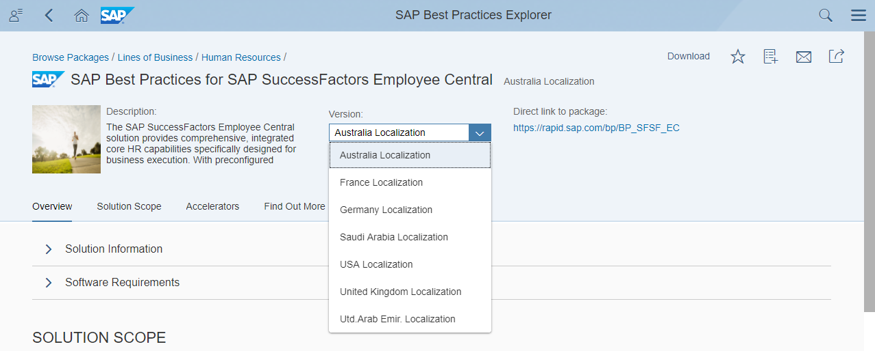
Accessing the SAP Best Practices Content Example: SAP Best Practices for SAP SuccessFactors Employee Central
United States
The SAP Best Practices for SAP SuccessFactors Employee Central package can be accessed via the quick link: https://rapid.sap.com/bp/BP_SFSF_EC
For SAP SuccessFactors Employee Central we have localized content.
Choose the country version you wish to know more about.

Slide 4
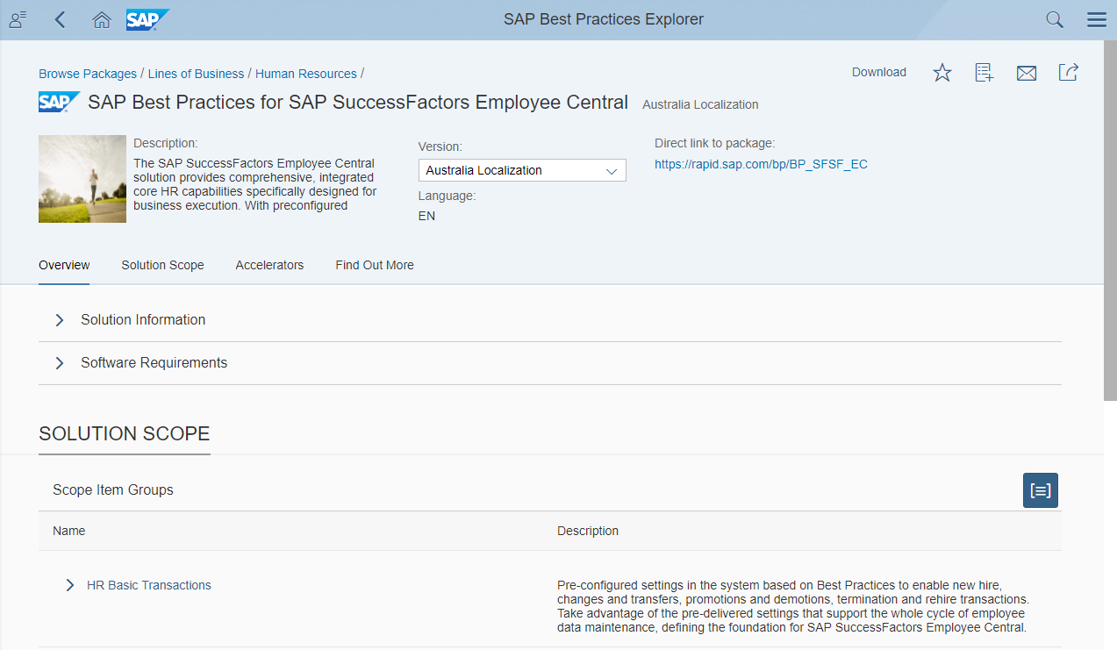
Structure of the SAP Best Practices Explorer Overview
The page is divided in four sections: Overview, Solution Scope, Accelerators, Find Out More.
Overview Here you will find a description of the solution package, business benefits, key competitive differentiators and software requirements

Slide 5
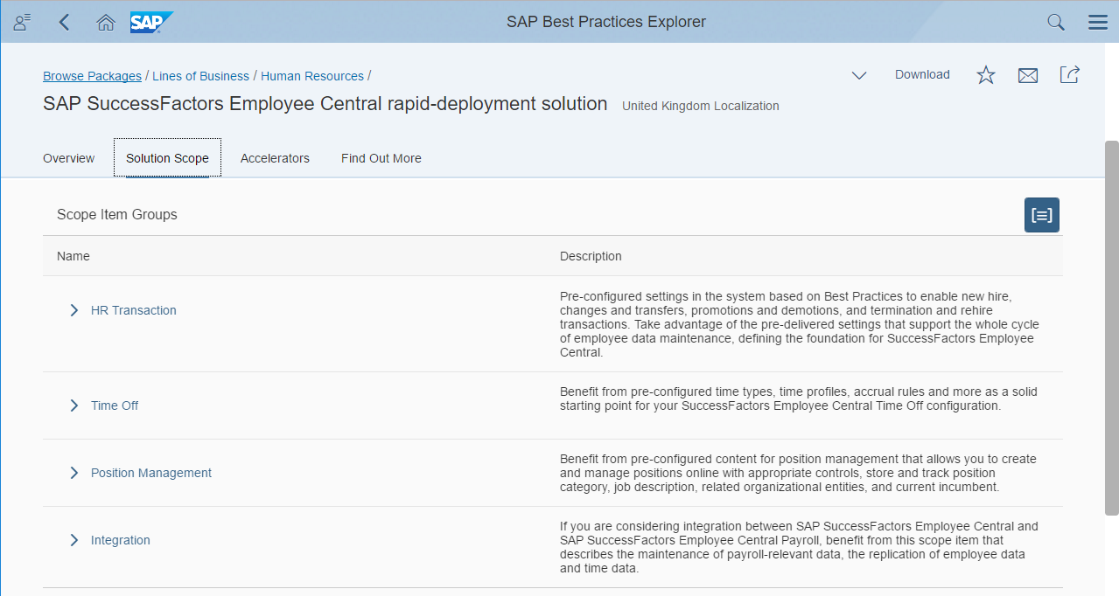
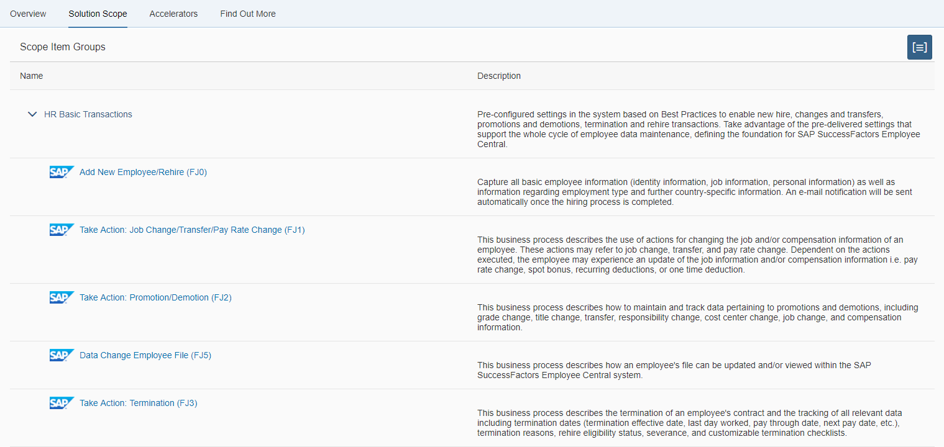
Structure of the SAP Best Practices Explorer Solution Scope
Solution Scope In this section you can find out more about the different scope items that are included in the package.
By clicking on a specific scope item you will get detailed information as well as access to a process diagram and test script.

Slide 6
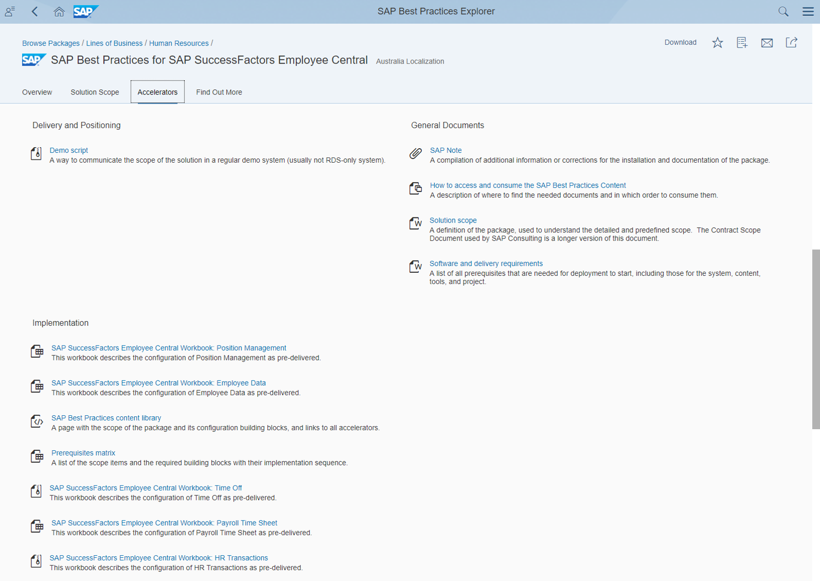
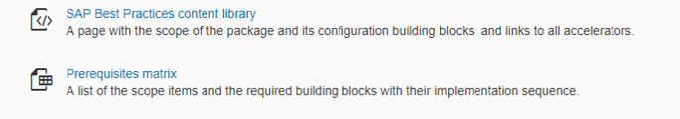

Structure of the SAP Best Practices Explorer Accelerators
Accelerators If you are customer, partner or SAP internal, you will find different kinds of documents in the subsections Delivery and Positioning, General Documents and Implementation.

Slide 7
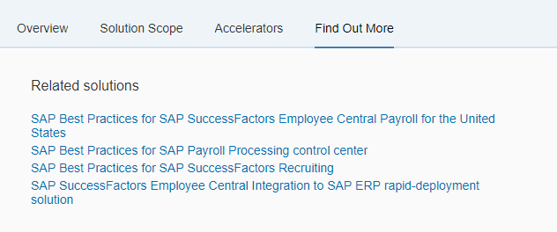

Structure of the SAP Best Practices Explorer Find Out More
Find Out More In this section you will find links to related solution packages

Slide 8
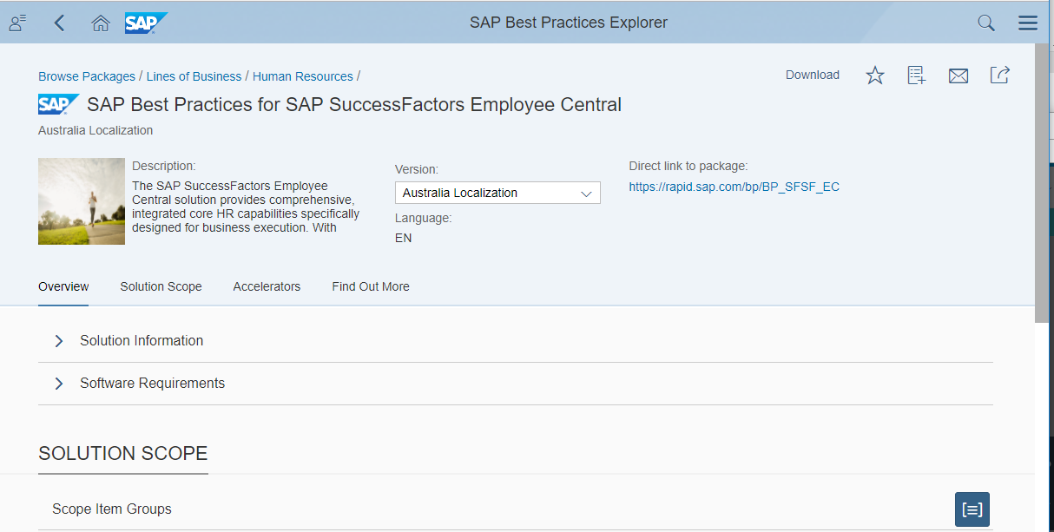
Accessing the SAP Best Practices Content Downloading the Package
If you like to download the different assets all at once, choose the Download Icon in the right top corner to get all the documents of the solution package in the Content Library.

Slide 9
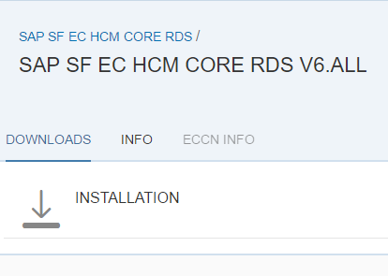

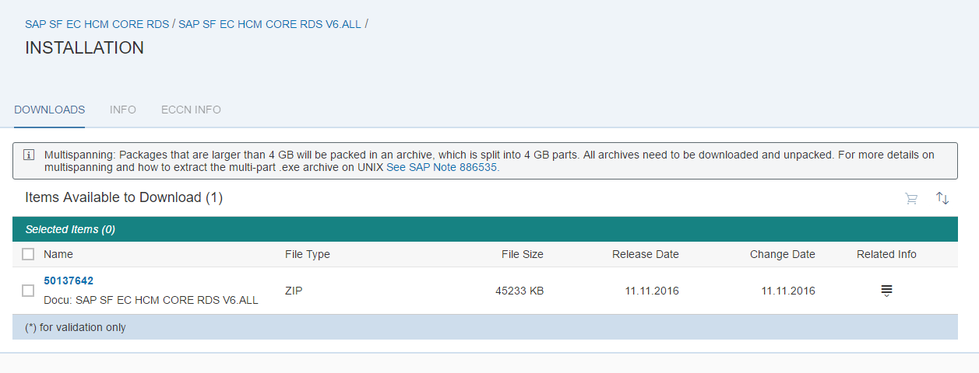
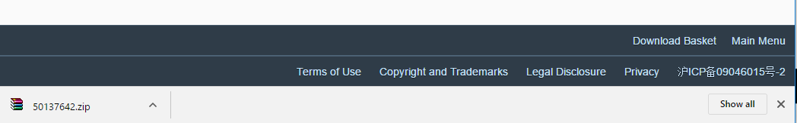
Accessing the SAP Best Practices Content Downloading the Zip-file
Choose Installation, then select the number under Name, and open the zip-file.

Slide 10
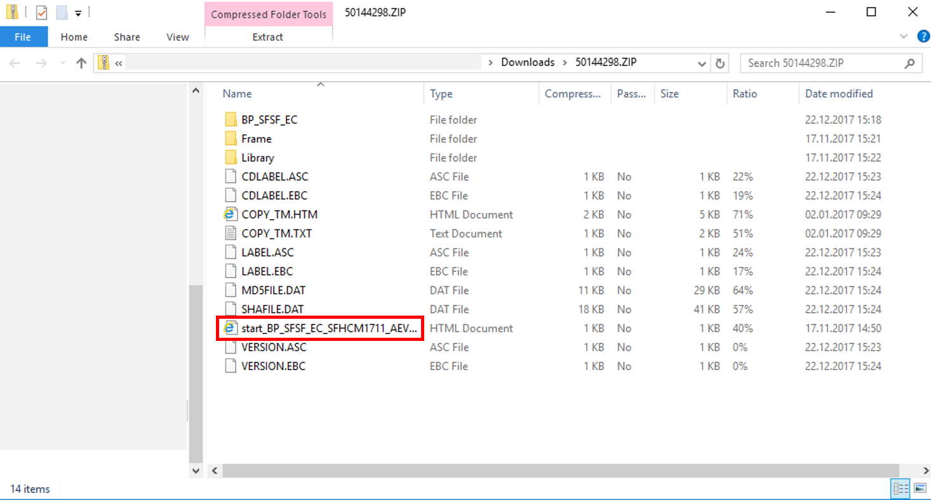
Accessing the SAP Best Practices Content Finding the Right File in the Zip-file
Extract the zip-file to a local folder on your computer. Then double-click on the html start file to open the Content Library.

Slide 11
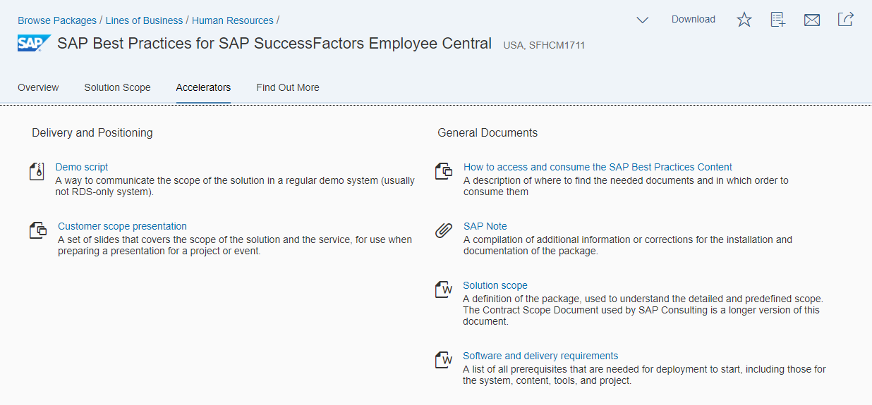


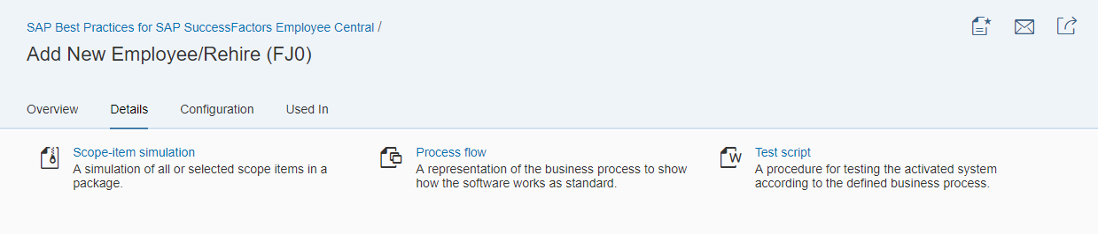
Using the SAP Best Practices Content Get Started with your Implementation!
Implementation
recommendation
1.
4.
5.
6.
2.
Find detailed information on the following slides.
3.
3.
3.
7.

Slide 12
Using the SAP Best Practices Content Get Started with your Implementation!
Implementation
recommendation
Consult the SAP Note and the attached “ReadMe” document In the SAP Note you will find general information and recommendations for your implementation project. The two different deployment options are briefly explained. All required documents on how to activate SAP Best Practices via the Upgrade Center can be accessed by clicking on the respective links or attachments in the SAP Note.
Take a look at the software and delivery requirements document. This document will tell you all you need to know about technical prerequisites in terms of systems and tools.
Get an overview of the different scope items. Make yourself familiar with the functional scope of the pre-defined content. On the SAP Best Practices Explorer you can navigate to the scope item of your interest and consult the corresponding process diagram and the test script. A process diagram contains a graphical overview of the process flow, a test script provides a detailed process step description of the business scenario. In addition, the scope-item simulation is an offline recorded demo which walks you through the most relevant business processes covered with each scope-item.
Check the pre-defined configuration & dependencies To get a deep understanding of what is being pre-configured as part of the scope, check out the Workbooks which you can find by clicking on the respective link in the SAP Note.

Slide 13
Using the SAP Best Practices Content Get Started with your Implementation!
Implementation
recommendation
Start with the Activation of SAP Best Practices Once decided that you will deploy SAP Best Practices using the Upgrade Center, go to the SAP Note and open the link to the Upgrade Center relevant documents. It is essential to start with going through “read me” document. Afterwards, you can consult the Configuration Guide: Getting Started (see “Quick Guide”). This guide provides you with an overview of the steps you need to do before you can activate the preconfigured scope via the Upgrade Center. Described are also some required post-processing steps which need to be performed after the automated implementation. Based on the provided workbooks the SAP Best Practices pre-configuration can then be adapted to the customer requirements. The configuration guides and workbooks for the EC to ECP integration can be found in the Best Practices Explorer.
Sample data help you to test Attached to the SAP Note you will find the “How to”- guide for the Employee Upload. By clicking on the respective link you can get to the guide and access the sample employee data (upload import files).
Use the test scripts to test the process Use the detailed test scripts to test the preconfigured process in your system.

Slide 14
Thank you

