Slide 1
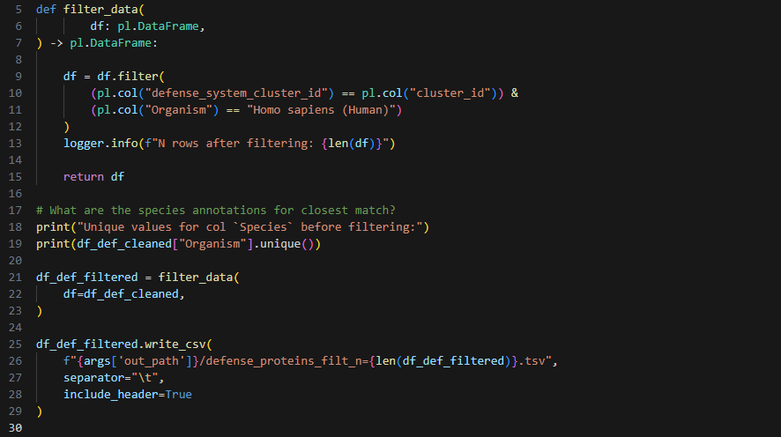

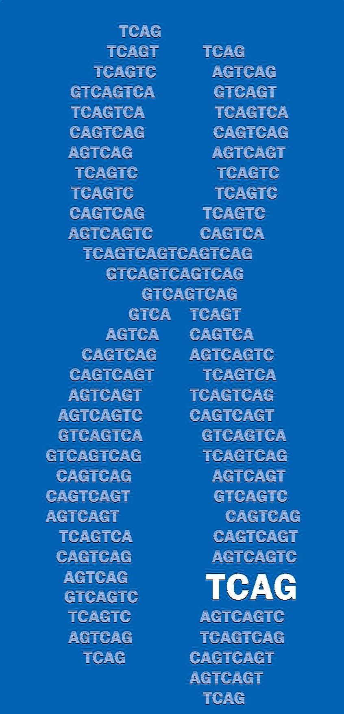
IEI project: update 2
Julian Moran
2026-04-10
The Centre for Applied Genomics, SickKids

Slide 2
Aims
Automate pairwise structural alignment with PyMOL
Manually curate positive control set of bacteria-human protein pairs
source: high-impact literature
purpose: to serve as positive control in subsequent analysis
criteria: bacterial homology to human, proof of bacterial immune function
Build pipeline frontend user interface for interactive analysis
target users: C Trost lab, J Moran, bacterial protein research community
features: structural alignment visualization, sequence alignment visualization, domain annotation overlay
Run pipeline on all bacterial defense systems
incurs prioritization problem
Get gene list
target users: C Marshall clinical research group
purpose: improve diagnostic yield for rare single-variant immune disease from genome sequencing
Notes:
Gene list is for C Marshall
Used for improving diagnostic yield for pre-existing

Slide 3
Why use PyMol to check structural alignment?
e-values [given by Foldseek] denote the probability of observing this level of structural alignment due to random chance
They are the principal measure of structural similarity in Foldseek
Why the discrepancy between e-value and PyMOL structural alignment?

Slide 4

Why use PyMol to check structural alignment?
Worse structural alignment according to PyMol
e-values [given by Foldseek] denote the probability of observing this level of structural alignment due to random chance
They are the principal measure of structural similarity in Foldseek
Why the discrepancy between e-value and PyMOL structural alignment?
Better structural alignment according to PyMol
Better structural alignment according to Foldseek ($e ={10}^{−35}$)
Worse structural alignment according to Foldseek

Slide 5

Why use PyMol to check structural alignment?
Worse structural alignment according to PyMol
e-values are contingent on alignment length, which means filtering for only the most significant e-values risks missing domain-specific alignment
Alignment length [TMalign] (AAs)
Conversely, PyMOL alignments can be good but insignificant
Better structural alignment according to PyMol
Better structural alignment according to Foldseek ($e ={10}^{−35}$)
Worse structural alignment according to Foldseek

Slide 7
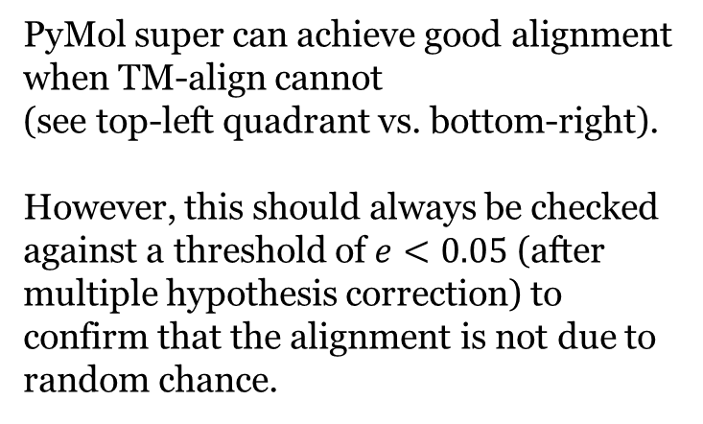
Why use PyMol to check structural alignment?
n = 237
PyMol super can achieve good alignment when TM-align cannot
(see top-left quadrant vs. bottom-right).
However, this should always be checked against a threshold of $e<0.05$ (after multiple hypothesis correction) to confirm that the alignment is not due to random chance.

Slide 8
To this end, we have incorporated PyMol super into our pipeline for interactive filtering

Slide 9
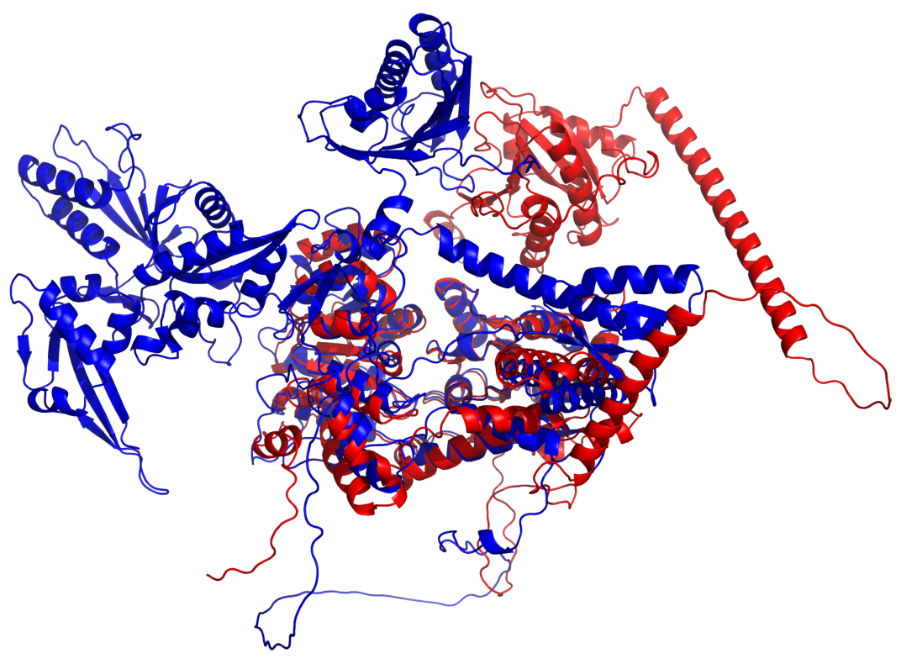
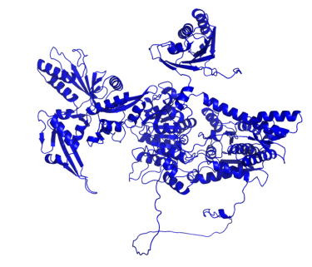
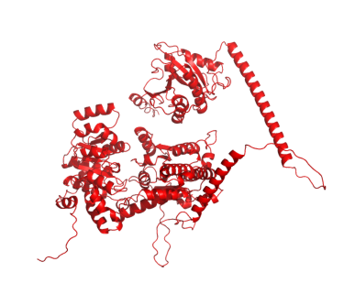
A0A0H4VDC2
X5D2E5
A0A0H4VDC2 [A. atlanticus]
System | Zorya
e-value | 3.8e⁻³⁴
PyMol RMSD | 1.47 Å
Aln length | 636 AAs
unreviewed, uncharacterised protein
strong sequence homology to ATP-, DEAD-box helicases in other bacterial species
X5D2E5 [H. sapiens][CHD1L]
ATP-binding, helicase activity
"binds histones that are poly-ADP-ribosylated on serine residues in response to DNA damage"
Notes:
Convincing domain-specific alignment

Slide 10
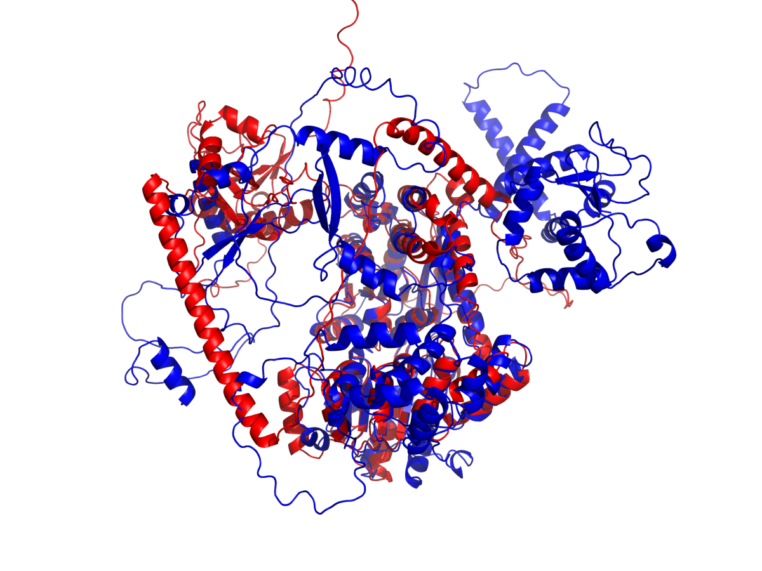
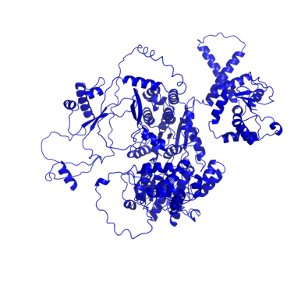

A0A5B8XTL3
A0A0A0MSH9
A0A5B8XTL3 [M. marinus]
System | Zorya
e-value | 2.21e⁻²⁷
PyMol RMSD | 1.56 Å
Aln length | 623 AAs
DEAD-box helicase
A0A0A0MSH9 [H. sapiens][CHD1L]
ATP-binding, helicase activity
"binds histones that are poly-ADP-ribosylated on serine residues in response to DNA damage"
Notes:
Convincing domain-specific alignment

Slide 11
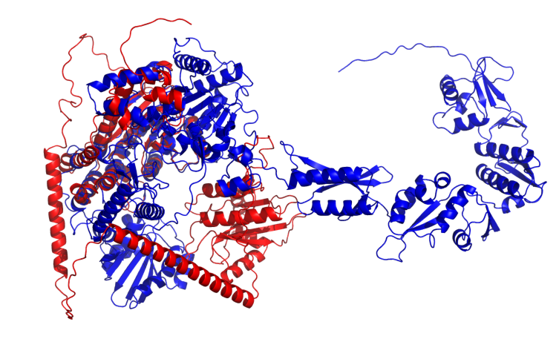

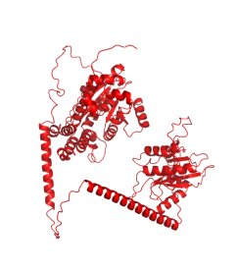
A0A4Y6RC84
B4DLS6
A0A4Y6RC84 [J. tructae]
System | Zorya
e-value | 1.55e⁻¹³
PyMol RMSD | 1.17 Å
Aln length | 267 AAs
ATP-dependent helicase
unreviewed
B4DLS6 [H. sapiens][unreviewed]
"highly similar to Homo sapiens chromodomain helicase DNA binding protein 1-like (CHD1L)"
Notes:
Less convincing; alignment length is an important qualification.

Slide 12
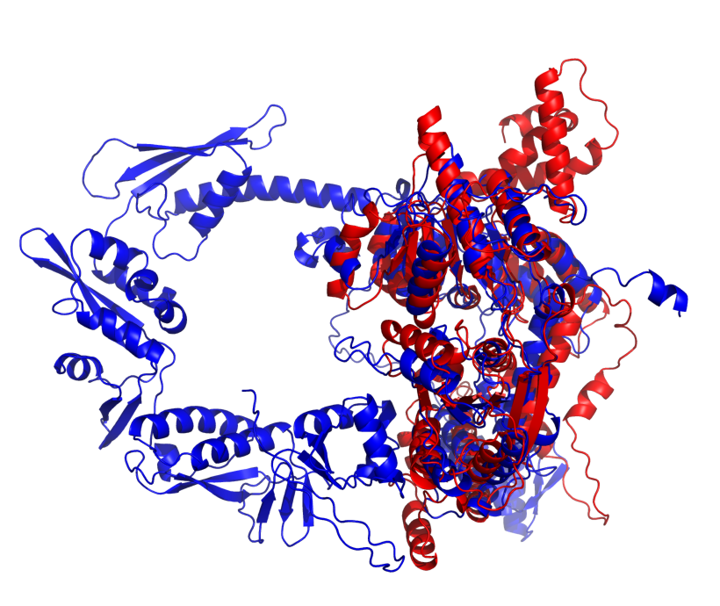
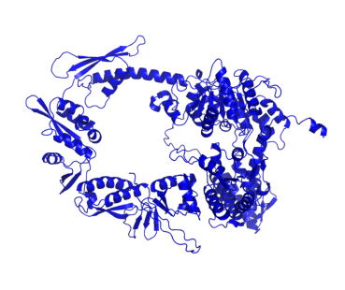

A0A6L8M512
Q8N6J1
A0A6L8M512 [A. baumannii]
System | Zorya
e-value | 5.65e⁻³²
PyMol RMSD | 3.41 Å
Aln length | 553 AAs
DEAD box helicase protein
Q8N6J1 [H. sapiens][BTAF1]
evidence of existence only at transcript level
predicted helicase, hydrolase activity
Notes:
Convincing structural homology

Slide 13
Curating a positive control set of homologous bacterial-human protein pairs from high-impact literature
Experimental criteria
provide protein accession for bacterial protein
express in new organism
perform functional assay proving bacterial immune system action
Homology criteria
provide protein accession for human protein
present convincing evidence of sequence or structure homology

Slide 14
Positive control set
Source: high-impact literature
Criteria: bacterial homology to human, proof of bacterial immune function
Purpose: positive control for subsequence analysis
PMID | Bact. UniProt | Bact. gene name | H.s. UniProt | H.s. gene name
30787435 | Q6XGD5 | cdnE | Q8N884 | CGAS
30787435 | G2SLH8 | cdnE | Q8N884 | CGAS
40705877 | J8G6Z1 | ThsA | Q9BPY3 | FAM118B
40705877 | J8G6Z1 | ThsA | Q96EB6 | SIRT1
40705877 | J8G6Z1 | ThsA | Q8IXJ6 | SIRT2
40705877 | J8G6Z1 | ThsA | Q9Y6E7 | SIRT4
40705877 | J8G6Z1 | ThsA | Q9NXA8 | SIRT5
40705877 | J8G6Z1 | ThsA | Q8N6T7 | SIRT6
40705877 | J8G6Z1 | ThsA | Q9NRC8 | SIRT7
32937646 | A0A1H0NKS3 | vip6 | Q8WXG1 | RSAD2
32937646 | P0DW49 | vip8 | Q8WXG1 | RSAD2
32937646 | D5EID4 | vip15 | Q8WXG1 | RSAD2
32937646 | P0DW52 | vip21 | Q8WXG1 | RSAD2
32937646 | A0A1S1YUU1 | vip47 | Q8WXG1 | RSAD2
32937646 | A0A110A2W7 | vip50 | Q8WXG1 | RSAD2
32937646 | A0A1M7D0R2 | vip56 | Q8WXG1 | RSAD2
32937646 | A0A244CMP0 | vip58 | Q8WXG1 | RSAD2
32937646 | P0DW53 | vip60 | Q8WXG1 | RSAD2
Total number: 18 pairs

Slide 15
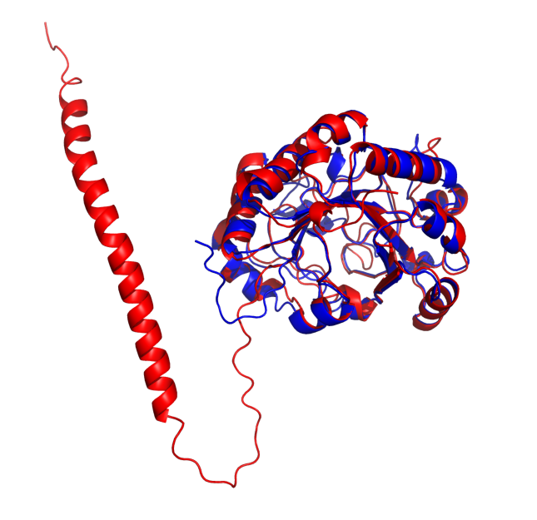


A0A1S1YUU1
Q8WXG1
A0A1S1YUU1 [F. pacifica][vip47]
System | Vipirin
PyMol RMSD | 0.89 Å
Aln length | 1423 atoms [75 AAs]
confers resistance to phage P1
represses T7 RNA-polymerase action
Q8WXG1 [H. sapiens][RSAD2]
interferon-inducible antiviral protein
initiates pathway to repress RNA polymerase action

Slide 16

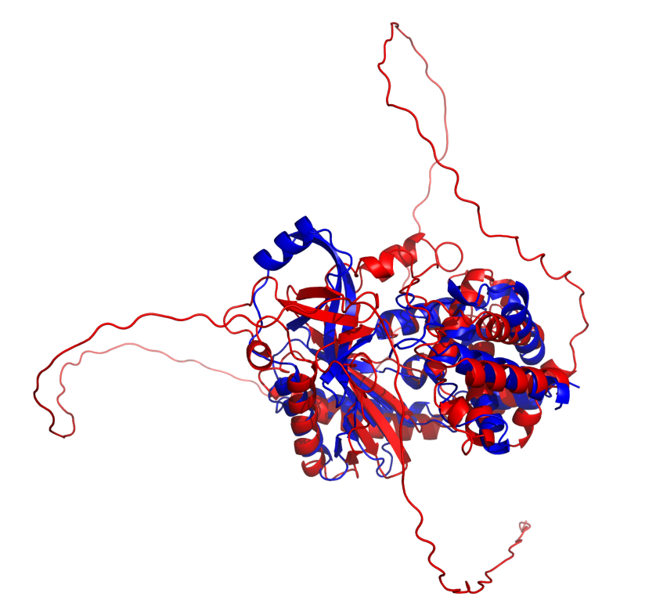
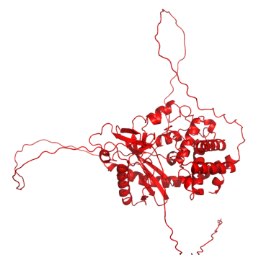
Q6XGD5
Q8N884
Q6XGD5 [E. coli][cdnE]
Cyclic nucleotide synthase (second messenger synthesis) in CBASS system
System | CBASS
PyMol RMSD | 5.53 Å
Aln length | 1385 atoms [73 AAs]
Q8N884 [H. sapiens][CGAS]
nucleotidyltransferase catalyzing formation of cyclic GMP-AMP; plays role in innate immunity

Slide 17
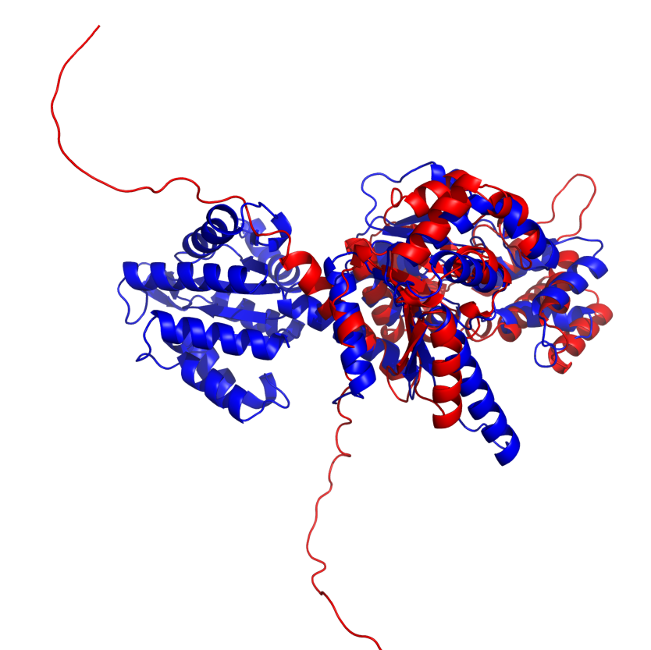

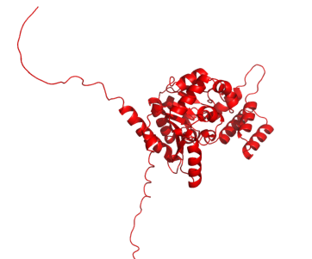
J8G6Z1
Q9BPY3
J8G6Z1 [B. cereus][thsA]
System | SIR2 antiphage
PyMol RMSD | 3.88 Å
Aln length | 1252 atoms [66 AAs]
NAD+ hydrolyzing component (NADase) of Thoeris antiviral defense system
Q9BPY3 [H. sapiens][FAM118B]
Cajal body regulation

Slide 18
Next steps
Work with V Furlan to further develop composite score for protein pair prioritization
Use V Furlan's pipeline frontend to conduct prioritization
develop Blastp canonical protein flagger tool and integrate with frontend
Work with V Furlan to get a gene list by next meeting (1 - 2 months)
target users: C Marshall clinical research group
purpose: improve diagnostic yield for rare single-variant immune disease from genome sequencing
Notes:
Gene list is for C Marshall
Used for improving diagnostic yield for pre-existing

