Slide 1
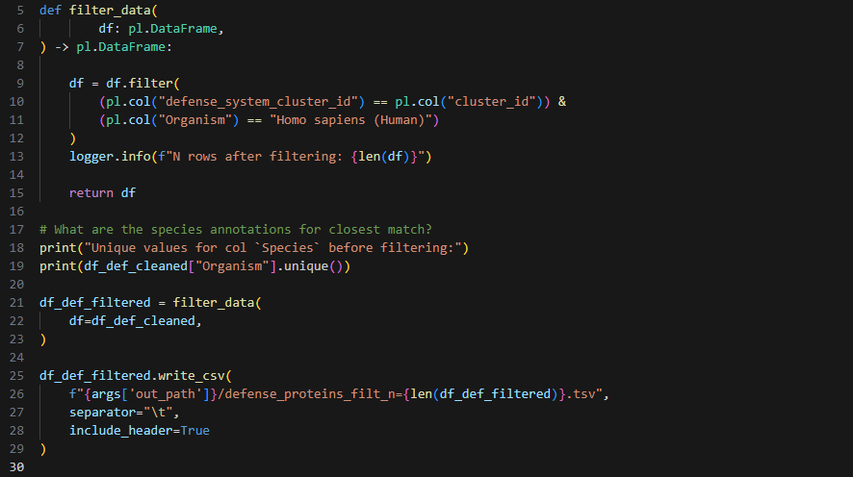

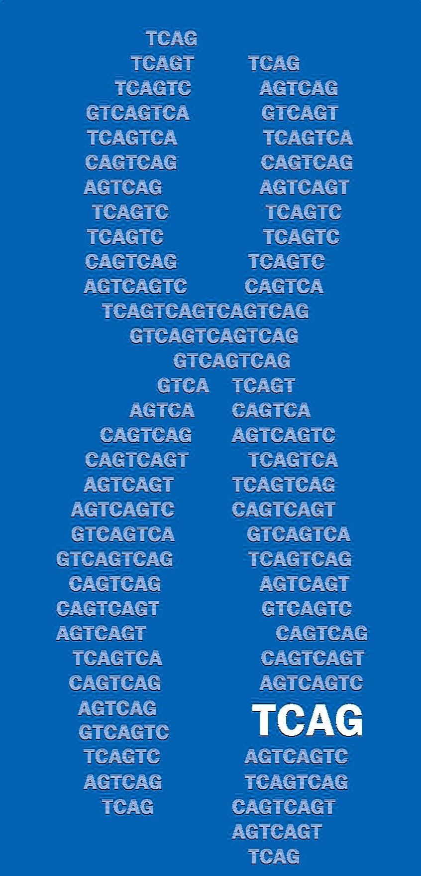
IEI project: update 2
Julian Moran
2026-04-10
The Centre for Applied Genomics, SickKids

Slide 2
Review – next steps
Automate pairwise structural alignment with PyMol
Finalize manually curated list of gold-standard bacteria-human protein pairs
source: high-impact literature
purpose: to serve as positive control in subsequent analysis
criteria: bacterial homology to human, proof of bacterial immune function
Build a user interface for interactive analysis
target users: C Trost lab, J Moran, bacterial protein research community
features: structural alignment visualization, sequence alignment visualization, domain annotation overlay
Get gene list
target users: C Marshall clinical research group
purpose: improve diagnostic yield for rare single-variant immune disease from genome sequencing
Notes:
Gene list is for C Marshall
Used for improving diagnostic yield for pre-existing

Slide 3
Why validate with structural alignment?

Slide 4
Gold standard list
Source: high-impact literature
Criteria: bacterial homology to human, proof of bacterial immune function
Purpose: positive control for subsequence analysis
PMID | Bacterial gene name | Human gene name
30787435 | cdnE | CGAS
30787435 | cdnE | CGAS
40705877 | ThsA | FAM118B
40705877 | ThsA | SIRT1
40705877 | ThsA | SIRT2
40705877 | ThsA | SIRT4
40705877 | ThsA | SIRT5
40705877 | ThsA | SIRT6
40705877 | ThsA | SIRT7
32937646 | vip6 | RSAD2
32937646 | vip8 | RSAD2
32937646 | vip15 | RSAD2
32937646 | vip21 | RSAD2
32937646 | vip47 | RSAD2
32937646 | vip50 | RSAD2
32937646 | vip56 | RSAD2
32937646 | vip58 | RSAD2
32937646 | vip60 | RSAD2
Total number: 18 pairs

