Slide 1
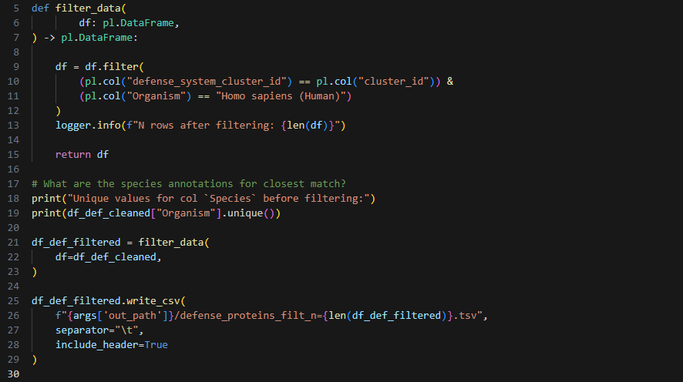

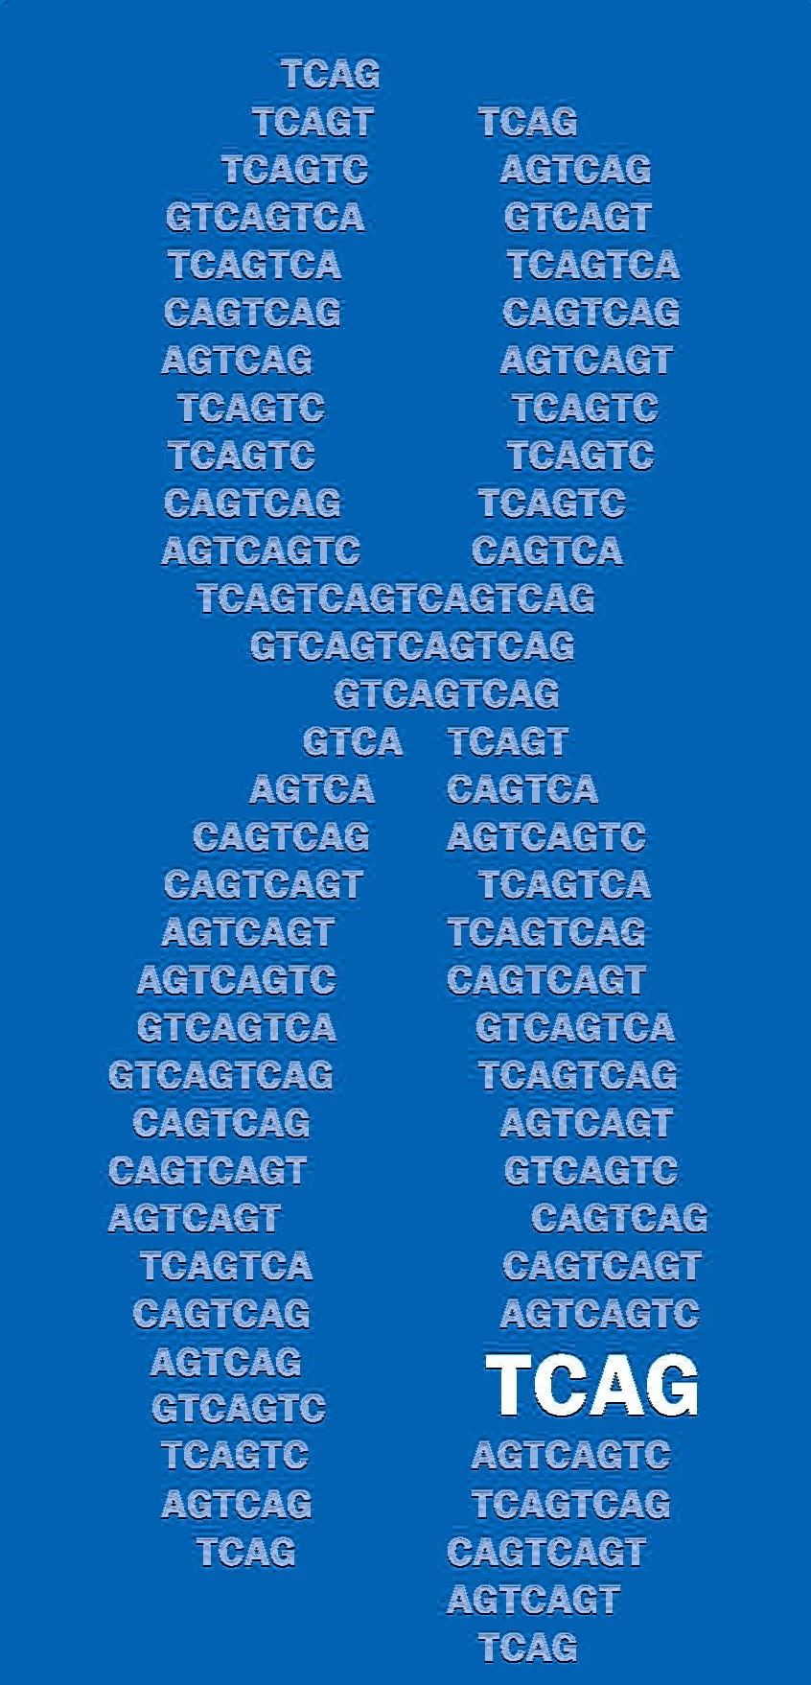
Bacterial anti-phage structural homology: update 1
Julian Moran
2026-02-19
The Centre for Applied Genomics, SickKids

Slide 2
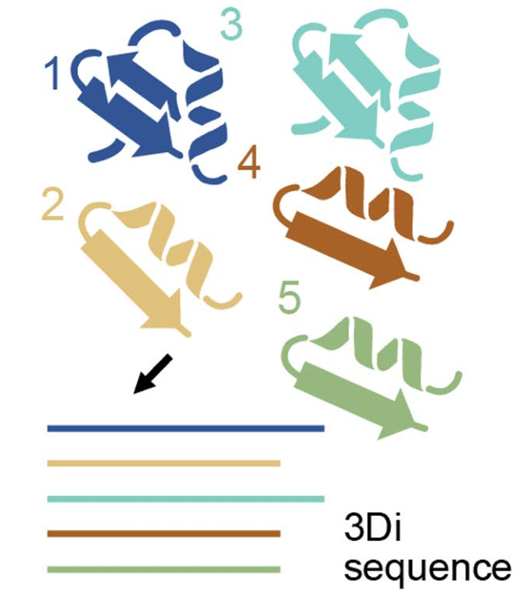


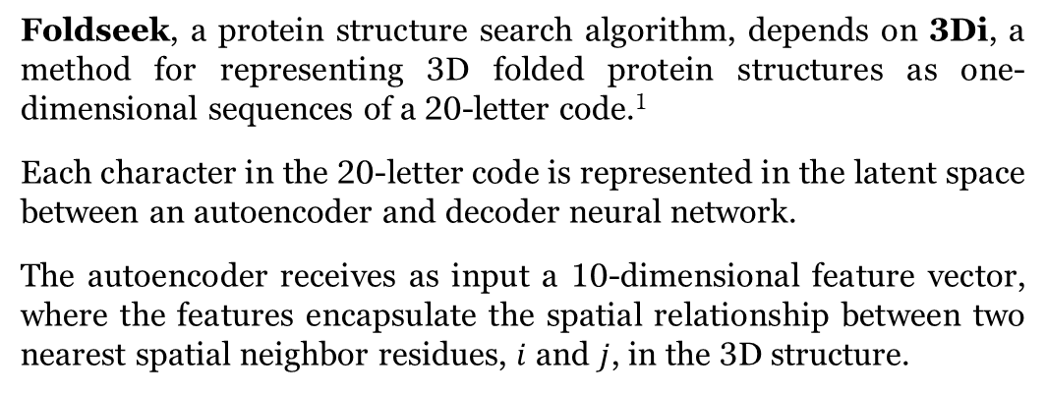




Background
Foldseek, a protein structure search algorithm, depends on 3Di, a method for representing 3D folded protein structures as one-dimensional sequences of a 20-letter code.¹
Each character in the 20-letter code is represented in the latent space between an autoencoder and decoder neural network.
The autoencoder receives as input a 10-dimensional feature vector, where the features encapsulate the spatial relationship between two nearest spatial neighbor residues, $i$ and $j$, in the 3D structure.
$$C_{α,i−1}$$
$$u1$$
$$cos⁡(θ_{u1,u2})$$
θ
Adapted from Barrio-Hernendez et al. 2023.¹
$$C_{α,i}$$
$$u2$$
$$C_{α,j}$$

Slide 3
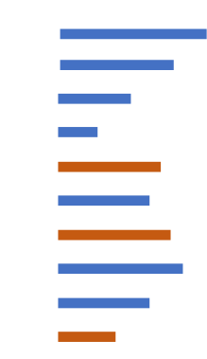
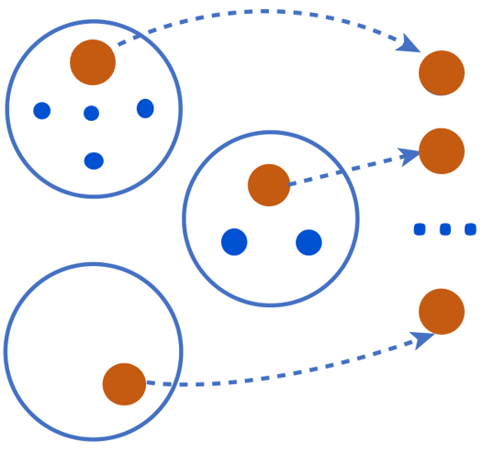
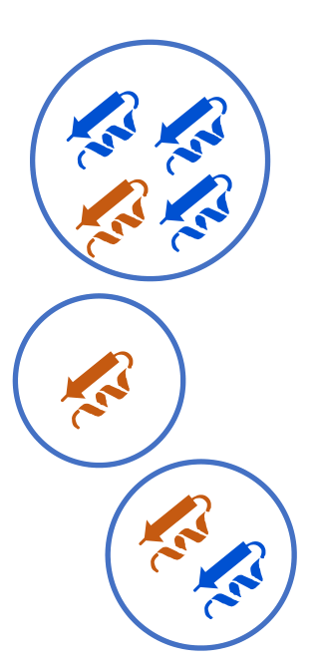
Background
214 million protein sequences
Foldseek cluster, a clustering algorithm, leverages both primary amino acid sequence homology and structural homology to group proteins together.²
It takes as input the entire AlphaFold database (214 million sequences and predicted structures) clustered with MMSeqs2, which uses primary amino acid sequence. Here, sequence cluster membership is thresheld at 50% sequence identity and 90% sequence alignment overlap, yielding 52 million clusters.
Foldseek cluster then further clusters the 3Di sequences of "representative structures" ( ) from each cluster (i.e. structure with highest pLDDT), with membership thresheld at e-value 0.01 and 90% structural alignment overlap, yielding 19 million clusters.
MMSeqs2
52 million sequence clusters
Foldseek cluster
19 million Foldseek clusters

Slide 4
Research questions
Which human proteins in the Foldseek cluster dataset exhibit strong homology with bacterial immune system proteins?
Based on the structural homology, can we hypothesise about previously uncharacterised functions of the human proteins?

Slide 5

A Jain pipeline summary
DefenseFinder RefSeq IDs
DefenseFinder UniProt IDs
Foldseek clusters containing DefenseFinder proteins
Anjali Jain
Bioinformatician at the Centre for Computational Medicine (CCM)
DefenseFinder proteins and their homologous H. sapiens proteins (based on cluster similarity)
UniprotKB annotations for DefenseFinder → H. sapiens protein pairs
321,575 protein pairs for the Zorya, Vipirin, and Gasdermin bacterial immune systems
Notes:
NOTE: I likely will not go through this slide, as Vinicius should cover this all in greater depth.

Slide 6
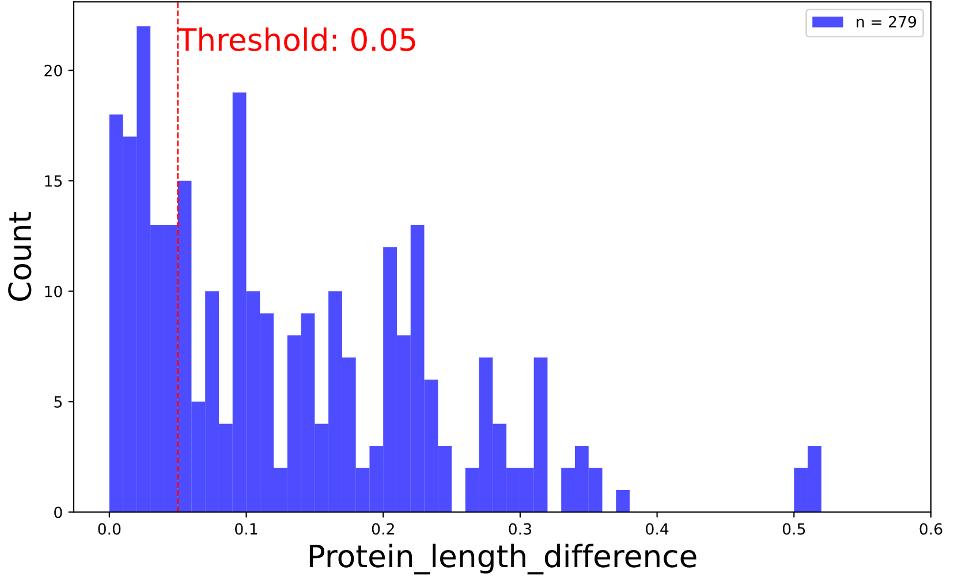
Downstream prioritization
321,575
DefenseFinder → H. sapiens protein pairs
DefenseFinder cluster_id ==
H. sapiens cluster_id
279
DefenseFinder → H. sapiens protein pairs
Protein_length_difference ≤ 0.05
34
DefenseFinder → H. sapiens protein pairs

Slide 7
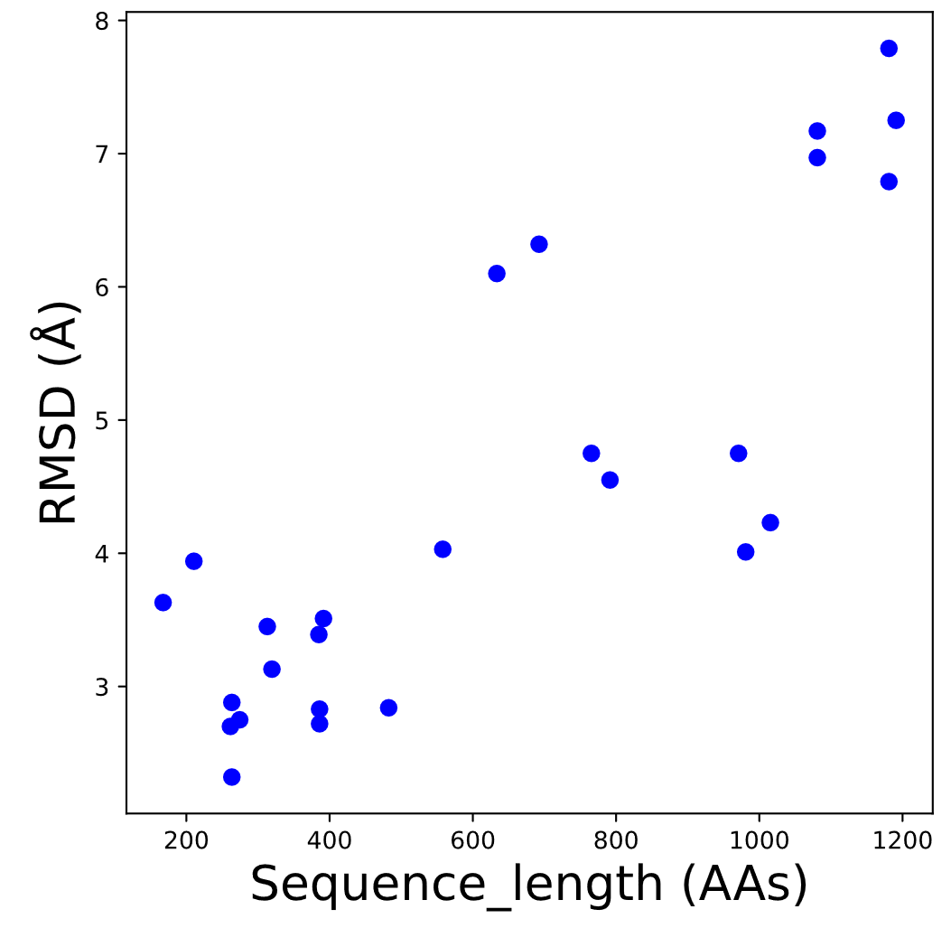
279
DefenseFinder → H. sapiens same-cluster protein pairs
contains proteins from 17 distinct clusters
functions generally pertain to triphosphate metabolism and chromosome organization
G profiler GO terms
name | p_value
ATP hydrolysis activity | 5.32E-14
ATP-dependent activity | 8.18E-12
ribonucleoside triphosphate phosphatase activity | 5.90E-10
pyrophosphatase activity | 1.10E-09
hydrolase activity, acting on acid anhydrides | 1.11E-09
hydrolase activity, acting on acid anhydrides, in phosphorus-containing anhydrides | 1.11E-09
condensed chromosome | 7.14E-09
condensed nuclear chromosome | 8.75E-09
ATP binding | 1.13E-08
chromosome organization | 1.19E-08

Slide 8
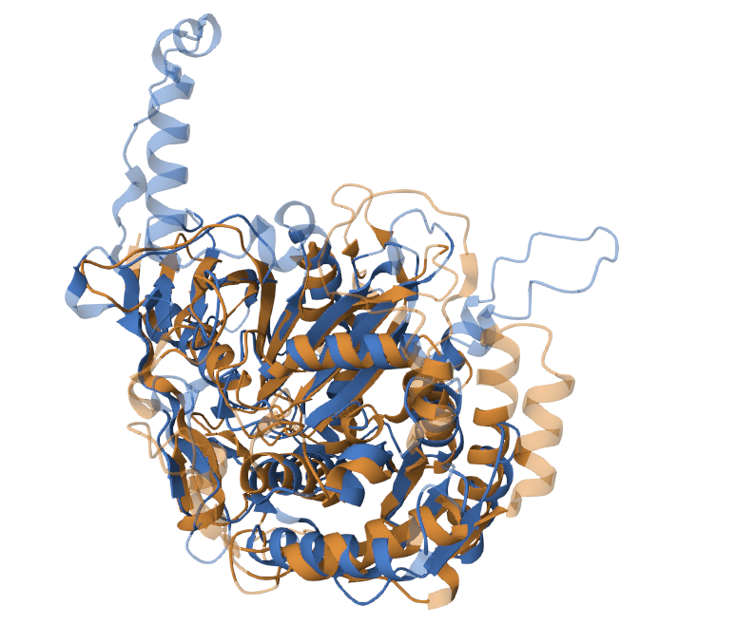
cDNA FLJ56591, highly similar to Eukaryotic translation initiation factor 2C3
Molecular functions
DNA binding
DNA-binding transcription factor activ.
RNA binding
Biological processes
immune system process
carbohydrate metabolic process
DNA metabolic process
Domains
Argonaute-like, PIWI domain (29-454)
Ribonuclease H-like superfamily (140-456)
RMSD: 2.7 Å
TM-score: 0.72
Identity: 11%
Aligned residues: 351
B4DY67_HUMAN
(496 AAs)
A0A414Z6D3
(469 AAs)
Protein argonaute (Bacteroides sp. AM16-24)
Domains
Ribonuclease H-like superfamily (2-469)
PIWI domain (144-457)

Slide 9
References
Van Kempen M, et al. Fast and accurate protein structure search with Foldseek. Nat Biotechnol. 2024;42:243-246. DOI: 10.1038/s41587-023-01773-0
Barrio-Hernandez I, et al. Clustering predicted protein structures at the scale of the known protein universe. Nature. 2023;622:637-645. DOI: 10.1038/s41586-023-06510-w

