Slide 1
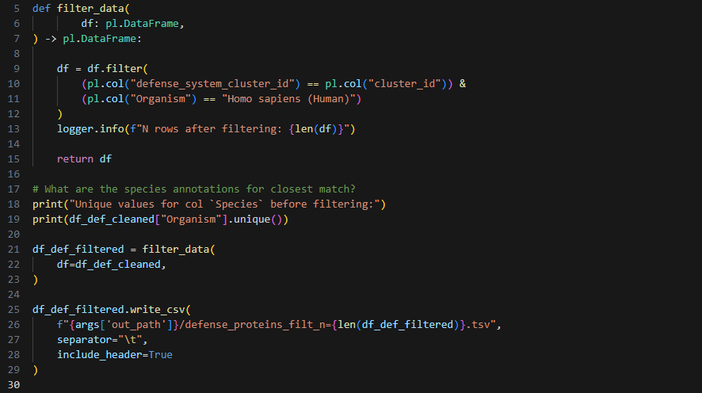

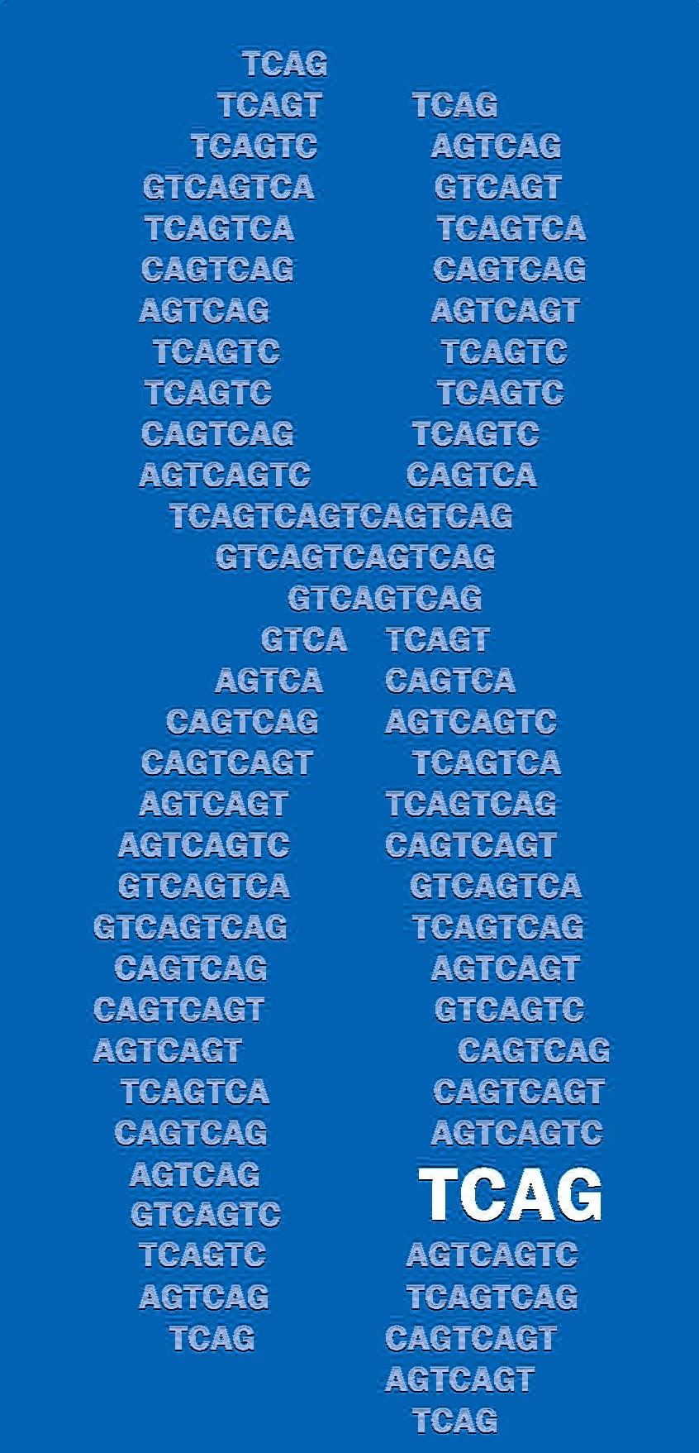
IEI project: update 3
Julian Moran
2026-08-28
The Centre for Applied Genomics, SickKids

Slide 2
Background

Slide 3
Aims
Run pipeline on all bacterial defense systems
incurs prioritization problem
therefore design composite score for protein pair prioritization
Yield gene list
target users: C Marshall clinical research group
purpose: improve diagnostic yield for rare single-variant immune disease from genome sequencing

Slide 4
Why use PyMol to check structural alignment?
n = 237
PyMol super can achieve good alignment when TM-align cannot
(see top-left quadrant vs. bottom-right).

Slide 5

PyMOL-super and FoldSeek e-values
Worse structural alignment according to PyMol
e-values are contingent on alignment length, which means filtering for only the most significant e-values risks missing domain-specific alignment
Alignment length [TMalign] (AAs)
Conversely, PyMOL alignments can be good but insignificant
Better structural alignment according to PyMol
Better structural alignment according to Foldseek ($e ={10}^{−35}$)
Worse structural alignment according to Foldseek

Slide 6
Composite scoring
method

Slide 7
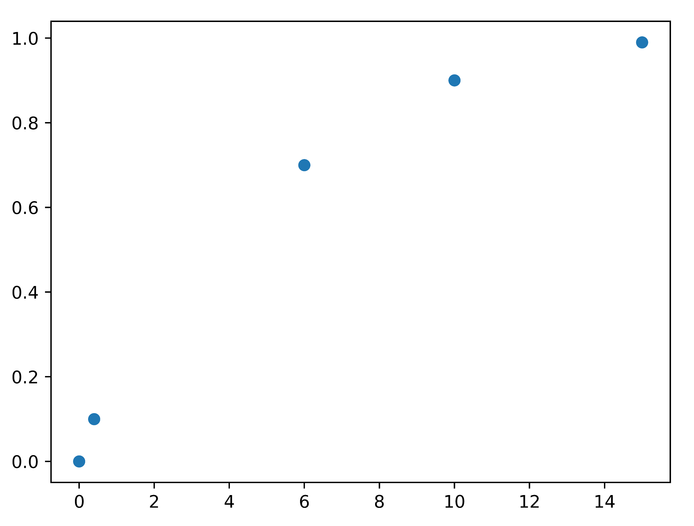

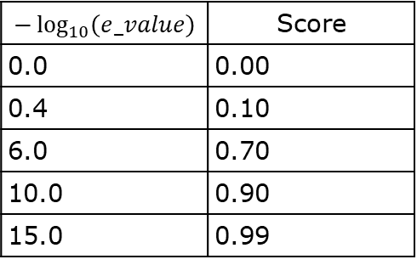


Composite score: FoldSeek e-value term
$$−\log_{10}\left(e_value\right)$$ | Score
0.0 | 0.00
0.4 | 0.10
6.0 | 0.70
10.0 | 0.90
15.0 | 0.99
$y=1−e^{{−\left(\frac{x}{4.7}\right)}^{1.03}}$
E-value score term
E-value score term
$$−\log_{10}\left(e_value\right)$$
$$−\log_{10}\left(e_value\right)$$

Slide 8


Composite score: PyMOL RMSD term
PyMOL RMSD (Å) | Score
0.0 | 1.0
1.0 | 0.99
2.9 | 0.85
4.0 | 0.70
5.0 | 0.50
10.0 | 0.10
$$y=\frac{1.06}{1+e^{0.635(x−4.94)}}$$
PyMOL score term
PyMOL score term
PyMOL RMSD (Å)
$$\text{PyMOL RMSD (Å)}$$

Slide 9








Composite score: PyMOL RMSD term
PyMOL score term
$$=\frac{1.06}{1+e^{0.635(PyMOL_RMSD−4.94)}}$$
0.40
$$×$$
FoldSeek e-value score term
$=1−e^{{−\left(\frac{−\log_{10}⁡(e_value)}{4.7}\right)}^{1.03}}$
0.35
$$×$$
0.05
$$×$$
TM score (human protein)
Composite score
0.05
$$×$$
TM score (bacterial protein)
0.0 → 1.0
0.075
$$×$$
pLDDT (human protein) / 100
0.075
$$×$$
pLDDT (bacterial protein) / 100
Notes:
Gene list is for C Marshall
Used for improving diagnostic yield for pre-existing

Slide 10
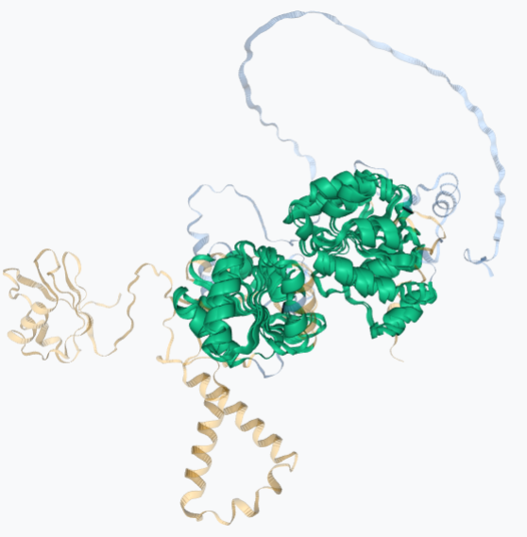
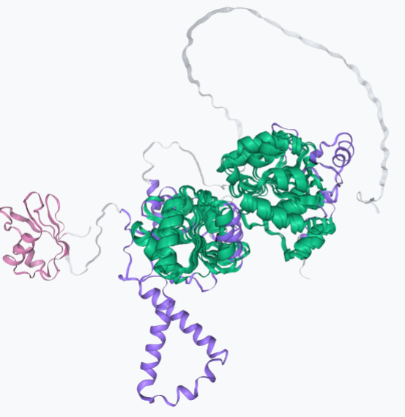
IEI_BISSH pipeline workflow
DefenseFinder UniProt IDs
Human-bacteria protein pairs
AlphaFold structures
Proteins with ...
1. H. sapiens taxID in FoldSeek
2. e-value with DefenseFinder protein
TM-align
AFDB FoldSeek all-v-all
network
PyMOL-super
Domain annotation
Composite score annotation
0.92

Slide 11
Composite scoring results

Slide 12
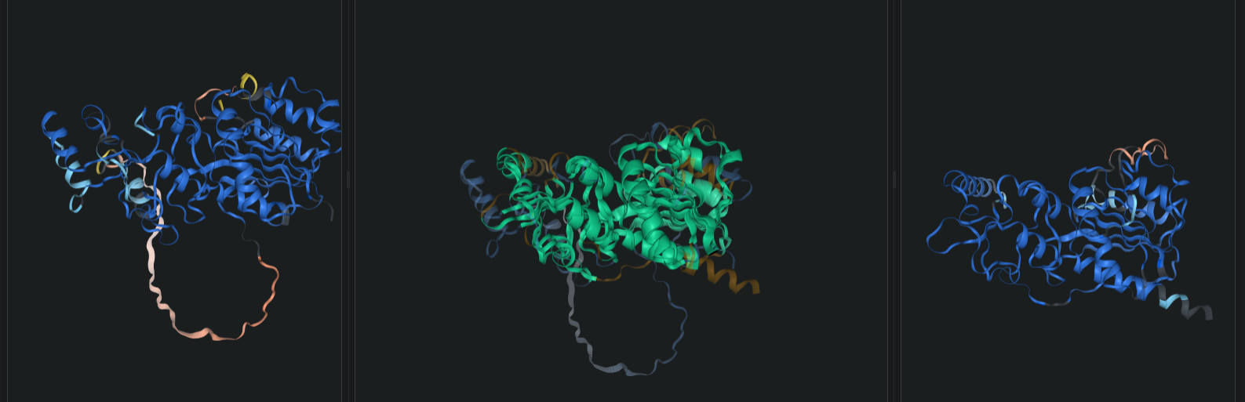
DNMT2: C5 methyltransferase
DNMT2 (Q6ICS7)
tRNA methyltransferase
Composite score: 0.95
FoldSeek e-value: 6.31e-25
PyMOL RMSD: 1.23 Å
C5 methyltransferase
(E4ZAF3)
RM Type II system
C5 methyltransferase protecting tRNA from stress-induces cleavage¹
Facilitates HIV RNA stability²
DNMT2 is reported in the literature as exhibiting sequence homology to bacterial RM Type II C5 methyltransferases³
recognises short motifs on bacterial DNA and transfers methyl group to cytosine carbon 5 on the motif⁴
viral DNA lacking methylation is targeted by restriction enzymes⁴
Notes:
E4ZAF3 species: N. lactamica

Slide 13
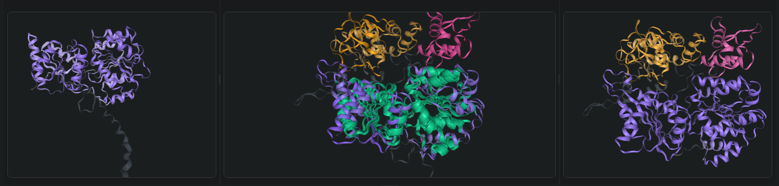
DDX20: HelY
DDX20 (A0A7P0TB94)
RNA helicase
Composite score: 0.87
FoldSeek e-value: 1.10e-17
PyMOL RMSD: 2.81 Å
HelY (A0A509EDC2)
(SngC?)
Shango system
ATP-dependent DEAD-box helicase
Participates in snRNP assembly for spliceosome-mediated pre-mRNA splicing
Exerts antiviral activity via transcriptional regulation in Vero E6 cells⁵
Align at helicase and ATP hydrolase domains
HelY A0A509EDC2 has additional non-aligned domains that do not bear InterPro annotations
Orange region does not bear a CATH superfamily annotation
ATP-dependent helicase
Proposed that SngA acts as a sensor, Shango helicase effects antiviral response
Notes:
HelY species: Methylobacterium symbioticum

Slide 14
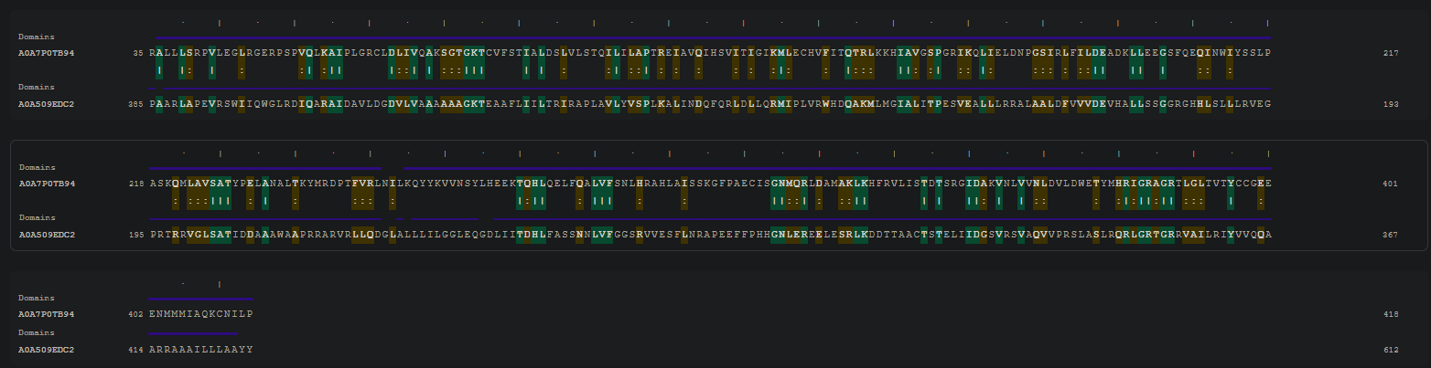
DDX20: HelY
DDX20
HelY
Sequence identity: 24.3% BLASTp score: 29.6
Sequence alignment coverage: 24%
BLASTp e-value: 2e-4
Notes:
If I run BLASTp of the HelY sequence, DDX20 is not a hit.
If I run psiBLAST of the HelY sequence, DDX20 is not a hit.
There is no literature evidence that I could find indicating that DDX20 and the HelY have either sequence of structural homology.

Slide 15
IUIS-IEI genes
2025 gene list from International Union of Immunological Societies Expert Committee
Inclusion criteria:⁶
Has a monogenic genotype reported in IEI cases
Not found in individuals without IEI
Experimental studies show variant impairs, destroys, or alters expression or function of gene product.
The causal relationship between the candidate genotype and IEI is confirmed via a relevant cellular phenotype, including where possible rescue of a functional defect.

Slide 16
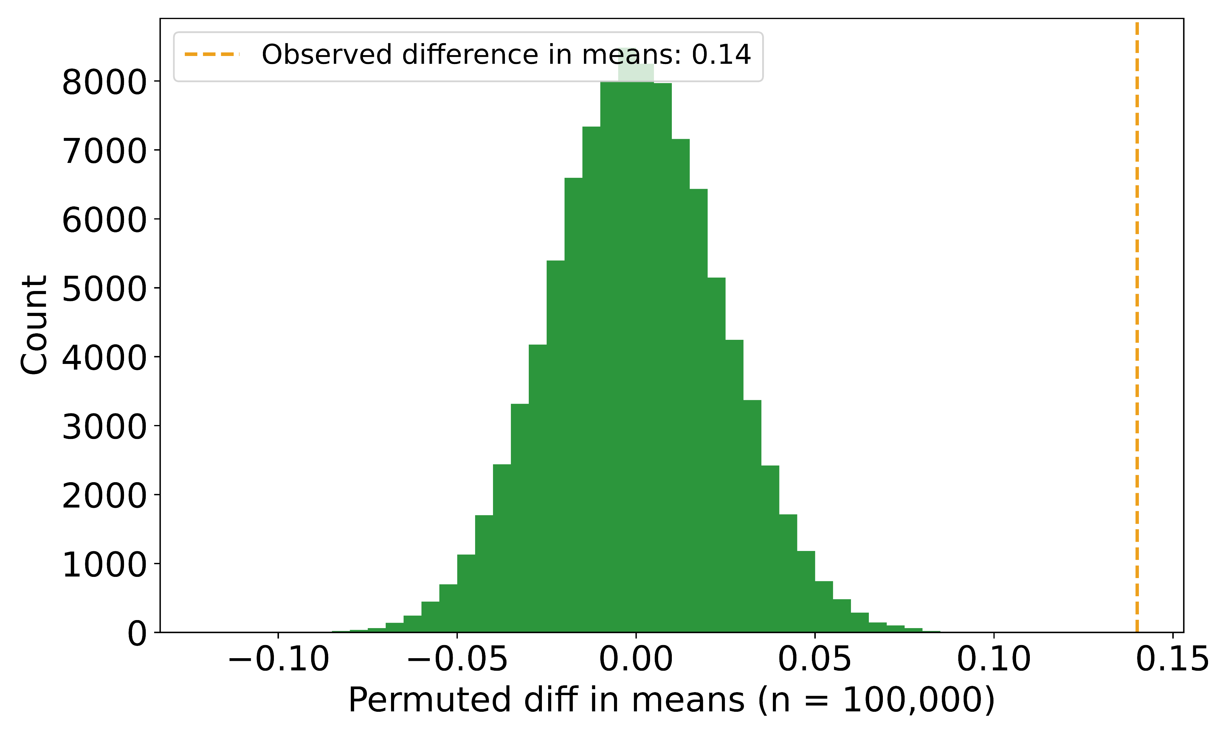
IUIS-IEI have significantly greater composite score
Permuted diff in mean composite score (100,000 iterations)

Slide 17
ImmPort annotations on >= 0.825 set
N genes: 1,008
ImmPort annotation set
curated from "Immune System" event in Reactome and "Immune System Process" term in GO
further separated these broad term events until each gene list contains a maximum of 200 genes
ImmPort annotations

Slide 18
Conclusions
IEI_BISSH pipeline annotates protein pairs with a composite score that encapsulates strength of evidence for structural homology
examples of known homologous proteins as per literature have high composite score
IUIS-IEI genes in pipeline output have significantly greater composite score than background
examples of H. sapiens proteins in top-scoring pairs have documented antiviral roles in humans
composite score threshold can be used to compile a gene list for clinical genetics applications
IEI_BISSH pipeline elucidates human-bacteria protein homology that is not discernible from sequence homology alone

Slide 19
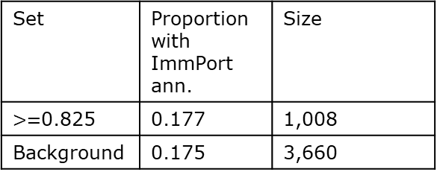
ImmPort annotations enrichment
Set | Proportion with ImmPort ann. | Size
$>=$0.825 | 0.177 | 1,008
Background | 0.175 | 3,660

Slide 20
Acknowledgements
Vinicius Furlan
Anjali Jain
Andy Wang
Matthew Uchmanowicz
Dr. Chantel Trost
Dr. Christian Marshall
Dr. Stephen Scherer
Centre for Computational Medicine

Slide 21
References
Schaefer M, et al. RNA methylation by Dnmt2 protects transfer RNAs against stress-induced cleavage. Genes Dev. 2010;24:1590–1595. DOI: 10.1101/gad.586710.
Dev RR, et al. Cytosine methylation by DNMT2 facilitates stability and survival of HIV-1 RNA in the host cell during infection. Biochem J. 2017;474:2009–2026. DOI: 10.1042/BCJ20170258.
Dong A, et al. Structure of human DNMT2, an enigmatic DNA methyltransferase homolog that displays denaturant-resistant binding to DNA. Nucleic Acids Res. 2001;29:439–448.
Flodman K, et al. In vitro Type II Restriction of Bacteriophage DNA With Modified Pyrimidines. Front Microbiol. 2020;11:604618. DOI: 10.3389/fmicb.2020.604618
Chen Z, et al. DDX20 positively regulates the interferon pathway to inhibit viral infection. Antiviral Res. 2024;225:105875. DOI: 10.1016/j.antiviral.2024.105875
Poli MC, et al. Human inborn errors of immunity: 2024 update on the classification from the International Union of Immunological Societies Expert Committee. J Hum Immun. 2025;1:e20250003. DOI: 10.70962/jhi.20250003.

