Slide 1




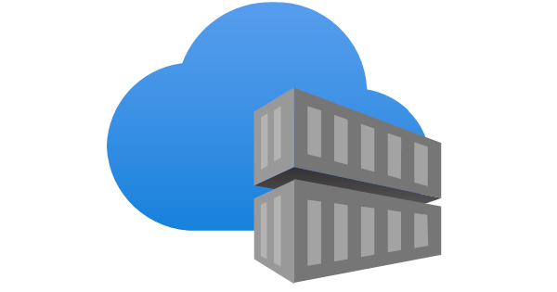
Administrator
1) Create resource group, container registry, Azure ML workspace
1) Setup forecast/prediction using online endpoint information (https://bcmlendpoint.eastus...)
2) Call online endpoint (https://bcmlendpoint.eastus...)
PowerShell
Azure
2) Build and upload container image
Business Central
Azure Machine Learning - online endpoint
Azure Container Registry
3) Create online endpoint using container image (https://bcmlendpoint.eastus...)
4) Pull container image
Azure Machine Learning

