Slide 1
MISC-V Processor by team Orange: Drew, Julian, Ziyu, Yash, and Eli

Slide 2
Brief Overview
A Pipelined Load-Store Architecture mimicking RISC-V
Focuses on speed and ease of programming
Instructions picked specifically for the Euclid’s Algorithm program
Symbol based Assembly language.

Slide 3
Instruction symbols
All instructions are symbol based:
Simple arithmetic instructions like +, -, and &
Immediate instructions have underscores: +_, X|_, <<_
Branches are denoted by Y: Y=, Y<
Memory instructions are arrows: <-, ->
Jumps: \/, /\

Slide 4
Registers/command construction
Type | Layout
R | rs1 (op) rs2, rd
I | rs1 (op) imm, rd
M | rd (op) rs1+imm
Y | rs1 (op) rs2, imm
J | rd (op) imm
8 registers total:
Zero, ra, sp, at, a0, a1, s0, s1

Slide 5
Example program
On the back of the handout there is an example program:
Takes in a location in memory, which holds two numbers
(m0+m1)-(m2+m3)
Then outputs the result

Slide 6
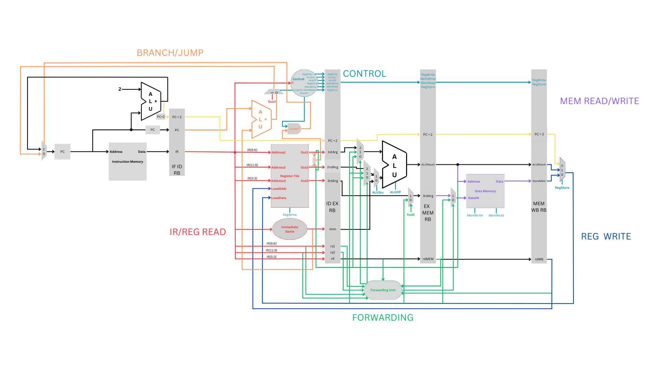
Datapath and Stage Details
The Processor has five stages:
Fetch
Decode
Execute
Memory
Writeback

Slide 7
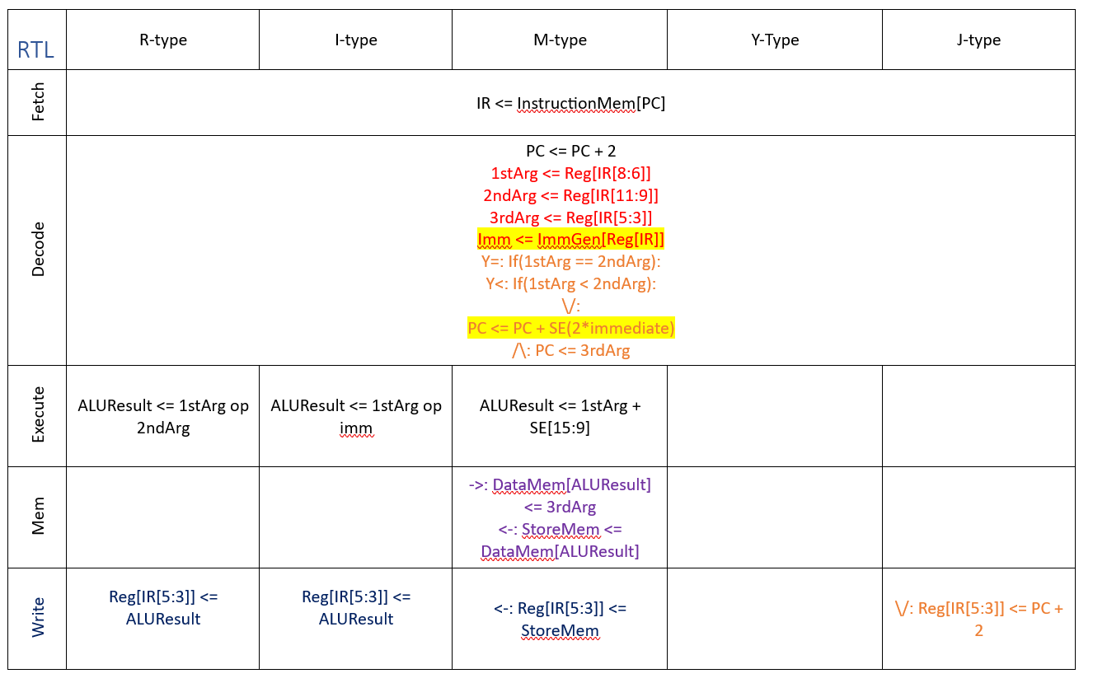
RTL

Slide 8
Benchmark Data
Instruction Mem size: 88 bytes using branch delay slot
Data Mem size: 10 bytes for stack used by functions.
total instructions executed when relPrime is called with 0x13B0: 71520
total number of cycles: 71524, 17.29908ns
The total execution time: 1.237 3652 ms
Total logic elements 6,297 / 10,320 ( 61 % )

