Slide 1
Precision public health: imprecise thoughts
Julian Flowers

Slide 2
Table of Contents
What is precision public health?
Current and possible uses
Precision ph vs precision medicine
Critiques and controversies
Implications for health intelligence
References

Slide 3
What is precision public health?
A recently coined term first appearing in print in 2014 (Dolley 2018)
Sparse literature
Various definitions but all encompass a set of consistent ideas:
Use of big data and new tehcnology to improve health
Data used to give more precise descriptions of populations and individuals
Application of new techniques and methods
Speed, accuracy and scale
“the application and combination of new and existing technologies, which more precisely describe and analyse individuals and their environment over the life course, to tailor preventive interventions for at-risk groups and improve the overall health of the population.” (Weeramanthri et al. 2018)
“improving the ability to prevent disease, promote health, and reduce health disparities in populations by applying emerging methods and technologies for measuring disease, pathogens, exposures, behaviors, and susceptibility in populations; and developing policies and targeted implementation programs to improve health” (Khoury and Galea 2016)
“requires robust primary surveillance data, rapid application of sophisticated analytics to track the geographical distribution of disease, and the capacity to act on such information” (Dowell, Blazes, and Desmond-Hellmann 2016)
“Precision public health is characterized by discovering, validating, and optimizing care strategies for well-characterized population strata” (Arnett and Claas 2016)

Slide 4
Current and possible uses
Current literature has identified 4 main use cases for precision public health:
Disease surveillance and signal detection
Risk prediction
Targeting treatment interventions
Improved disease understanding

Slide 5
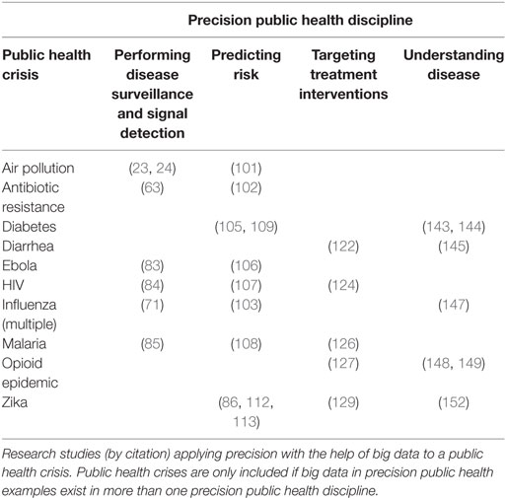
Source:(Dolley 2018)

Slide 6
These are largely in environmental health and communicable disease control. The only studies identified by Dolley in non-communicable disease or broader public health relate to diabetes.

Slide 7
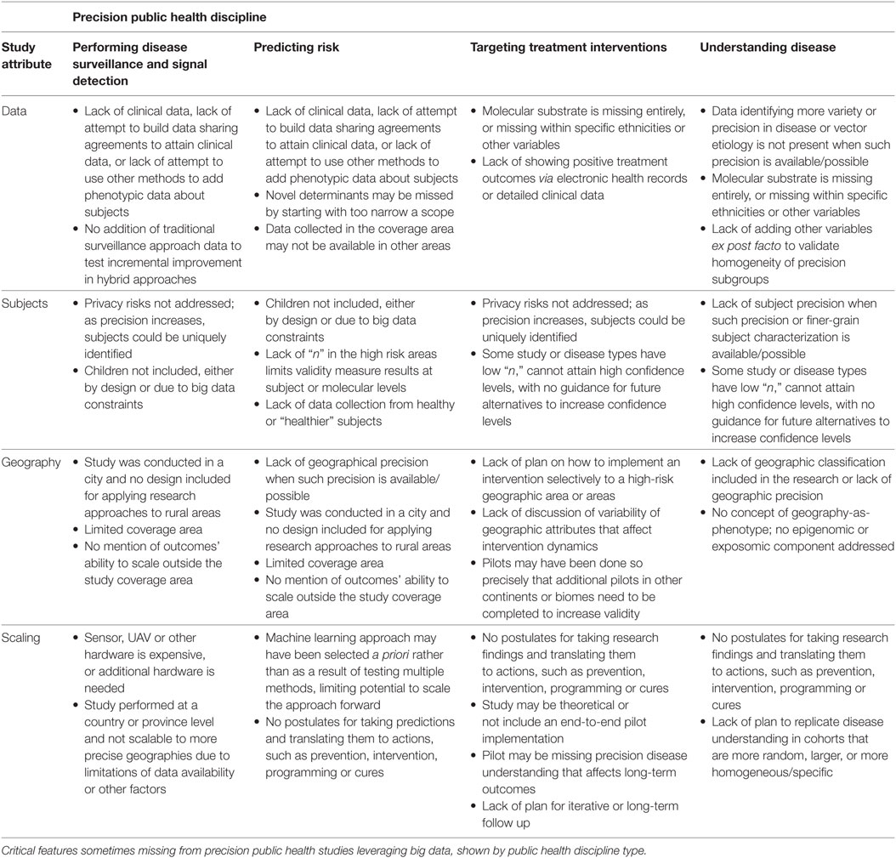
Source:(Dolley 2018)

Slide 8
Examples developing of:
Synthesizing data, academic literature and expert opinion for priority setting (https://www.frontiersin.org/articles/10.3389/fpubh.2017.00125/full)
Combining big and “smaller” data (https://www.frontiersin.org/articles/10.3389/fpubh.2016.00248/full)

Slide 9
Precision ph vs precision medicine
There has been some debate about the relationship or otherwise between precision medicince and precision public health. There are number of strands:
The 4 Ps of precision medicine (Predictive, Preventive, Personalised, Particpatory) should be extended to 5 with the addition of P for “population”…
Some argue that the two are unconnected
Some argue that the precision medicine is the antithesis of public health and that precision medicine may increase inequality, and divert resources and focus away from population health and prevention
Many agree that the distinction is unhelpful and that they are two sides of the same coin.

Slide 10
Critiques and controversies
## [1] "A new paradigm for disease prevention" ## [2] "Both classical public health and health promotion provide the foundations of a further leap forward for prevention; the personalisation of risk assessment and interventions for the individual, so called personalised prevention. This is a new paradigm for disease prevention that we wish to promote. Like health promotion it is effected through human agency, but unlike the undifferentiated messages typical of health promotion, personalised prevention takes into account individual susceptibility to disease risk (which has a biological basis), individual values and concepts of utility (which are social and culturally determined) and the need for individual autonomous decision making about the take-up of preventive interventions. The interventions that it offers require an individualised risk assessment and the provision of advice or preventive management as an interaction between the individual and some form of health professional, classically recognised as a clinical activity. " ## [3] "Risk assessments are likely to include some combination of clinical and family history, a range of biomarkers and imaging for risk or early disease, and increasingly the use of biosensors. Interventions may range from intensive weight reduction based on individual assessment of eating habits, to the recommendation of devices and mobile apps or prescription of pharmacological agents for chemoprevention. Finally, unlike Geoffrey Rose’s distinction between the use of population and high risk strategies in prevention, personalised prevention does not only target high risk individuals. It may equally be directed at those at lower risk who may or may not require further intervention. Properly advised, these people will experience less inconvenience and even harm from unnecessary interventions. There will also be the potential for reduced cost or more efficient use of preventive services." ## [4] "Classical public health, health promotion and the new field of personalised prevention will all be important activities in the future but there is a question about how they will best be practised. The first two would seem logically to remain with public health professionals and the local authorities to which they have recently been relocated. However, the personal interaction, clinical testing and sometimes medical interventions required for personalised prevention would not sit comfortably within this structure, which does not deal with individual patients, nor would it be within the skill set of most current public health practitioners."
A new paradigm for disease prevention, Both classical public health and health promotion provide the foundations of a further leap forward for prevention; the personalisation of risk assessment and interventions for the individual, so called personalised prevention. This is a new paradigm for disease prevention that we wish to promote. Like health promotion it is effected through human agency, but unlike the undifferentiated messages typical of health promotion, personalised prevention takes into account individual susceptibility to disease risk (which has a biological basis), individual values and concepts of utility (which are social and culturally determined) and the need for individual autonomous decision making about the take-up of preventive interventions. The interventions that it offers require an individualised risk assessment and the provision of advice or preventive management as an interaction between the individual and some form of health professional, classically recognised as a clinical activity. , Risk assessments are likely to include some combination of clinical and family history, a range of biomarkers and imaging for risk or early disease, and increasingly the use of biosensors. Interventions may range from intensive weight reduction based on individual assessment of eating habits, to the recommendation of devices and mobile apps or prescription of pharmacological agents for chemoprevention. Finally, unlike Geoffrey Rose’s distinction between the use of population and high risk strategies in prevention, personalised prevention does not only target high risk individuals. It may equally be directed at those at lower risk who may or may not require further intervention. Properly advised, these people will experience less inconvenience and even harm from unnecessary interventions. There will also be the potential for reduced cost or more efficient use of preventive services., Classical public health, health promotion and the new field of personalised prevention will all be important activities in the future but there is a question about how they will best be practised. The first two would seem logically to remain with public health professionals and the local authorities to which they have recently been relocated. However, the personal interaction, clinical testing and sometimes medical interventions required for personalised prevention would not sit comfortably within this structure, which does not deal with individual patients, nor would it be within the skill set of most current public health practitioners.

Slide 11
Implications for health intelligence
In some ways these ideas are nothing new - our users and stakeholders continually want more granularity and timeliness, more comprehensive data and insight, and actionable data linked to intervention. We have anlytical techniques like population segmentation, risk profiling and geodemographics.
Modernisation of surveillance, epidemiology, information systems and targeted interventions with population health prespective.
Precision and precision PH implies:
More granular data - build up from smallest analytical unit by default (e.g. SOA for populations, GP for clinical populations).
More timely data - latest available data by default
More granular time data - smallest feasible time unit (e.g. day, week or month)
Incorporating big and small data
Balanced against issues of information and data governance (re-identification risk)
Large scale ecological linkage (e.g. large datasets of small area data - phenomics)
Cohort development - requires linkage e.g. people with specific conditions
Better measures of disease frequency - incidence for prevention, prevalence for burden and planning => data linkage
Improved risk factor estimation and surveillance
Combining multiple datasets - “n-tangulation”
Application of new techniques - timeseries/ forcasting, predictive models and machine learning (unsupervised and supervised)
Complexity/ network analysis
Reference list for “precision public health”

Slide 12
title | link | date
Integrating Genomics into Public Health Surveillance: Ushering in a New Era of Precision Public Health | https://blogs.cdc.gov/genomics/2017/07/19/integrating-genomics/ | Wed, 19 Jul 2017 20:28:00 GMT
The Shift From Personalized Medicine to Precision Medicine and Precision Public Health: Words Matter! | http://blogs.cdc.gov/genomics/2016/04/21/shift/ | Thu, 21 Apr 2016 16:48:00 GMT
Precision Public Health: More Precision Ahead for Individual and Population Interventions | https://blogs.cdc.gov/genomics/2016/09/07/precision_public_health/ | Wed, 07 Sep 2016 20:16:00 GMT
The Shift From Personalized Medicine to Precision Medicine and Precision Public Health: Words Matter! | https://blogs.cdc.gov/genomics/2016/04/21/shift/ | Thu, 21 Apr 2016 16:48:00 GMT
Public Health is Striving Towards More Precision | https://blogs.cdc.gov/genomics/2018/09/17/public-health/ | Mon, 17 Sep 2018 18:34:00 GMT
Public Health in the Precision-Medicine Era. | http://www.ncbi.nlm.nih.gov/pubmed/26244305 | Thu, 06 Aug 2015 00:00:00 GMT
Precision Public Health: Harnessing the Power of the Human Microbiome | https://blogs.cdc.gov/genomics/2017/06/07/precision-public-health/ | Wed, 07 Jun 2017 15:42:00 GMT
Precision Public Health and Precision Medicine: Two Peas in a Pod | http://blogs.cdc.gov/genomics/2015/03/02/precision-public/ | Mon, 02 Mar 2015 18:17:00 GMT
Precision Public Health: Reconciling Biological and Social Determinants of Health | http://blogs.cdc.gov/genomics/2016/06/15/precision-reconciling/ | Wed, 15 Jun 2016 19:52:00 GMT
Precision Public Health: Reconciling Biological and Social Determinants of Health | https://blogs.cdc.gov/genomics/2016/06/15/precision-reconciling/ | Wed, 15 Jun 2016 19:52:00 GMT
2016: The Year of Precision Public Health! | https://blogs.cdc.gov/genomics/2016/12/14/2016/ | Wed, 14 Dec 2016 22:31:00 GMT
Precision medicine and genomics: an opportunity to improve public health? | http://feeds.plos.org/~r/plos/blogs/main/~3/4rEm_DKQ28Q/ | Mon, 31 Oct 2016 01:30:00 GMT
Precision Public Health: Using Malawi Population-Based Impact Assessment (MPHIA) Data to Reach HIV Epidemic Control in Malawi | https://blogs.cdc.gov/global/2017/10/11/precision-public-health/ | Wed, 11 Oct 2017 16:04:00 GMT
Precision Medicine and Public Health: Improving Health Now While Generating New Knowledge for the Future | http://blogs.cdc.gov/genomics/2015/06/02/precision/ | Tue, 02 Jun 2015 17:07:00 GMT
The Success of Precision Medicine Requires a Public Health Perspective | http://blogs.cdc.gov/genomics/2015/01/29/precision-medicine/ | Thu, 29 Jan 2015 17:08:00 GMT
Infectious Diseases: Precision Medicine for Public Health | http://blogs.cdc.gov/genomics/2015/09/24/infectious-diseases/ | Thu, 24 Sep 2015 19:09:00 GMT
Precision Medicine vs. Public Health: a False Dichotomy? | http://blogs.cdc.gov/genomics/2015/09/28/precision-medicine-2/ | Mon, 28 Sep 2015 15:59:00 GMT
Precision Medicine, Implementation Science and Public Health: How Do We Scale Up From 1 Million to 300 Million? | http://blogs.cdc.gov/genomics/2015/08/24/precision-2/ | Mon, 24 Aug 2015 14:16:00 GMT
Genomics and Precision Medicine: How Can Emerging Technologies Address Population Health Disparities? Join the Conversation. | https://blogs.cdc.gov/genomics/2017/11/13/genomics-and-precision/ | Mon, 13 Nov 2017 20:52:00 GMT
Precision Medicine and Population Health: Dealing With the Elephant in the Room | https://blogs.cdc.gov/genomics/2016/08/17/precision-medicine-3/ | Wed, 17 Aug 2016 20:03:00 GMT

Slide 13
## Please wait...Your query is precision[All Fields] AND "public health"[MeSH Terms] AND 2015[PDAT] : 2018[PDAT]. This returns 12166 abstracts. By default 1000 abstracts are downloaded. You downloaded 12145 abstracts. To retrieve more set 'n =' argument to the desired value
’r p %>% knitr::kable()`
## Warning in stri_replace_all_regex(string, pattern, ## fix_replacement(replacement), : argument is not an atomic vector; coercing
https://blogs.cdc.gov/genomics/2018/05/15/precision-public-health-2/, https://www.nature.com/news/four-steps-to-precision-public-health-1.21089, https://www.frontiersin.org/articles/10.3389/fpubh.2018.00068, https://www.frontiersin.org/research-topics/4526/precision-public-health, https://www.ncbi.nlm.nih.gov/pmc/articles/PMC5937027/, https://www.ncbi.nlm.nih.gov/pmc/articles/PMC4915347/, https://pdfs.semanticscholar.org/presentation/5f8e/242966ebcce86cc50b4ae62cddf04b42da18.pdf, https://www.nejm.org/doi/full/10.1056/NEJMp1806634, http://www.phgfoundation.org/blog/precision-public-health-a-conversation, https://academic.oup.com/ije/advance-article/doi/10.1093/ije/dyy184/5096004

Slide 14
References
Arnett, Donna K., and Steven A. Claas. 2016. “Precision medicine, genomics, and public health.” Diabetes Care. https://doi.org/10.2337/dc16-1763.
Dolley, Shawn. 2018. “Big Data’s Role in Precision Public Health.” Frontiers in Public Health. https://doi.org/10.3389/fpubh.2018.00068.
Dowell, Scott F., David Blazes, and Susan Desmond-Hellmann. 2016. “Four steps to precision public health.” https://doi.org/10.1038/540189a.
Khoury, Muin J., and Sandro Galea. 2016. “Will Precision Medicine Improve Population Health?” JAMA. https://doi.org/10.1001/jama.2016.12260.
Weeramanthri, Tarun Stephen, Hugh J S Dawkins, Gareth Baynam, Matthew Bellgard, Ori Gudes, and James Bernard Semmens. 2018. “Editorial: Precision Public Health.” Frontiers in Public Health 6 (April): 3–5. https://doi.org/10.3389/fpubh.2018.00121.

