Slide 1
Standard report for Health Intelligence Google Analytics
Julian Flowers

Slide 2
Table of Contents
Introduction
Getting IDs
Getting data
Summary data
Landing pages
Search terms
Events

Slide 3
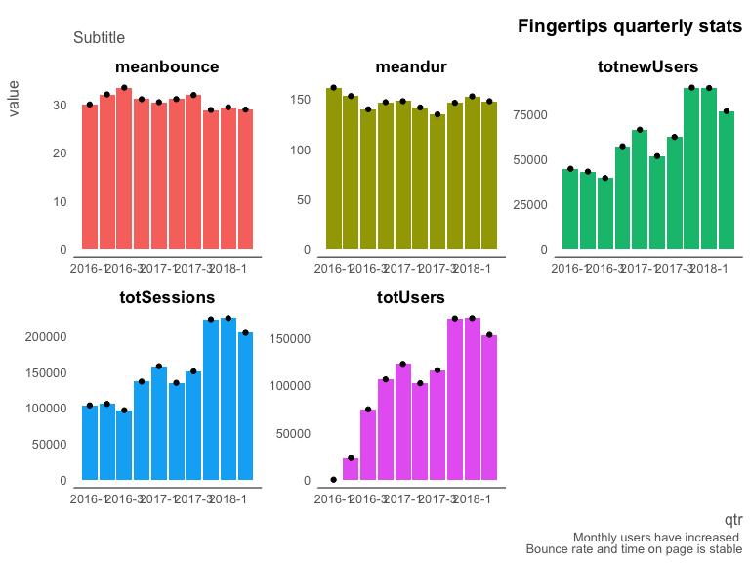

Slide 4
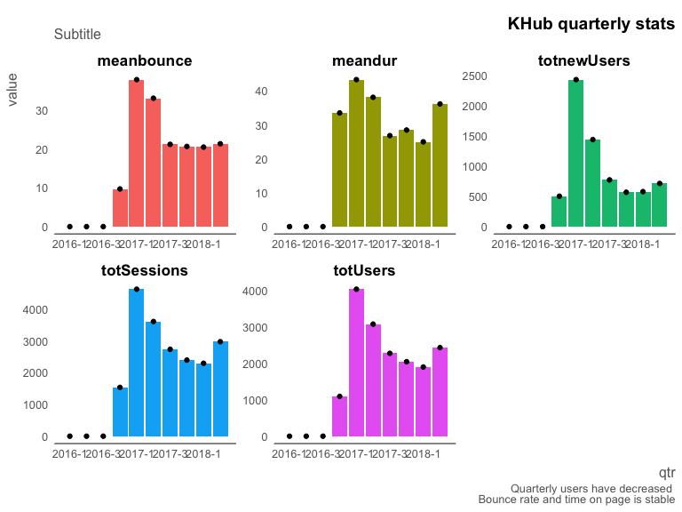

Slide 5
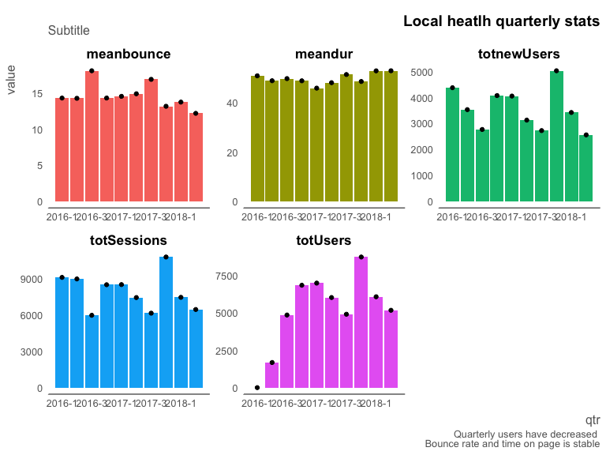

Slide 6
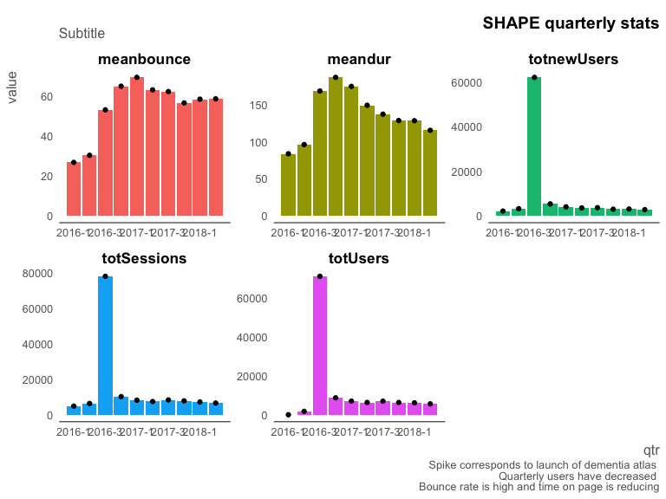

Slide 7
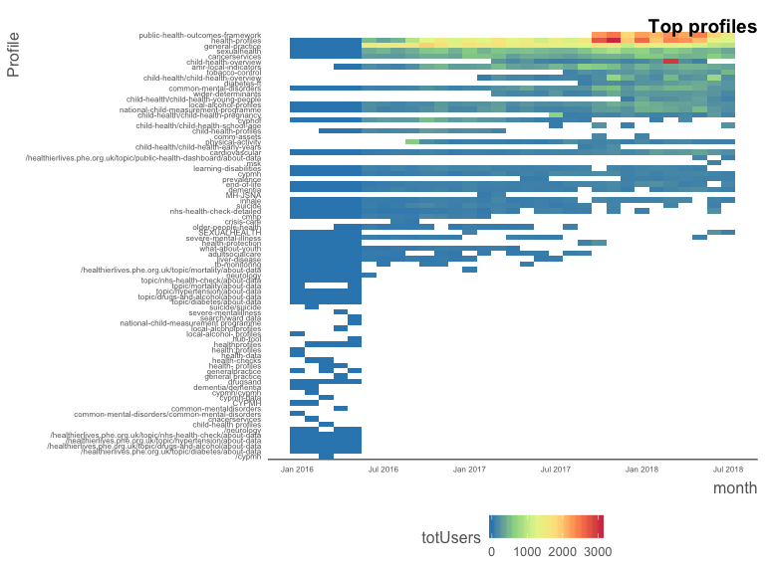

Slide 8
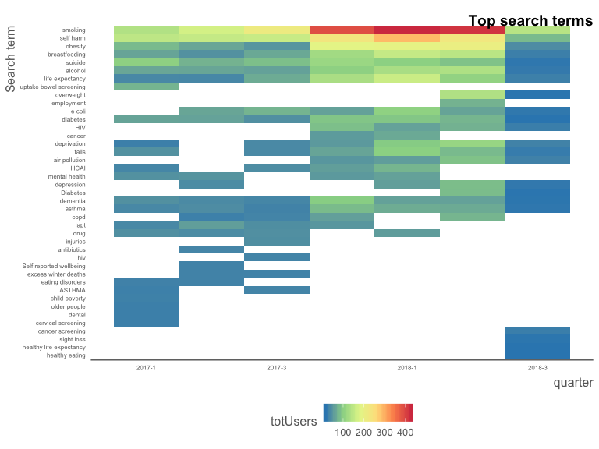

Slide 9
