Slide 1
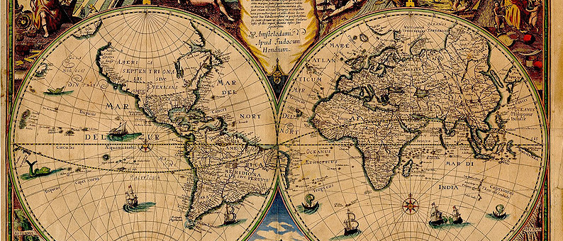

MOD004089 GIS Tools for Biodiversity Mapping and Conservation
Week 2: Databases
Dr Hannah White

Slide 2
Aims of a database
Store information/data
Secure
Version control
Unique point of access

Slide 3
Aims of a database
Store information/data
Secure
Version control
Unique point of access
2. Retrieve information/data
Queries
Customised questions

Slide 4
Aims of a database
Store information/data
Secure
Version control
Unique point of access
2. Retrieve information/data
Queries
Customised questions
3. Multiple access
Collaboration

Slide 5
Principles
Join multiple tables into relational database
Each table has unique data

Slide 6
Principles
Site | Observer | Date | Species | Common name | Habitat | Abundance
Plot1 | Alfred | 02.08.2021 | Certhia familiaris | Treecreeper | Woodland | 1
Site1 | Russel | 10.08.2021 | Sitta europaea | Nuthatch | Woodland | 1
Plot2 | Charles | 10.9.2021 | Certhia familiaris | Treecreeper | Farmland | 2 individuals
Plot3 | Charles D. | 22.09.2021 | Sitta europea | Nuthatch | Woodland | 2

Slide 7
Principles
Observer ID | Observer name
1 | Alfred
2 | Russel
3 | Charles
Species ID | Species name | Common name
1 | Certhia familiaris | Treecreeper
2 | Sitta europaea | Nuthatch
Plot ID | Plot name | Habitat
1 | Plot1 | Woodland
2 | Plot2 | Farmland
3 | Plot3 | Woodland

Slide 8
Principles
Observer ID | Observer name
1 | Alfred
2 | Russel
3 | Charles
Species ID | Species name | Common name
1 | Certhia familiaris | Treecreeper
2 | Sitta europaea | Nuthatch
Plot ID | Plot name | Habitat
1 | Plot1 | Woodland
2 | Plot2 | Farmland
3 | Plot3 | Woodland
Plot ID | Date | Observer ID | Species ID | Abundance
1 | 02.08.2021 | 1 | 1 | 1
1 | 10.08.2021 | 2 | 2 | 1
2 | 10.09.2021 | 3 | 1 | 2
3 | 22.09.2021 | 3 | 2 | 2

Slide 9
Principles
Constrain data types:
Number
Integer
Date
String/factor

Slide 10

Queries
Rows = features
Columns = fields
Tables linked by unique field
Ask question extracts data that answers query

Slide 11
Queries
Simple Query Language (SQL)
SELECT * FROM [table] WHERE [criteria]
e.g. Observer name = Russel
Abundance > 1
Combine criteria using AND or OR

Slide 12
Software
Excel (not great for a lot of data)
MS Office Access
Open source e.g. Open Office Base
Commercial e.g. Oracle

Slide 13
Queries in GIS
Information
GIS is a database
Attribute table
.dbf
Geography
Location
Spatial queries – where things are?

Slide 14
Queries in GIS
Information
GIS is a database
Attribute table
.dbf
Geography
Location
Spatial queries – where things are?

Slide 15
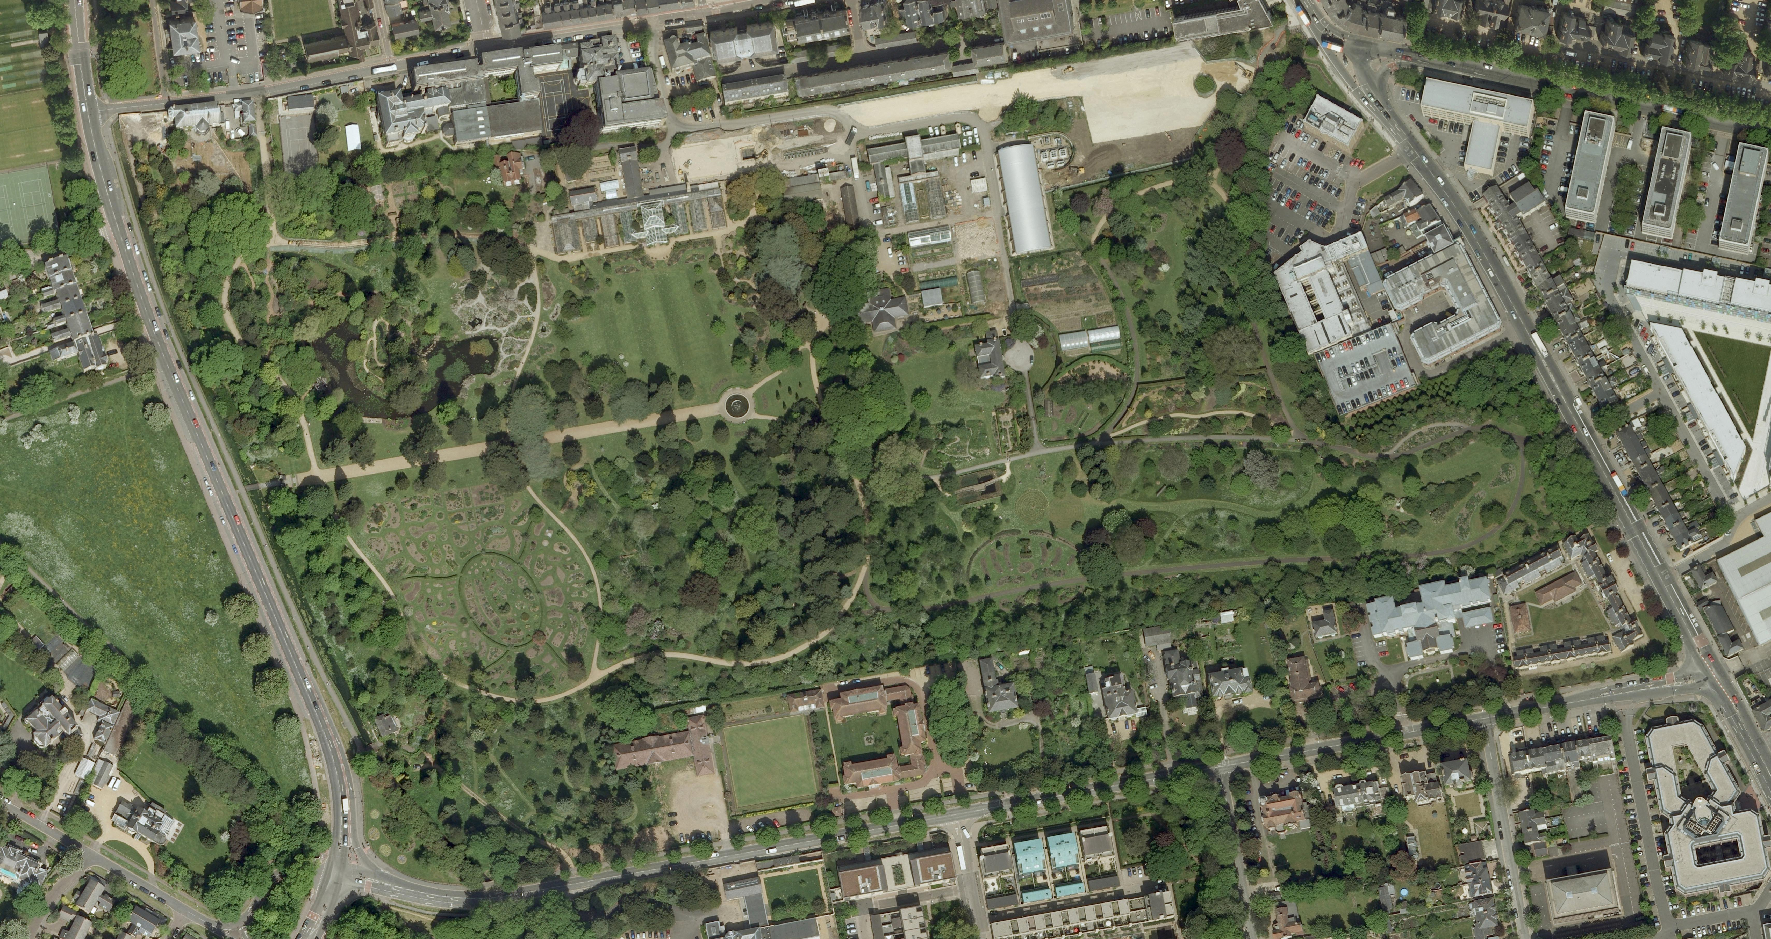
What have we talked about?
Relational databases
Queries
Software
Spatial Queries

