Slide 1
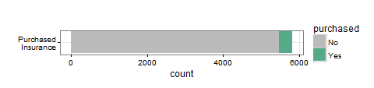
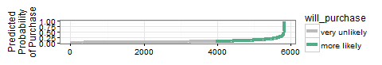
Can we use analytics to improve ROI?
Only 6% of our customer database actually bought caravan insurance. Can analytics help us predict the type of household most likely to buy?
Finding a pattern could help focus our sales efforts where we have the best chance. If we ignore leads with little chance of purchasing, we can increase conversion rates and consequently profit margins.
Even a relatively simple technique, such as logistic regression could be used to predict the probability that a new lead will purchase insurance.
We don’t have to predict exactly which leads will buy, we only need to reject more of the leads that won’t buy. With such a large proportion, this is rather easy and the risk of rejecting good leads is low.
Imagine from our original list of 5822 leads, we could have rejected 3861 + 98 = 3959 as very unlikely to purchase!
Even if some of those classifications were false negatives, our conversion rates and ROI would rocket.
 | Predict Unlikely | Predict Likely
Actual No | 3861 | 1613
Actual Yes | 98 | 250
With only 1613 + 250 = 1863 leads, if we manage to sell 250 insurance policies, this is a 13.4% conversion rate. More than double where we started.
Even though we make 98 fewer sales overall, we’ll soon recoup this because the sales team will have much more time to work on more leads coming in.

