Slide 1
ANALYSTRISING
Subscribe to my channel

Slide 2
Now For Some Bullet Points
Subscribe
to
my
Channel!

Slide 3
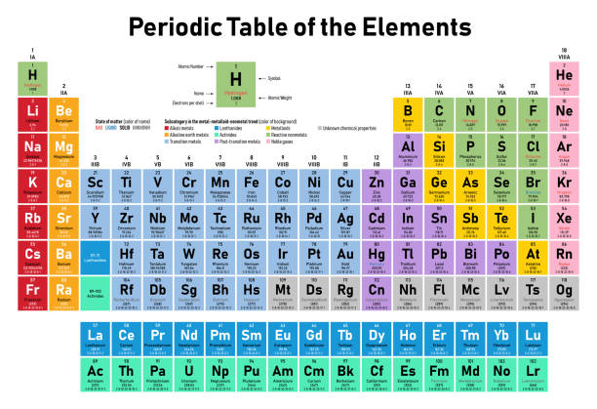
Picture Time!

Slide 4
Shapework
Pijl111

