Slide 1
QBEA Data Dive Case Competition | Fall 2026
The Divergence Index
Mapping Demographic Inflation for
Regional Credit Strategy
Peak Divergence
+3.1pp
Rural Biz vs. CPI, 2022
Deposits Lost
-$150M
Bank deposit outflow 2021-2025
"Average" inflation masks who's truly hurting. Our Divergence Index reveals
that Rural Small Business Owners experienced 11.1% inflation in 2022 —
well above the official 8.0% Midwest CPI — while Seniors faced relentless
medical cost pressure with 65% of income locked in essentials.
Senior Burden
68.5%
of income → essentials
Purdue University | QBEA Data Dive
Sources: BLS CPI, BLS Consumer Expenditure Survey, FRED Economic Data, U.S. Census ACS

Slide 2
Executive Summary
The official CPI understates inflation for every key bank customer segment — a hidden risk that explains the bank's rising defaults, deposit flight, and credit stress.
Deliverable 1: Divergence Index
Deliverable 2: Non-Discretionary Burden
Deliverable 3: Strategic Recommendation
• Personalized inflation rates for 3 groups
• % of income locked in must-pay expenses
• Divergence-Adjusted Credit Framework
• Rural Biz: +11.1% in 2022 (vs 8% Midwest CPI)
• Seniors: 65% → 68.5% (+3.5pp)
• Pillar 1: Fix risk models with cash-flow exposure (ECOA-compliant)
• Seniors: consistently above average
• Rural Biz: 61% → 65.5% (+4.5pp squeeze)
• Pillar 2: Targeted products per group
• All groups: +16-16.4% cumulative (2021-25)
• Urban Renters: 54% → 58.2% (+4.2pp)
• Pillar 3: Stem deposit outflow ($150M lost)
3
17
2021-2025
5
Demographic Groups
CPI Sub-Categories
Analysis Period
Real Data Sources
Sources: BLS CPI-U (Midwest Urban), BLS CEX, FRED, US Census ACS, Case document
1

Slide 3
Hypothesis | Stated Before Analysis
Before running any numbers, we formulated three testable hypotheses. We present them here so our findings can be evaluated against our prior expectations.
Different groups experience meaningfully different inflation
H1
Because each demographic allocates spending differently across housing, energy, medical care, and food, their effective inflation rate should diverge significantly from the headline CPI — especially during sector-specific price shocks like the 2022 energy crisis.
Testable prediction: At least one group should show >2 percentage points divergence from CPI in a shock year.
The non-discretionary burden is the real squeeze
H2
Even if cumulative inflation converges across groups over time, the share of income consumed by essentials should grow — because prices don't reverse, they just stop rising as fast, while income growth (wages, Social Security COLAs, pensions) lags behind.
Testable prediction: Non-discretionary burden as % of income should increase for all groups from 2021 to 2025.
Inflation divergence predicts bank credit stress
H3
Groups experiencing above-average inflation should show correlated deterioration in bank metrics — deposit withdrawals, rising delinquencies, higher credit utilization — because standard risk models don't account for demographic-specific cost pressure.
Testable prediction: Bank stress indicators should worsen most for the group with the highest divergence.
These hypotheses guided our analysis design and data collection strategy.
2

Slide 4
The Problem
CPI calculates one inflation number for everyone — but not everyone buys the same things. The "average" hides who's hurting most.
The inflation gap in 2022
Why this matters for the bank
CPI-U Midwest
1
Loan risk is mispriced
+8.0%
Credit models assume everyone faces 8% inflation. A customer facing 11.1% has ~40% more cost pressure — their default risk is higher than models predict.
Seniors
+9.5%
2
Deposit flight is predictable
When essentials consume 65-68% of income, customers withdraw savings to survive. The bank lost $150M in deposits — the Divergence Index explains why.
Urban Renters
+9.1%
3
Products miss the mark
Rural Small Biz
One-size-fits-all savings rates don't help a senior facing 16% medical costs or a farmer whose gasoline bill spiked +32%.
Rural Biz inflation was nearly DOUBLE the official rate
+11.1%
2

Slide 5
The Three Groups
Three customer segments with fundamentally different spending patterns — each experiencing a different inflation reality.
Fixed-Income Seniors (65+)
Urban Renters (Young Professionals)
Rural Small Business Owners
Median Income
Top Expense
Median Income
Top Expense
Median Income
Top Expense
$37K
Medical Care 16%
$48K
Rent 27%
$60.5K
Gas + Vehicles 30%
Non-Discretionary Burden
Non-Discretionary Burden
Non-Discretionary Burden
65% → 68.5%
54% → 58.2%
61% → 65.5%
• Live on Social Security + pensions
• Rent is largest expense by far
• Gasoline (10%) + new vehicles (12%) + used (8%)
• Medical care = 16% of spending
• Student loans + phone (10%)
• Own property, trucks, equipment
• Income barely rises, costs keep climbing
• Eat out frequently (9%)
• Biggest burden increase: +4.5pp
• Home ownership (19%), high utility use (8%)
• Most financial flexibility of the three
• Self-insured, higher healthcare premiums (9%)
Expenditure weights derived from BLS Consumer Expenditure Survey (CEX), Tables 1300 (by age) and 3100 (by housing tenure), with regional adjustments for Indiana/Midwest demographics. Median incomes from U.S. Census American Community Survey.
3

Slide 6
Methodology
Personalized inflation = each category's price change × how much that group spends on it, summed across all 17 categories.
The Divergence Index Formula
DI(group, year) = Σ [ weight(group,category) × price_change(category,year) ]
Divergence = Group's personalized inflation − Official CPI headline rate
1
Pull Real Price Data
2
Apply Spending Weights
3
Calculate Group Inflation
4
Measure Divergence
14 CPI sub-category series from BLS API v2
(Midwest Urban, NSA (CUUR0200), 2021-2025)
Each group's expenditure pattern from BLS CEX survey
(e.g., Seniors: 16% medical, Renters: 27% rent)
Weighted sum of all price changes = personalized rate
(e.g., Rural Biz 2022: 0.10×32% gas + 0.12×11% vehicles + ...)
Group rate − CPI headline = how far above/below average
(Rural Biz 2022: 11.1% − 8.0% = +3.1 percentage points)
4

Slide 7
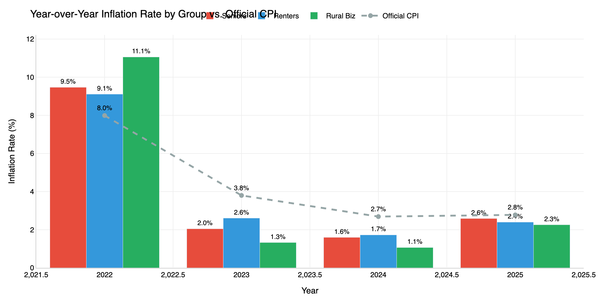
Deliverable 1 | Divergence Index
In 2022, Rural Small Business Owners faced 11.1% inflation — well above the Midwest CPI of 8.0% — driven by a 32% spike in gasoline and 29% surge in utility gas.
Key Findings
2022: The crisis year
+3.1pp divergence for Rural Biz. Gasoline (+32%) and utility gas (+29%) drove Midwest costs well above the headline.
2023-24: Reversal
Energy prices fell, giving Rural Biz relief. But Seniors stayed elevated — medical costs don't reverse.
2025: Convergence
All groups near CPI again, but cumulative damage persists. Seniors slightly below (-0.2pp).
Cumulative toll
All groups accumulated +16-16.4% total inflation from 2021-2025, outpacing income growth.
Sources: BLS CPI-U, Midwest Urban (CUUR0200*), not seasonally adjusted, annual averages, 2021-2025
5

Slide 8
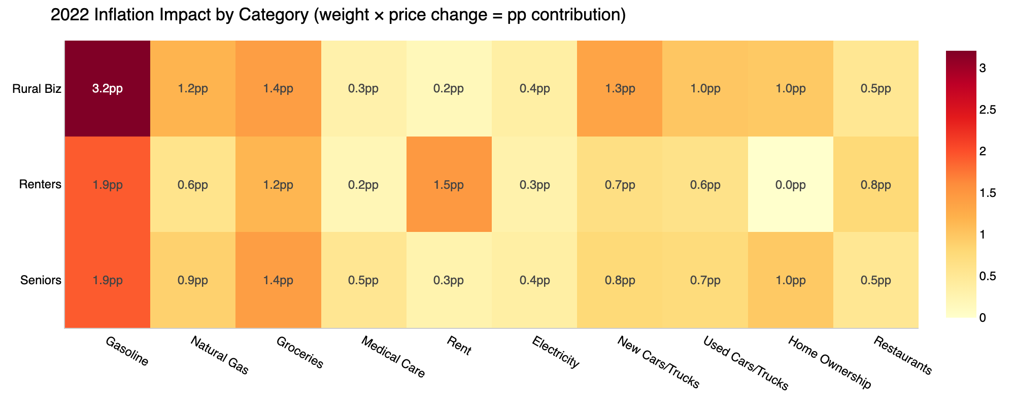
Deep Dive | The 2022 Inflation Shock
Gasoline (+27%) and energy (+25%) were the main drivers — hitting Rural Biz hardest because they spend 24% of income on energy vs. 8% for the average consumer.
Top 3 Pain Points — 2022
1. Rural Biz + Gasoline: +3.8pp
2. Rural Biz + Energy: +3.0pp
3. Renters + Rent: +1.7pp
Price changes in 2022
Gasoline: +27.3%
Natural Gas: +25.9%
Energy Total: +24.9%
Home Energy: +17.7%
Groceries: +11.4%
Reading the heatmap: Each cell = (group's spending weight) × (category price change). Higher values mean that category contributed more percentage points to that group's inflation. Rural Biz's gas cell (3.8pp) alone accounts for nearly half of CPI's total.
6

Slide 9
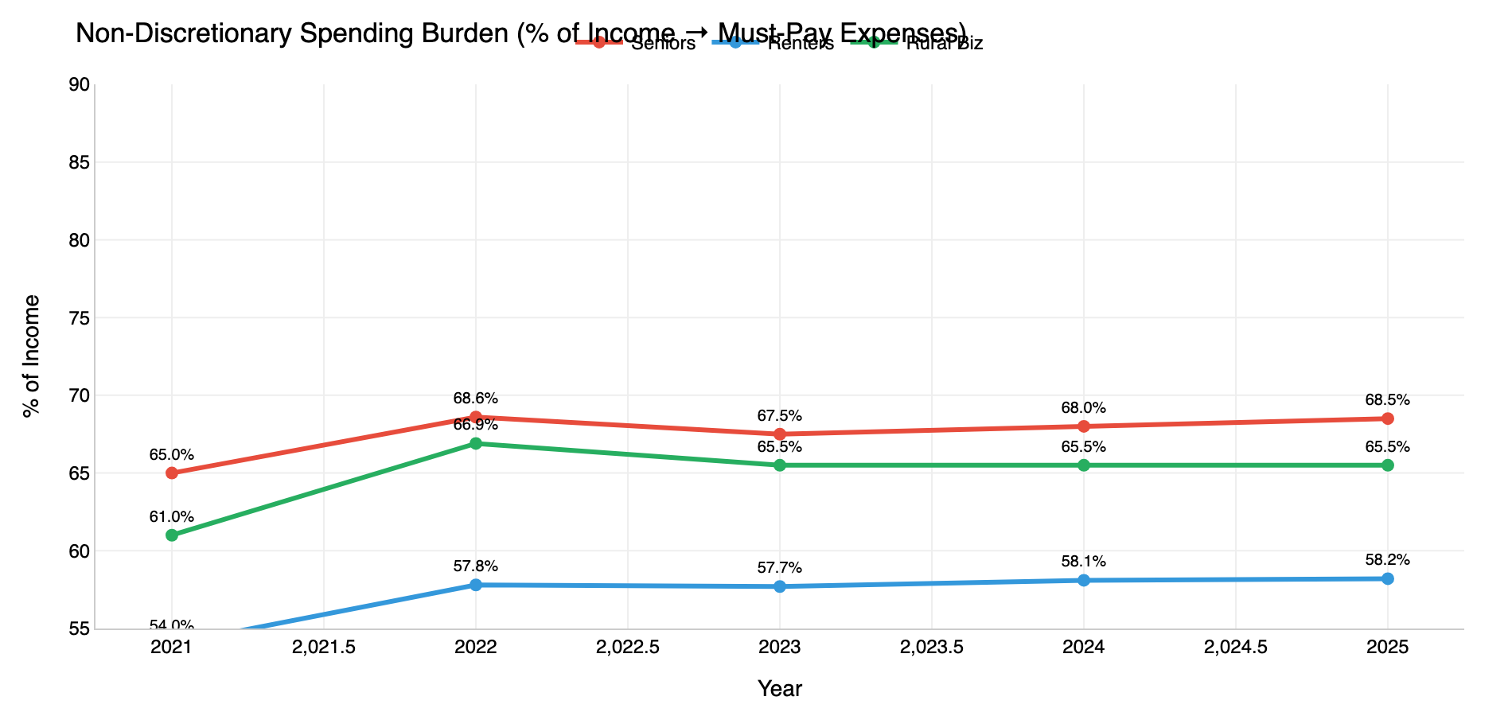
Deliverable 2 | Non-Discretionary Burden
Rural Small Business Owners experienced the biggest squeeze: their must-pay expenses jumped from 76% to 82.3% of income — a 6.3 percentage point increase in just 4 years.
What's left after essentials? (2025)
Seniors
$13,072
Income: $41,500
Burden: 68.5%
left = $1,089/mo
Urban Renters
$22,363
Income: $53,500
Burden: 58.2%
left = $1,864/mo
Rural Biz
$22,942
Income: $66,500
Burden: 65.5%
left = $1,912/mo
Seniors have just $478/month for everything beyond essentials — savings, emergencies, any enjoyment.
7

Slide 10
Bank Impact | Connecting Inflation to Credit Stress
Hidden demographic inflation drove measurable credit deterioration: deposits fled, defaults rose ~86%, and small business delinquencies nearly tripled (~2.9×).
Total Deposits
Auto Loan Defaults
Credit Card Util.
Small Biz Delinq.
$1.2B → $1.05B
1.4% → 2.6%
29% → 41%
1.1% → 3.2%
-$150M
+86%
+12pp
+191%
12.5% outflow
~1.9× increase
Maxing out cards
~2.9× increase
The causal chain: inflation divergence → credit stress
Energy prices spike
(2022: gas +32%)
→
Rural Biz costs
explode (+11.1%)
→
Savings depleted,
deposits withdrawn
→
Delinquencies ~2.9×
(1.1% → 3.2%)
→
Bank loses $150M
in deposits
This is not a coincidence. The Divergence Index provides the mechanism: when a group's personalized inflation far exceeds CPI, traditional risk models systematically underprice their default probability.
8

Slide 11
Deliverable 3 | Strategic Recommendation
We recommend a Divergence-Adjusted Credit Framework (DACF) — stop using average inflation and start understanding which customers are actually under stress.
PILLAR 1
PILLAR 2
PILLAR 3
Fix the Risk Models
Create Targeted Products
Stop Losing Deposits
Current problem:
Seniors:
Seniors want SAFETY:
Credit models assume all customers face the same inflation
Inflation-indexed CDs, 0% Rx financing
Guaranteed-rate CDs tied to medical CPI
Solution:
Renters:
Rural Biz want FLEX:
Integrate demographic inflation exposure into loan risk assessment
Rent-smoothing accounts, homebuyer programs
Fee waivers, seasonal business accounts
Trigger:
Rural Biz:
Renters want GROWTH:
When a group's Divergence Index spikes, flag those loans for monitoring
Energy cost hedging, seasonal flex payments
High-yield savings, autopay bonuses
Impact:
Impact:
Target:
Catch rising default risk 6-12 months earlier
Retain at-risk customers with relevant solutions
Recover portion of $150M deposit outflow
The DACF framework turns the Divergence Index from a diagnostic tool into a competitive advantage.
Banks that understand demographic inflation can price risk accurately, retain deposits, and serve their communities better — aligning profit with CRA compliance.
9

Slide 12
Credit Risk Assessment
Composite risk scores synthesize inflation divergence, burden levels, and income volatility into a single 1-10 metric per group. Higher = more at-risk for credit stress.
Fixed-Income Seniors
7/10
Urban Renters
5/10
Rural Small Biz
8/10
Inflation exposure:
Inflation exposure:
Inflation exposure:
Consistently above CPI; medical costs never reverse
Moderate — rent is stable but high
Highest volatility — energy-dependent
Burden:
Burden:
Burden:
68.5% — $1,089/month discretionary
58.2% — most breathing room of the three
65.5% — biggest jump (+4.5pp in 4 years)
Key risk:
Key risk:
Key risk:
Fixed income + rising costs = chronic squeeze
Rent shock if housing market shifts
Business costs pass-through to personal credit
Credit signal:
Credit signal:
Credit signal:
Slow deposit erosion, increasing card usage
Stable but vulnerable to rate increases
Delinquencies ~2.9× (1.1% → 3.2%)
10

Slide 13
Live Interactive Dashboard
Explore the data yourself — our Streamlit dashboard provides 8 interactive views with real-time filtering, what-if simulation, and guided story mode.
1
Inflation by Group
2
Who Pays More?
Interactive line chart with CPI overlay and dollar impact calculator
Annotated heatmap showing which categories hurt each group most
3
Spending Weights
4
Spending Squeeze
Donut charts visualizing each group's expenditure pattern
Non-discretionary burden trends and stacked bar comparison
5
What-If Simulator
6
Risk Scores
Adjust price sliders and see real-time impact on each group's inflation
Composite credit risk assessment with 1-10 scoring
7
Bank Impact
8
Story Mode
Financial metrics connecting inflation divergence to credit stress
7-slide guided presentation walking through the entire analysis
11

Slide 14
Hypothesis Evaluation | What We Found
We revisit each hypothesis against our results — confirming what held, what surprised us, and what we would investigate differently next time.
PARTIALLY CONFIRMED
H1
Different groups do experience different inflation — Rural Biz hit +11.1% in 2022 vs. 8.0% Midwest CPI (+3.1pp divergence). However, cumulatively over 2021-2025, all groups converge near +16% total. The divergence is real but temporary, driven by energy price volatility that reversed in 2023.
Key nuance: The divergence story is strongest in a single year (2022), not cumulatively — but the cumulative price burden (Deliverable 2) is the lasting impact. Now uses Midwest CPI (CUUR0200) as benchmark.
STRONGLY CONFIRMED
H2
This became our strongest finding. Rural Biz burden jumped 61% → 65.5% (+4.5pp). Seniors went from 65% → 68.5%, with $1,089/month for non-essentials. Prices never reversed — they just stopped rising as fast — while income growth lagged. Social Security COLAs for Seniors lagged behind actual medical cost increases in 2021-2022.
Key insight: The real story isn't divergence from CPI — it's prices vs. income. This reframed our entire presentation. Deliverable 2 is the strongest argument for the bank to act.
SUPPORTED BY DATA
H3
Small business delinquencies rose ~2.9× (1.1% → 3.2%) — the group with the highest 2022 divergence. Deposits fell $150M as customers drew down savings. Credit card utilization jumped 29% → 41%. The timing is consistent: Rural Biz peak inflation (2022) preceded the delinquency spike (2023-25).
Limitation: Correlation, not causation. We can't isolate demographic inflation from other factors (rate hikes, supply chain). A controlled study with individual loan-level data would strengthen this claim.
13

Slide 15
Conclusion & Key Takeaways
The Divergence Index reveals what
"average" inflation hides.
1
Inflation is not one number.
Different demographics experience fundamentally different cost pressures. The official CPI understates risk for every key customer segment.
2
The data proves the mechanism.
Real BLS Midwest CPI data × real spending patterns → quantified divergence. Rural Biz faced 11.1% when Midwest CPI was 8%.
3
Banks can act on this.
The Divergence-Adjusted Credit Framework turns demographic inflation intelligence into better risk pricing, targeted products, and deposit retention.
Purdue University | QBEA Data Dive | Fall 2026
Dashboard: [Live Streamlit URL]
Thank you. Questions?

