Slide 1



Open Source
Column Store
John Sichi
Project Founder for
Sponsored by

Slide 2

Why Are You Here?
You have a boatload of data
You need to analyze it
You are lazy
You are cheap
You are smart

Slide 3

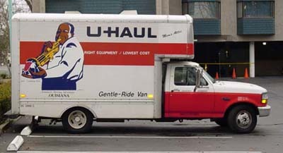

Analytic Data Volume Scale
terabytes: distributed horizontal parallelism (column store a plus)
10's of gigabytes: vanilla PostgreSQL, MySQL ®

Slide 4
TPC-H* Scale Factor 10
LucidDB 0.7.4 (prerelease)
  6GB buffer pool; libaio and O_DIRECT
MySQL 5.0.22
  MyISAM storage engine
Scale factor 10 = 10GB flat file data = 60 million lineitems
  same schema; all primary and foreign keys indexed
Machine used for timing runs
  AMD64 2GHz, RHEL5, kernel 2.6.18-8.el5, JRockit R27.4
  8 GB RAM, 1MB L2 cache, SATA 10K RPM, ext3
* (not an official TPC-H compliant execution)

Slide 5
Query Performance Compared
all times in seconds (queries 19 through 22 omitted)
thrash
Query 11
Bad Run
(ignore)

Slide 6
Load Performance Compared
all times in seconds

Slide 7
Storage Compression
storage in bytes for LINEITEM table (LucidDB)
RAM

Slide 8
Column Store: Pay As You Go
base data storage per column in LINEITEM table (LucidDB)

Slide 9
Bitmap Indexing
storage per index on LINEITEM table (LucidDB)

Slide 10
Storage Architecture Benefits
Disks are getting bigger, not faster, and data keeps growing, so...
  Apply aggressive compression (homogeneous domains)
  Only read what you need
Optimal use of available I/O bandwidth
Larger effective data cache
What can you do with all the storage/bandwidth you save?
  More precomputed aggregate tables (OLAP cubes)
  More indexes, materialized views

Slide 11
Scaling Beyond Main Memory
all times in seconds (LucidDB only)

Slide 12
Star Join Optimization
browser
(30%)
user_profile
(20%)
“For each heavily-commented page
visited by twentysomethings using
a Mozillaesque browser in the given week,
return the URL and hit count.”
-- join fact with filtered dimensions,
-- then aggregate
select page_info.page_url, count(*)
from page_hits, browser,
user_profile, calendar, page_info
where page_hits.browser_id=browser.id
and page_hits.user_id=user_profile.id
and page_hits.access_date=calendar.date_id
and page_hits.page_id=page_info.id
and browser.family='Mozilla'
and user_profile.age between 20 and 30
and calendar.week='2008 Week 10'
and page_info.comment_count > 10
group by page_info.page_url
page_hits
(0.006%)
calendar
(1%)
page_info
(10%)

Slide 13
Star Join Plan (Index Semijoin)
calendar
browser
user_profile
page_info
Filter
(1%)
Filter
(30%)
Filter
(20%)
Filter
(10%)
Bitmap access
page_hits.
access_date
Bitmap access
page_hits.
browser_id
Bitmap access
page_hits.
user_id
Bitmap access
page_hits.
page_id
Bitmap
intersection
page_hits
(0.006%)
Hash Join
Hash
Aggregate
Result

Slide 14
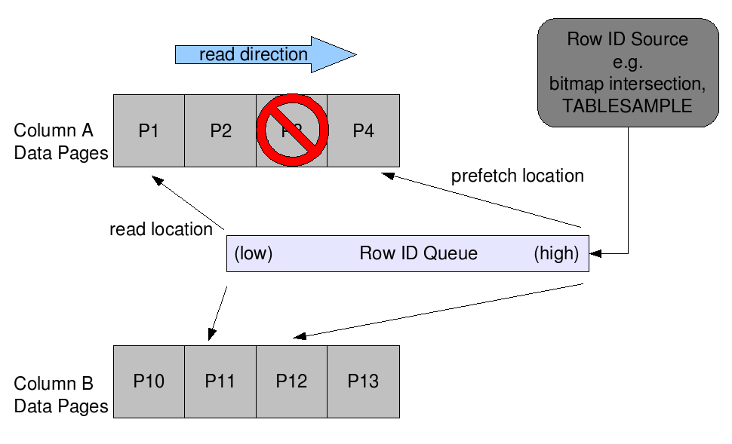
Intelligent Prefetch
Make every disk read count!
High selectivity, fragmentation: page reads may be non-contiguous

Slide 15
Hybrid Architecture
Java (standalone or deployed in J2EE app server)
  catalog, sessions, parser, validator, optimizer, JDBC driver
  JDBC clients (e.g. Mondrian OLAP, JMX mbeans)
  scalar expression codegen/evaluation
  connectivity, extensibility (user-defined routines)
C++ heavy lifting (integrated via JNI and java.nio)
  sorter, hash join/agg, nested loop join, flatfile reader
  persistence, cache, btrees, column read/write, bitmap indexes

Slide 16
External Data Extraction
SQL/MED: “Management of External Data” in SQL:2003
Integrated with LucidDB's catalog+optimizer
LucidDB
Storage
SalesForce.com
LucidEra's
SalesForce
Wrapper
Foreign
Data
Wrapper
Plugins
Flat File
Wrapper
Staging
Tables
csv Files
JDBC
Wrapper
Any
DBMS
INSERT INTO staging_table
SELECT ... FROM foreign_table
WHERE last_modification_date > ...;

Slide 17
User-Defined Transforms
public class TopN
{
/**
* Return the first n rows of a cursor.
*/
public static void execute(
ResultSet cursorInput,
int n,
PreparedStatement resultInserter)
throws SQLException
{
int columnCount = cursorInput.getMetaData().getColumnCount();
for (; n > 0; --n) {
if (!cursorInput.next()) break;
for (int i=1; i <= columnCount; i++) {
resultInserter.setObject(i, cursorInput.getObject(i));
}
resultInserter.executeUpdate();
}
}
}

Slide 18
Pipelined Transform Invocation
-- install the jar
create or replace jar applib.applibJar
library '/path/to/plugin/applib.jar'
options(0);
-- register the UDX
create or replace function applib.topn(in_cursor cursor, n int)
returns table(in_cursor.*)
language java
parameter style system defined java
no sql
external name 'applib.applibJar:com.lucidera.luciddb.applib.cursor.TopN.execute';
-- invoke the UDX as a filter while moving data
insert into top10_popular_browsers
select * from table(
applib.topn(
cursor(select * from browsers order by usage_count desc),
10));

Slide 19
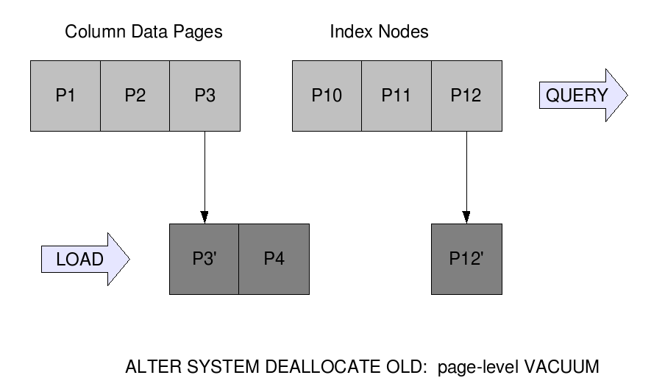
Page-level Multiversioning
default page size: 32KB
never overwrite data pages: copy-on-write

Slide 20
LucidDB Project History
Original codebase developed at Broadbase (1996 – 2001), KANA
  closed source; Windows NT with Visual C++ and Microsoft JVM
  sold as traditional enterprise software (data mart)
Modernized frameworks (Sun JVM, Linux, g++, SQL:2003) developed as open source by The Eigenbase Project (2003-present)
Broadbase design+code acquired and reworked into Eigenbase frameworks by LucidEra (2005-2007)
  new additions: page versioning, upsert
70+ production SaaS deployments in LucidEra data center since 2006
First packaged open source release (GPL v2) in Jan 2007
  3-5 month release cycle since then

Slide 21
Under Development
Point-in-time query
  Concurrent OLAP (including Mondrian cache consistency) and ETL
Hot/incremental/differential backup
  Reduce downtime and archive size/bandwidth
Tablespaces
  Better manageability for complex deployments
Parallel Executor
  Keep all those cores humming!

Slide 22
Q&A
http://www.luciddb.org
http://pub.eigenbase.org/wiki/LucidDbDocs
http://pub.eigenbase.org/wiki/LucidDbTpch
luciddb-users@lists.sourceforge.net
jsichi@gmail.com

Slide 23
Bonus Slides...
presentation ends on previous slide

Slide 24
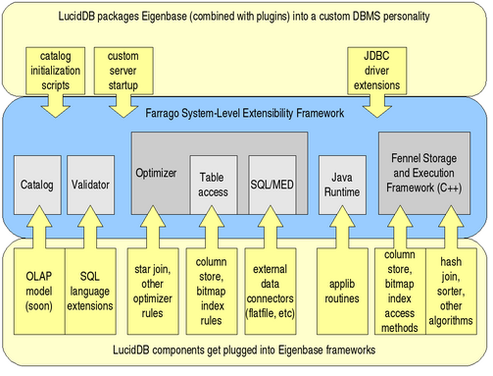
Eigenbase Integration

Slide 25
Column Store Details
Column0
Column1
ColumnN
Multiple columns can be stored on a single cluster
Cluster pages flushed to disk once they're filled during loads
Each cluster bulk loaded independent of other clusters
Clusters uniquely identified by pageId of root in btree map
...
Clusters
PageId X:
Contains
rids 0-95
Rid-to-PageId Btree Map
PageId Z:
Contains
rids
8000-8500
startRid pageId
0 X
96 Y
256
... ...
8000 Z
...
PageId Y:
Contains
rids 96-255
Pages from a
Single Cluster

