Slide 1

  Building a Dedicated Analytic Server with
  John Sichi
  Project Founder

Slide 2
A Bit About LucidDB
GPL v2 (w/LGPL for JDBC driver)
Developed by LucidEra
  part of its SaaS business intelligence stack
  used in production apps since 2006
  100+ trial/customer deployments
  built on Eigenbase frameworks
  design derived from an earlier commercial column store (Broadbase)

Slide 3
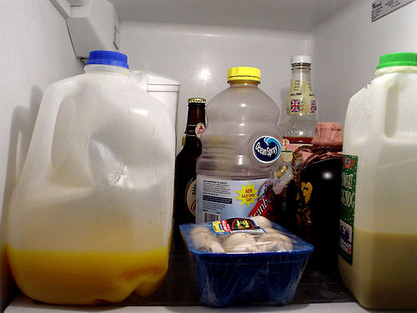
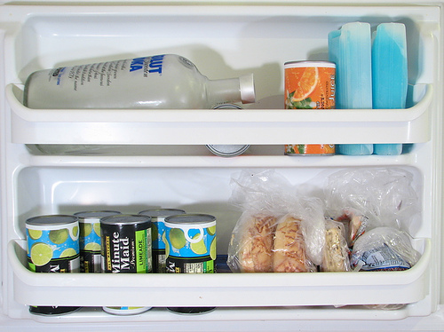
Why More Than One DBMS?

Slide 4
Because It's Worth The Complexity
Row store
  Good for transactions
  Compression difficult
  Small scattered writes
  Row versioning
  I/O bound
Column store
  Good for queries
  Compression easy
  Bulk load
  Page versioning
  CPU bound

Slide 5
Data Transformations
No transformation:
    run analysis queries directly against OLTP system
Physical:
    replicate to read-only slaves; additional indexing
    load into column store, materialize views
Logical:
    denormalize into stars (facts and dimensions)
    fact archive/summary tables (sales by region for 2005)
    dimension history tracking (customer single -> married)

Slide 6
System Dataflow
Reporting UI
ETL Tool
e.g. PDI
(Push)
SQL
MDX
LucidDB
OLAP Engine
e.g. Mondrian
Transactional
databases
OR
SQL
SQL/MED
Extraction
(Pull)
INSERT INTO warehouse_tbl
SELECT ... FROM mysql_external_table ...

Slide 7
So, Why Use LucidDB?
OLAP query acceleration
    Column store, bitmap indexes, hash join/agg
    Cost-based star join optimization
    Mondrian aggregate table builder
Extract/transform/load expressed as SQL
    SQL/MED data extraction
    Upsert, user-defined transformations
    Page multiversioning, hot/incremental backup
    Pentaho Data Integration bulk load via fifo pipe

Slide 8
Extract/Transform/Load
With an external ETL tool
  tool pushes data into fifo pipe; LucidDB pulls from other end via its flatfile reader
Or cut out the middleman
  LucidDB can query source system directly via JDBC
  You can also write your own SQL/MED foreign data wrappers and plug them in

Slide 9
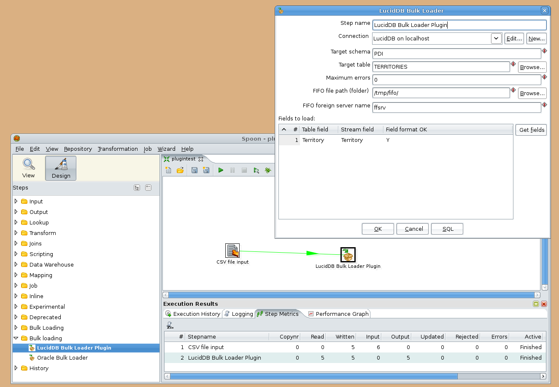
Pentaho Data Integration

Slide 10
Applying Transformations
Example transformations
  Surrogate key assignment/lookup
  Cleansing dirty data “Calif -> CA”
  Deduplication “C.J. Date -> Chris Date”
How?
  express directly as SQL (e.g. CASE ... WHEN)
  plug custom Java transformations into SQL
  or use ETL tool's transformation library

Slide 11
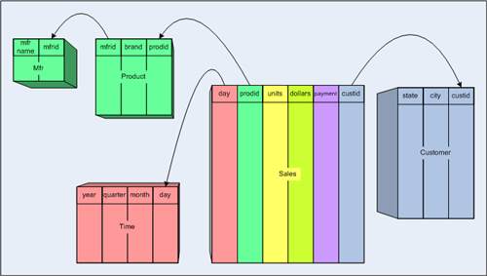
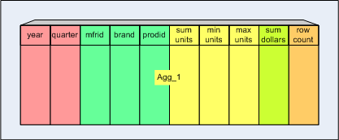
Aggregate Tables
preaggregation

Slide 12
LucidDB Agg Table Benefits
Column store and bitmap compression work well with repeated values in aggregate compound keys
  save disk space, I/O
LucidDB hash aggregation is quite fast
  reduce load time
Page versioning efficiently guarantees a consistent query view across all tables

Slide 13
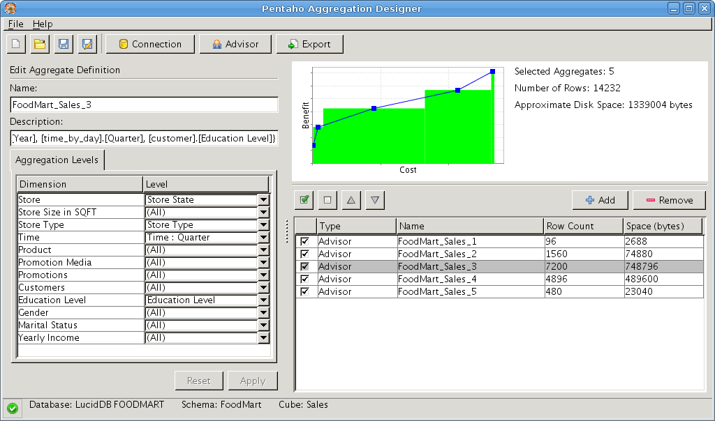
Mondrian Aggregate Designer
LucidDB system procedure for automation

Slide 14
Warehouse Labels
Old
Label
Query
Query
New
Label
(page-level versioning)
Load
Preaggregate

Slide 15
Rolling the Active Label
Old
Label
Long-running report
(JDBC connect string from Mondrian
requests a specific label per report)
New
Label
Query for new report
(drop old label once
all old report executions
have drained off)
Query for new report

Slide 16
Performance (anecdotal)
Biggest difference seen vs row store when data does not fit in memory (can be 10X and up)
  http://pub.eigenbase.org/wiki/LucidDbTp
When data fits in memory, more like 2X
  http://www.tholis.net/news/open-source-data-warehousing/
  http://pentahomusings.blogspot.com/2009/02/lucid-warehouse-results-well-sorta.html
No rigorous comparisons performed yet; would like to collaborate on DBT-3 benchmarks etc
SSD helps row store more than column store

Slide 17
Future Efforts
Incremental view materialization
SQL/OLAP support (e.g. fast TOP-N)
Multicore parallel load/query
  currently experimental
Scale-out parallelism
  multi-node load/query partitioning
Tool support: generate SQL for ETL

Slide 18
References
jsichi@gmail.com
luciddb-users@lists.sf.net
http://www.luciddb.org
http://pub.eigenbase.org/wiki
  [[LucidDbPdiBulkLoad]]
  [[LucidDbAggregateDesigner]]

Slide 19
Attributions
Images
  http://www.flickr.com/photos/jekemp/3424782/
  http://www.flickr.com/photos/lenore-m/409731388/
  Mondrian aggregate table documentation
Trademarks
  LucidDB is a trademark of LucidEra, Inc.
  Pentaho is a trademark of Pentaho, Inc.

