Slide 1

Optiq: a SQL front-end for everything
Julian Hyde @julianhyde
http://github.com/julianhyde/optiq
http://github.com/julianhyde/optiq-splunk
Pentaho Community Meetup
Amsterdam, 2012

Slide 2

http://www.flickr.com/photos/torkildr/3462606643

Slide 3
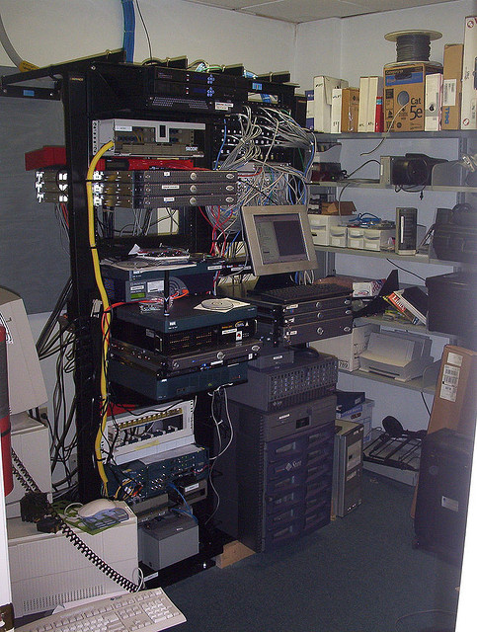
http://www.flickr.com/photos/sylvar/31436961/

Slide 4
“Big Data”
Right data, right time
Diverse data sources / Performance / Suitable format
Notes:
The obligatory “big data” definition slide.
What is “big data”? It's not really about “big”. We need to access data from different parts of the organization, when we need it (which often means we don't have time to copy it), and the performance needs to be reasonable.
If the data is large, it is often larger than the disks one can fit on one machine. It helps if we can process the data in place, leveraging the CPU and memory of the machines where the data is stored. We'd rather not copy it from one system to another.
It needs to be flexible, to deal with diverse systems and formats. That often means that open source is involved.
Some systems (e.g. reporting tools) can't easily be changed to accommodate new formats. So it helps if the data can be presented in standard formats, e.g. SQL.

Slide 5
Use case: Splunk
NoSQL database
Every log file in the enterprise
A single “table”
A record for every line in every log file
A column for every field that exists in any log file
No schema
  SELECT “source”, “product_id”, “http_code”
  FROM “splunk”.”splunk”
  WHERE “action” = 'purchase'

Slide 6
How do it (wrong)
action =
'purchase'
“search”
Splunk
Optiq
filter
SELECT “source”, “product_id”
FROM “splunk”.”splunk”
WHERE “action” = 'purchase'
Notes:
The wrong way to execute the query is for Splunk to send all of the data to Optiq. Splunk does more work than it needs to, it doesn't use any indexes, the network sends too much data, Optiq does too much work.

Slide 7
How do it (right)
“search
action=purchase”
Splunk
Optiq
SELECT “source”, “product_id”
FROM “splunk”.”splunk”
WHERE “action” = 'purchase'
Notes:
The right way to execute the query is to pass the filter down to Splunk. This lets Splunk use its indexes, so it does less work, passes less data over the network, and the query finishes faster.
This is just a simple answer, but a lot of problems can be solved by “pushing down” expressions, filters, computation of summaries. Do the work, and reduce the volume of data, as early in the process as possible.

Slide 8
Example #2
Combining data from 2 sources (Splunk & MySQL)
Also possible: 3 or more sources; 3-way joins; unions
Notes:
Demo connecting to Splunk via the Optiq driver.
We aer using sqlline as the shell (it works with any JDBC driver).
Se;ect “source” from “splunk”.”splunk” where “sourcetype=” = 'mysqld-4';
In the generated Java on the screen, Note how sourcetype is pushed down to Splunk.

Slide 9
Expression tree
SELECT p.“product_name”, COUNT(*) AS c
FROM “splunk”.”splunk” AS s
JOIN “mysql”.”products” AS p
ON s.”product_id” = p.”product_id”
WHERE s.“action” = 'purchase'
GROUP BY p.”product_name”
ORDER BY c DESC
Splunk
Table: splunk
Key: product_name
Agg: count
Key: product_id
Condition:
action =
'purchase'
Key: c DESC
scan
join
MySQL
filter
group
sort
scan
Table: products
Notes:
It's much more efficient if we psuh filters and aggregations to Splunk. But the user writing SQL shouldn't have to worry about that.
This is not about processing data. This is about processing expressions. Reformulating the question.
The question is the parse tree of a query. The parse tree is a data flow. In Splunk, a data flow looks like a pipeline of Linux commands. SQL systems have pipelines too (sometimes they are dataflow trees) built up of the basic relational operators. Think of the SQL SELECT, WHERE, JOIN, GROUP BY, ORDER BY clauses.

Slide 10
Expression tree
(optimized)
SELECT p.“product_name”, COUNT(*) AS c
FROM “splunk”.”splunk” AS s
JOIN “mysql”.”products” AS p
ON s.”product_id” = p.”product_id”
WHERE s.“action” = 'purchase'
GROUP BY p.”product_name”
ORDER BY c DESC
Splunk
Table: splunk
Condition:
action =
'purchase'
Key: product_name
Agg: count
Key: c DESC
scan
filter
Key: product_id
MySQL
join
group
sort
scan
Table: products
Notes:
It's much more efficient if we psuh filters and aggregations to Splunk. But the user writing SQL shouldn't have to worry about that.
This is not about processing data. This is about processing expressions. Reformulating the question.
The question is the parse tree of a query. The parse tree is a data flow. In Splunk, a data flow looks like a pipeline of Linux commands. SQL systems have pipelines too (sometimes they are dataflow trees) built up of the basic relational operators. Think of the SQL SELECT, WHERE, JOIN, GROUP BY, ORDER BY clauses.

Slide 11
Optiq is not a database.
Notes:
To recap. Optiq is not a database. It does as little of the database processing as it can get away with. Ideally, nothing at all.
But what is it?

Slide 12
http://www.flickr.com/photos/torkildr/3462606643

Slide 13
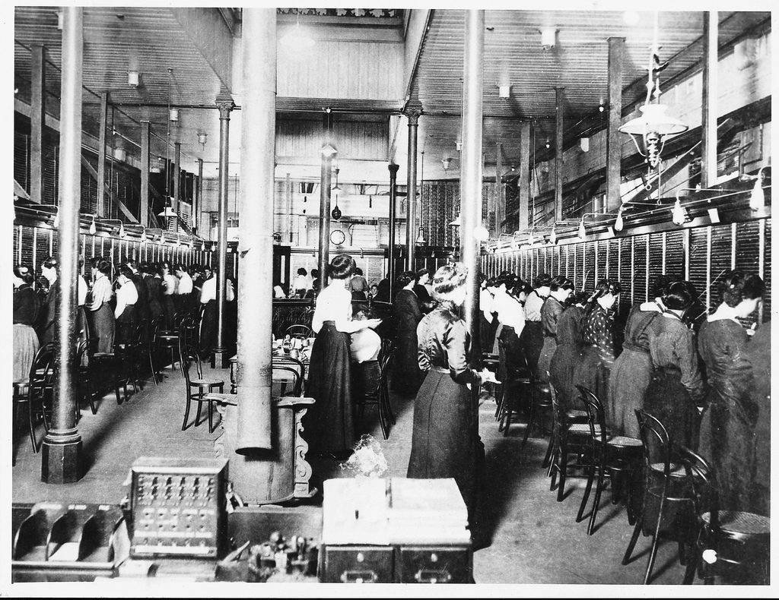
http://www.flickr.com/photos/telstra-corp/5069403309/
Notes:
Optiq is not a database... it is more like a telephone exchange. Applications can get the data they need, quickly and efficiently.

Slide 14
Conventional database architecture
JDBC client
JDBC server
SQL parser /
validator
Metadata
Query
optimizer
Data-flow
operators
Data
Data
Notes:
Conventional database has ODBC/JDBC driver, SQL parser, . Data sources. Expression tree. Expression transformation rules. Optimizer.
For NoSQL databases, the language may not be SQL, and the optimizer may be less sophisticated, but the picture is basically the same.
For frameworks, such as Hadoop, there is no planner. You end up writing code (e.g MapReduce jobs).

Slide 15
Optiq architecture
JDBC client
Optional
JDBC server
SQL parser /
validator
Metadata
SPI
Core
Query
optimizer
Pluggable
rules
Pluggable
3rd
party
ops
3rd
party
ops
3rd party
data
3rd party
data
Notes:
In Optiq, the query optimizer (we modestly call it the planner) is central.
The JDBC driver/server and SQL parser are optional; skip them if you have another language.
Plug-ins provide metadata (the schema), planner rules, and runtime operators.
There are built-in relational operators and rules, and there are built-in operators implemented in Java. But to access data, you need to provide at least one operator.

Slide 16
What is Optiq?
A really, really smart JDBC driver
Framework
Potential core of a data management system
Notes:
It needs to be said. Optiq is not a database.
It looks like a database to your applications, and that's great. But when you want to integrate data from multiple sources, in different formats, and have those systems talk to each other, it doesn't force you to copy the data around. It gets out of your way.
You configure Optiq by writing Java code. Therefore it is a framework, like Spring and, yes, like Hadoop.
Optiq masquerades as a really, really smart JDBC driver. It has a SQL parser and JDBC driver. And actually you can embed it into another data management system, with a language other than SQL.

Slide 17
Writing an adapter
Driver – if you want a vanity URL like “jdbc:splunk:”
Schema – describes what tables exist (Splunk has just one)
Table – what are the columns, and how to get the data. (Splunk's table has any column you like... just ask for it.)
Operators (optional) – non-relational operations
Rules (optional, but recommended) – improve efficiency by changing the question
Parser (optional) – to query via a language other than SQL

Slide 18

http://www.flickr.com/photos/walkercarpenter/4697637143/

Slide 19
Optiq roadmap ideas
Mondrian use Optiq to read from data sources such as Splunk & MongoDB, combine multiple data sources
Kettle integration: JDBC front-end; optimize jobs; push down filters & aggregations to data sources (e.g. SQL database)
Adapters: Cascading, MongoDB, Hbase, Apache Drill, …?
Front-ends: linq4j, Scala SLICK, Java8 streams
Contributions

Slide 20
Conclusions
Liberate your data!
Optiq is a framework
Build & share Optiq adapters

Slide 21
Questions?
@julianhyde
http://julianhyde.blogspot.com
http://github.com/julianhyde/optiq
http://github.com/julianhyde/optiq-splunk

Slide 22
Additional material: The following queries were used in the demo
select s."source", s."sourcetype" from "splunk"."splunk" as s;
select s."source", s."sourcetype", s."action" from "splunk"."splunk" as s
where s."action" = 'purchase';
select s."source", s."sourcetype", s."action" from "splunk"."splunk" as s
where s."action" = 'purchase';
select s."action", count(*)
from "splunk"."splunk" as s
group by s."action";
select s."action", s."method", count(*)
from "splunk"."splunk" as s
group by s."action", s."method";
select * from "mysql"."products";
select p."product_name", s."action"
from "splunk"."splunk" as s
join "mysql"."products" as p
on s."product_id" = p."product_id";
select p."product_name", s."action", COUNT(*) AS c
from "splunk"."splunk" AS s
join "mysql"."products" AS p
on s."product_id" = p."product_id"
where s."action" = 'purchase'
group by p."product_name", s."action"
order by c desc;

