Slide 1
Why is data independence
(still) so important?
Julian Hyde @julianhyde
http://github.com/julianhyde/optiq
http://github.com/julianhyde/optiq-splunk
Apache Drill Meeting
2012/9/13

Slide 2
Data independence
This is my opinion about data management systems in general. I don't claim that it is the right answer for Apache Drill.
I claim that a logical/physical separation can make a data management system more widely applicable, therefore more widely adopted, therefore better.
What “data independence” means in today's “big data” world.

Slide 3
About me
Julian Hyde
Database hacker (Oracle, Broadbase, SQLstream, LucidDB)
Open source hacker (Mondrian, olap4j, LucidDB, Optiq)
@julianhyde
http://github.com/julianhyde

Slide 4

http://www.flickr.com/photos/torkildr/3462606643

Slide 5
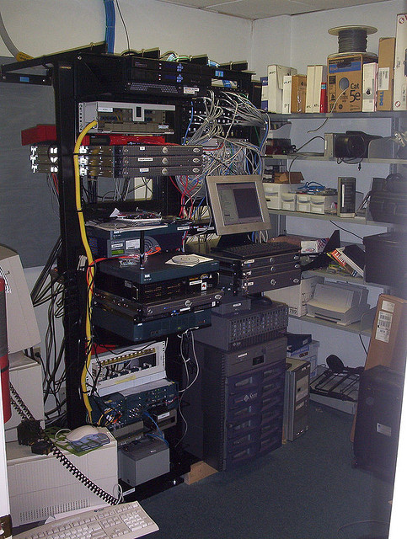
http://www.flickr.com/photos/sylvar/31436961/

Slide 6
“Big Data”
Right data, right time
Diverse data sources / Performance / Suitable format
Volume / Velocity / Variety
Volume – solved :)
Velocity – not one of Drill's goals (?)
Variety – ?
Notes:
The obligatory “big data” definition slide.
What is “big data”? It's not really about “big”. We need to access data from different parts of the organization, when we need it (which often means we don't have time to copy it), and the performance needs to be reasonable.
If the data is large, it is often larger than the disks one can fit on one machine. It helps if we can process the data in place, leveraging the CPU and memory of the machines where the data is stored. We'd rather not copy it from one system to another.
It needs to be flexible, to deal with diverse systems and formats. That often means that open source is involved.
Some systems (e.g. reporting tools) can't easily be changed to accommodate new formats. So it helps if the data can be presented in standard formats, e.g. SQL.

Slide 7
Variety
Variety of source formats (csv, avro, json, weblogs)
Variety of storage structures (indexes, projections, sort order, materialized views) now or in future
Variety of query languages (DrQL, SQL)
Combine with other data (join, union)
Embed within other systems, e.g. Hive
Source for other systems, e.g. Drill | Cascading > Teradata
Tools generate SQL

Slide 8
Use case: Optiq* at Splunk
SQL interface on NoSQL system
“Smart” JDBC driver – pushes processing down to Splunk
* Truth in advertising: I am the author of Optiq.

Slide 9
Expression tree
SELECT p.“product_name”, COUNT(*) AS c
FROM “splunk”.”splunk” AS s
JOIN “mysql”.”products” AS p
ON s.”product_id” = p.”product_id”
WHERE s.“action” = 'purchase'
GROUP BY p.”product_name”
ORDER BY c DESC
Splunk
Table: splunk
Key: product_name
Agg: count
Key: product_id
Condition:
action =
'purchase'
Key: c DESC
scan
join
MySQL
filter
group
sort
scan
Table: products
Notes:
It's much more efficient if we psuh filters and aggregations to Splunk. But the user writing SQL shouldn't have to worry about that.
This is not about processing data. This is about processing expressions. Reformulating the question.
The question is the parse tree of a query. The parse tree is a data flow. In Splunk, a data flow looks like a pipeline of Linux commands. SQL systems have pipelines too (sometimes they are dataflow trees) built up of the basic relational operators. Think of the SQL SELECT, WHERE, JOIN, GROUP BY, ORDER BY clauses.

Slide 10
Expression tree
(optimized)
SELECT p.“product_name”, COUNT(*) AS c
FROM “splunk”.”splunk” AS s
JOIN “mysql”.”products” AS p
ON s.”product_id” = p.”product_id”
WHERE s.“action” = 'purchase'
GROUP BY p.”product_name”
ORDER BY c DESC
Splunk
Table: splunk
Condition:
action =
'purchase'
Key: product_name
Agg: count
Key: c DESC
scan
filter
Key: product_id
MySQL
join
group
sort
scan
Table: products
Notes:
It's much more efficient if we psuh filters and aggregations to Splunk. But the user writing SQL shouldn't have to worry about that.
This is not about processing data. This is about processing expressions. Reformulating the question.
The question is the parse tree of a query. The parse tree is a data flow. In Splunk, a data flow looks like a pipeline of Linux commands. SQL systems have pipelines too (sometimes they are dataflow trees) built up of the basic relational operators. Think of the SQL SELECT, WHERE, JOIN, GROUP BY, ORDER BY clauses.

Slide 11
Conventional DBMS architecture
JDBC client
JDBC server
SQL parser /
validator
Metadata
Query
optimizer
Data-flow
operators
Data
Data
Notes:
Conventional database has ODBC/JDBC driver, SQL parser, . Data sources. Expression tree. Expression transformation rules. Optimizer.
For NoSQL databases, the language may not be SQL, and the optimizer may be less sophisticated, but the picture is basically the same.
For frameworks, such as Hadoop, there is no planner. You end up writing code (e.g MapReduce jobs).

Slide 12
Drill architecture
DrQL client
DrQL parser /
validator
Metadata
?
Data-flow
operators
Data
Data
Notes:
Conventional database has ODBC/JDBC driver, SQL parser, . Data sources. Expression tree. Expression transformation rules. Optimizer.
For NoSQL databases, the language may not be SQL, and the optimizer may be less sophisticated, but the picture is basically the same.
For frameworks, such as Hadoop, there is no planner. You end up writing code (e.g MapReduce jobs).

Slide 13
Optiq architecture
JDBC client
Optional
JDBC server
SQL parser /
validator
Metadata
SPI
Core
Query
optimizer
Pluggable
rules
Pluggable
3rd
party
ops
3rd
party
ops
3rd party
data
3rd party
data
Notes:
In Optiq, the query optimizer (we modestly call it the planner) is central.
The JDBC driver/server and SQL parser are optional; skip them if you have another language.
Plug-ins provide metadata (the schema), planner rules, and runtime operators.
There are built-in relational operators and rules, and there are built-in operators implemented in Java. But to access data, you need to provide at least one operator.

Slide 14
Analogy: Compiler architecture
C++
C
Fortran
front end
middle end
Optimizations
x86
ARM
Fortran
back end

Slide 15
Conclusions
Clear logical / physical separation allows a data management system to handle a wider variety of data, query languages, and packaging.
Also provides a clear interface between the sub-teams working on query language and operators.
A query optimizer allows new operators, and alternative algorithms and data structures, to be easily added to the system.

Slide 16
Extra material follows...

Slide 17
Writing an adapter
Driver – if you want a vanity URL like “jdbc:drill:”
Schema – describes what tables exist
Table – what are the columns, and how to get the data.
Operators (optional) – non-relational operators, if any
Rules (optional, but recommended) – improve efficiency by changing the question
Parser (optional) – additional source languages

