Slide 1
SQL on Big Data using Optiq
@julianhyde
Real-time Big Data Meetup
at RichRelevance
April 2013

Slide 2
What is “SQL on Big Data?”
□ “Open-source Teradata”
□ SQL generator for Map-Reduce
□ ETL (Extract-Transform Load)
□ Scalable transaction processing
□ Querying nested data sets
□ Querying documents & populating databases
□ Continuous query/streaming
(Check one or more.)

Slide 3
Revolution & counter-revolution
“Big Data” was a revolution in data management.
Lots of broken things got fixed (unlimited scale, data anywhere & any format, late schema, flexible queries).
Some useful things got broken (standard interface, data independence, central control).
“In 5 years everyone will be using Hadoop and they won't even know it.” – me, a few years ago

Slide 4
Conventional DBMS architecture
JDBC client
JDBC server
SQL parser /
validator
Metadata
Query
optimizer
Data-flow
operators
Data
Data

Slide 5
Optiq architecture
JDBC client
Optional
JDBC server
SQL parser /
validator
Metadata
SPI
Core
Query
optimizer
Pluggable
rules
Pluggable
3rd
party
ops
3rd
party
ops
3rd party
data
3rd party
data

Slide 6
Expression tree
SELECT p.product_name, COUNT(*) AS c
FROM splunk.splunk AS s
JOIN mysql.products AS p
ON s.product_id = p.product_id
WHERE s.action = 'purchase'
GROUP BY p.product_name
ORDER BY c DESC
Splunk
Table: splunk
Key: product_name
Agg: count
Key: product_id
Condition:
action =
'purchase'
Key: c DESC
scan
join
MySQL
filter
group
sort
scan
Table: products

Slide 7
Expression tree (optimized)
SELECT p.product_name, COUNT(*) AS c
FROM splunk.splunk AS s
JOIN mysql.products AS p
ON s.product_id = p.product_id
WHERE s.action = 'purchase'
GROUP BY p.product_name
ORDER BY c DESC
Splunk
Table: splunk
Condition:
action =
'purchase'
Key: product_name
Agg: count
Key: c DESC
scan
filter
Key: product_id
MySQL
join
group
sort
scan
Table: products

Slide 8
Apache Drill
“Apache Drill (incubating) is a distributed system for interactive analysis of large-scale datasets, based on Google's Dremel. Its goal is to efficiently process nested data. It is a design goal to scale to 10,000 servers or more and to be able to process petabyes of data and trillions of records in seconds.”
Data model: JSON, late-binding
Optiq:
  SQL → logical plan (current)
  Logical → physical plan (proposed)

Slide 9
Cascading Lingual
“Cascading is the de facto Java API for creating complex data processing workloads and the engine underneath Scalding, Cascalog, and others.”
Lingual uses Optiq to translate SQL onto Cascading flows
SQL is “yet another DSL” for Cascading
Just released!

Slide 10
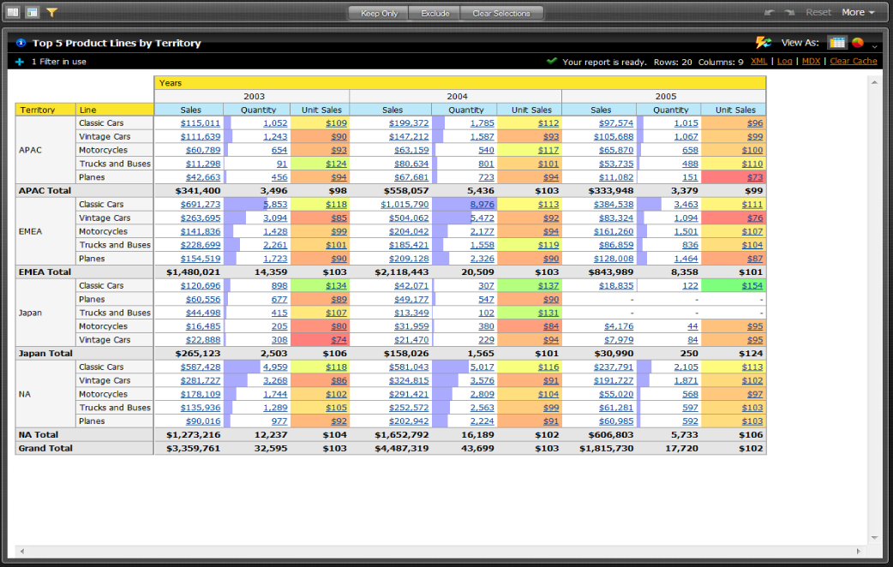
Mondrian (Pentaho Analysis)

Slide 11
Mondrian next-gen architecture
mondrian
mondrian
mondrian
Optiq provides SQL
view onto hybrid
SQL + NoSQL +
in-memory store
optiq
optiq
optiq
cache
cache
cache
data grid
In-memory tables
(query results,
planned & on-the-fly
materializations)
cache
control
cache
control
cache
control
Raw data +
summarized /
projected / sorted /
re-organized data.
Partitions.
HDFS
MongoDB
DBMS

Slide 12
Summary: Data independence
Logical & physical data models
Requires & allows query optimization
Allows you (or the system) to re-organize data
Query federation, data movement, caching
SQL interface for humans & machines
Optiq lets you add rules to optimize better

Slide 13
Thank you!
@julianhyde
optiq https://github.com/julianhyde/optiq
drill http://incubator.apache.org/drill/
lingual http://www.cascading.org/lingual/
mondrian http://mondrian.pentaho.com
slides https://github.com/julianhyde/share/tree/master/slides

