Slide 1

Mondriaan update
Pentaho community meetup
Amsterdam
September 2012
@julianhyde

Slide 2
Agenda
Mondrian 4 – beta
Other new stuff
(Yahoo)

Slide 3
Mondrian 4 – What's new?
Attributes
Measure groups
Physical schema
Internals

Slide 4
Richer semantic model
Physical schema:
Only define attributes and relationships once
Compound keys
Attribute hierarchies
Hierarchies & attributes grouped into dimensions
E.g. Customers dimension contains Customer hierarchy (State-City-Customer) and Age, Gender, Salary attribute hierarchies

Slide 5
Measure groups
In Mondrian 3.x, if you want a cube with multiple fact tables, you build a virtual cube:
<Cube name=“Sales”>
<Table name=“sales_fact”/>
</Cube>
<Cube name=“Warehouse”>
<Table name=“warehouse_fact”/>
</Cube>
<VirtualCube name=“Warehouse and Sales”>
<Cube name=“Sales”/>
<Cube name=“Warehouse”/>
</VirtualCube>

Slide 6
Measure groups (2)
In Mondrian 4, cubes can contain multiple measure groups
Virtual cubes are obsolete
Many-to-many association between measure groups and dimensions
Different ways to link dimensions to
fact tables
Aggregate tables are measure groups
<Cube name=“Warehouse and Sales”>
<MeasureGroups>
<MeasureGroup name=“Sales”>
<Table name=“sales_fact”/>
<Measure name=“unit_sales”/>
</MeasureGroup>
<MeasureGroup name=“Warehouse”>
<Table name=“warehousee_fact”/>
<Measure name=“inventory_units”/>
</MeasureGroup>
</MeasureGroups>
</Cube>
 | Sales | Warehouse
Time | X | X
Product | X | X
Customer | X
Warehouse |  | X

Slide 7


Slide 8
Gone / Replacements
Mondrian 3 schema | Mondrian 4 Schema Schema upgrader
Aggregate recognizer | Aggregate table API (define / enable / disable)
Schema workbench | Pentaho modeler?
XMLA server | olap4j-xmlaserver @github
Hierarchy syntax [Time.Weekly].[Day] [Time].[Month] | SSAS-style syntax [Time].[Weekly].[Day] [Time].[Time].[Month]

Slide 9
Done / Remaining
The important things work! | Ragged hierarchies
Schema converter | Analyzer upgrade
2511 of 2770 tests pass | Aggregate table API
 | Complex schema mappings

Slide 10
Beta
1. Download from CI
http://ci.pentaho.com/view/Analysis/job/mondrian-git-4.0/
2. Run Mondrian-4 on your current schema
Auto-upgrade
Schema converter tool TBA
MDX syntax differences
  mondrian.olap.SsasCompatibleNaming=true
3. Write a new-style schema
4. Log bugs!

Slide 11
Futures

Slide 12


Slide 13
“Mondrian in Action” book
Publish date: Spring 2013
Join the early-access program: http://www.manning.com/back/

Slide 14
Future features
Shelved aggregate tables
Connections
Defined in schema
Multiple connections
Non-JDBC databases
Advanced SQL generation

Slide 15
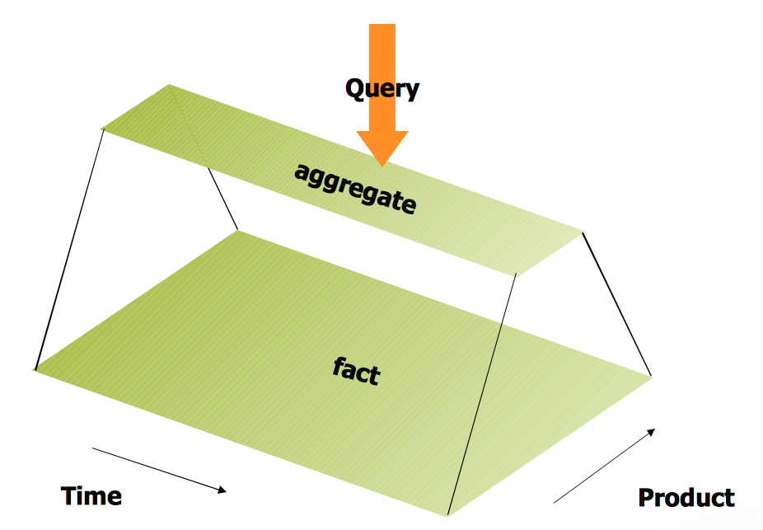
Regular aggregate table

Slide 16
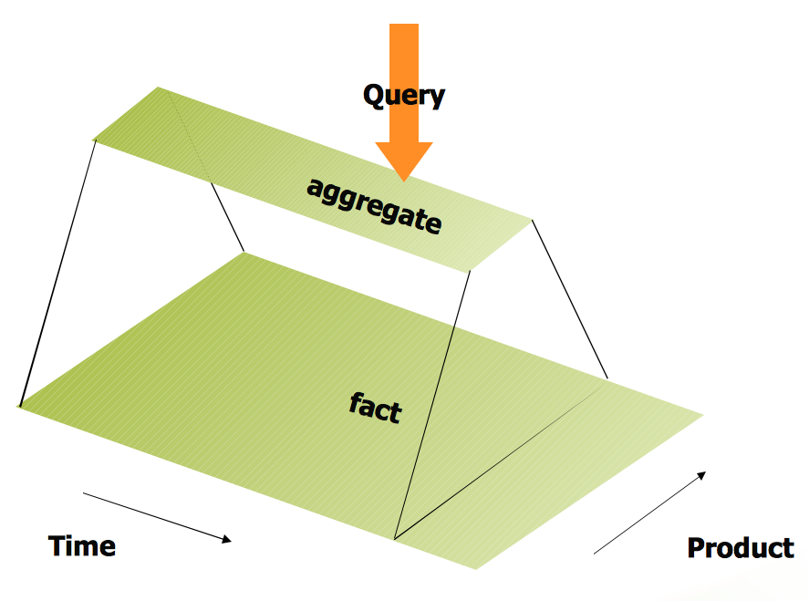
Shelved aggregate table

Slide 17
Aggregate table API – some ideas
Define
Enable
Disable
Specify beginning/end of valid range
Kettle can tell Mondrian that aggregate table is no longer valid
Kettle can ask Mondrian to tell it when it has finished using an aggregate table

Slide 18
Multiple connections in schema
<Schema name='FoodMart'>
<Connections>
<Connection name='default' default='true' uuid='abcd-1234'>
<Jdbc>jdbc:mysql://localhost/foodmart?characterEncoding=latin1&lt;/Jdbc>
<JdbcUser>foodmart</JdbcUser>
<JdbcPassword>foodmart</JdbcPassword>
</Connection>
<Connection name='aggs' default='false' uuid='abcd-2345'>
<Jdbc>jdbc:mysql://localhost/foodmartAggs?characterEncoding=latin1</Jdbc>
<JdbcUser>foodmartAggs</JdbcUser>
<Properties>
<Property name='prop1'>value1</Property>
<Property name='prop2'>value2</Property>
</Properties>
</Connection>
</Connections>
Cannot join tables from different connections
Also: non-JDBC connection (via SPI or Optiq)

Slide 19
Advanced SQL generation
Access control
Killing big IN lists
Push down aggregates (esp. time ranges)
Need a new strategy... TBD

Slide 20
Summary
Mondrian 4 – A major improvement to Mondrian model & engine
As compatible as possible
Will enable further improvements in performance / flexibility in upcoming releases
Help us test it, and get it to production quality faster

Slide 21

Questions?
@julianhyde
jhyde@pentaho.com
http://julianhyde.blogspot.com
https://github.com/julianhyde/

