Slide 1

Lowering hospital bills with technology
Julian Kanaan (julian.kanaan@nyu.edu)
Spring ‘19

Slide 2
Opportunity
Millions of Americans visit ERs and hospitals every year
These bills are massive and often contain errors and overcharges ¹
Procedure code errors
Above-market rates
Status-quo: Americans either negotiate with the facility themselves, alongside insurance, or hire a lawyer ²
Notes:
https://www.vox.com/health-care/2017/12/4/16679686/emergency-room-facility-fee-monopolies
https://www.wikihow.com/Reduce-Emergency-Room-Bills

Slide 3
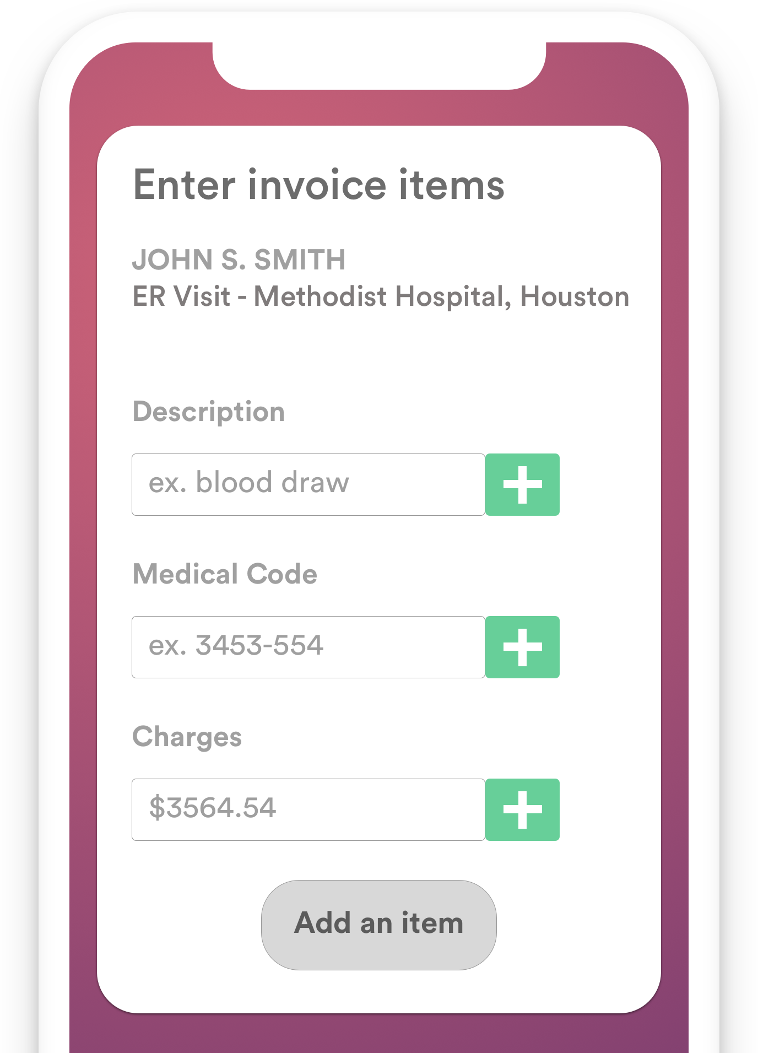
Solution
Reductible checks user-entered invoice info for common errors, comparing to a database of correct information & market prices for medications / procedures.
The system then catches errors and potential overcharges.

Slide 4
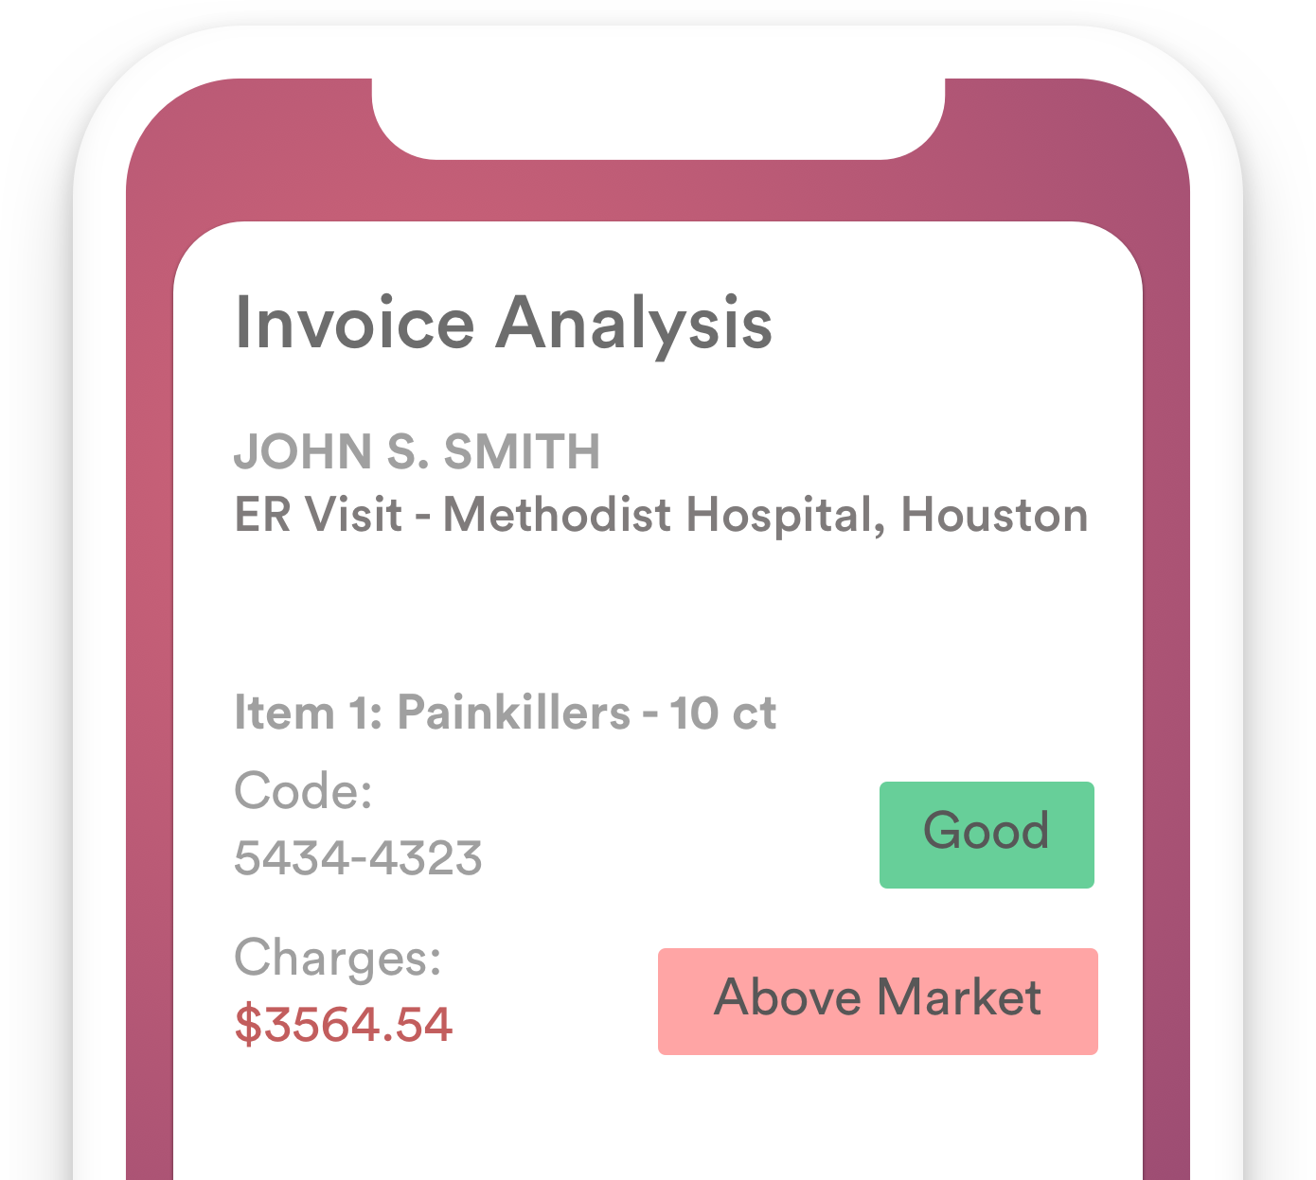
Market Size
141M ER visits per year (US)^{1,2}
$10 per invoice*
~1.4B market
*uncertain pricing structure
Notes:
https://money.cnn.com/2018/03/19/news/economy/emergency-room-er-bills/index.html
https://www.vox.com/health-care/2017/12/4/16679686/emergency-room-facility-fee-monopolies

Slide 5
Feasibility & Next Steps
Some full-stack web development experience, ex-founder, PE analyst
No marketing experience
Main pain-point:
Building the database of reference information
Drug pricing websites exist by region (ie. goodrx.com)
Medical codes & common prices?
Julian Kanaan (julian.kanaan@nyu.edu)
Spring ‘19

