Slide 1
Feature Extraction
Medical Image Analysis Lab
By
Julian Lehmann, Pablo Rodriguez, Marcel Allenspach

Slide 2
Hypothesis
" A combination of multiple features increases the robustness of the segmentation of brain MRI images with a random forest classifier"

Slide 3
Approach
Find most important feature of pipeline
Find / implement new features
Evaluation of robustness of the pipeline with new feature

Slide 4
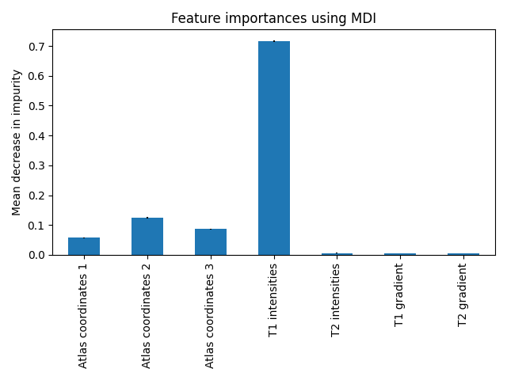
Progress
?Boxplot?

Slide 5
Challenges
Different combination of different feature
Dependencies between features

Slide 6
Insights

