Slide 1
Sudo-random: A rule-based mario level generator
Glen Takahashi & Gillian Smith
CIG 2010 Mario AI Level Generation Competition
glen.takahashi@gmail.com
gsmith@soe.ucsc.edu

Slide 2
Adaptation
Receives and categorizes data from playerMetrics
Calculates probabilities for level generation based off of data
Examples:
Player likes jumping → high probability for blocks and gaps
Player dies often → fewer enemies
Player collects coins → more coins and possibly high density coin zone

Slide 3
Adaptation (cont’d)
Categorizes players by skill, patience, and interests based off of informal experimental testing
Examples:
Player never dies and kills enemies → more difficult level, with more enemies, and a dead end
Player mostly cares about collecting things → more casual level with fewer enemies but lots of blocks and coins
Implements given constraints and calculated probabilities to generate level

Slide 4
Level Generation
Builds world in a “block-by-block” manner
Each block contains
A piece of ground or gap of specified length
Blocks, coins, enemies, pipes, or hills
Generates next block by using probabilities and info about previous block
Sometimes adds special zones which replace blocks based off player categorization
Examples:
Fire zone, shell zone, dead end, secret area, etc.

Slide 5
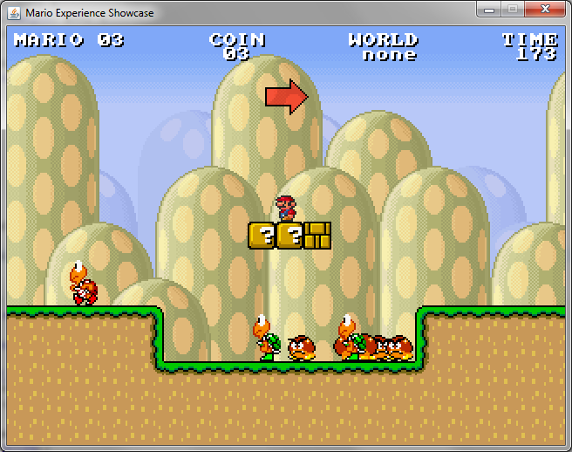
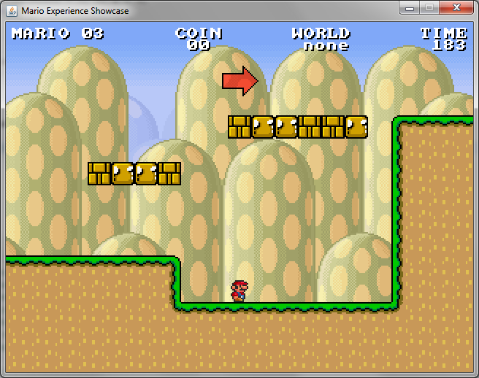
Special Zones
Shell zone
Provides fun area to kill many enemies at once with a shell
Dead end
Only passable by using series of blocks
Adds fun challenge

Slide 6
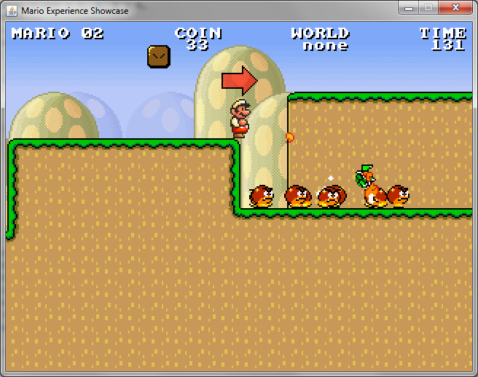
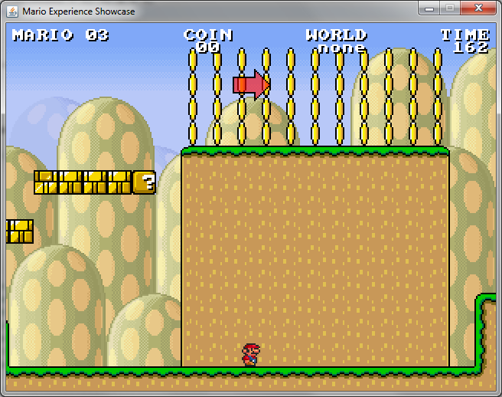
Special Zones (cont’d)
Fire zone
Allows player to use fireballs to kill lots of enemies
Secret Area
Easily accidentally avoided
Provides many coins and excitement for players

