Slide 1

Data access and analysis of Metop-A/B/C Level 3 trace gas products relevant for fires
Julian Meyer-Arnek (DLR)

Slide 2

Overview
Wild fires are a global problem with massive effects on local, regional and global air quality.
Major wild fires are visible from space:
Not only by visual instruments such as Sentinel-2,
but also by atmosphere-sensing spectral missions (Metop-C).
This presentation focuses on the 2025-wildfires on the Iberian Peninsula and focuses on
  Getting and accessing atmosphere data (discovery and access),
  Perform data analysis
using Jupyter Notebooks.

Slide 3



Let’s dive into it.
These layers are touched...
Science (Wild Fires / Air Chemistry)
Slido.com: 2601092
Trace Gas Retrieval
from Space
Data Access and Management
Jupyter Notebook

Slide 4
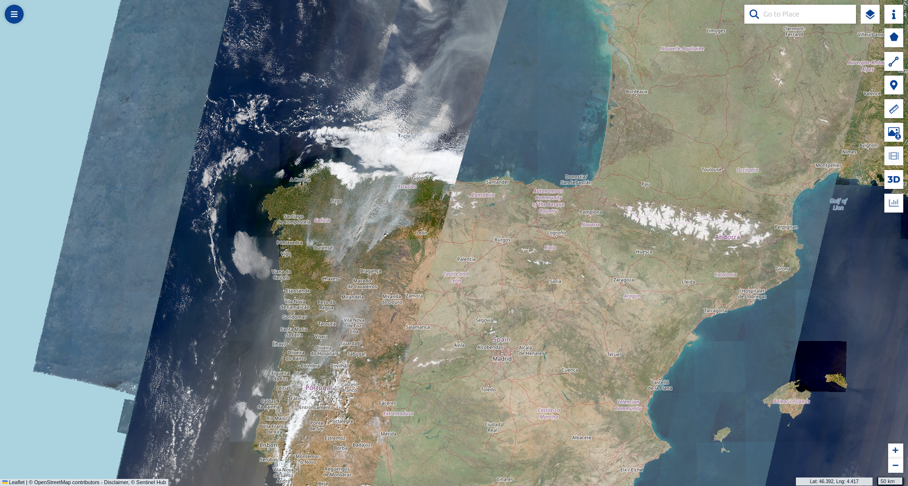
Focusing Wildfires on the Iberian Peninsula
Copernicus Data Space, Sentinel 2, 16.08.2025

Slide 5
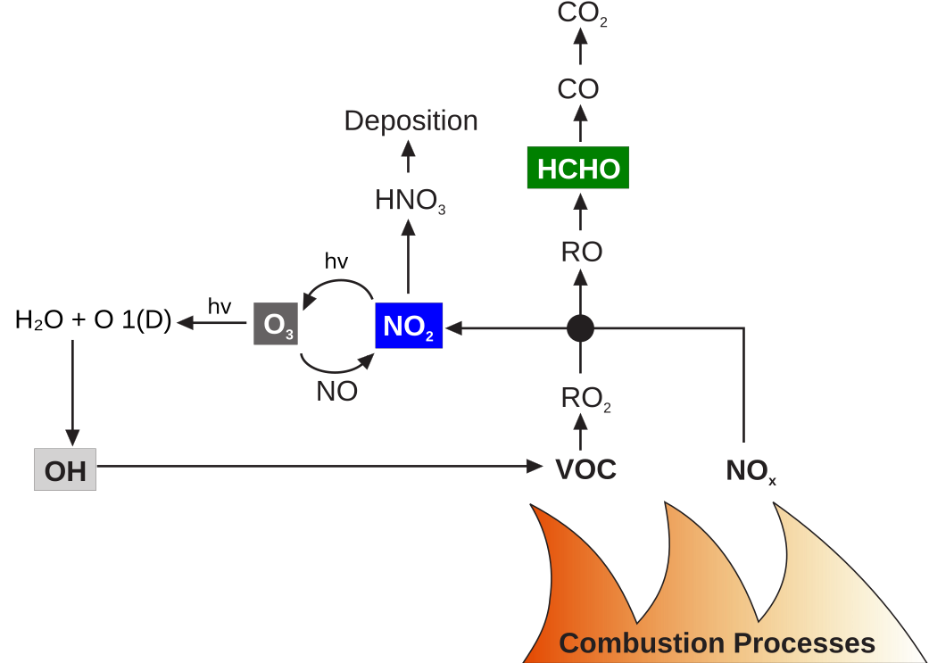

Slide 6
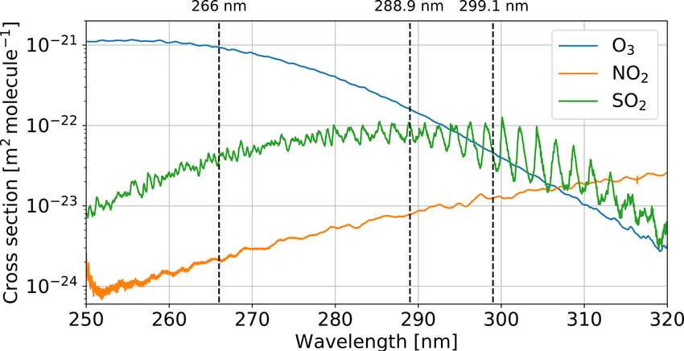
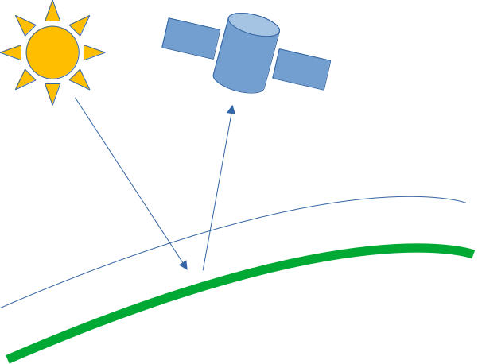
How to retrieve trace gas amounts

Slide 7
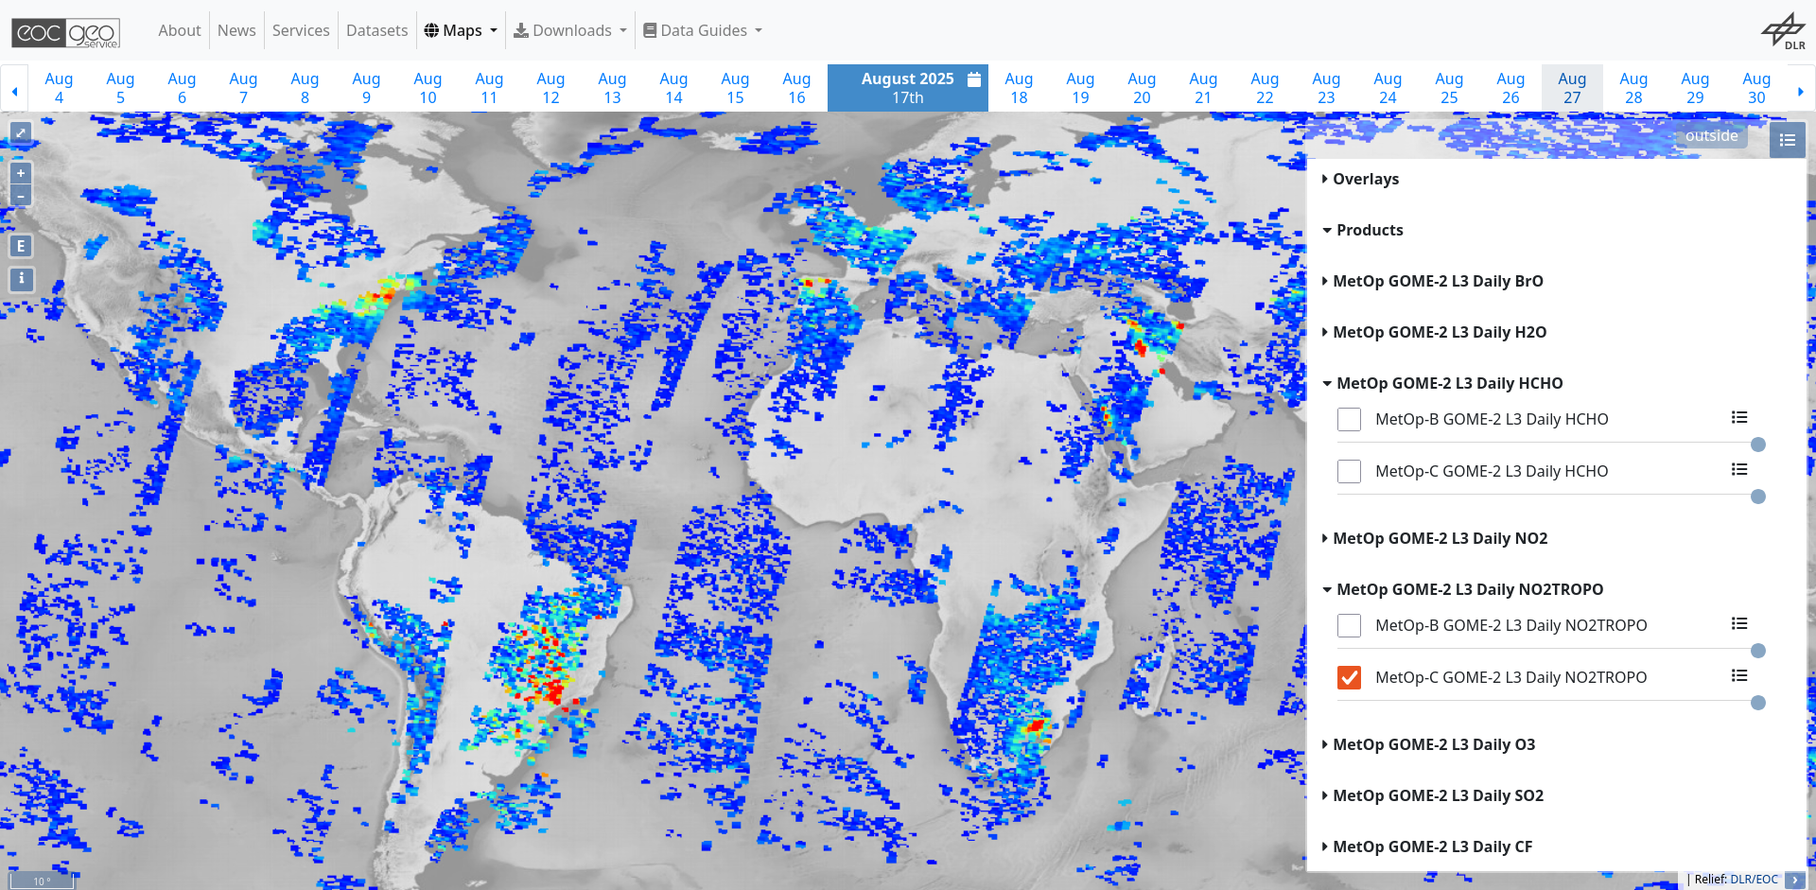
https://geoservice.dlr.de/web/maps/metop:gome2:l3:daily

Slide 8
https://geoservice.dlr.de/web/maps/metop:gome2:l3:daily

Slide 9
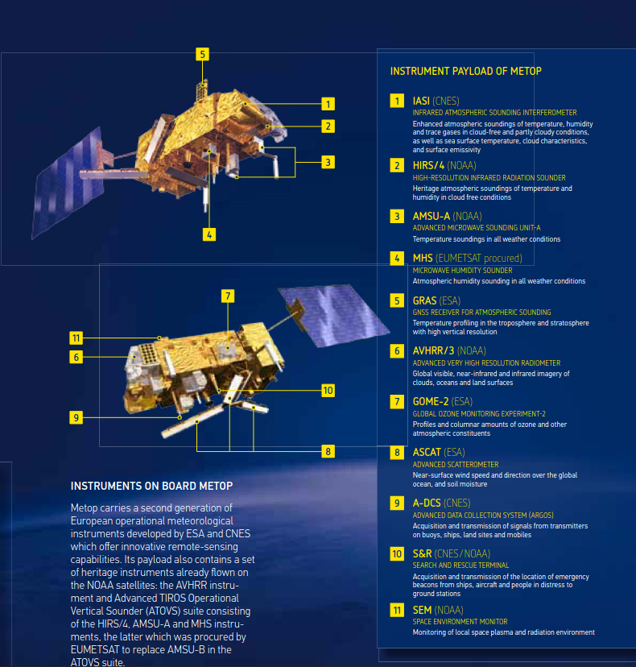
Metop – Satellites:
Orbit:
sun-synchronous polar orbit,
morning orbit 09:30 local time descending node
Inclination: 98.7° to the Equator
Altitude: 800 - 850 km
GOME-2: 40 x 80 km² pixel size
Long Time Series: 3 Satellites
Metop-A, Metop-B, Metop-C 2007 - 2032
Source: EUMETSAT, https://www.eumetsat.int/media/15002

Slide 10

Let’s dive into it.
These layers are touched...
Science (Wild Fires / Air Chemistry)
Data Access and Management
Slido.com: 4089103
Jupyter Notebooks
Jupyter Notebook

Slide 11
Jupyter Notebook
Development environment for Python, R, Rust, …
Linux: Start by typing „jupyter-lab“ in your terminal
Jupyter Lab may run locally on your desktop.

Slide 12
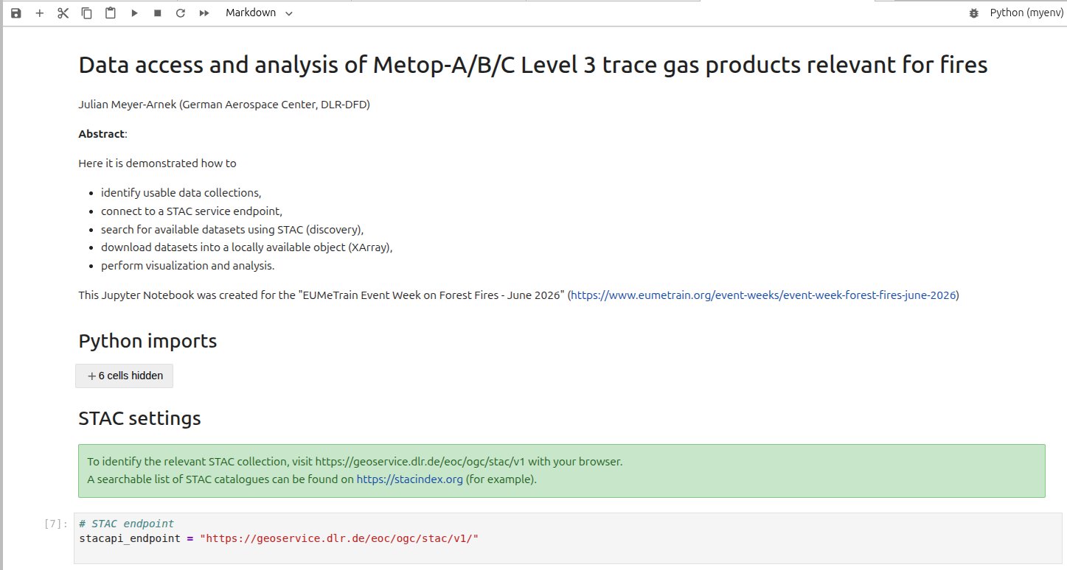

Slide 13

Let’s dive into it.
These layers are touched...
Science (Wild Fires / Air Chemistry)
Data Access and Management
Slido.com: 3525232
STAC
Jupyter Notebook

Slide 14
STAC – SpatioTemporal Asset Catalog
Metadata
Data
Collection
  Items
    Asset 1
    Asset 2
    Asset 3

Slide 15
STAC – SpatioTemporal Asset Catalog
Metadata
Data
Collection
  Items
    Asset 1
    Asset 2
    Asset 3
NetCDF dataset
GeoTIFF dataset
(Cloud optimized)
Auxilliary dataset(s)
1. Discover STAC Items

Slide 16
STAC – SpatioTemporal Asset Catalog
Metadata
Data
Collection
  Items
    Asset 1
    Asset 2
    Asset 3
NetCDF dataset
GeoTIFF dataset
(Cloud optimized)
Auxilliary dataset(s)
1. Discover STAC Items

Slide 17
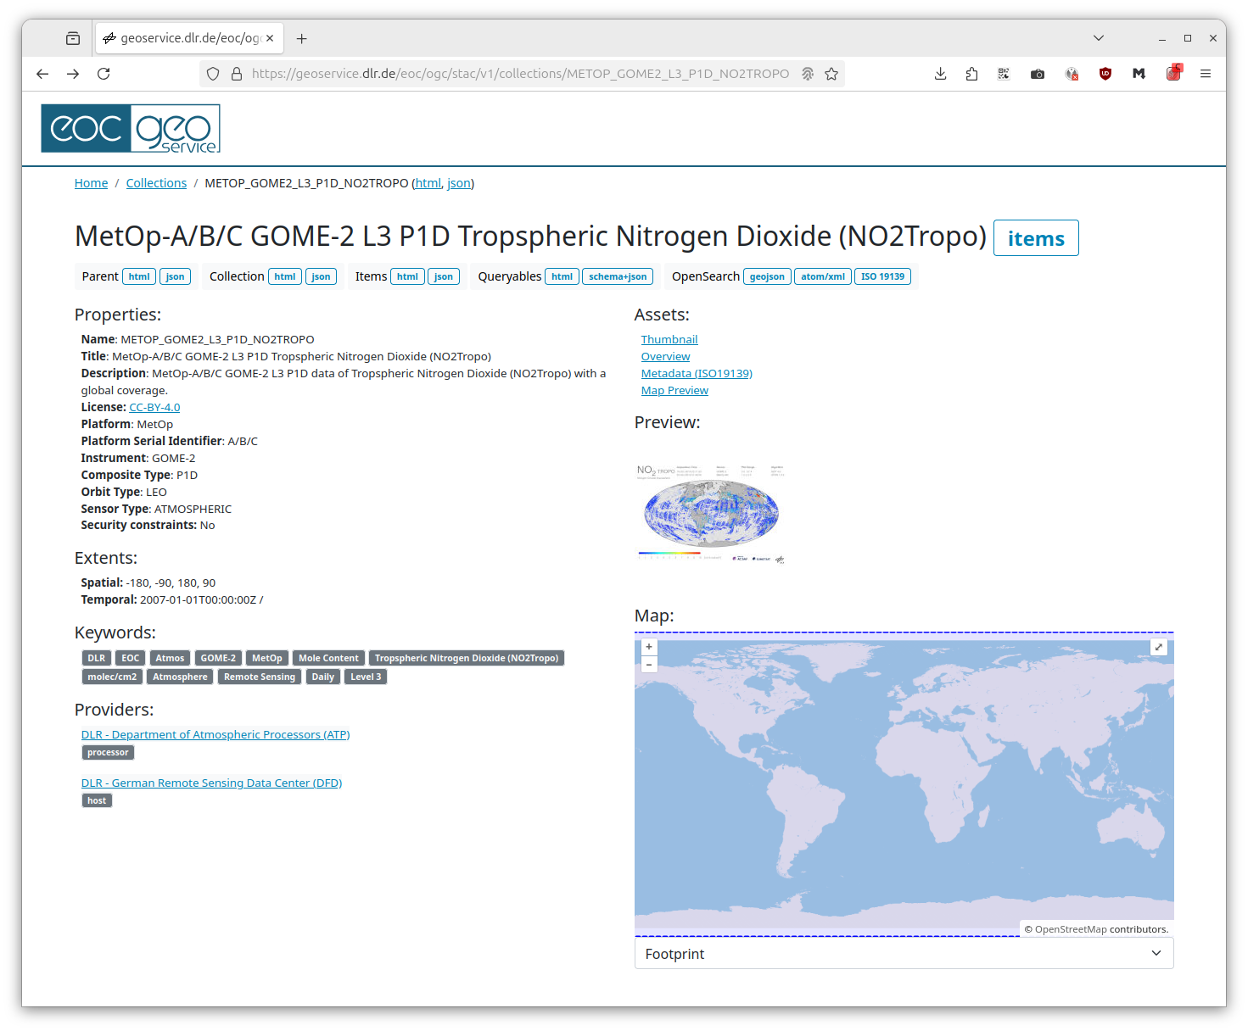
STAC – SpatioTemporal Asset Catalog
Metadata
Data
Collection
  Items
    Asset 1
    Asset 2
    Asset 3
NetCDF dataset
GeoTIFF dataset
(Cloud optimized)
Auxilliary dataset(s)
1. Discover STAC Items

Slide 18
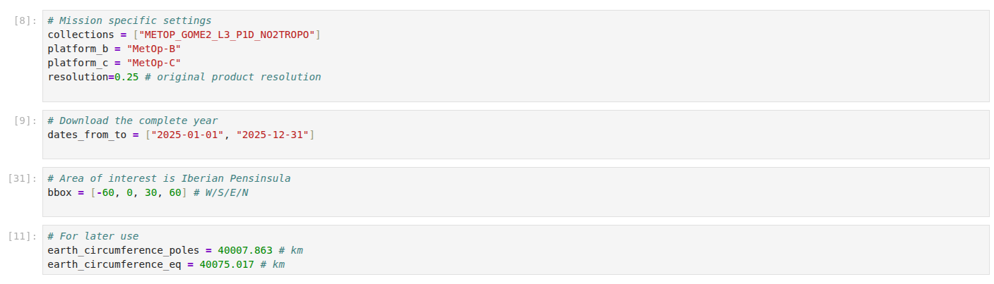
STAC – SpatioTemporal Asset Catalog
Metadata
Data
Collection
  Items
    Asset 1
    Asset 2
    Asset 3
NetCDF dataset
GeoTIFF dataset
(Cloud optimized)
Auxilliary dataset(s)
1. Discover STAC Items

Slide 19
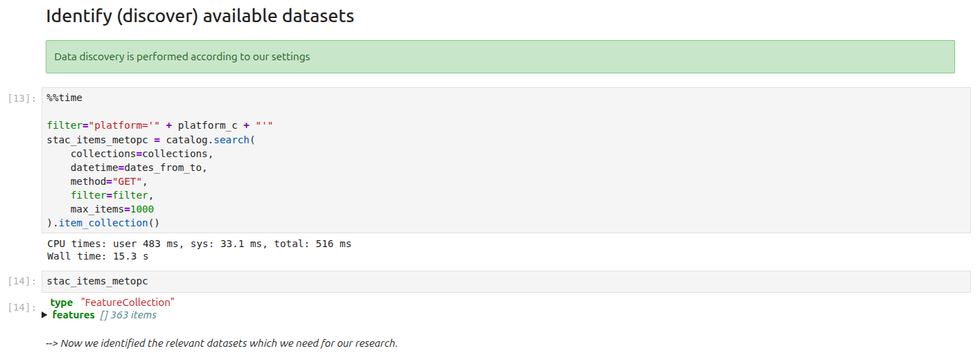
STAC – SpatioTemporal Asset Catalog
Metadata
Data
Collection
  Items
    Asset 1
    Asset 2
    Asset 3
NetCDF dataset
GeoTIFF dataset
(Cloud optimized)
Auxilliary dataset(s)
1. Discover STAC Items

Slide 20
STAC – SpatioTemporal Asset Catalog
Metadata
Data
Collection
  Items
    Asset 1
    Asset 2
    Asset 3
NetCDF dataset
GeoTIFF dataset
(Cloud optimized)
Auxilliary dataset(s)
1. Discover STAC Items
2. Download corresponding data into local data cube

Slide 21
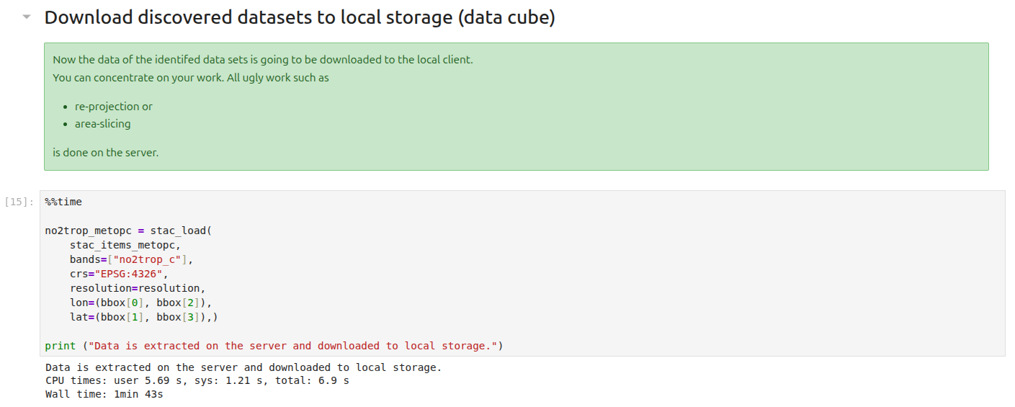
STAC – SpatioTemporal Asset Catalog
Metadata
Data
Collection
  Items
    Asset 1
    Asset 2
    Asset 3
NetCDF dataset
GeoTIFF dataset
(Cloud optimized)
Auxilliary dataset(s)
1. Discover STAC Items
2. Download corresponding data into local data cube

Slide 22
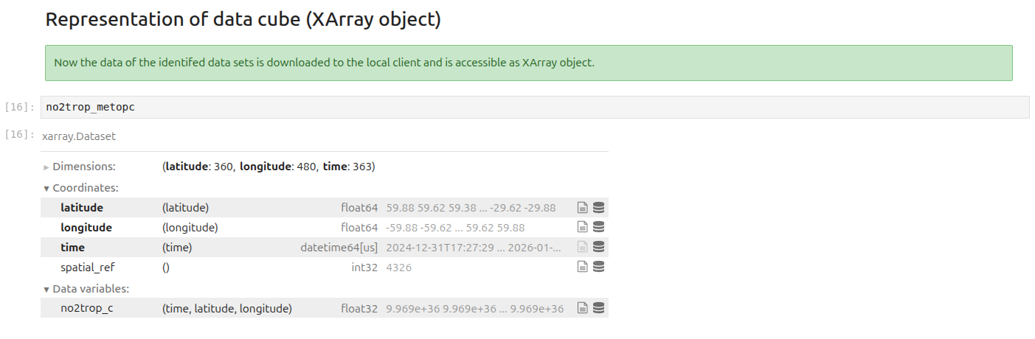
STAC – SpatioTemporal Asset Catalog
Collection
  Items
    Asset 1
    Asset 2
    Asset 3
NetCDF dataset
GeoTIFF dataset
(Cloud optimized)
Auxilliary dataset(s)
1. Discover STAC Items
2. Download corresponding data into local data cube

Slide 23
STAC – SpatioTemporal Asset Catalog
Collection
  Items
    Asset 1
    Asset 2
    Asset 3
NetCDF dataset
GeoTIFF dataset
(Cloud optimized)
Auxilliary dataset(s)
1. Discover STAC Items
2. Download corresponding data into local data cube
3. Analyze data

Slide 24
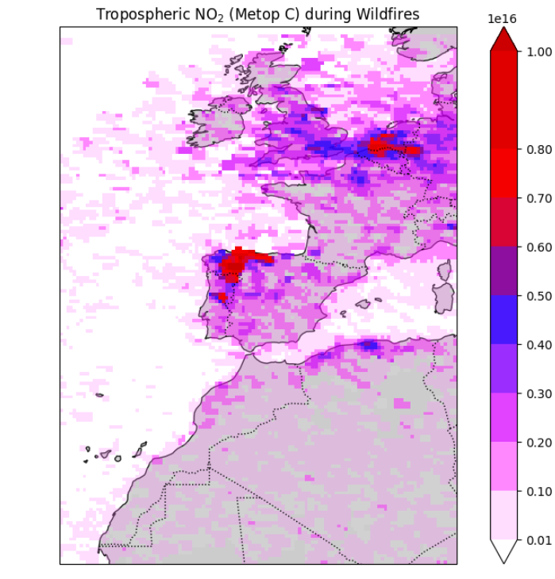
molecules/cm²

Slide 25
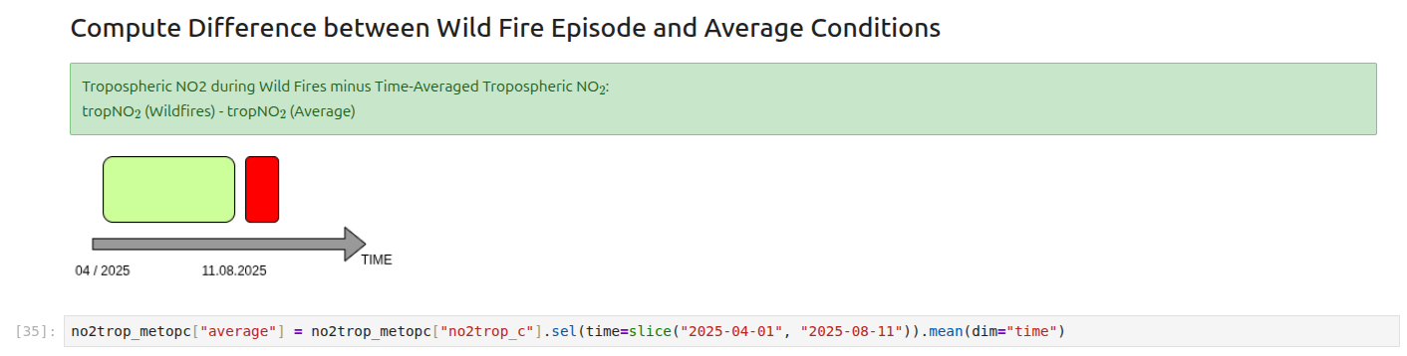

Slide 26
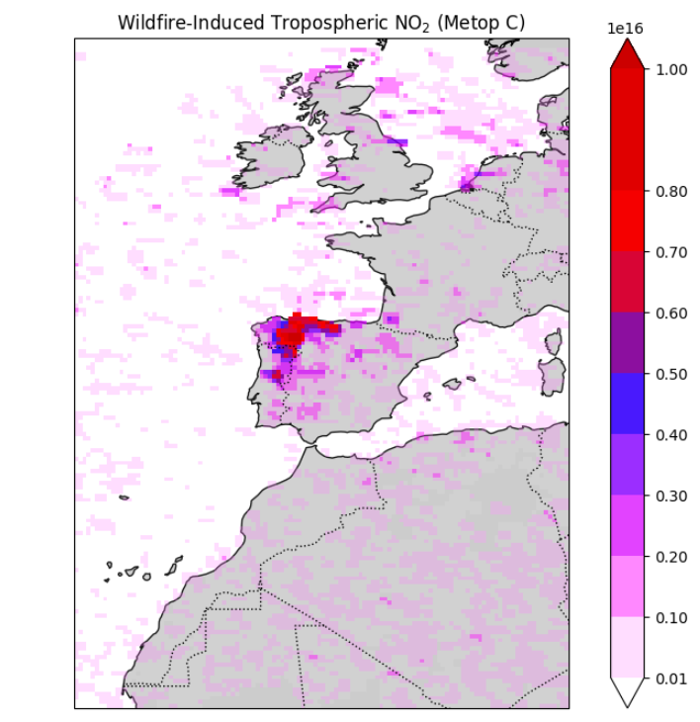

Slide 27
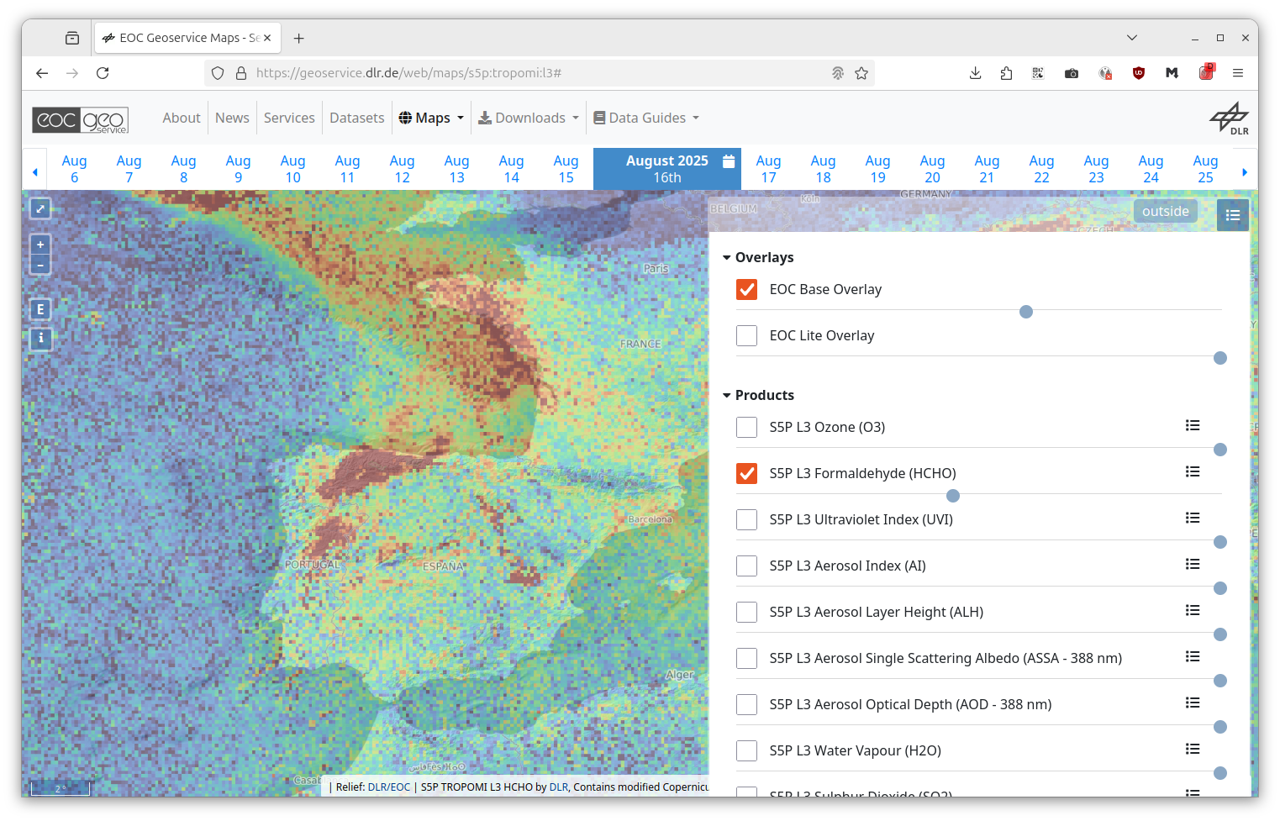
Sentinel 5P
Spatial Resolution: 3.5 x 7 km²
Temporal Resolution Level 3: 1 day
Currently the best available polar orbiting trace gas observing instrument.
Products are also accessible via STAC at EOC Geoservice.

Slide 28
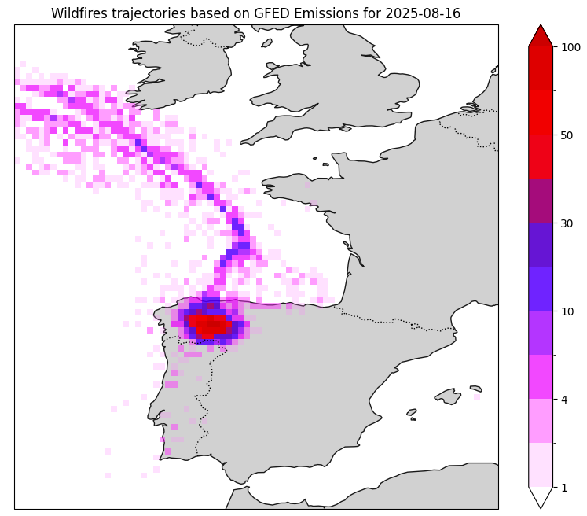

Slide 29

We are finished.
These layers were touched.
Science (Wild Fires / Air Chemistry)
Data Access and Management
Slido.com: 1502593
Did you like it?
Jupyter Notebook

Slide 30
Impressum
Topic: Data access and analysis of Metop-A/B/C Level 3 trace gas products relevant for fires
Date: 2026-06-03
Author: Julian.Meyer-Arnek@DLR.de
Institute: DFD
Credits: All images „DLR (CC BY-NC-ND 3.0)“,
if not stated differently

Slide 31
Get the Notebook
Topic: https://www.meyer-arnek.de

