Slide 1
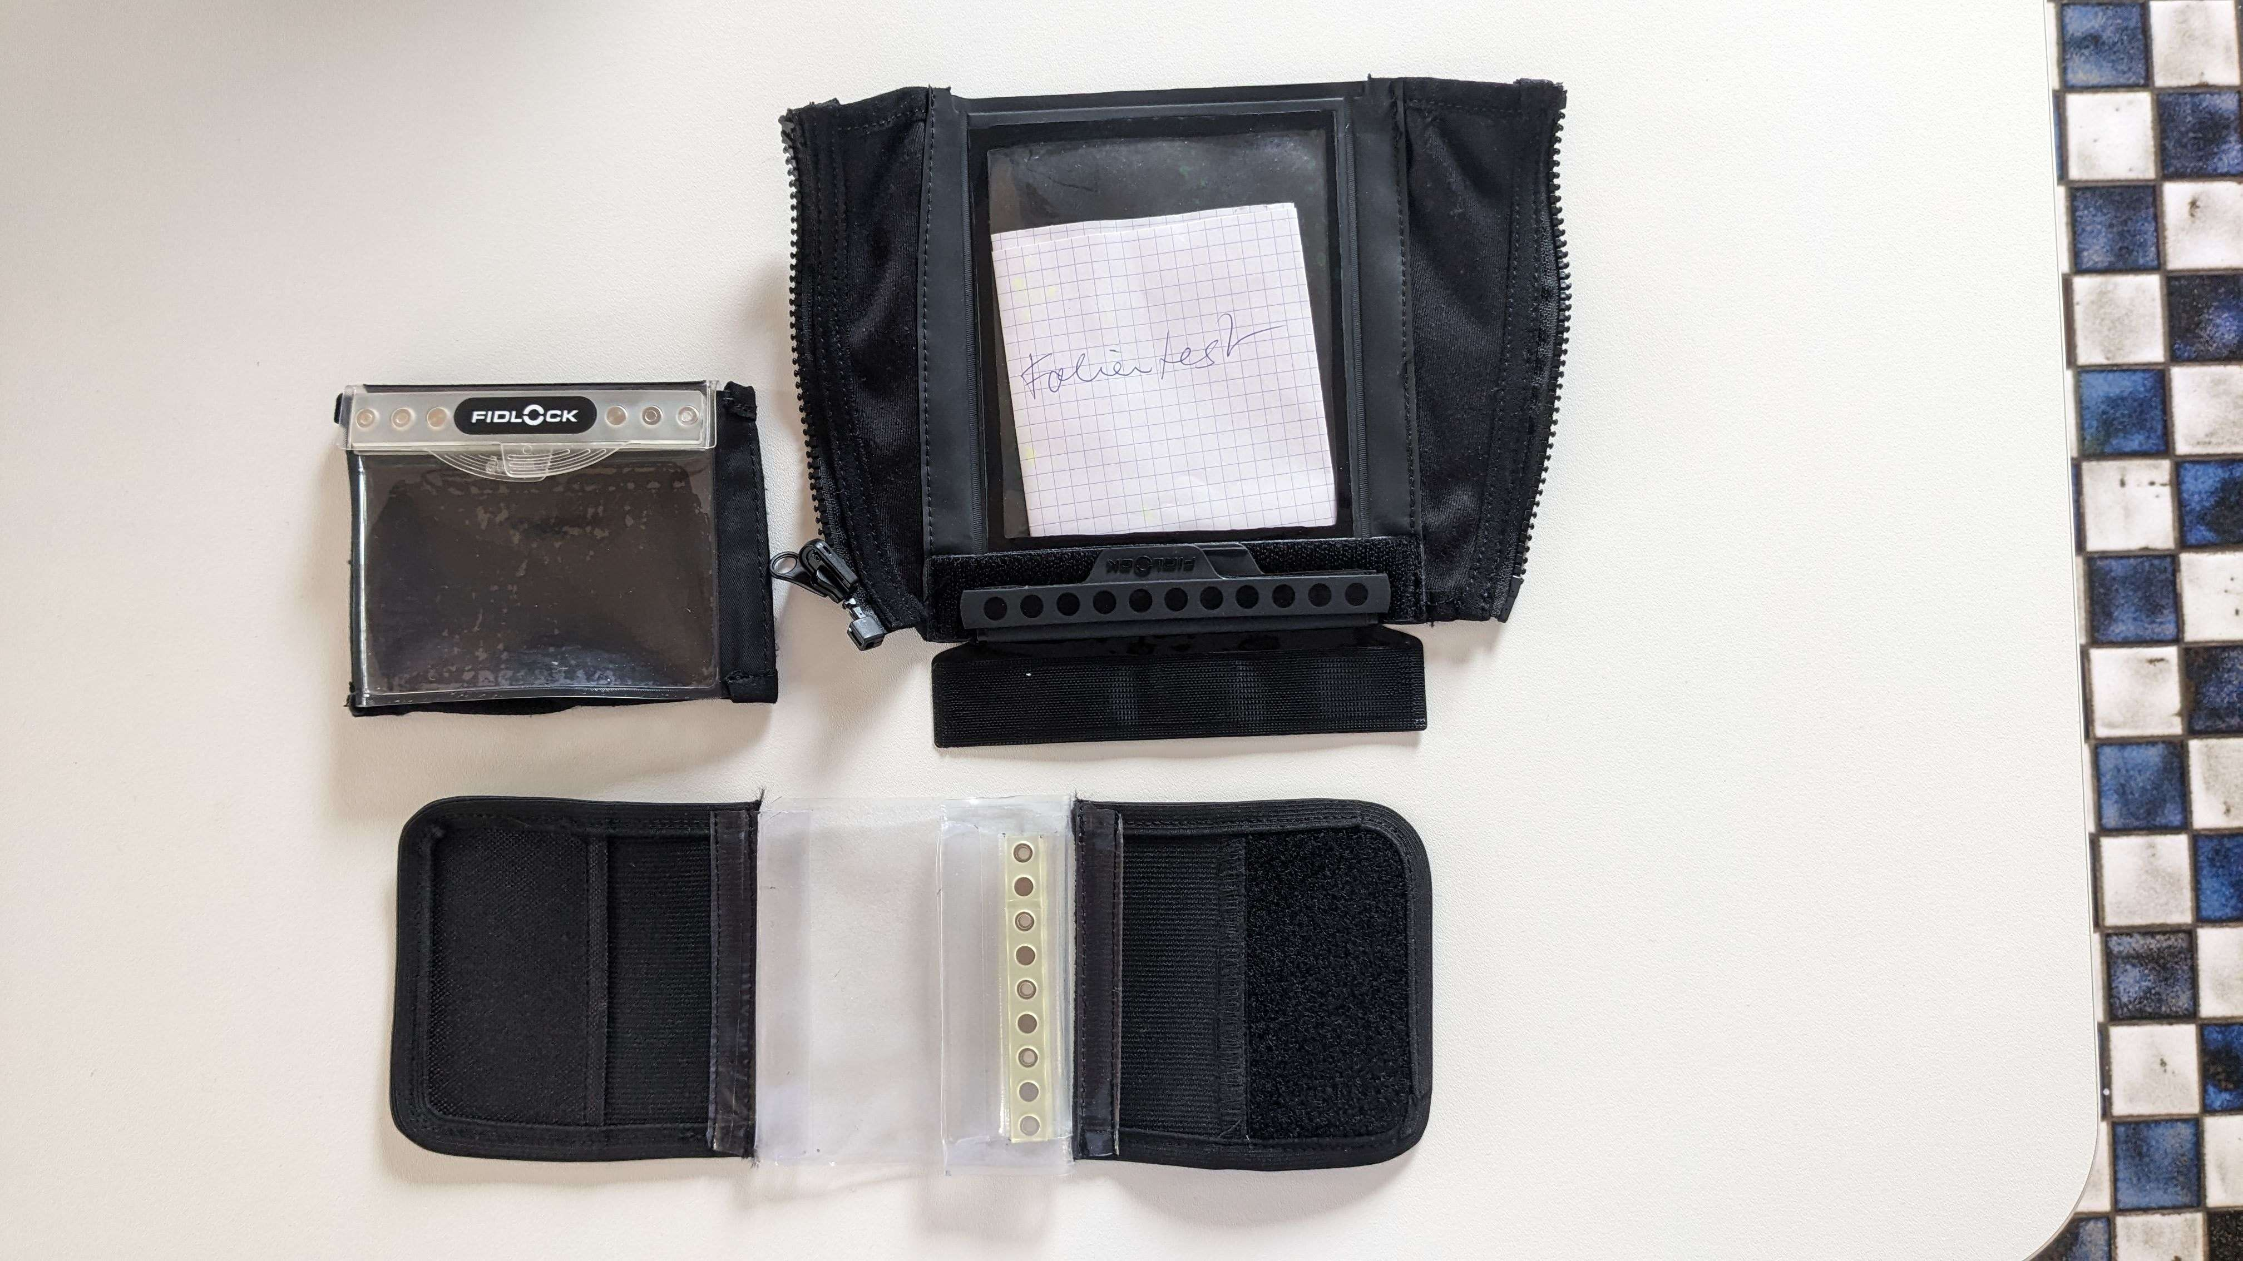
Tests für wasserdichte Tasche
22.03.2024, München, Tests im Garten um 10:00 Lokalzeit.

Slide 2
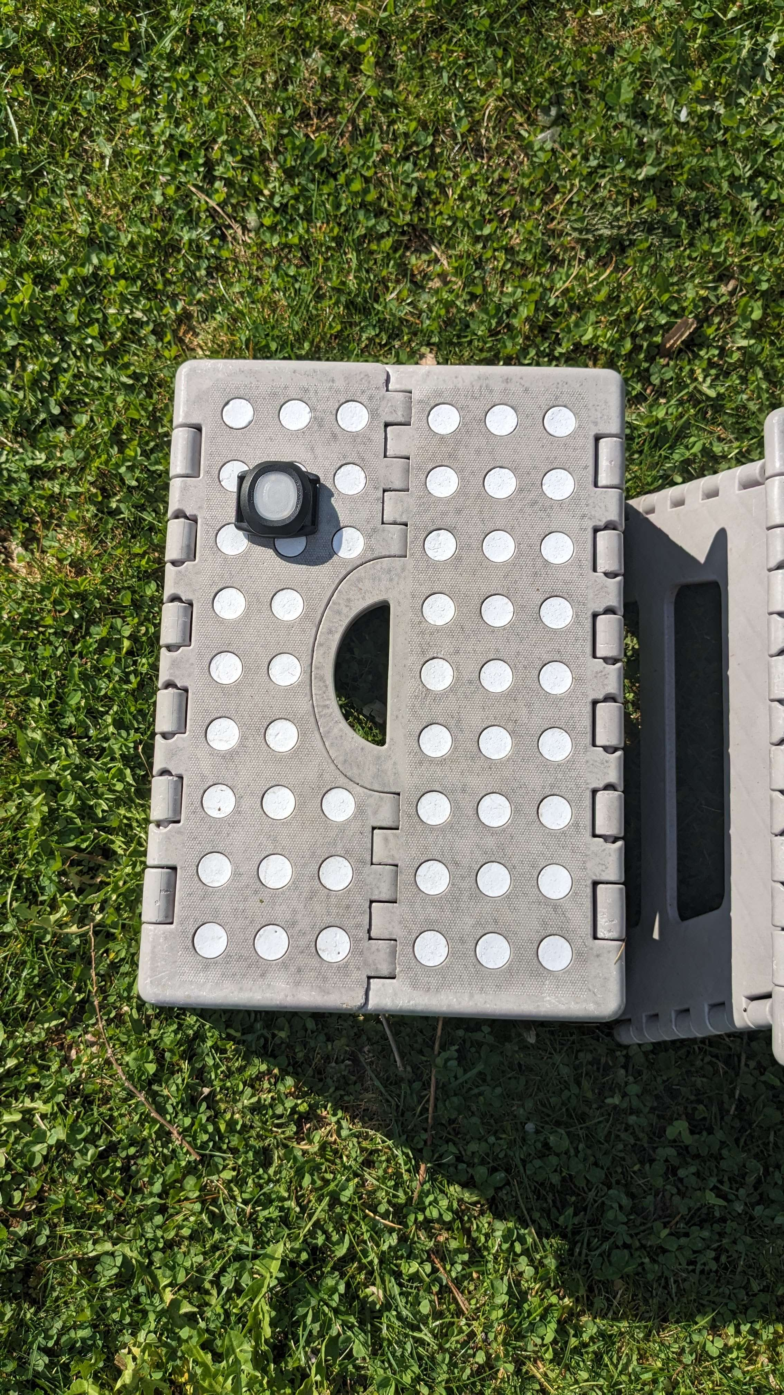
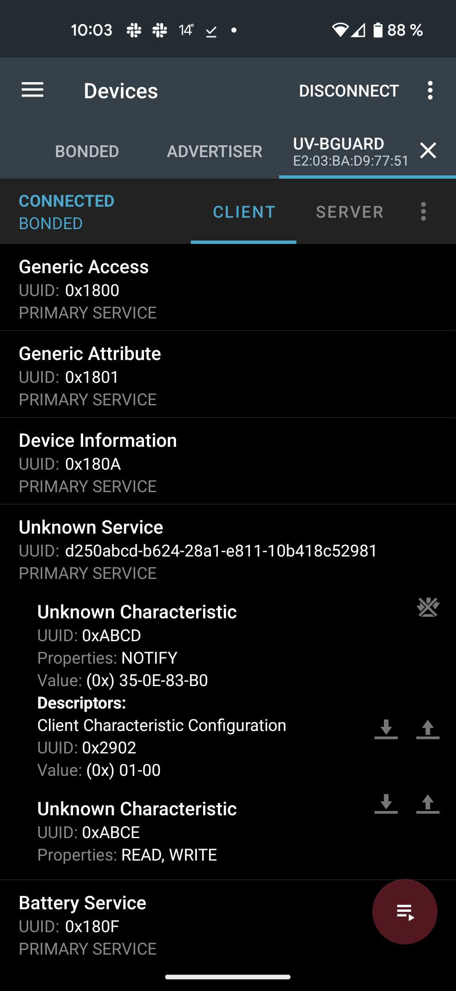
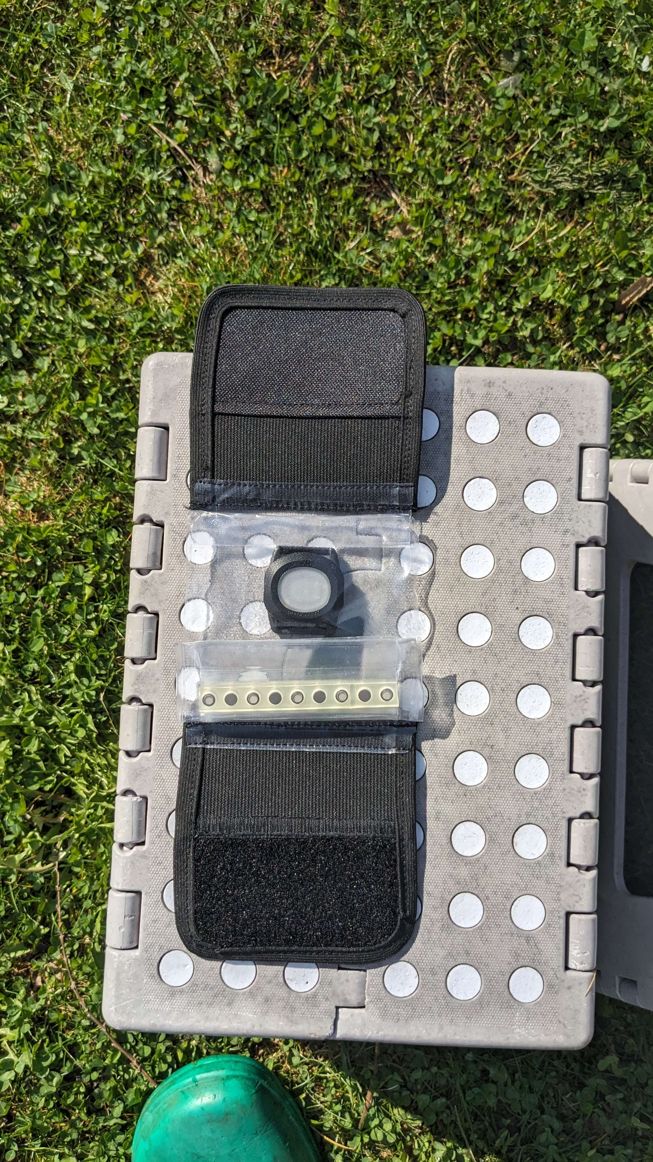

Baseline:
35 0E
= 3637
Materialtest:
C9 03
=969

Slide 3
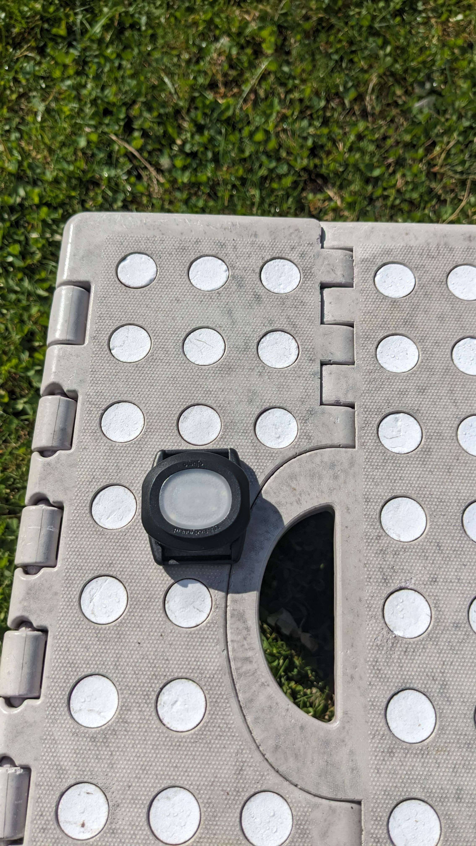

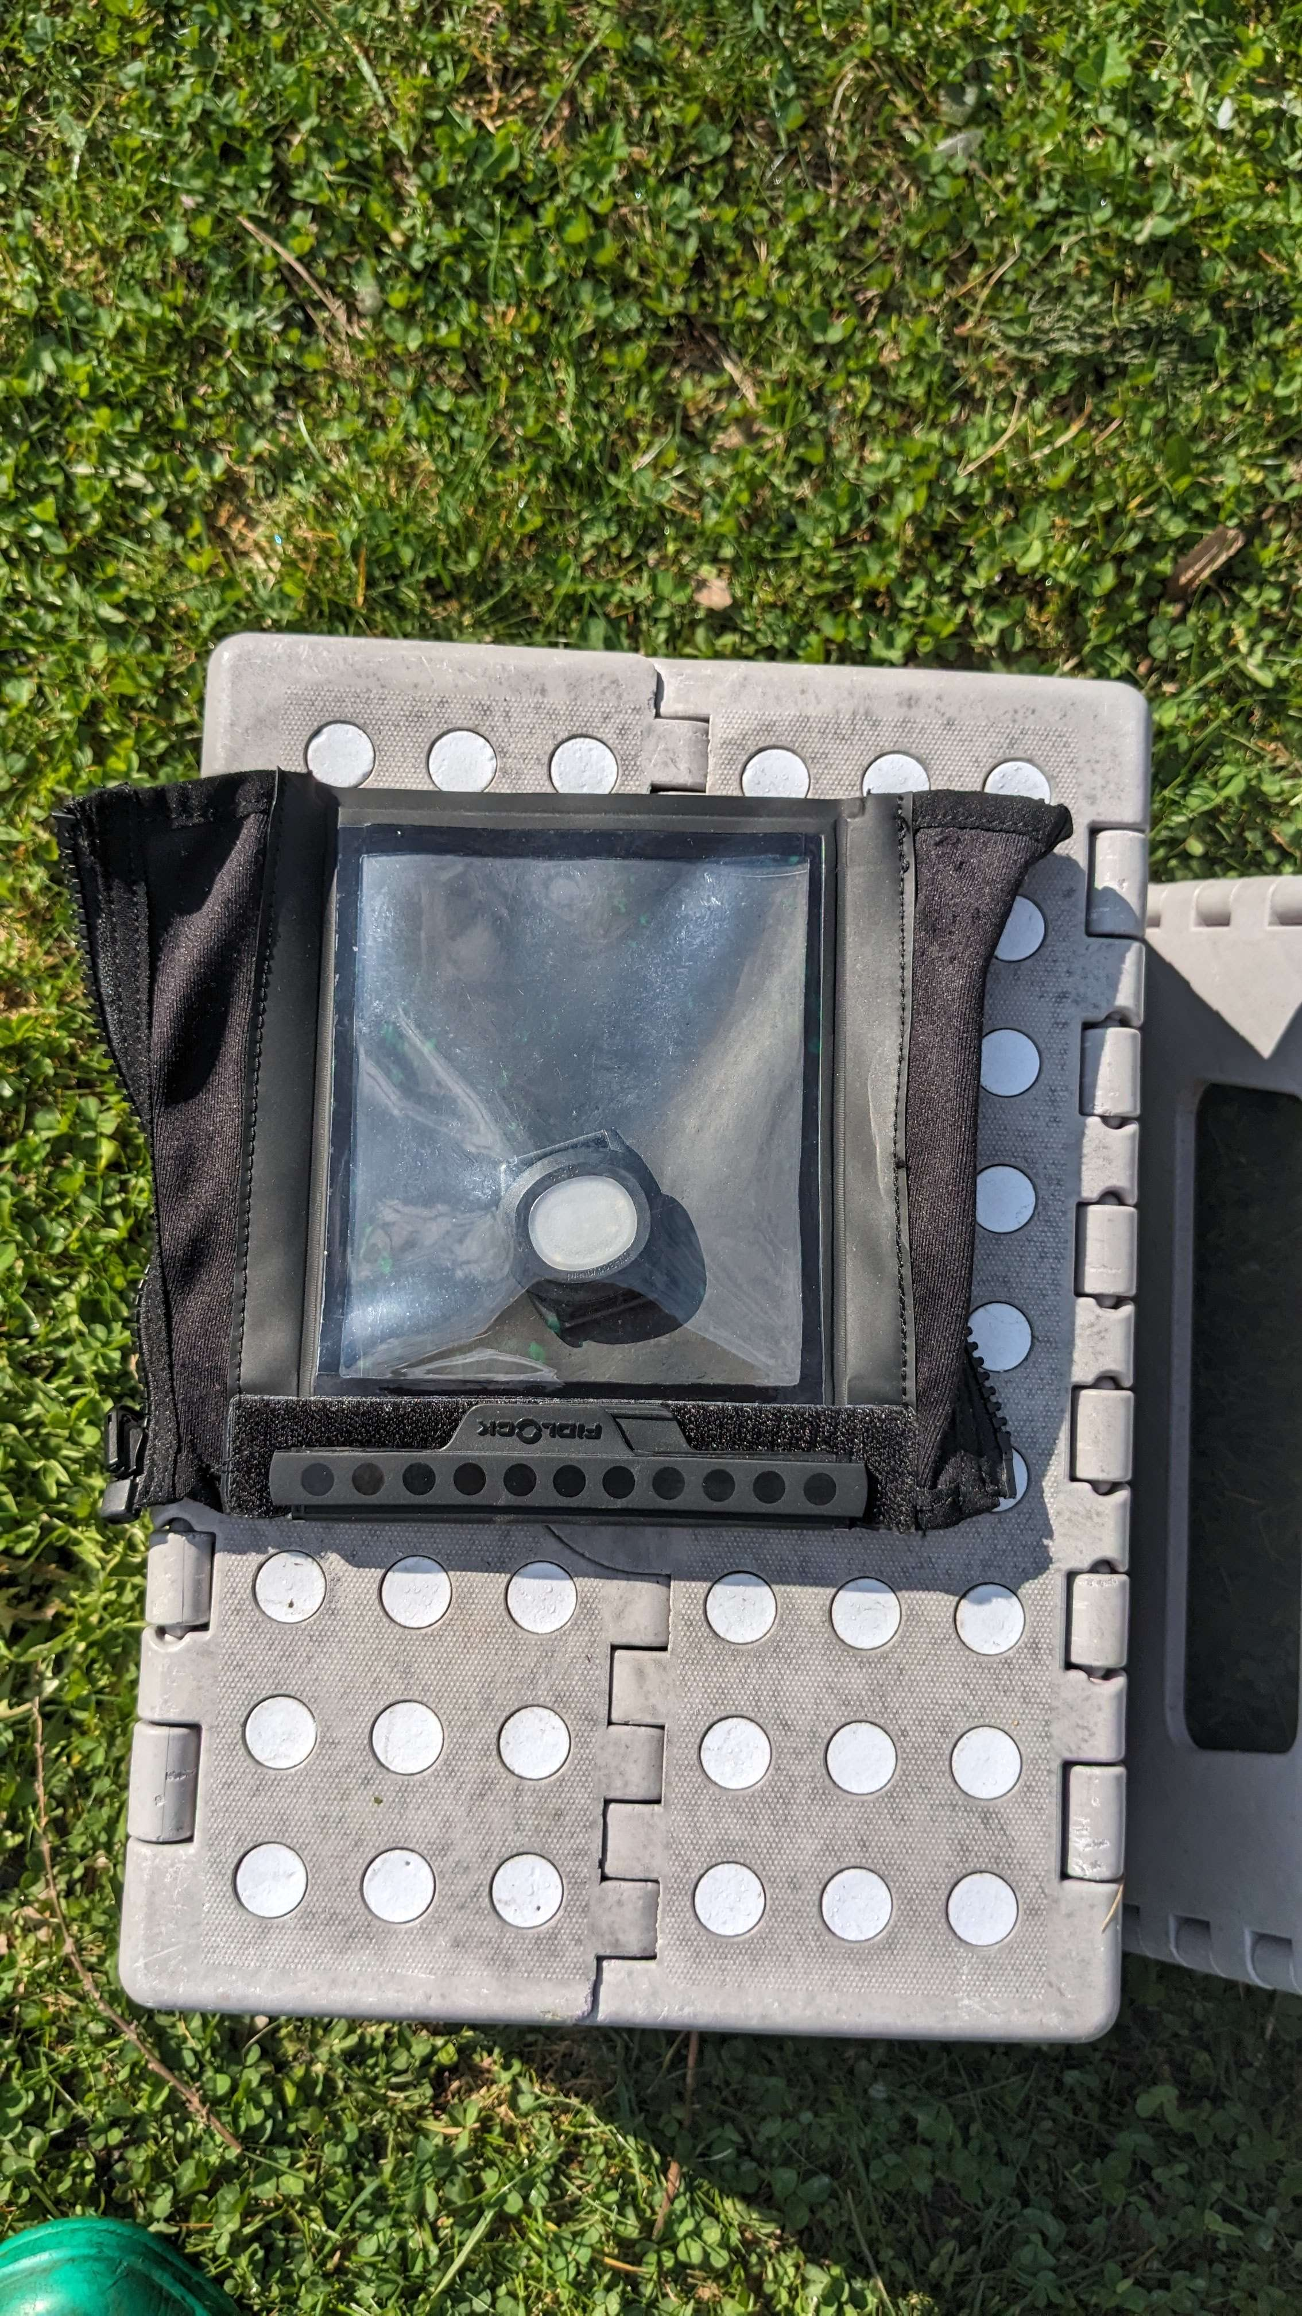
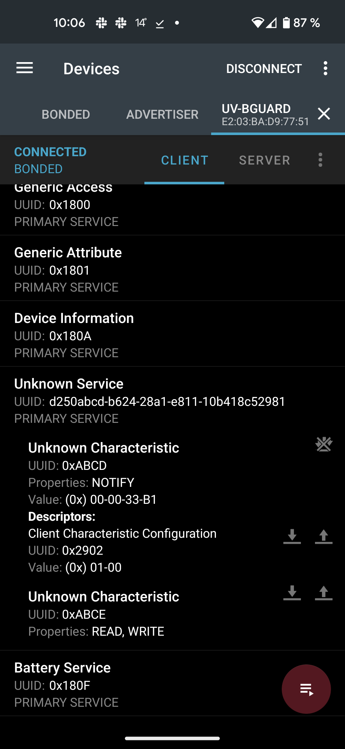
Baseline:
32 0D
=3378
Materialtest:
00 00
= 0

Slide 4
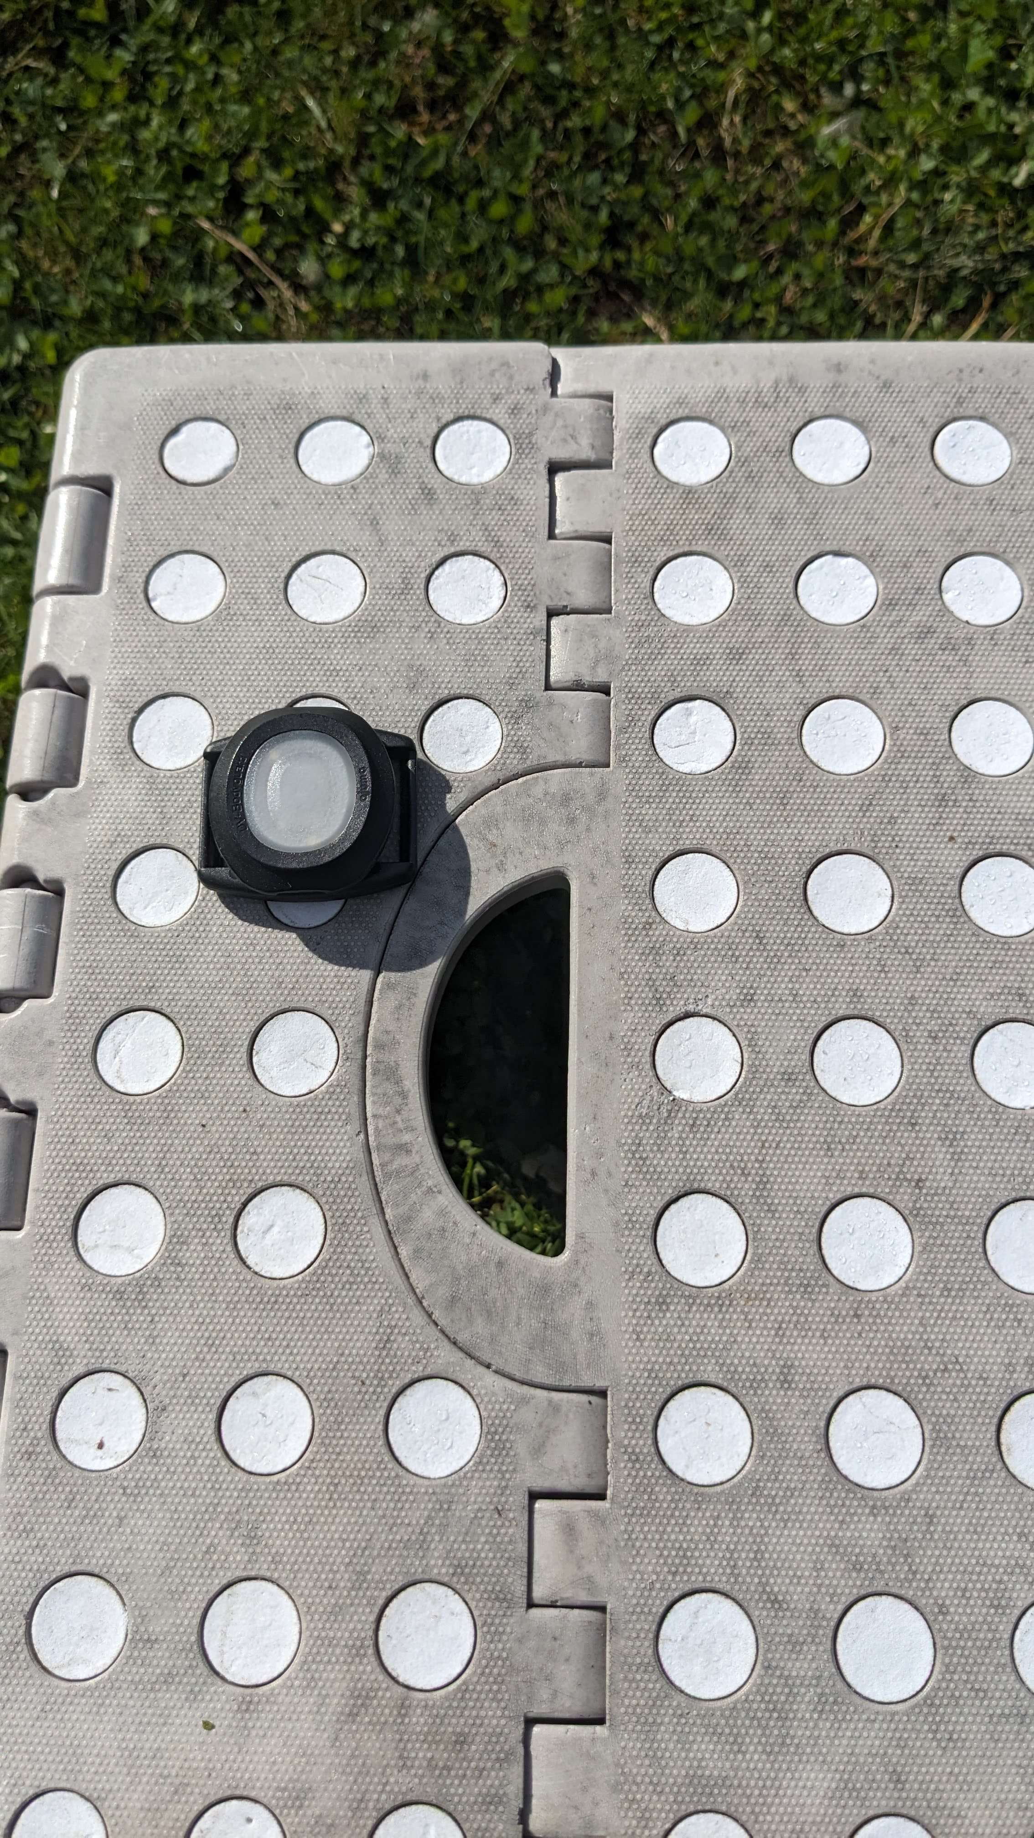

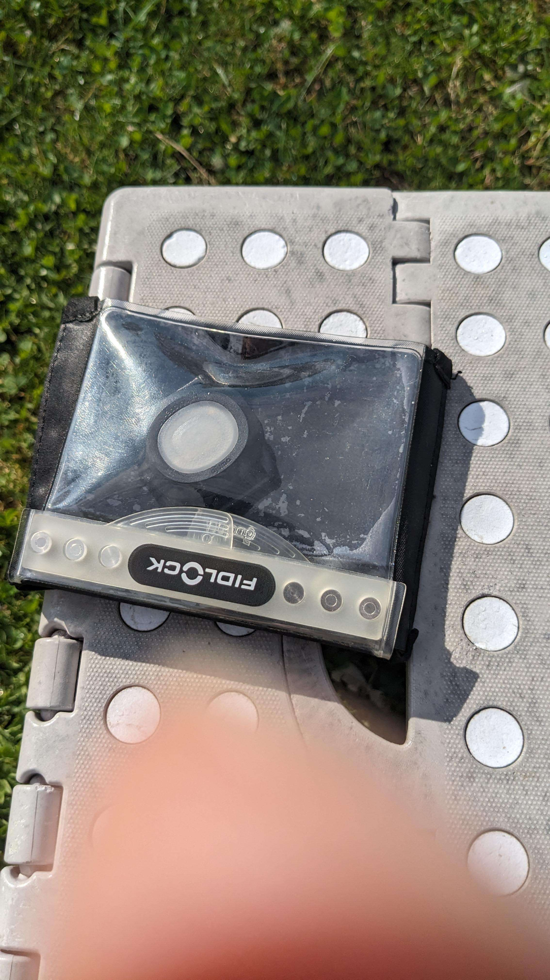

Baseline:
7B 10
= 4219
Materialtest:
79 00
→ 0

Slide 5
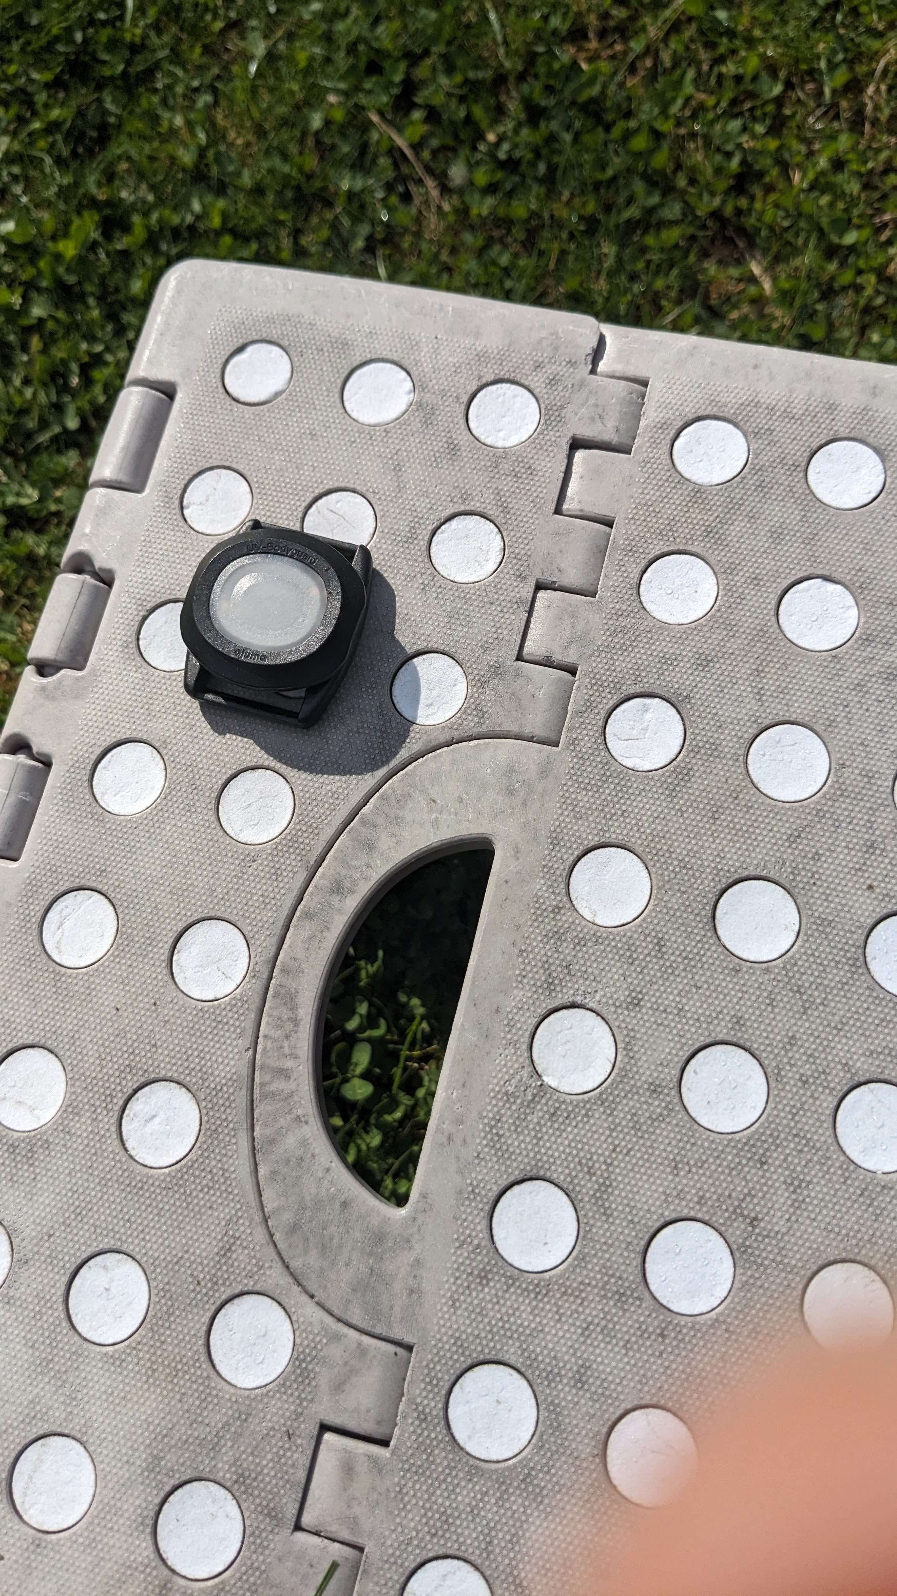

Baseline:
BC 10
=4284

Slide 6
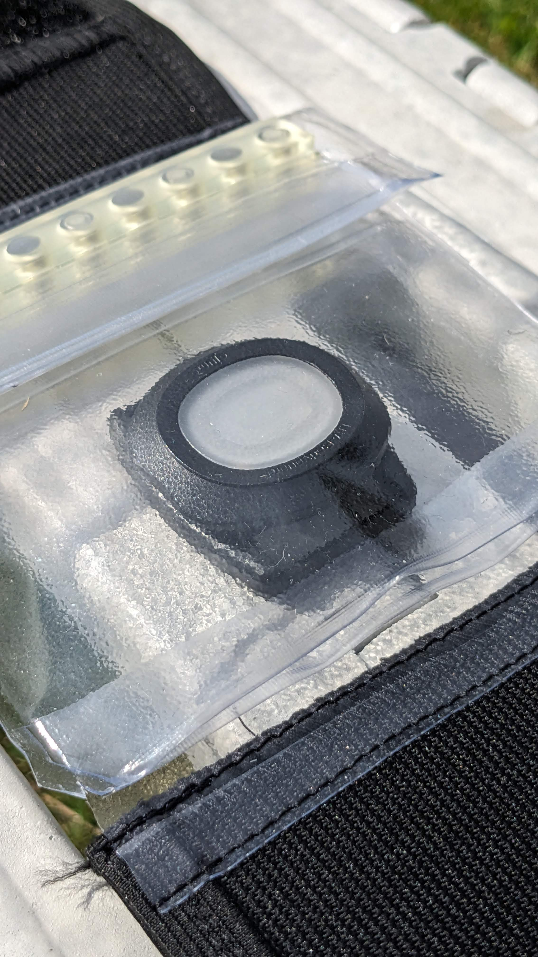
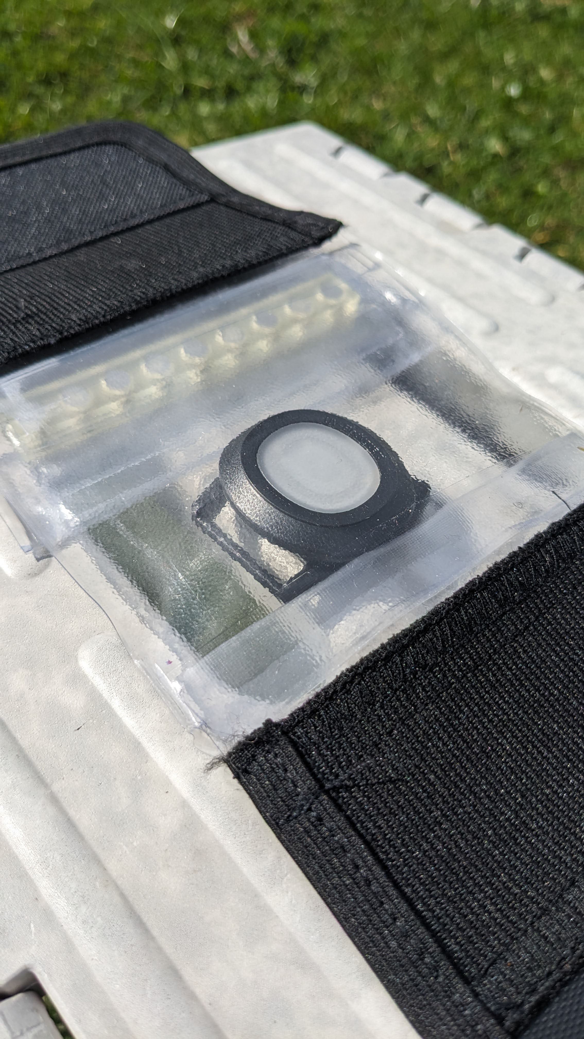
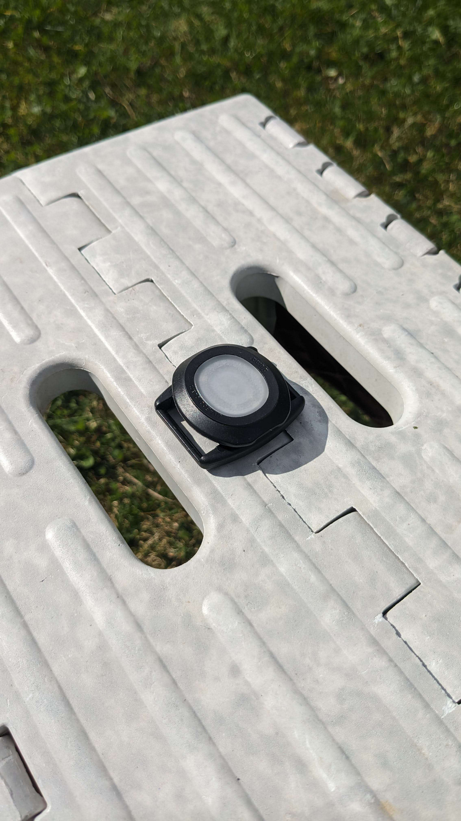
Case is „flipped over“
Materialtest:
1310
(21-25% Transmission)
Baseline:
5967
Materialtest:
1513
(21-25% Transmission)

Slide 7
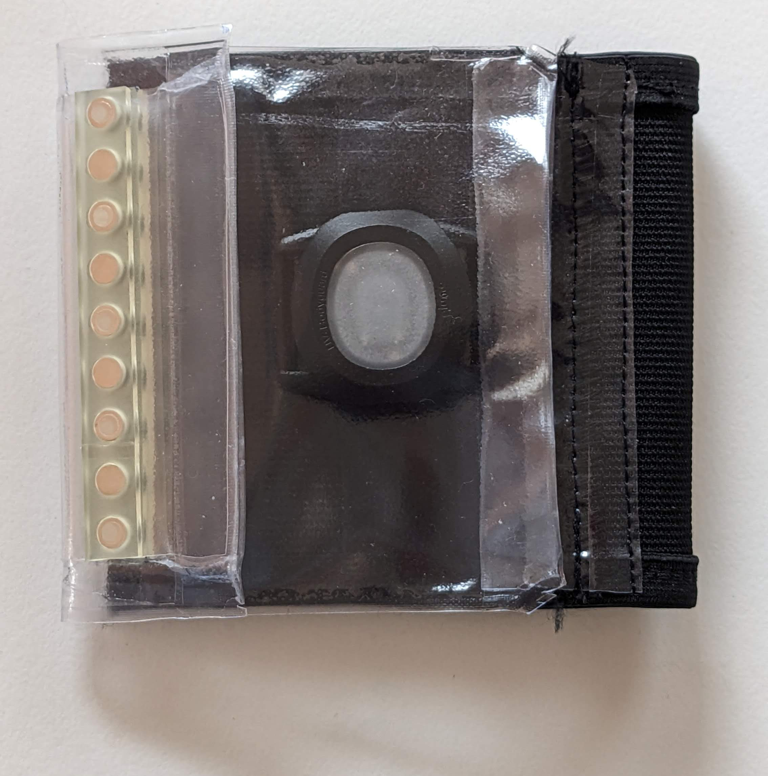
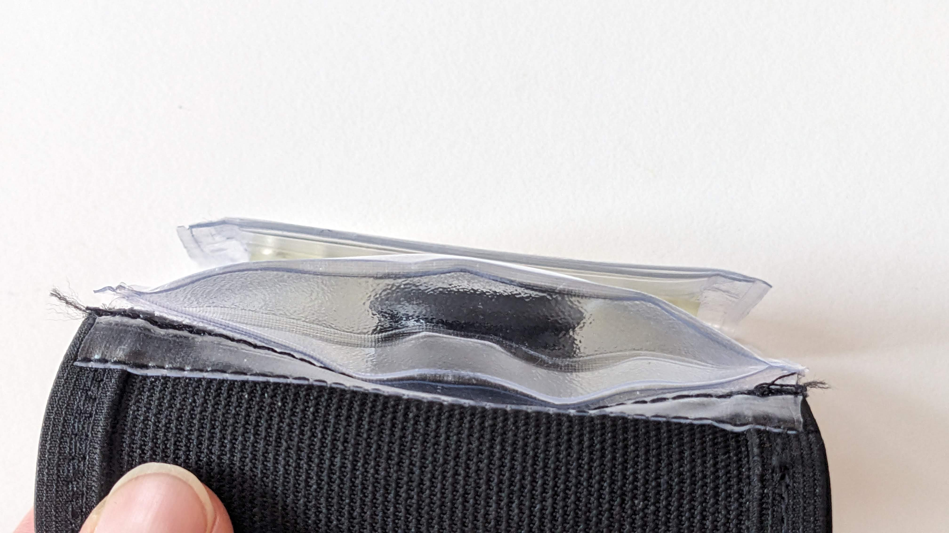
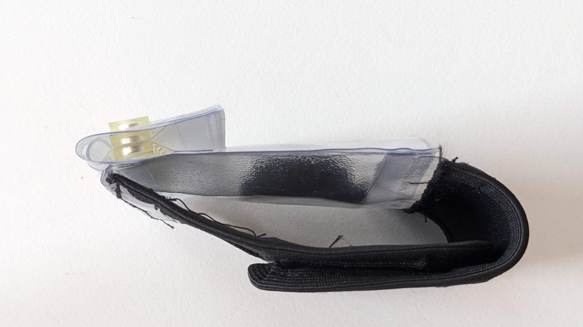
Favorit

