Slide 1

Task Manager Application
By: Julianna Truitt

Slide 2
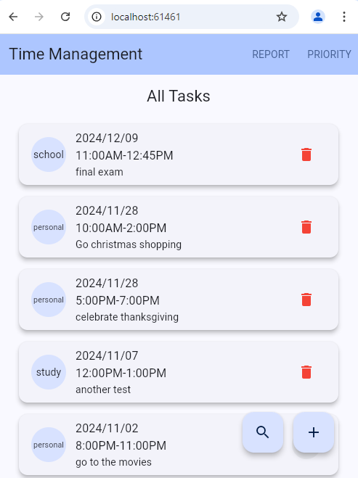
Feature 1: Display all task
The home page will neatly display your tasks
Tasks will be arranged in order by the date
Tasks will include the date, time, tag, and description
You have the option to delete a task

Slide 3
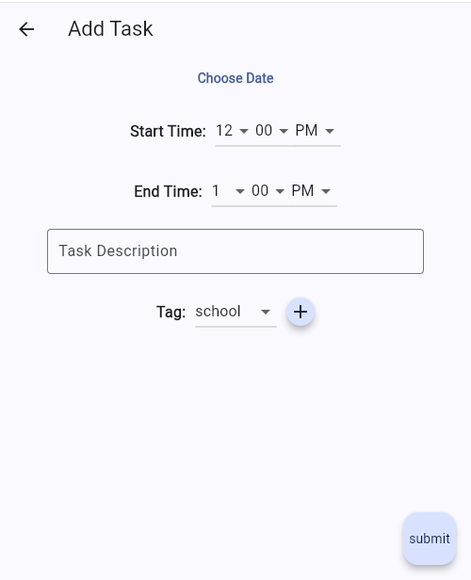
Feature 2: Add Task
Click the “+” button to add a new task
Choose a date, start/end time, description, and tag
Pressing submit will add your task to the database and redirect you back to the home screen

Slide 4
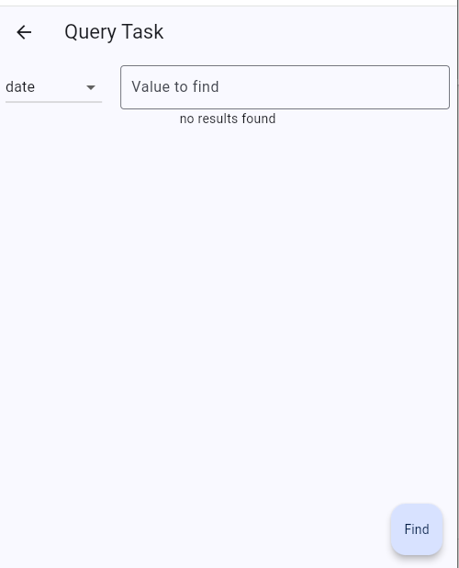
Feature 3: Search Task
Search a task by the date, tag, or description
It will filter all the tasks and provide you with only tasks that fit that criteria.
Use drop down menu to choose date, tag, or description and type in value to find accordingly

Slide 5
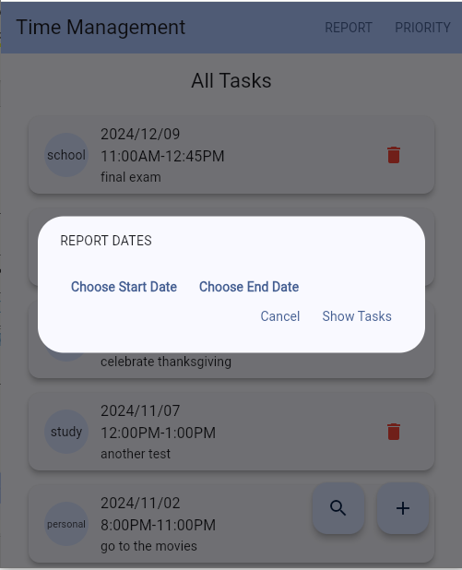
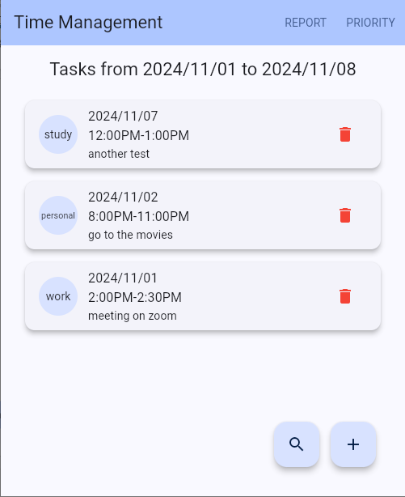

Feature 4: Report Dates
Report a range of dates with report button
This will show you only dates within the specific range that you select

Slide 6
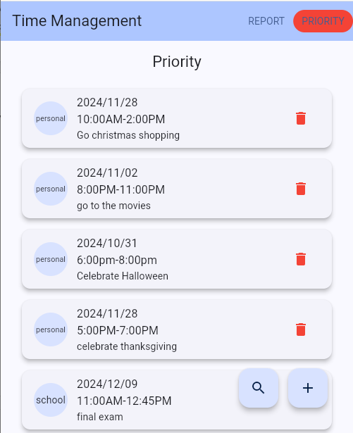
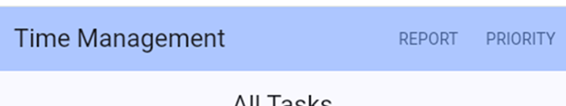
Feature 5: Priority
Selecting priority will show you your tasks reordered from time most spent on a task to least spent
This will give users an idea of what they spend most their time on

