Slide 1
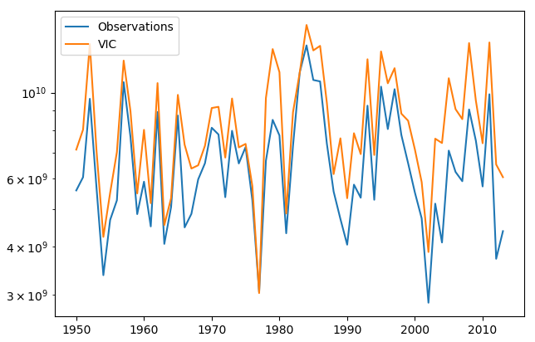
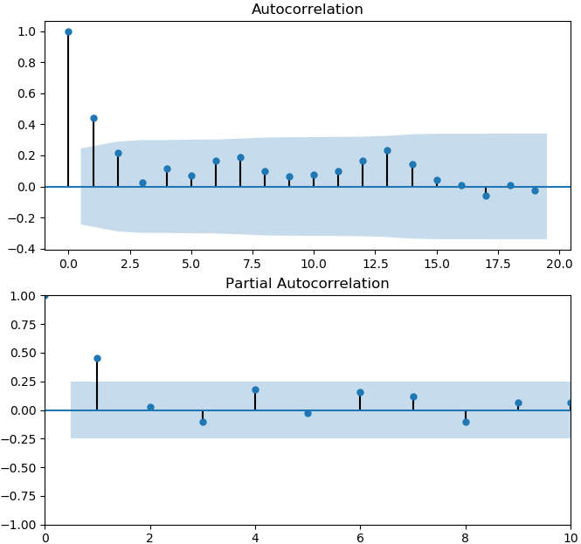
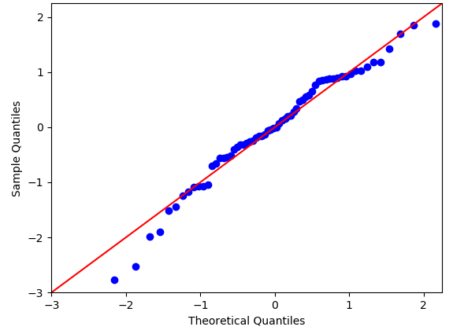
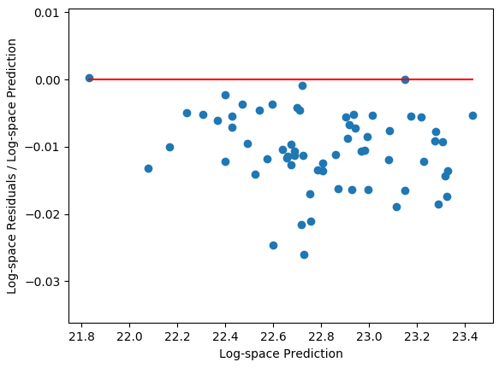
Log-space residual fractions auto-correlated (AR1)
Computed residuals in log-space and then divided by mean of log-space predicted value
Log-space residual fractions fairly normal (empirical p-value of Monte Carlo PPCT = 0.18)
97 CMIP5 scenarios run through VIC
Generated normal AR1 noise with mean and variance estimated from normal fit to historical log-space residual fractions
Multiplied synthetic residual time series above by the log-space mean from the respective CMIP5 scenario
Added above to predictions and fit HMM
Repeated 100x and used average parameter fits
Log-space residual fractions fairly homoscedastic but biased

Slide 2
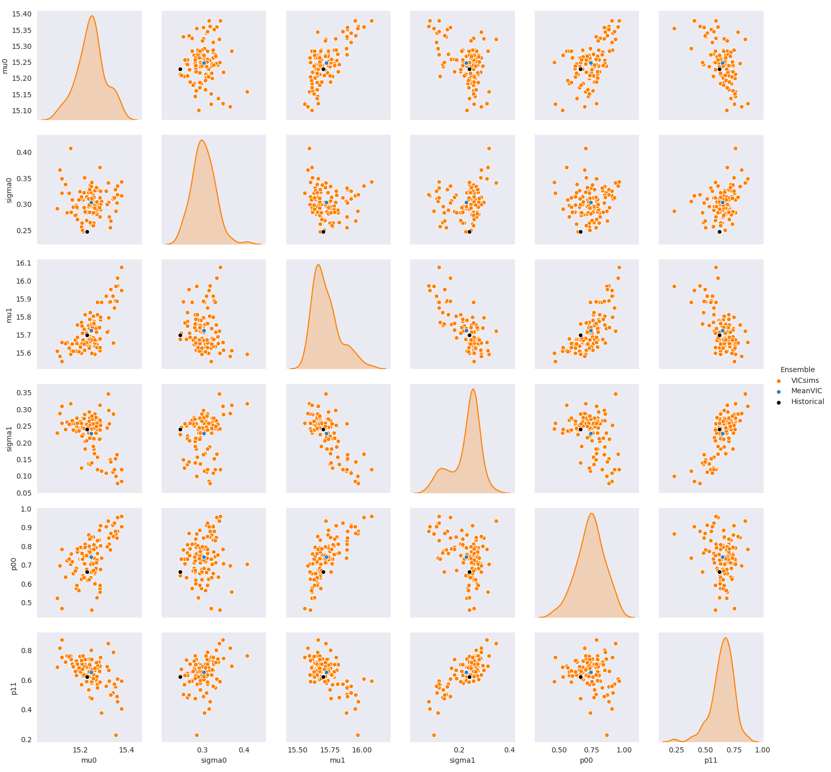
Historical
CMIP->VIC simulations
Mean CMIP->VIC
Dry state variability and persistence overestimated.
Other parameters pretty good.
Could try fitting another distribution to the residual fractions or using a k-nn bootstrap.

Slide 3
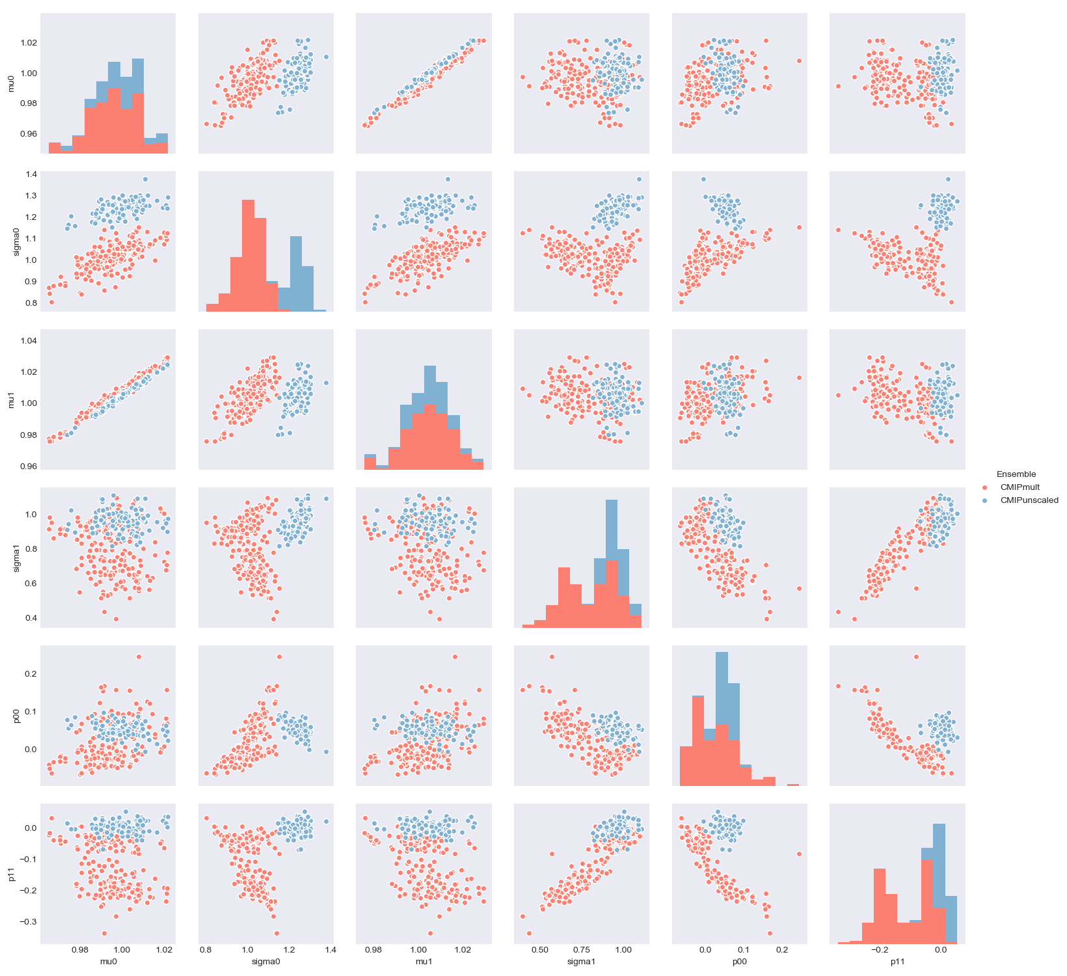
CMIP->VIC Multipliers
CMIP->VIC + Error Model
Still a strong positive correlation between the wet and dry state means. This is likely due to the input precipitation and temperature time series to VIC. If CMIP projected P would increase by 5%, all historical P data was multiplied by 1.05. If CMIP projected T would increase by 1C, all historical T data was increased by 1C.
Bias-corrected method has greater variability in both dry and wet state distributions. Dry state might be a problem from previous slide.
Multiplier method observed wider range of transition probabilities. Unsure why this is/if it makes sense. Is our AR1 noise overestimating (see previous slide) or better capturing persistence? (Note the units on the axes are multipliers on the historical log-space mus and sigmas, and deltas for the transitional probabilities)

Slide 4
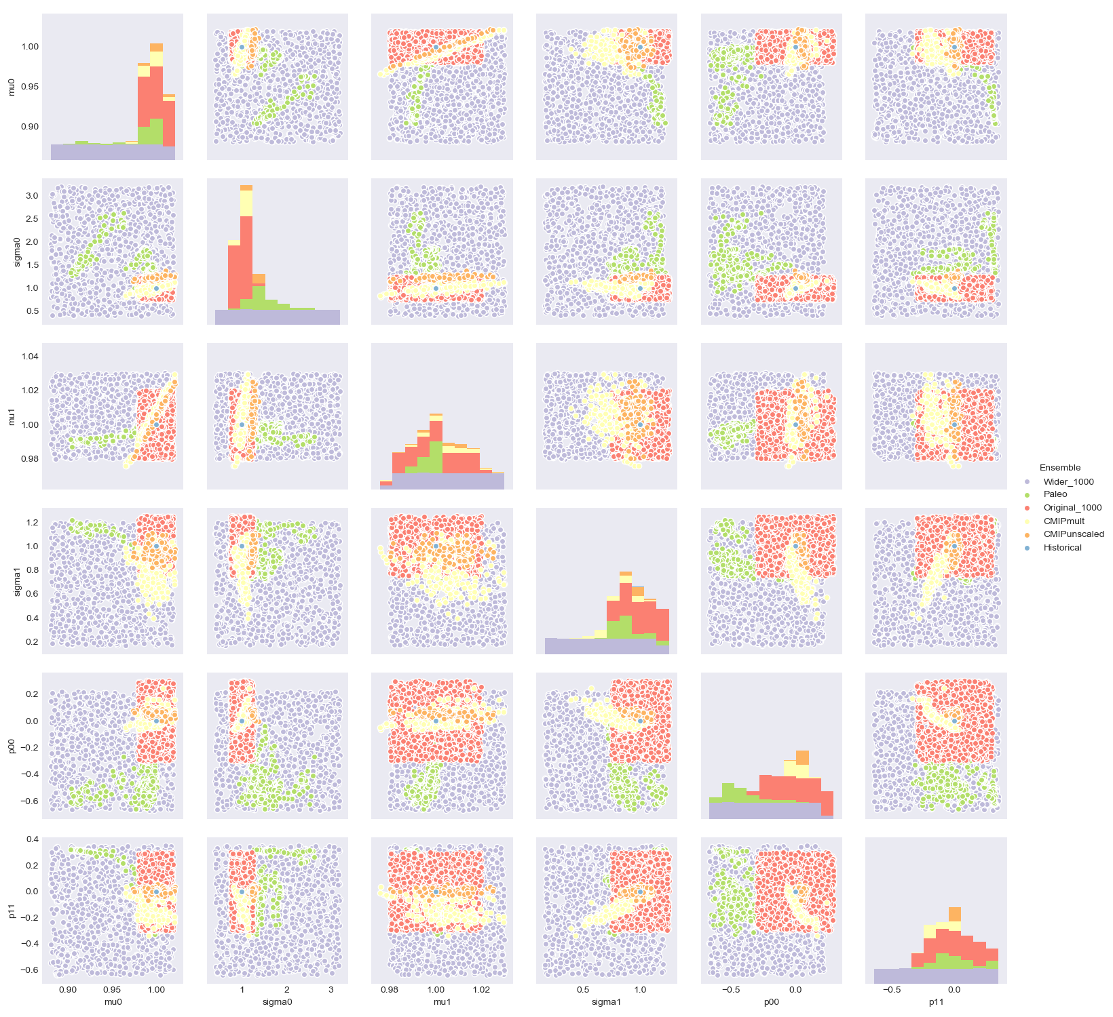
Historical
Box around Historical
CMIP Multiplier
CMIP Error Model
Paleo
All-encompassing

Slide 5
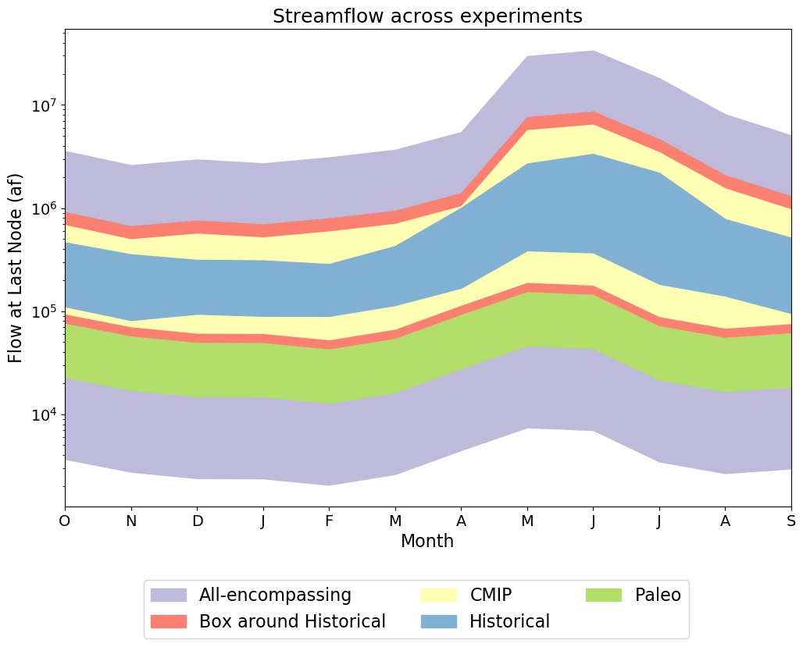
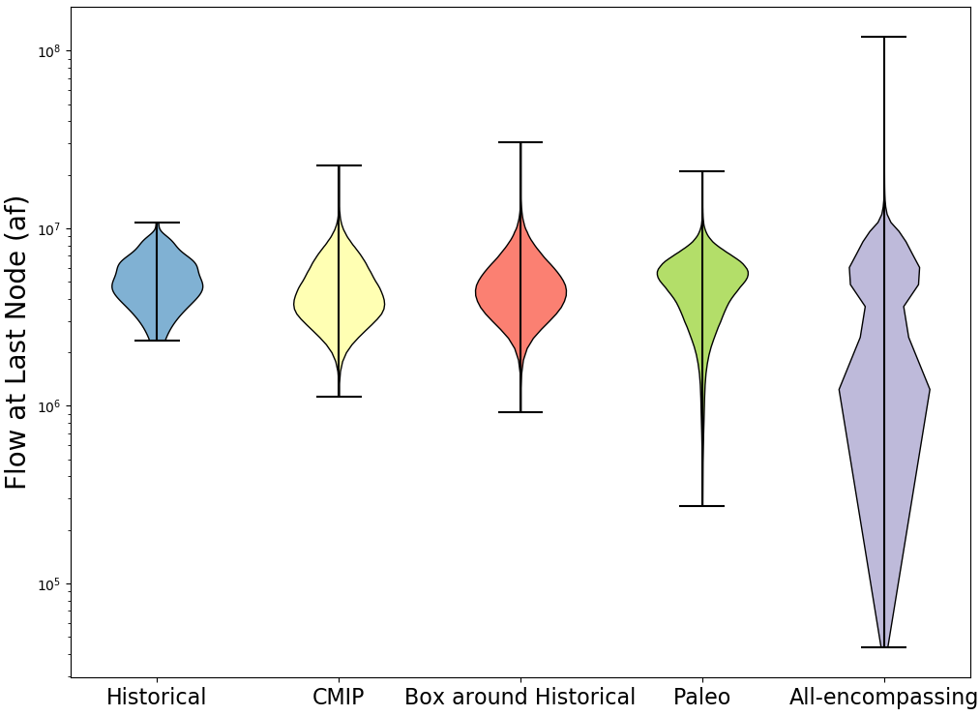
Next steps (once I get mpi4py working on Comet):
See how the figures below change when using the parameters estimated using the bias-corrected CMIP data instead of the multiplier CMIP data.
See how the variance decomposition figures change
Note: The CMIP ranges in these figures are based on synthetic data generated from the parameters fit to the CMIP->VIC multiplier time series. The actual CMIP->VIC time series will have different seasonality in the first figure that the synthetic data won’t capture because we’re only looking at changes in annual data and downscaling to monthly data using historical neighbors. The CMIP->VIC data has different monthly multipliers/deltas on P and T, resulting in changing Q seasonality.

