Slide 1
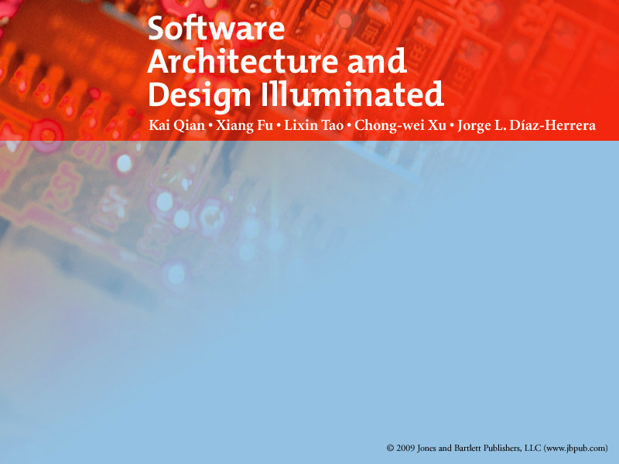
Chapter 14
Product-Lines Architectures

Slide 2

Objectives
Motivate the reader on the concept of systematic reuse and its particular implementation using product lines
Discuss the design considerations for product line architectures and component bases
Demonstrate the enabling technology

Slide 3
14.1 Overview
Today, organizations are emphasizing component-based development (CBD)
  A renewed interest on engineering applications by interconnecting prefabricated components
in the hope that this will bring about the elusive goal of systematic reuse
  building software systematically from a set of “prefrabricated components”
Notes:
This is what this chapter tries to explain; we present to you product line architectures and component bases as a way of institutionalizing systematic reuse; we discuss its motivation and benefits, and its technical support for the modeling and development processes involved.
The former (DfC) forms the basis for reusability and standardization by identifying those crosscutting aspects that are typically present in the systems in a given domain, whereas the latter (CoV) anticipates variation without compromising commonality, they capture the way that these aspects may vary from one product to another, providing plug-in compatibility via standard interfaces to achieve control-of-variability.
A PLA provides a common architectural framework as a design model that standardizes and maximizes the reuse potential of all software artifacts generated during the development process of systems within a given domain, at the same time that it clearly identifies variation points; these artifacts include requirements, designs and patterns, and, of course, the actual software components. A reusable Componentbase specifies common functionality across families of systems with direct control of variability.

Slide 4
14.1 Overview
A result of such approach is the notion of software product line (PL for short)
  generic architecture & library of components
  design-for-commonality & control-of-variability
What is a domain?
  area of expertise with specialized particular tasks
  organized into systems where all tasks work towards a common goal
  Example: MS Office suite
Notes:
Reuse is not an end in itself but a means to an end.
Systematic reuse refers to the organized creation of common assets with controlled variability that forms the basis for building systems in a domain of expertise by assembling them (systematically) from these reusable assets.
Reusable assets are not limited to code components.
Reusable assets include any artifact produced during the development cycle and serve as templates for the generation of the various work-products during product development. To assure higher probability of success, assets should be organized around ongoing business activities or domains, such as specific mission areas, areas of expertise, or core competencies (e.g., command and control, automotive, web development, etc).
Software components may need adaptation.
Assets must adapt to particular problem solutions at reuse time. This process requires original design effort only once, and it can be applied in two ways:
Adaptive design: use known, established solution principles adapting the embodiment to the requirements. It may be necessary to perform original design on some individual parts or components.
Variant design: arrangements of parts or components and other product properties (size, etc.) are varied within the limits set by a previously designed product structure.

Slide 5
14.1 Overview
This is what this chapter tries to explain
  product line architectures and component bases
  institutionalizing systematic software reuse
  motivation and benefits
  technical support for modeling and development

Slide 6
14.2 Introduction & Motivation
Complexity, size, and number of software-intensive systems becoming unmanageable
  routine functionality is custom-written repeatedly from scratch, over and over
Lack of standards and formalization
  a quagmire of data formats and applications
  taxonomy ambiguities and conflicts not only across disciplines but also even between groups within the same discipline
Notes:
Competitiveness of development organizations depends increasingly on the ability to improve their design and development processes faster than their competitors
The complexity of these systems is increasing fast involving thousands of computers with millions of lines of code, operating continuously and requiring higher levels of reliability, making them more difficult to design and maintain. Furthermore, the general lack of standards and formalization in scientific computing has resulted in a quagmire of data formats and applications, and taxonomy ambiguities and conflicts not only across disciplines but also even between groups within the same discipline.

Slide 7
14.2 Introduction & Motivation
There is clearly a need to
reduce considerably development effort
increase productivity
Moving from engineering single applications to engineering families of systems
providing universal platforms
synthesizing systems automatically
identifying generic solutions to common problems
building related products by assembling prefabricated parts
APPLICATIONS
Notes:
so that scientists and engineers can focus on the core competencies of their respective disciplines: scientific discovery and product innovation
There is clearly a need to reduce considerably the development effort of complex scientific and engineering computer applications, so that scientists and engineers can focus on the core competencies of their respective disciplines: scientific discovery and product innovation [].
[]National Research Council (2002). Preparing for the Revolution: Information Technology and the Future of the Research University. The National Academies Press, Washington, D.C.

Slide 8
14.2 Introduction & Motivation
Product Line Architecture: provides a common architectural framework as a design model that
  standardizes & maximizes reuse potential of all software artifacts generated during development
    these artifacts include requirements, designs and patterns, and, of course, actual code components
  specifies common functionality across systems
  clearly identifies variation points

Slide 9
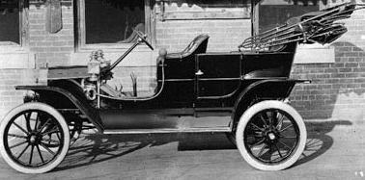
14.2 Introduction & Motivation
Lessons from other Industries

Slide 10
14.2 Introduction & Motivation
What varied?
Use features to satisfy diversity of needs
Why it worked?
Standard architecture and common parts
What resulted?
Product and assembly lines

Slide 11
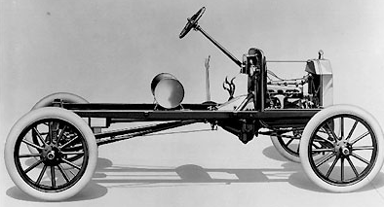
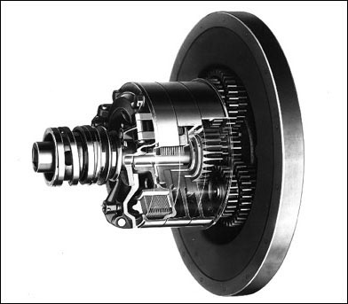
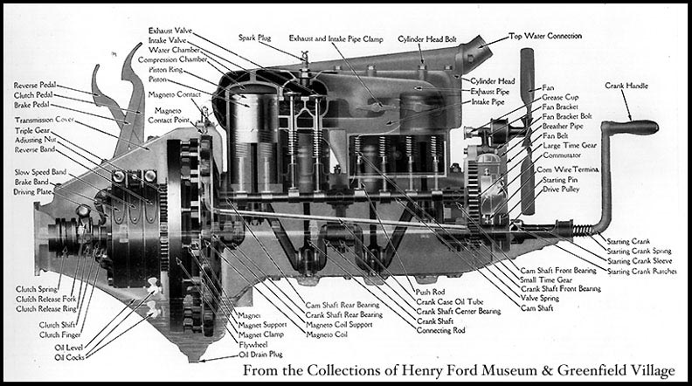
14.2 Introduction & Motivation
Architecture was key
Simple, Flexible
Built from Standard Parts

Slide 12
14.2 Introduction & Motivation
Why is software reuse critical?
  provides predictable behavior
  enables shorter delivery timeframes
  reduces routine functionality repeatedly from scratch
History dated back to 1950’s
  subroutine libraries
  standardized class libraries
Notes:
A domain is an area of expertise with specialized particular tasks organized into systems where all tasks work towards a common goal: example, MS Office suite.
In today’s post-PC era, new artifacts and systems are increasingly more software-driven. Plummeting hardware costs are leading to rapid growth in many new application areas all of which depend on well-engineered software for their continuing functioning; they require more software being built and in shorter time frames. However, it is quite typical that for many such systems each time a new product is built, routine functionality is custom-written repeatedly from scratch. Typically, development takes place according to the standard stovepipe approach. This conventional approach contributes to higher demands for more software since quality and productivity suffer.
For quite some time now there has been an explicit recognition of the need for building software based on “reusable components” [], paving the way for systematic reuse. The goal of systematic reuse is to produce quality software products consistently and predictably by moving toward an asset-supported development approach []. In short, we need to move our focus from engineering single systems to engineering families of systems by identifying “reusable” solutions within a collection of related products; these collections are called software product lines.

Slide 13
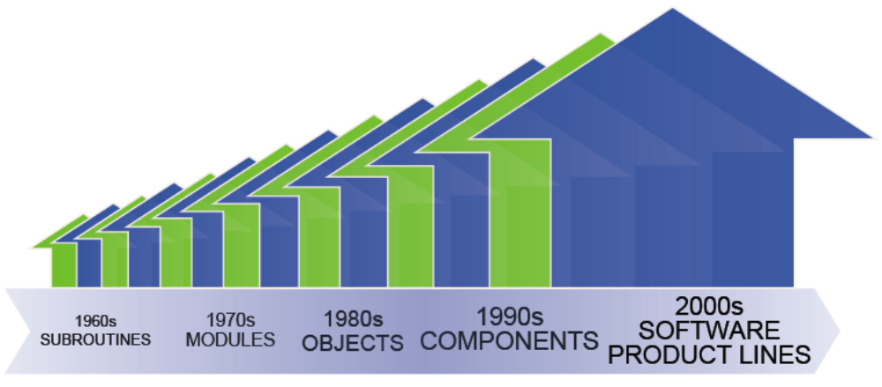
14.2 Introduction & Motivation return on investment (ROI)
ROI
Notes:
Fulfill an organization’s mission
Evolve common strategy and strengthen core competency
More efficient management of legacy systems
Achieve economies of scope
Increasing likelihood of longer time-IN-market
use trusted components
Intellectual Property: any packaged knowledge that can be bought and reused (e.g., algorithms, code, designs, test benches, blocks)
Automatic Generation of Products (in a domain)
Component Architecture for Reconfigurable Systems
65% Bratthall, L. and P. Runeson. Architecture Design Recovery of a Family of Embedded Software Systems. In proceedings on TC2 First Working IFIP Conference on Software Architecture. P. Donohoe, Ed. Kluwer Academic Pub. 1999.
The benefits from reuse are clear, provided that assets can be reused several times.
How can IP cores be designed as product lines, and at the same time allow the assimilation of (new) technology effectively, and offer the flexibility required for SoC design-with-reuse?
What are successful product line solutions in the context of embedded systems?
Reuse in general needs to be planned-for
analysis identifies explicitly variations to anticipate adaptations, and
design for adaptability is engineered a priori to create assets for future software development.
In SoC arena issues and problems are fundamentally the same than software reuse
There are important differences, too.
Component interfaces are far simpler and more standard. (Virtual Socket Interface Alliance)
hardware difficult to adapt (hard IPs)

Slide 14
14.2 Introduction & Motivation
Earlier definitions of software reuse include the following:
  “Re-use is considered as a means to support the construction of new programs using in a systematical way existing designs, design fragments, program texts, documentation, or other forms of program representation.”
  “Reusability is the extent to which a software component can be used (with or without adaptation) in multiple problem solutions.”
Notes:
0.5 min

Slide 15
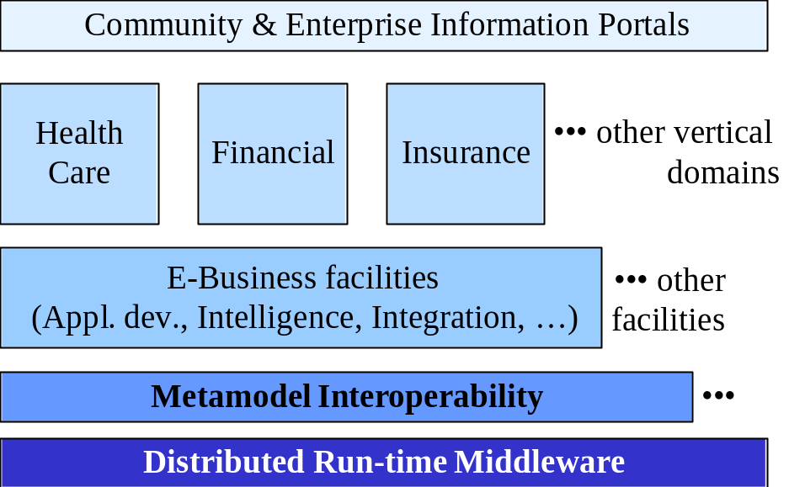
14.2 Introduction & Motivation
Reuse aspects
  It is not an end in itself but a means to an end
  Reusable components are not limited to code
  Software components may need adaptation
    Adaptive design
    Variant design
  Horizontal and
  Vertical Reuse

Slide 16
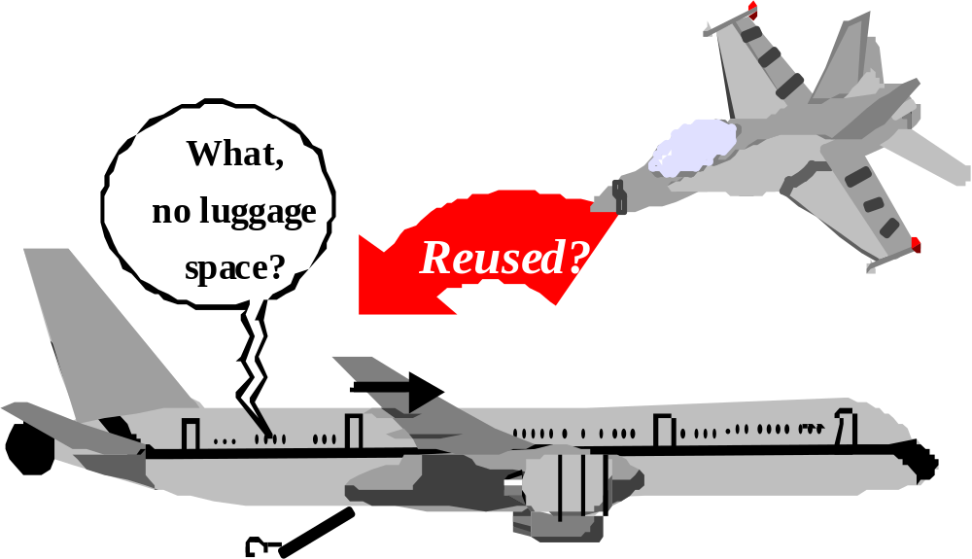
14.2 Introduction & Motivation
ad-hoc Reuse
Notes:
2 min

Slide 17
14.2 Introduction & Motivation
Benefits of Systematic Reuse: By planning ahead in support of future multiple systems, an organization
  reduces cycle time and cost of new products
  reduces risk and improves quality
  manages its legacy assets more efficiently
  evolves a common marketing strategy
  makes decisions based on the (worth of) the asset base and the strategic goals
Notes:
Systematic reuse occurs when reusable assets are planned and created as a separate activity from product development, a process known as product line engineering []. Systematic reuse requires more “original” engineering design work, by focusing first on identifying as much commonality and flexibility as possible; these are then optimized out by reducing unnecessary variation, and by providing specific variability control mechanisms. Thus, by planning ahead in support of the future development of multiple systems, an organization
reduces cycle time and cost of new products by eliminating redundancy and by producing them from common assets
reduces risk and improves quality by using trusted components
manages its legacy assets more efficiently
evolves a common marketing strategy and strengthens core competency around strategic business investments and goals
makes decisions based on the (worth of) the asset base and the strategic goals
This approach represents another evolutionary step in the development of the software field. A move, we believe, in the right direction toward the more encompassing aim of attaining industrial-strength software engineering, a necessary condition that naturally leads to systematic reuse as in other engineering fields.

Slide 18
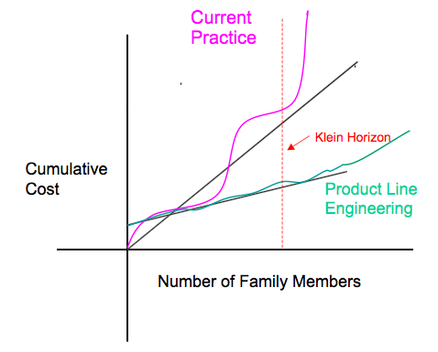
14.2 Introduction & Motivation
David Weiss 2007
Notes:
0.5 min

Slide 19
14.2 Introduction & Motivation
Methods, Processes, and Tools
  A methodology refers to a specific approach to developing software
  A process specifies a list of activities and the work-products produced hence
  Techniques and tools directly support the production by packaging best practices
  The platform is a set of subsystems and technologies that provide a coherent set of functionality
Notes:
1 min

Slide 20
14.3 Product Line Engineering
PL engineering uses domain-driven, model-based methodology for building software
  Model Driven Architecture (MDA) framework
    separating specification of operation of a system from details of the way it uses the capabilities of its platform.
    specifying a system independently of the platform
    specifying platforms, choosing a particular platform for the system, and transforming the system specification into one for a particular platform.
  Two Complementary Processes
    Modeling (domain engineering)
    Development (applications engineering)

Slide 21



14.3 Product Line Engineering
Technology
Domain Experts &
Domain Engineering Experts
1. Modeling (Domain Engineering, a.k.a Design-for-Reuse)
Refers to original design, i.e.,
the use of first principles
Domain
knowledge
Solution
models
New
requirements
Domain Expert
2. Development (Application Engineering,
a.k.a design-with-Reuse)
refers to routine practice, i.e.,
the use of known solutions
Domain Experts &
IT technicians
Product
Notes:
Reuse in general needs to be planned-for
analysis identifies explicitly variations to anticipate adaptations, and
design for adaptability is engineered a priori to create assets for future software development.
In SoC arena issues and problems are fundamentally the same than software reuse
There are important differences, too.
Component interfaces are far simpler and more standard. (Virtual Socket Interface Alliance)
hardware difficult to adapt (hard IPs)
The issues addressed during IP reuse are similar to those of conventional software reuse, as follows:
solve a general problem
design-for-reuse: create a reusable asset, i.e. one that is fully documented, has good code and robust scripts; is verified independently of any chip design, and with high-level of confidence
design-with-use: create a usable asset, i.e. one that is adaptable to multiple technologies, and that is usable in a variety of simulators
The technical problems are also fundamentally similar to those encountered in reusing conventional software as well:
inappropriate design representation
incomplete design information
unavailable or obscured supporting scripts
not appropriately archived design (configuration management)
unavailable tools or lack of interoperability
Design-for-Commonality forms the basis for standardizing assets to build products in a domain by encapsulating common features of related products, and by defining a common architecture for related products. Each component is a means of achieving one or more reusability features. They must have syntactically and semantically clear specification separate from implementation details and independence from environment. Today, each IP vendor uses its own specification and documentation style.
Like commonality, adaptability must be engineered a priori, and thus, Analysis-of-Variation must explicitly identify variations that anticipate adaptations. Optional parts are very important. Possible combinations of optional features must be supported by the product line architectural design and the flexibility incorporated in the component design, otherwise it may be impossible to reuse an asset “as-is” because commonality and specificity are mixed. This would make it necessary to modify the asset when reused in the new context, and this should obviously be voided whenever feasible. Configuration models help here.
Control-of-Variability provides flexibility in the assets to meet requirements for a variety of products without compromising commonality; it requires careful design to include appropriate levels of parameterization, generalization and specialization, and extension. Like commonality, adaptability must be engineered a priori, and thus, analysis must explicitly identify variations that anticipate adaptations.

Slide 22
14.3 Product Line Engineering
Reuse in general needs to be planned-for
  create a reusable asset, i.e. one that is fully documented, has good code and robust scripts; is verified independently with high confidence
  create a usable asset, i.e. one that is adaptable and that is usable in a variety of simulators
Design-for-Reuse/Use involves
  analysis to identify explicitly variations to anticipate adaptations, and
  design for adaptability, engineered a priori to create assets for future software development

Slide 23
14.3 Product Line Engineering
Design-for-Commonality
  standardizing assets by encapsulating common features
Analysis-of-Variation
  must explicitly identify variations that anticipate adaptations
Control-of-Variability
  provide assets flexibility without compromising commonality
Notes:
Design-for-Commonality forms the basis for standardizing assets to build products in a domain by encapsulating common features of related products, and by defining a common architecture for related products. Each component is a means of achieving one or more reusability features. They must have syntactically and semantically clear specification separate from implementation details and independence from environment. Today, each IP vendor uses its own specification and documentation style.
Like commonality, adaptability must be engineered a priori, and thus, Analysis-of-Variation must explicitly identify variations that anticipate adaptations. Optional parts are very important. Possible combinations of optional features must be supported by the product line architectural design and the flexibility incorporated in the component design, otherwise it may be impossible to reuse an asset “as-is” because commonality and specificity are mixed. This would make it necessary to modify the asset when reused in the new context, and this should obviously be voided whenever feasible. Configuration models help here.
Control-of-Variability provides flexibility in the assets to meet requirements for a variety of products without compromising commonality; it requires careful design to include appropriate levels of parameterization, generalization and specialization, and extension. Like commonality, adaptability must be engineered a priori, and thus, analysis must explicitly identify variations that anticipate adaptations.

Slide 24
14.3 Product Line Engineering
Levels of Reuse
  Domain-independent components
    Designed for reuse to fit any product (e.g., general purpose class libraries)
  Domain-specific components
    Designed for reuse to fit several different products in a given market (e.g., multi-media, jpeg encoders, data communications, digital signal processing, ...)
  Product-specific components
    Designed for reuse within a specific “application” (to generate various instances or products)

Slide 25
14.3 Product Line Engineering
There are several issues to consider
  design exploration support
  standard component design and acquisition process
  specification of reusable component at the appropriate level of abstraction
  system approach
It is difficult to foretell the future!
Notes:
1.1 IP design-with-reuse
Systematic reuse only occurs when reusable assets are planned and created as a separate activity from application development. The achievement of design-for-commonality and control-of-variability requires the establishment of a reuse infrastructure, an overall framework that integrates the corresponding set of modeling, planning, and asset construction activities necessary for systematic reuse, and that, at the same time, allows the assimilation of technology effectively.
There are several issues that the IP integrator using reusable components will face. These include (1) design exploration support, (2) Standard IP design and acquisition process, (3) Specification of reusable IP ate the appropriate level of abstraction, and (4) System approach.

Slide 26
Traditional Model
Domains
Individual
applications
Individual
domains
Systems
Individual
implementations
Assets
Notes:
Product lines recognize variability among similar user requirements for the same product. Individual products (systems) typically tend to be the result of responding to a unique set of requirements from the user. The product line approach focuses on efforts to create assets for future software development. These assets constitute an investment for future work. Once product line assets have been identified, engineers can then organize collections of one or more product line assets, managing multiple lines and implementation technology that go into building members of a product line. Another important issue is that of re-engineering. When legacy systems are viewed as examples of product lines, rather than as individual, unique systems, the application of a specific reengineering activity is broadened considerably. The focus shifts from maintaining legacy systems to that of anticipating future requirements.
A product line is an abstract concept defined in terms of a set of features that closely related systems must posses to meet some market requirements. In this way, a product line is a “description” of the systems, both existing or planned, that provide a set of similar capabilities addressing similar customer needs (features visible to the end product user). These systems are generally variations of a theme, such as command and control centers, communications systems, and simulation systems. Hence, a system is an explicit specification of what the software/hardware must do to meet a product’s requirements.
The notion of product lines can be a difficult concept for software. It can be taken to mean software systems that share a common design and a set of product line assets. Others regard a product line as a collection of systems that share common capabilities (may have different designs and may be built using different assets) that provide similar services or that satisfy similar mission objectives of the organization. We have chosen the latter connotation.

Slide 27
14.4 Product Development
Design-with-Reuse: Routine application of models and known solutions in direct support to automatic system generation
Domain-
specific
Models
Domain-
specific
components
New
Product
Domain Experts &
IT technicians
Domain
Expert
New Product
Requirements
Domain-
specific
Interface

Slide 28
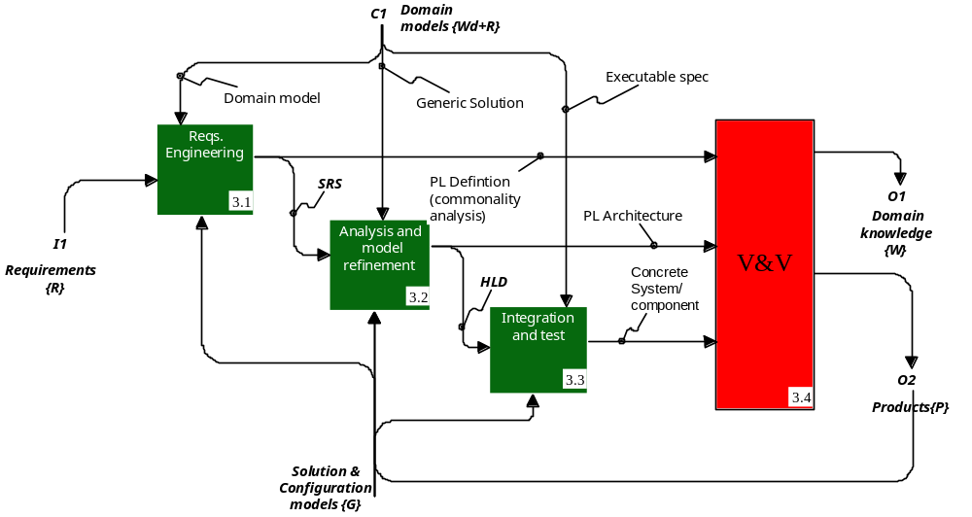
14.4 Product Development

Slide 29
14.4 Product Development
Design Exploration
  Designers need to know what design alternatives exist for the problem in hand
  more importantly, which component exists that can support these alternatives, and
  what is the impact of (re)using one component vs. another (assuming there could be several vendors)

Slide 30
Product Lines and UML
Domain Analysis
Problem Analysis
Solution Analysis
Specify basic problem overall functionality, and identify and specify system features
Describe implementation of the solution in terms of interactions between classes and permitted (expected) overall system behavior
Identify the “entities” and their relations in the applications domain
Problem Model
(Activity diagram)
Behavioral Model
(traces + constraints)
Domain Model
(class diagram)
Requirements Model
(Use Case diagram)
Implementation Model
(Collaboration diagram)
Notes:
Our development approach incorporates concepts in support of embedded systems development based on a fundamentally product line-driven process. Product lines capture the commonality across a given domain so that new products can be created easily by interchanging components, changing design parameters, leveraging established synthesis and testing suites, or other development artifacts. The focus is thus one of analysis and design of variability within a product line and the analysis and design of commonality across product lines []. This takes special consideration of contextual differences to allow an asset to cater to the variability found in the various products, while designing for commonality across products. Optional subsystems (or parts) are very important for component-based development within a product line. Possible combinations of optional features must be supported by two complementary elements: (1) the derivation of variants from the product line architecture, and (2) the flexibility incorporated in the component design, otherwise it may be impossible to reuse an asset “as designed” because commonality and specificity are mixed. This would make it necessary to modify the asset when reused in the new context, and this should obviously be avoided whenever feasible.
[]Díaz-Herrera, J. L. and R. Schroeder. "Product Line Software Development for Embedded Systems: a Model-Based, Component-Driven approach" (OOPSLA99 workshop on Object Technology & Product Lines, Denver Oct. 1999).

Slide 31
Separation of Concerns
Specified as collaborations
Specified as traces + constraints
Feature
structural
Specification
Feature
behavioral
Specification
Product Line
specification
Specified as Use cases

Slide 32
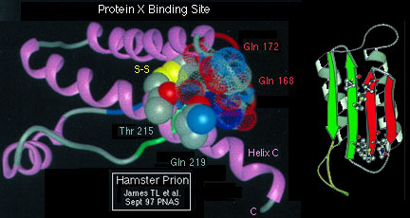
Example: Bioinformatics
Domains
Astroinformatics ––
Bioinformatics ––
Geoinformatics ––
Mechatronics ––
Med. Informatics ––
… ––
Functional genomics
Comparative genomics
Structural genomics
Drug Discovery
Phylogenetics
Needs
–– Algorithms
–– Visualization
–– Networks
–– Grid-computing
–– …
Assets
Notes:
Product lines recognize variability among similar user requirements for the same product. Individual products (systems) typically tend to be the result of responding to a unique set of requirements from the user. The product line approach focuses on efforts to create assets for future software development. These assets constitute an investment for future work. Once product line assets have been identified, engineers can then organize collections of one or more product line assets, managing multiple lines and implementation technology that go into building members of a product line. Another important issue is that of re-engineering. When legacy systems are viewed as examples of product lines, rather than as individual, unique systems, the application of a specific reengineering activity is broadened considerably. The focus shifts from maintaining legacy systems to that of anticipating future requirements.
A product line is an abstract concept defined in terms of a set of features that closely related systems must posses to meet some market requirements. In this way, a product line is a “description” of the systems, both existing or planned, that provide a set of similar capabilities addressing similar customer needs (features visible to the end product user). These systems are generally variations of a theme, such as command and control centers, communications systems, and simulation systems. Hence, a system is an explicit specification of what the software/hardware must do to meet a product’s requirements.
The notion of product lines can be a difficult concept for software. It can be taken to mean software systems that share a common design and a set of product line assets. Others regard a product line as a collection of systems that share common capabilities (may have different designs and may be built using different assets) that provide similar services or that satisfy similar mission objectives of the organization. We have chosen the latter connotation.
Structural genomics: genome sequencing, gene discovery, gene regulation
Comparative genomics
Phylogenetics
Functional genomics:high throughput transcriptional profiiling (geneexpression analysis e.g. for classifcation and diagnosis of disease);proteomics (protein structure & function; 3D modeling, high throughputsequencing, expression), Genotyping (population genetics; simple andcomplex human genetic diseases; disease risk assessment)
Drug Discovery (via some of the above applications)

Slide 33
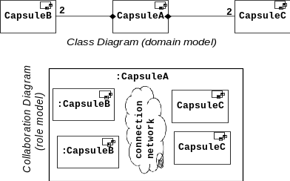
SE Technology
Domains
Domain
models
Startup
<<includes>>
Start
compressor
<<extends>>
<<extends>>
Operator
<<includes>>
Shutdown
<<includes>>
Alarm
detected
Plant
Remote
Shutdown
<<extends>>
Operate
Local
Remote
<<includes>>
<<includes>>
<<includes>>
Local
Shutdown
• Features
• Variability analysis
Stop
compressor
Reusable
Component
Systems
Cn
Cn
•••
Cn
Cn
Cn
Solution models
Configuration models
Assets
Architectural
Framework
Notes:
There are both technical and product elements in the platform:
Architecture (product): these are the core assets of a product line. The architecture provides the structure for building products, identifies product line assets, and defines the means for connecting assets.
Domain model: refers to the specification of product line assets that defines common capabilities, areas of variation and reasons for those variations as they relate to a set of end users.
Module:refers to abstract design concepts defining rules for the layering of components and interfaces and their coordination.
Domain Models {Wd}
knowledge about “physical” world (W) within a specific scope or domain (d)
PL Specification {Spl}
systems’ features & functions as seen by “users”
Identification of “hot-spots” (variation points)

Slide 34
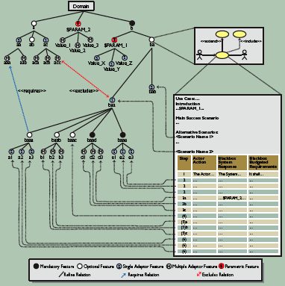
Use Cases Variability
Optional Use cases
Optional scenarios
Varying flow of events
Cross-cutting aspects
Magnus Eriksson, Jürgen Börstler, and Kjell Borg, CACM, Dec. 2006
Notes:
We distinguish four kinds of variations in use case models for product families [2]:
• Use cases might or might not be included in a particular product.
• Certain scenarios of an included use case might be excluded from a particular product.
• The flow of events within an included scenario might vary.
• Cross-cutting aspects that can affect several use cases on several levels. For example, the existence of different sets of use case actors (system users) in different products.

Slide 35
Components
A component “C” implements functionality and connects to other components through exported & imported (required) interfaces
A system built out of a
network of components
is itself a component.
implemented
functionality
exported
interface
C
imported
interface
B
C1
C2
B2
B1
Notes:
If the participant graph of a collaboration needs to be embedded into a complex application class graph, the adapter might be brittle with respect to changes in the class graph.
“An Ada software component is an Ada library unit
(in practice, most components will turn out to be generic packages).” – Gautier&Wallis 1990
Parametric polymorphism (as opposed to inclusion polymorphism)
dynamic (type inferencing)
static (Ada generic formal types)
Sockets: access to services provided by component.
Correspond to entities in the visible part of a specification (use nesting packages to export collections of entities as single sockets)
Plugs: the artifact through which a component accesses another component.
Correspond to generic formal parameters (this makes components as independent as possible)
Type of information that flows through sockets/plugs should be parameterized.
Component capacity/constraints should also be parameterized.
Hierarchy of composition is needed to control complexity.
In practice most components will turn out to be generic packages.
Type of information that flows through sockets/plugs should be parameterized.
Sockets: access to services provided by component. Correspond to entities in the visible part of a specification (use nesting packages to export collections of entities as single sockets).
Different components may provide socket (or plugs) of identical appearance, but with different semantics (overloading or homographs).
“Through” sockets: re-exported plugs (permits another component to use whatever this component plugged into)
Plugs: the artifact through which a component accesses another component. Correspond to generic formal parameters (this makes components as independent as possible).
When putting components together, it is only possible to insert a plug into a compatible socket.
Connector: a component with only plugs but not sockets (data flow may be bidirectional)
Component capacity/constraints should also be parameterized.
generic
type Index is (<>);
type T is private;
type L is array(Index range <>)of T;
with function “<“ (X, Y: T) return BOOLEAN;
procedure Sort (A : in L; B : out L);
with Sort;
procedure Sort_Chars is new Sort (POSITIVE, CHARACTER, STRING, “<“);
procedure Boolean_sort is new Sort (BOOLEAN, B_Array);
A component C (either Hw/or Sw)
implements functionality
specified by a use case
connects to other components
through an exported interface
has interface ports
that implement a protocol
specified by a corresponding
<<interface>> class (a.k.a. required
interface, not necessarily shown in the diagram)
If the participant graph of a collaboration needs to be embedded into a complex application class graph, the adapter might be brittle with respect to changes in the class graph.
“An Ada software component is an Ada library unit
(in practice, most components will turn out to be generic packages).” – Gautier&Wallis 1990
Parametric polymorphism (as opposed to inclusion polymorphism)
dynamic (type inferencing)
static (Ada generic formal types)
Sockets: access to services provided by component.
Correspond to entities in the visible part of a specification (use nesting packages to export collections of entities as single sockets)
Plugs: the artifact through which a component accesses another component.
Correspond to generic formal parameters (this makes components as independent as possible)
Type of information that flows through sockets/plugs should be parameterized.
Component capacity/constraints should also be parameterized.
Hierarchy of composition is needed to control complexity.
In practice most components will turn out to be generic packages.
Type of information that flows through sockets/plugs should be parameterized.
Sockets: access to services provided by component. Correspond to entities in the visible part of a specification (use nesting packages to export collections of entities as single sockets).
Different components may provide socket (or plugs) of identical appearance, but with different semantics (overloading or homographs).
“Through” sockets: re-exported plugs (permits another component to use whatever this component plugged into)
Plugs: the artifact through which a component accesses another component. Correspond to generic formal parameters (this makes components as independent as possible).
When putting components together, it is only possible to insert a plug into a compatible socket.
Connector: a component with only plugs but not sockets (data flow may be bidirectional)
Component capacity/constraints should also be parameterized.
generic
type Index is (<>);
type T is private;
type L is array(Index range <>)of T;
with function “<“ (X, Y: T) return BOOLEAN;
procedure Sort (A : in L; B : out L);
with Sort;
procedure Sort_Chars is new Sort (POSITIVE, CHARACTER, STRING, “<“);
procedure Boolean_sort is new Sort (BOOLEAN, B_Array);

Slide 36
Putting it All Together
Why
product lines'
UML
SpecC
features
XMI
(mission)
Organization
Domain
business factors
•••
models
What
Java/VHDL
[SpecC]
Horizontal
reuse
Vertical
•••
Design
reuse
models
Component base
How
Product Line architectures
Tengger
Hyper/J

Slide 37
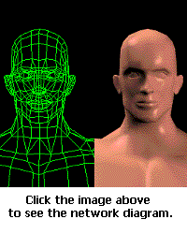
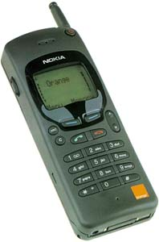

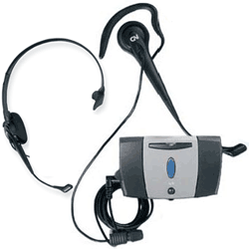
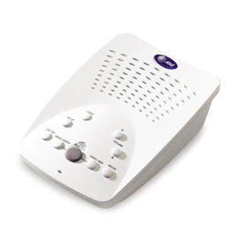

Multimedia Product Line
VCR Features:
Play Tape
Rewind Tape
Forward Tape
Button Control
Signal Handling
Answering machine Features:
Play Announcement
Record Announcement
Rewind Announcement
Play Message
Record Message
Rewind Message
Forward Message
Display Messages
Button Control
Signal Handling
Audio Player Features
Play Tape
Record Tape
Rewind Tape
Forward Tape
Button Control
Signal Handling

Slide 38
Hyperspaces
Identification of all the concerns: multidimensional space, each axis represents a dimension of concern, points represent concerns in that dimension;
ARTIFACT
DomainModeling
Requirements
Hyperslice
(encapsulation & de-coupling)
Concerns that are declaratively complete. (i.e., inclusive closure).
Audio Player
Specifications
Answering Machine
VCP
Implementation
Signal
Handling
DisplayMsg
Play
Announcement Unit
ButtonControl
Rewind
Forward
Record
FEATURE
Line Circuitry
MessageDisplay
Play
Audio Tape Unit
Controller
Video Tape Unit
CLASS
Hypermodules (integrated product)
Integrated hyperslices and integration relationships

Slide 39
Prototyping
Domain Modeling Tool
Domain Model
(information
features)
DM Prototyper
Evolving
System
retest prototype
modify/create new prototype
modify model /prototyping capability
Notes:
While the domain model provides enough information to build systems, automatic prototyping provides the capability to validate the model, to easy application development, and to understand the range of capabilities possible from the selection of features.
To meet this need for integration, the domain modeling tool must support both domain model creation and model-based prototyping.
Using domain modeling tool, the domain analyst documents the domain model and implements a prototyping capability
The prototyper allows implementation of a working model of the system under development based on a selection of features.
The fidelity of the prototype is a function of
completeness of the domain model (how many features within the domain have been captured)
implementation of code generation capability in the prototyper for those features
As the domain model matures, more features will be captured in the domain model and as prototyping verifies parts of the model, th prototyping capability will be increased.
The loops in the figure shown the pattern of development of both the model and the prototyper to validate the model.
The outermost loop shows model evolution
as the domain analyst captures more information, the model is expanded or changed to reflect this new information.
In parallel with domain model development, the domain analyst will construct a working model of the domain via the prototyper. A selection of features captured in the domain model will be built into the prototyper to allow both validation of the domain model (Does the model capture the common features of systems in the domain?) and prototyping of a system under development.
The loops attached to the prototyper show the ability of the domain modeling tool to test new system capability.
giving an existing model, the prototyper allows the selection of the features to implement a prototype for a system under development. The user may change these selection interactivelyct selection of features, or to incorrect implementation of the features within the prototyper.
The prototyper support both the model developer (domain engineer) and the system developer (application engineer)
domain engineer gets feedback on correctness and completeness of model
application engineer gets a sense fo the capabilities of a new system and the effect of selecting alternative or optional features.

Slide 40
14.5 A PL Analysis Example
Product line 1: safety
  DSSS: Driving Safety Support Systems
  HELP: Help system for Emergency Life saving and Public safety
  FAST: Fast Emergency Vehicle Preemption systems
Product line 2: control
  DRGS: Dynamic Route Guidance Systems
  MOCS: Mobile Operation Control Systems
  ITCS: Integrated Traffic Control Systems
  PTPS: Public Transportation Priority Systems
Product line 3: information management
  EPMS: Environment Protection Management Systems
  IIIS: Intelligent Integrated ITV Systems
  AMIS: Advanced Mobile Information Systems
  PICS: Pedestrian Information and Communication systems

Slide 41
14.6 Ultra-large Scale Systems
Software moving in two directions
  ubiquitous & increasingly of public importance
    high quality software becoming critical in our daily lives, our safety & security, in national and global economies
  becoming very, very large
    increasingly very complex in thousands of platforms
    pushing fast & far beyond what we can comprehend
      Thousands of millions of lines of code
      Hundreds of thousands of people employing systems for different purposes
      Billions of connections and interdependencies among architectural components
      Trillions of amount of data stored, accessed, manipulated

Slide 42
14.6 Ultra-large Scale Systems
ULS systems distinguishing characteristics
  operational independence
  managerial independence of the elements
  evolutionary development
  emergent behavior
  geographic distribution

Slide 43
14.6 Ultra-large Scale Systems
Furthermore, characteristics of ULS systems that will arise because of their scale include:
  decentralization of data, development, evolution, and operational control.
  inherently conflicting, unknowable, and diverse requirements.
  continuous evolution and deployment.
  heterogeneous, inconsistent, and changing elements.

Slide 44
14.7 Summary
We have argued establishing a
  causal relationship between models representing reusable assets, created by applying first principles, and
  the application of these models to actually develop the delivered application, by the routine application of solution models

Slide 45
14.7 Summary
Organizations must invest in creating models of the common capabilities of related software products.
  development-for-reuse process to create software assets
  development-with-reuse process to create specific systems with these prefabricated assets
Institutionalization of systematic reuse requires attainment of “economies of scope.”

Slide 46
14.7 Summary
Component-based development focuses on structure of a set of components, embodying features within a domain, leveraging prior investment to maximum degree in support of developing multiple products.
Components, objects, and architectures will all be important parts of the next generation of software development technologies.

Slide 47
14.7 Summary
Architectural style: a description of component types and a pattern of their interaction.
  Architecture styles are not architectures, however they represent, in a very high level sense, families of related systems.
  A related concept is that of a reference model, which specifies a division of functionality into conceptual components, i.e., a standard decomposition of a known problem into parts that cooperatively solve the problem.

Slide 48
14.7 Summary
Product Line Architecture (PLA) (i.e., solution models), rather than single-product architecture, supports systematic reuse
  represent architectures (i.e., components and their interfaces) suitable for solving typical problems in the domain
  depicts structure for design of related products and provide models for integrating optional/alternative components
  allows engineers to come up with the “right” solution quickly and effectively

Slide 49
14.7 Summary
This also represents a main motivation for component-based software engineering:
  a desire to modularize a system in such a way that there is a high probability that significant portions of the system can be built from “standard” parts –at least within an application domain.
  Component designs specify the structure for the explicit variability of components across products; they serve as models for specifying and encapsulating commonality.

Slide 50
14.7 Summary
Object-oriented technology does provide superior technical support for code reuse, however it by itself is not enough for institutionalized systematic reuse.
  One problem with object-oriented development is the low level of granularity of the assets being reused.
  Object-oriented systems are typically monolithic pieces with difficult to detach “components.”
  Current object-oriented component technology (including JavaBeans, ActiveX, COM, etc) imposes severe constraints on the components, tightly coupling them to implementation infrastructure.
  Truly reusable components must be specified as free of constraints as possible.

Slide 51
14.7 Summary
An important change in the traditional object-oriented analysis process to accommodate for systematic reuse is the need for a more formal variability analysis.
  Product line domain analysis must be done (not just domain analysis of one application domain) with emphasis on variability analysis.
  It is also important to keep domain-independent, product Line, and product-specific components apart and possibly physically separate

Slide 52
14.7 Summary
In conclusion, object technology is in fact neither necessary nor sufficient for systematic reuse.
The properties of adaptability and composability are not yet automatically achieved by applying object-oriented concepts.
Identifying flexibility and designing mechanisms that control this flexibility is the real issue.

