Slide 1
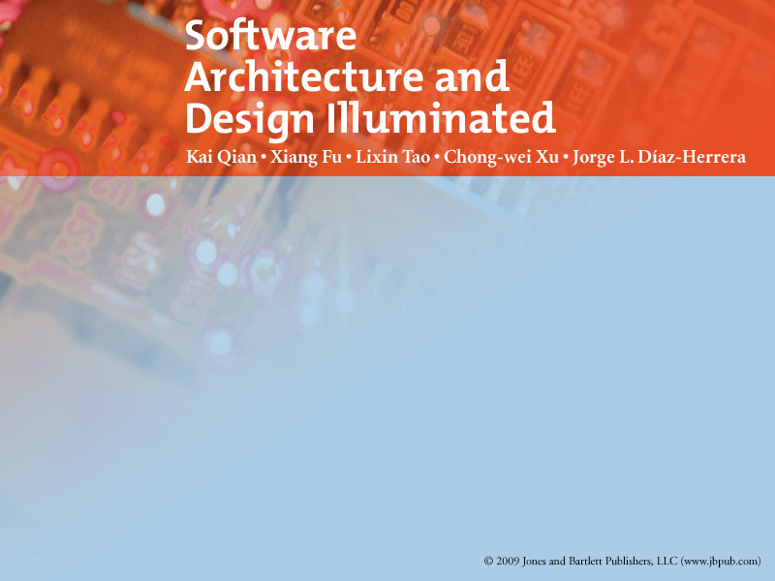
Chapter 10
DISTRIBUTED ARCHITECTURE

Slide 2
Objectives
• Introduce the client-server and multi-tier architectures
• Introduce the broker architectures
• Introduce the service-oriented architecture

Slide 3
Agenda
Distributed System Introduction
Client-Server architecture
Multi-Tiers architecture
Broker architecture
Service oriented architecture

Slide 4
Introduction
A distributed system
  a collection of computational and storage devices connected
    through a communications network.
  data, software, and users are distributed.
  sub-systems or components communicate with each other by
    Message Passing
    Remote procedure call
    Remote method invocation, etc.
  2 important issues for designing a distributed system
    Network Topology
      The way in which entities are organized to form a connected network.
    Communications Mode
      The method by which components communicate with each other.

Slide 5
Can be modeled by
  The client-server architecture
  and this forms the basis for multi-tier architectures;
  The broker architecture
    Common Object Request Broker Architecture (CORBA)
  Service-Oriented Architecture (SOA).
      Web services
      Grid services.
The important features are
  service location transparency
  services reliability
  services availability.

Slide 6
There are several technology frameworks to support distributed architectures
  .NET
  J2EE
  CORBA
  .NET Web services
  AXIS Java Web services
  GloBus Grid services.

Slide 7
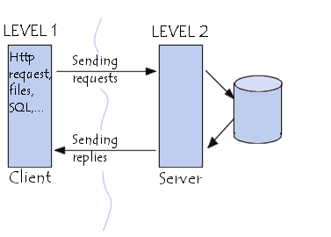
Client-Server

Slide 8
Client-Server
Benefits
  Separation of responsibilities such as user interface presentation and business logic processing.
  Reusability of server components.
Limitations
  Lack of heterogeneous infrastructure to deal with the requirement changes.
  Security complications.
  Server availability and reliability.
  Testability and scalability.
  Fat clients with presentation and business logic together.

Slide 9
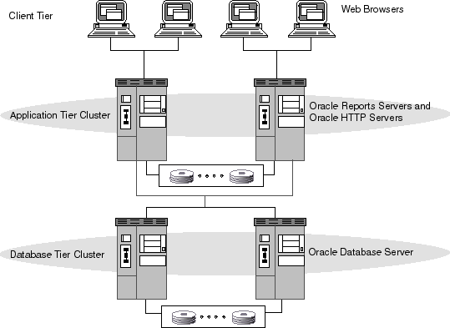
Multi-tiers

Slide 10
Multi-tiers
Benefits
  Enhancement reusability and scalability.
    Adding middle tier
      Have Portable design & Implementation
      Provide multi-threading supports for scalability.
  Reduce the traffic on the network
Limitations
  Testability
    Lack of testing tools
  Server reliability and availability is more critical issue.

Slide 11
Broker Architectural Style
A middleware architecture used in distributed computing
  to coordinate and facilitate communication between registered servers and clients.

Slide 12
Broker Architectural Style
A broker
  An invocation-oriented service
    clients send invocation requests for brokering
  A document or message- oriented broker
    clients send a message (such as an XML document).
The most important quality attributes is
  Better decoupling between clients and servers
    clients and server components are decoupled through the use of a broker.
Called the proxy-based system.

Slide 13
Broker Architectural Style
Servers register and publish their interfaces with the broker.
Clients can look-up and request the services of servers from the broker.
A broker component is responsible for coordinating communications
  Brokering the service requests
  Locating a proper server
  Forwarding and Dispatching requests
  Sending responses or exceptions back to clients.

Slide 14
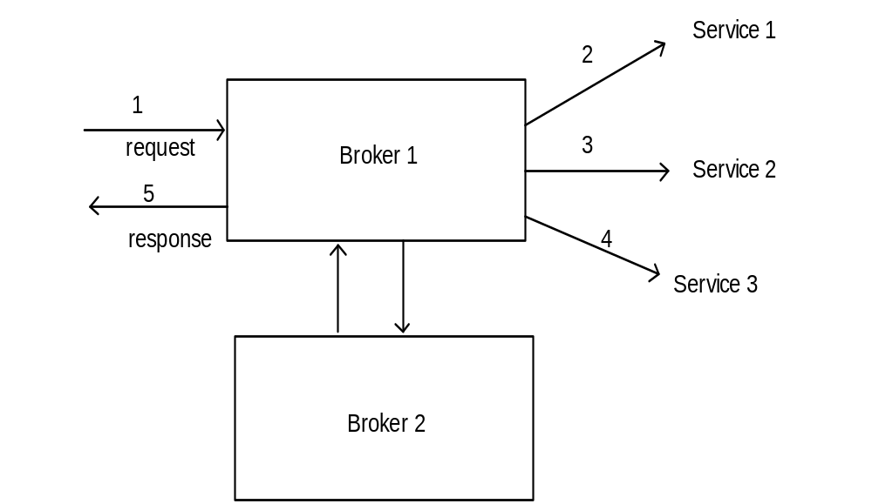
Figure 10.3 Broker model

Slide 15
Broker Architectural Style
With the broker pattern, a distributed client can access distributed services
  Simply by calling a remote method of a remote object
    just as if it were a local method call.
  The clients can dynamically invoke the remote methods
    even if the interfaces of the remote objects are not available at the compilation time
  Note: only need to obtain a reference to the appropriate object, instead of writing detailed code for protocol-oriented communication.

Slide 16
Broker Architectural Style
Similar to
  Remote Procedure Call (RPC) in Unix distributed structured programming
  Remote Method Invocation (RMI) in Java distributed object-oriented programming.
CORBA (Common Object Request Broker Architecture) is a good implementation example.

Slide 17
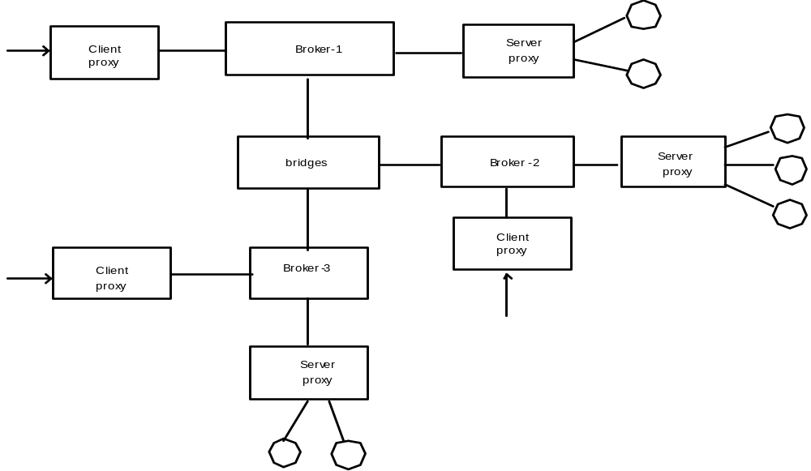
Connected brokers with client-server proxy

Slide 18
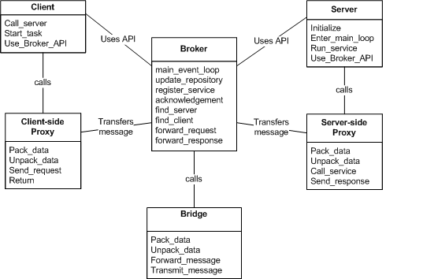
Broker class diagram

Slide 19
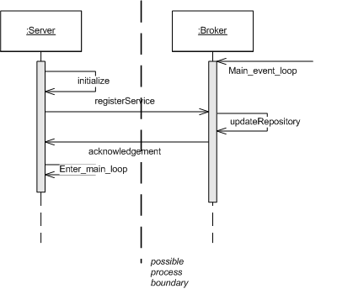
Server registration

Slide 20
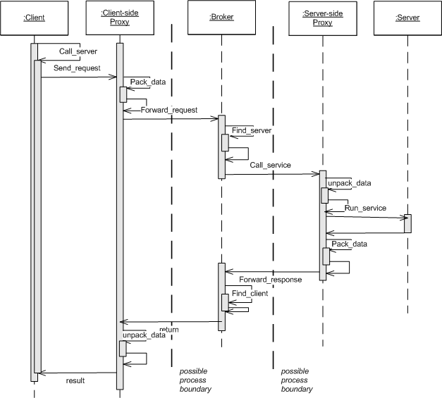
Client requests service

Slide 21
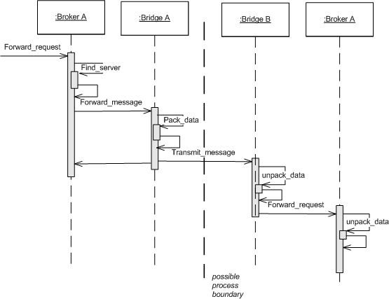
Broker forwards request

Slide 22
Broker with client-server proxy
Decompose the broker architecture into 5 sub-components:
  Broker:
    Co-ordinates communications
      passes on requests and returns replies.
    Keeps all servers registration information
      including their functionality and services as well as location information.
    provides APIs for
      clients to request
      servers to respond
      registering or unregistering server components
      transferring messages
      locating servers

Slide 23
Broker with client-server proxy
  Stub (client-side proxy):
    Mediates between client and broker
    Provides additional transparency between them.
    To the client, a remote object appears like a local one.
    The proxy hides
      the inter-process communication at protocol level
      performs marshalling of parameter values
      Performs unmarshalling of results from the server.
    Is generated at the static compilation time and deployed to the client side to be used as a proxy for the client.

Slide 24
Broker with client-server proxy
  Skeleton (server-side proxy):
    Is statically generated by the service interface compilation and then deployed to the server side.
    Encapsulates low-level system-specific networking functions
    Provides high-level APIs to mediate between the server and the broker.
    Receives the requests, unpacks the requests, unmarshals the method arguments, and calls the appropriate service.
    Marshals the result before sending it back to the client.

Slide 25
Broker with client-server proxy
  Bridges:
    optional components are used to hide implementation details when two brokers interoperate.
    Encapsulates underlying network detail implementation and mediates different brokers such as
      DCOM.
      .NET Remote brokers.
      Java CORBA brokers.
    Take requests and parameters in one format and translate them to another format.
    Can connect two different networks based on different communication protocols.
  Network: The connections between the components are the network with designated protocol standards such as
    TCP/IP – Internet protocol
    SOAP – Simple Object Access Protocol.

Slide 26
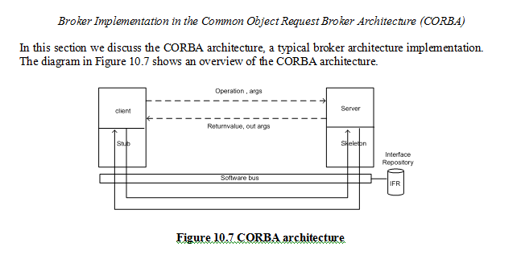
Broker with client-server proxy

Slide 27
Broker with client-server proxy
Benefits
  Server component implementation and location transparency.
  Changeability and extensibility.
  Simplicity for clients to access server and server portability.
  Interoperability via broker bridges.
  Reusability.
  Feasibility of runtime changes of server components
    add or remove server components on the fly.
Limitations
  Inefficiency
    due to the overhead of proxies
  Low fault-tolerance
  Difficulty in testing
    due to the amount of proxies

Slide 28
Service-Oriented Architecture (SOA)
A service is a business functionality
  Well-defined
  Self-contained
  Independent from other services,
  published and available
    to be used via a standard programming interface.
Software manages business processes through a SOA
  with well-defined and standard interfaces
    can build, enhance, and expand their existing infrastructure more flexible.

Slide 29
Service-Oriented Architecture (SOA)
SOA services can be
  Extensively reused within
    a given domain
    product line
    and even among legacy systems.
Loose coupling of service–orientation
  Provide great flexibility for enterprises to make use of all available service recourses regardless of platform and technology restrictions.
The connections between services
  are conducted by common and universal message oriented protocols
    SOAP Web service protocol
      which can deliver requests and responses between services loosely.
  Can be established statically or dynamically.

Slide 30
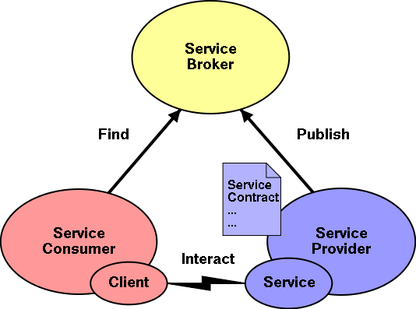
Service-Oriented Architecture (SOA)

Slide 31
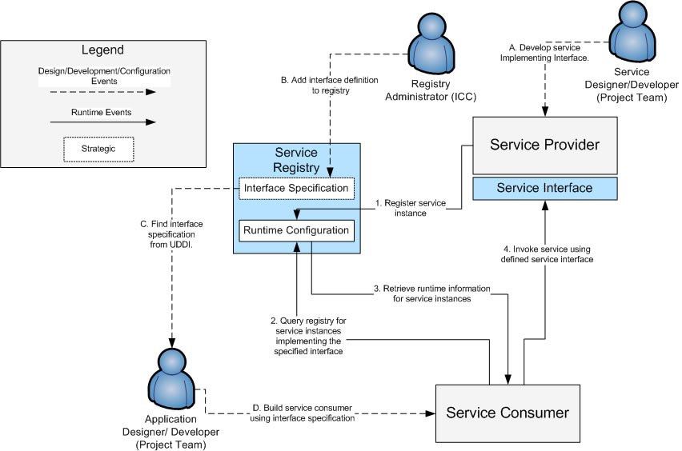

Slide 32
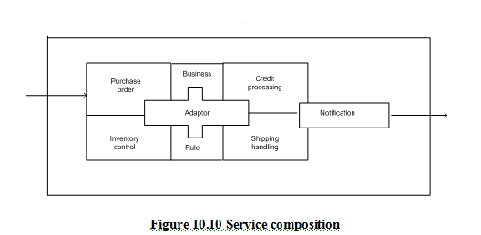
Service-Oriented Architecture (SOA)

Slide 33
Service-Oriented Architecture (SOA)
Benefits:
  Loosely-coupled connection:
    Loose-coupling is the key attribute of SOA.
  Each service component is independent from other services
    Due to the stateless service feature.
  Much easier to evolve and update.
    The implementation of a service will not affect the application of the service
      as long as the exposed interface is not changed.

Slide 34
Service-Oriented Architecture (SOA)
Benefits:
  Interoperability: Technically any client or any service can access other services regardless of their
    Platform
    Technology
    Vendors
    Language implementations.
  Reusability: Any service can be reused by any other service.
    Because clients of a service only need to know its public interfaces service composition and integration become much easier.
  More efficient in term of time and cost

Slide 35
Service-Oriented Architecture (SOA)
Benefits:
  Scalability: Loosely coupled services make themselves easy to scale.
    The coarse-grained, document-oriented, and asynchronous service features enhance the attribute.

