Slide 1

Chapter 11
COMPONENT-BASED SOFTWARE ARCHITECTURE

Slide 2

Objectives
• Introduce concepts of the software components
• Discuss UML notations for component-based architectures
• Introduce principles of component-based design
• Introduce quality attributes of component-based design

Slide 3
Overview
Divides the problem into sub-problems each associated with component partitions.
The interfaces of the components
  play important roles.
The main motivation is
  component reusability;
    a component encapsulates functionality and behaviours of a software element into a reusable and self-deployable binary unit.

Slide 4
Overview…
Designers can
  Use existing reusable components
    Commercial off the shelf (COTS)
    In house-developed
  May produce reusable components for future reuse.
This increases overall system reliability
  Since the reliability of each individual component enhances the reliability of the whole system via reuse.

Slide 5
Overview…
There are many standard component frameworks such as
  COM/DCOM,
  JavaBean,
  EJB,
  CORBA,
  .NET,
  Web services,
  Grid services.
These target component technologies are widely adopted in local desktop GUI application design
  Graphic JavaBean components,
  MS ActiveX components,
  COM components

Slide 6
Overview…
The combination of service-oriented and component technologies
  Getting more attention today
  include of
    Web services.
    Grid services.

Slide 7
What is A Component
A component is
  A modular (i.e., cohesive)
  Deployable software package (i.e., portable)
    provide services to its clients;
    require services from other components
  Replaceable (e.g., plug-and-play)
  Reusable set of well-defined functionality
    that encapsulates its implementation and exporting it as a higher-level interface.
A component should be
  self-contained
  substitutable
    as long as its interface is unchanged.

Slide 8
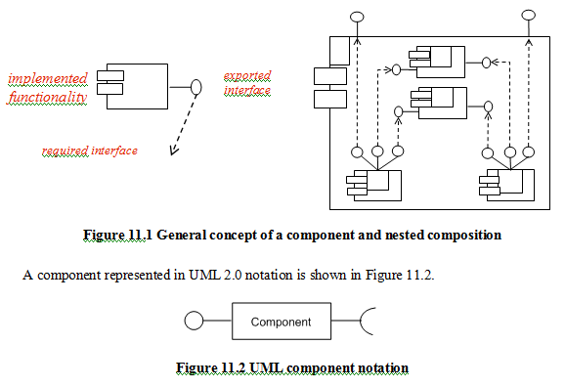

Slide 9
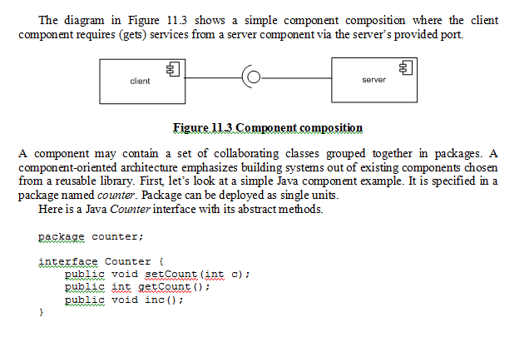

Slide 10
Component-oriented design
Is at a higher level of abstraction
  Than object-oriented design.
A component is a higher-level concept
  incorporating more than one class.
We identify all components and their interfaces first
  instead of identifying classes and their relationships.

Slide 11
Component-oriented design
Component-oriented advantages :
( compare with object-oriented ):
Reduced by reuse of existing components.
  Time to market and
  The development cost
Increased reliability
  With the reuse of the existing components.

Slide 12
Component-Based Design Principles
Decomposed the software system into
  Reusable,
  cohesive and
  encapsulated component units.
Each component
  Has its own interface
  Hides its detailed implementation.
    Each component can be seen as a black box building block grouping functionalities and data cohesively

Slide 13
Component-Based Design Principles
Components interaction can take the form of
  Method invocations
  Asynchronous invocations
    Event listener and registrations
    Broadcasting, message driven interactions
  Data stream communications
  Other protocol specific interactions.
The interaction type
  Is specified by the interfaces of the components.

Slide 14
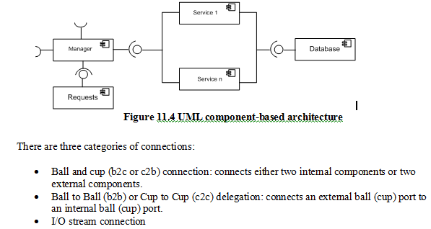

Slide 15
Figure 11.4 shows a component-based software architecture.
The manager component gets service support from a single component (requests) and a combined service component sub-system (Service 1 and Service n), and the latter gets data access service from a database.
The whole software system is a set of components connected by their interfaces.
Each component may be replaced or updated without any changes of the other part of the system.

Slide 16
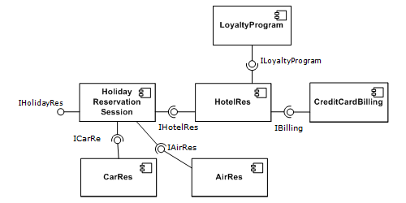

Slide 17
Component-Based Design Guidelines
Map Use Case diagrams to the provided service interfaces of the first-cut component specification.
The business concept diagram depicts the relationships of the business process entities in the domain,
  Extract these business process entities that can exist independently
    without any associated dependency on other entities.
    The current component needs these provided services from
  -> Can recognize and discover these independent entities as new components.

Slide 18
Component-Based Design Guidelines
A collaboration is any identifiable slice of functionality
  that describes a meaningful service, involving, in general, several concepts.
A collaboration can be seen as the implementation of a use case!
  Thus, for each use case U there will be a collaboration diagram “encapsulated” in a component C (one or more sequence diagrams will be drawn to exercise the use case through scenarios).
Figure 11.5 illustrates the component implementation of Use Case U (that happens to lay in between two other use cases).

Slide 19
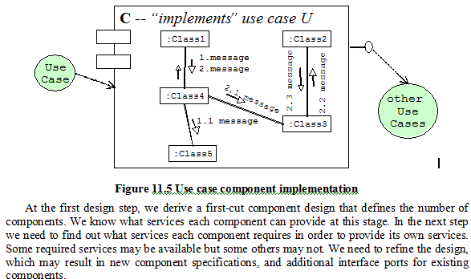

Slide 20
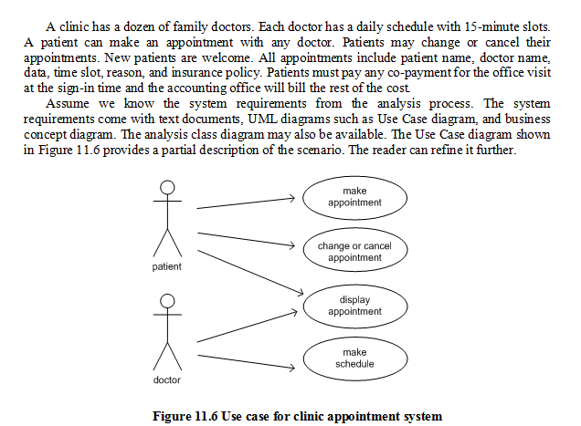

Slide 21
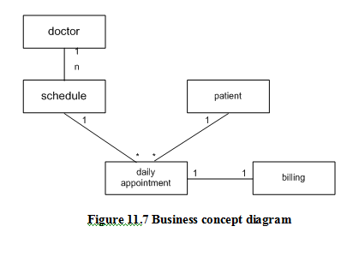

Slide 22
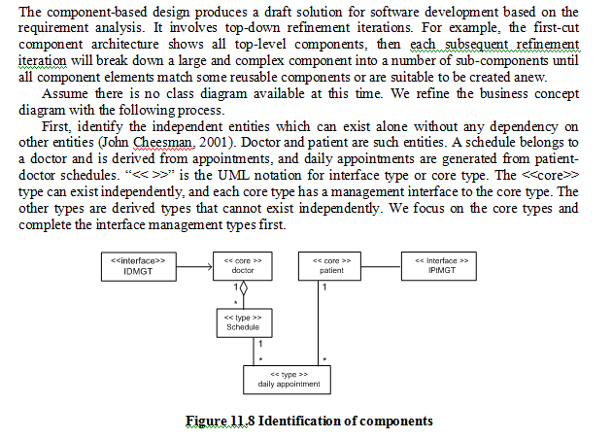

Slide 23
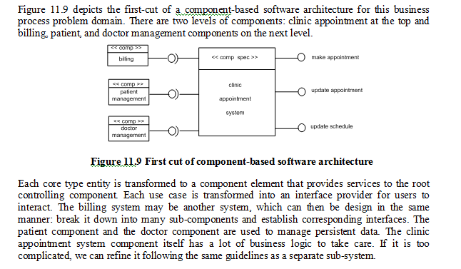

Slide 24
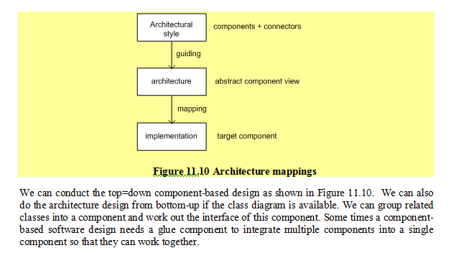

Slide 25
Component-based architecture
Applicable domain:
  Applications where the interface contracts between sub-systems are clear.
  Applications that require loose coupling between the components and many reusable components are available
  Suitable for the class library system organization.
    .NET class library and Java API themselves are built in component architecture.

Slide 26
Component-based architecture
Benefits:
  Reusability of components
  System maintenance and evolution
    Easy to change and update the implementation without affecting the rest of the system.
  Independency and flexible connectivity of components
  Independent development of components by different group in parallel
  Productivity for the software development and future software development
  Many OO design tools can also be used for Component-Based Software Development.

Slide 27
Component-based architecture
Limitations:
  Sometime it is difficult to find suitable available components to reuse.
  Adaptation of components is always an issue.
  Not many component-oriented design tools are available.

