Slide 1

Chapter 12
Heterogeneous Architecture

Slide 2

Chapter 12 Objectives
Introduce a general methodology of making architecture decisions.
Summarize the benefits and limitations of each architectural style.
Demonstrate how to apply the general principles in case study examples.

Slide 3
Motivation
Real-World Projects Are Complex!
Not likely One Architecture Suffices
Think About Designing a Castle
  Walls
  City Hall
  Civilian Housing ...
Notes:
1 min

Slide 4
Heterogeneous Arch.
Many ways to have heterogeneous arch.
(1) Hierarchical
  Components composed using on arch.
  Each component internally using a different one
(2) Mixture of Arch.
  E.g., filter of a pipe&filter arch. accesses central DB
Notes:
1 min

Slide 5
Our Plan
Study How to Select Architecture Styles
Go Through a Case Study
Notes:
0 min

Slide 6
Methodology of Architecture Decision
Question: Is the job of design to find one feasible solution? – No!
A Designer Has To
  Exhaust all possible solutions
  Pick up the best one
Task here:
  Given the list of architectural styles
  Pick up the best one
Notes:
1 min

Slide 7
Process of Choosing Style
Arch. Style Heavily Depends on Requirement Analysis
Example:
  Why does not DOS in 80’s runs in Kernel Mode?
  Limitation of the resources + different requirements (user’s in 80’s don’t care too much about crash of computers!)
Notes:
1.5 min

Slide 8
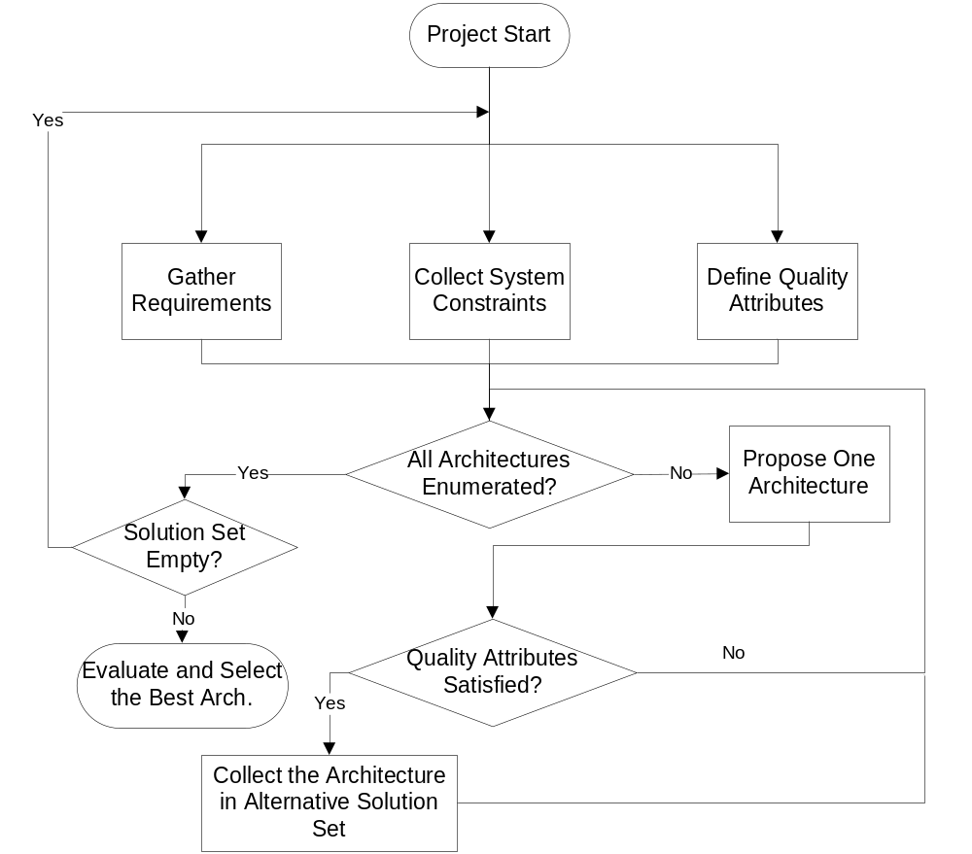
Flow Chart of Arch. Decision
Notes:
1.5 min explain the diagram.

Slide 9
Quality Attributes
Used to make architectural decision
Common Quality Attributes:
  Efficiency (time and space)
  Functionality (completeness, interoperability)
  Portability (hardware independence, installability)
  Reliability (error tolerance, availability)
  Usability (user interface, learnability)
Notes:
1.5 min

Slide 10
Architectural Decision Procedure
(1) Determine the required quality attributes in requirement analysis
(2) Quantify the quality attributes
  Many can be directly quantified
    E.g., time efficiency by throughput, latency, etc.
  Many should be assigned qualitative values first, then quantified
    E.g., “Excellent” → 100, “Average”→ 50, ...
(3) Compute the weighted sum
Notes:
1.5 min

Slide 11
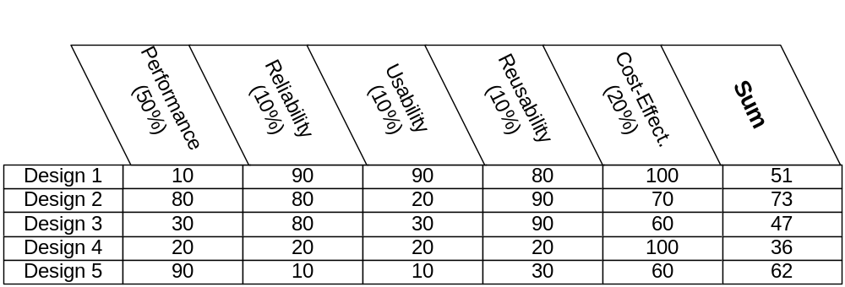
Example: Which to Choose?
Example: Weighted Sum of Design 1
10*50% + 90*10% + 90*10% + 80*10% + 100*20% = 51
Solution: Design 2
Notes:
2.5 min
Ask students to solve on board

Slide 12
Problems Solved?
Not Yet!
Decision Framework Done!
But How to Evaluate Architecture Design Against Quality Attributes?
Notes:
0.5 min
12.5 min now

Slide 13
Methods of Evaluating Arch. Style
Largely depends on designers’ expertise
However, tools available
  Engineering handbook
    E.g., typical applications such as DB app., Web App. – typical designs in textbook/handbook
  Qualitative Evaluation of Arch. Styles
    See diagram in next slide
Notes:
1 min

Slide 14
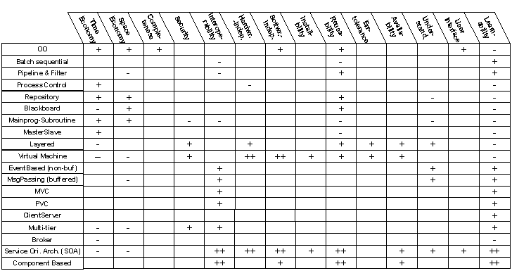
Notes:
1.5 min
Give examples

Slide 15
Evaluate System Arch. Design?
Many approaches available
  ATAM (Architecture Trade-off Analysis Method)
  SAAM (Software Architecture Analysis Method)
  ARID (Active Reviews for Intermediate Designs)
Notes:
1 min

Slide 16
SAAM (Software Architecture Analysis Method )
Idea: Evaluate design against Scenarios
Scenario
  Similar but different from use case
    Can contain situations not included in the scope of the project
Example:
  Given an online registration system
    Sample scenario: what if the internal registration form is changed?
    It tests the “modifiability” of the system
Notes:
1.5 min

Slide 17
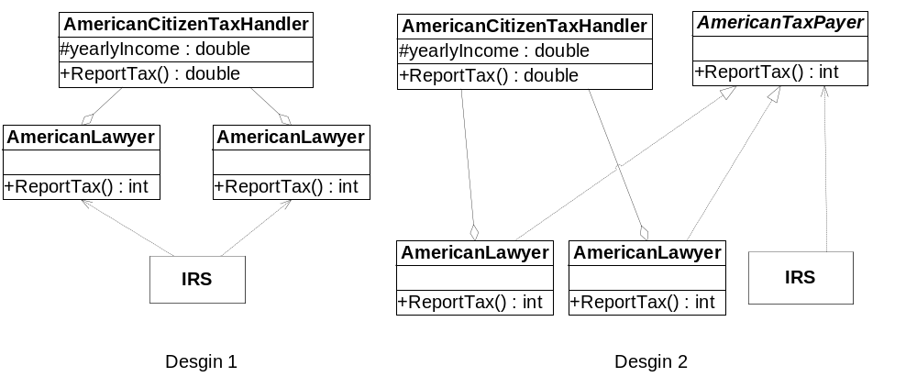
Case Study: Tax Payer Design
Notes:
Review 2 min

Slide 18
Design Objective: Tax Report Processor
Functionality:
  Process tax return forms
  Information incorporated into an tax payer object
  The object’s type determined by occupation of the tax payer
    E.g., AmericanLayer, AmericanProfessor, etc.
Notes:
1 min

Slide 19
Quality Attributes
System expandability.
  More occupation types can be added
    E.g., AmericanFarmer, AmericanBusinessOwner, etc.
System performance.
  Be able to process millions of cases per day
  Space efficiency is less concern
System modifiability
  Format of tax forms and the method of calculating tax rates change every year.
    System must be ready for such changes.
Notes:
1.5 min

Slide 20
Scenario 1: Expandability
Scenario 1:
  Add AmericanFarmer
  What will happen?
Notes:
0.5 min

Slide 21
Scenario 2: Performance
Scenario 2:
  Do a virtual testing.
  How will the system behave if it has to process 1 million tax payers per day?
Notes:
0.5 min

Slide 22
Scenario 3: Modifiability
Scenario 3:
  change the tax rate calculation method (e.g., to change the rules of itemized deduction).
Notes:
0.5 min

Slide 23
Evaluating Scenario 1
Scenario 1:
  Add AmericanFarmer, What will happen?
Design 2 is better!
Notes:
1.5 min

Slide 24
Evaluating Scenario 2
Scenario 2:
  How will the system behave if it has to process 1 million tax payers per day?
Both designs have similar performance!
Notes:
1.5 min
Discuss if they can satisfy the needs.

Slide 25
Evaluating Scenario 3
Scenario 3:
  change the tax rate calculation method (e.g., to change the rules of itemized deduction).
Both ok. Any refinements?
Notes:
1.5 min
28.5 min now
Inheritance will be better. Add a rule calculation base class to be inherited by AmericanLayer and so on.

Slide 26
OCV (Online Computer Vendor)
Business Ideology:
  Sell computers directly!
Consumer order online
  ➔ Parts Ordered
    ➔ Product Assembled
      ➔ Product Shipped
Benefits:
  Low inventory cost & maximize efficiency
Notes:
1 min

Slide 27
Requirement 1
Web portal provided to customers
Order can be highly customized
  Allows configuration of products step by step
Customer can
  check out shopping cart,
  or save the shopping cart for later use.
Credit card the only acceptable payment method.
The web portal should be able to serve 10000 customers simultaneously.
Notes:
1.5 min

Slide 28
Requirement 2
A subsystem be provided to product designers.
When product released, the designer can input the basic configuration of the product
When the specification of the new product is done, the corresponding web pages should be automatically generated
Inventory DB and the subsystem for assembly lines should also incorporate the information immediately.
Notes:
1 min

Slide 29
Requirement 3
A subsystem should be developed to assist assembly lines.
Each worker on an assembly line is equipped with a computer system which shows the job details that the worker has to perform.
Notes:
1 min

Slide 30
Requirement 4
An automatic inventory management system should be developed to trace the inventory.
An automatic scheduler reports the estimated number of parts required every day.
The reports, if approved by business managers, are converted to parts orders to suppliers.
Notes:
1 min

Slide 31
Requirement 5
The whole OCVS system should bridge information among all departments to maximize the efficiency of the organization.
The involved departments include
  order processing department
  manufacture and shipping department
  product design engineers
  business strategy makers
Notes:
1.5 min

Slide 32
Requirement 6 (Quality Attributes)
Expandable
  new products can be easily added
  can expand to serve more customers.
  cost of system increases linearly
Modifiable
  Allows modification of internal representation of products and configuration process over the time.
  The business rules (e.g., parts usage prediction), web pages of products, and configuration process will go through frequent changes.
Notes:
1.5 min

Slide 33
Requirement 6
(Quality Attributes)
Reliable and available
  especially for the modules that interact with customers and manufacture line.
Time efficiency is required for all modules.
  Bottom line: Sell1 million PCs per year.
  Peak time requirement: to support 10000 customers simultaneously.
Notes:
1 min
9.5 min now

Slide 34
Two Steps
Selection of Architecture Style
High Level Design
Notes:
0.5 min
Ask students

Slide 35
Selection of Architecture Styles
Data Flow
  Batch & Sequential:
    Candidate: suitable for order processing process. Cons: low efficiency, assembly line support not covered yet.
  Pipe & Filter:
    Ruled out: data transferred among dept. is not stream
  Process Control:
    Ruled out: OCVS not in its application domain (e.g., embedded systems)
Notes:
1.5 min

Slide 36
Selection of Architecture Styles
Data Centric
  Repository
    Candidate: suits the needs for storing customer data and product configuration.
    Cons: the pure model forbids communication among system components.
  Blackboard
    Ruled out: OCVS not quite in its app. domain. Debugging and testing very hard
Notes:
1.5 min

Slide 37
Selection of Architecture Styles
Hierarchy
  Main-Subroutine
    Ruled out: OCVS has to support multiple tasks (e.g., order processing, inventory management and prediction, etc.). There is no need for a central coordinator.
  Master/Slave
    Ruled out: similar to Main-program-Subroutine.
  Layered
    Candidate: the services of OCV can be classified into layers.
  Virtual Machine
    Ruled out: OCVS is not in its application domain (e.g., machine simulation and porting of existing systems)
Notes:
2 min

Slide 38
Selection of Architecture Style
Implicit Invocation
  Event Based
    Ruled out: OCVS does not fall in its application domain (e.g., GUI applications)
  Buffered Message
    Ruled out: OCVS does not fall in its application domain.
Notes:
1 min

Slide 39
Selection of Architecture Style
Interaction Based
  MVC
    Ruled out: Although the web portal subsystem which interacts with customers may be a good candidate using MVC, the OCVS system has many other non-interactive sub-systems. Hence MVC is not the most appropriate architecture style for OCVS.
  PAC
    Ruled out: similar reason as MVC.
Notes:
1 min

Slide 40
Selection of Architecture Style
Distributed System
  Client Server
    Ruled out: the model does not suit the multiple components and multiple tasks of OCVS.
  Multi-tier
    Candidate: similar to layered system.
  Broker
    Ruled out: low efficiency and difficulty in testing.
  SOA
    Candidate: suits loosely coupled services and departments.
Notes:
1.5 min

Slide 41
Selection of Architecture Style
Component Based
  Candidate: suits loosely coupled services provided by OCV. It has very good support from UML. The architecture is very similar to SOA, except that SOA provides service directory (such as UDDI) to locate services, which is not needed here.
  Cons: data representation may not be as flexible as XML (semi-structured) representation in SOA.
Notes:
1 min

Slide 42
Finalists
Batch Sequential + Repository
Layered or Multi-tier
Service Oriented Architecture (SOA)
Component Based Architecture (CBA)
Notes:
0.5 min

Slide 43
SOA vs. CBA
Disadvantages of CBA (compared with SOA)
  Older technique than SOA
  No directory service such as UDDI (service yellow page)
Benefits
  Better efficiency
    No need to convert to XML, use binary data exchange
    Can be stateful (unlike SOA)
  No need for directory service because all components are well known inside
Notes:
1.5 min

Slide 44
Final Decision
CBA vs. Batch Sequential + Data Repository
  CBA wins (better support for concurrency)
How about multi-tier?
  Good for web-portal
  However, how about manufacturing system?
    Many components mixed on the same tier -> not clear cut → out
Final Decision: CBA
Notes:
1 min

Slide 45
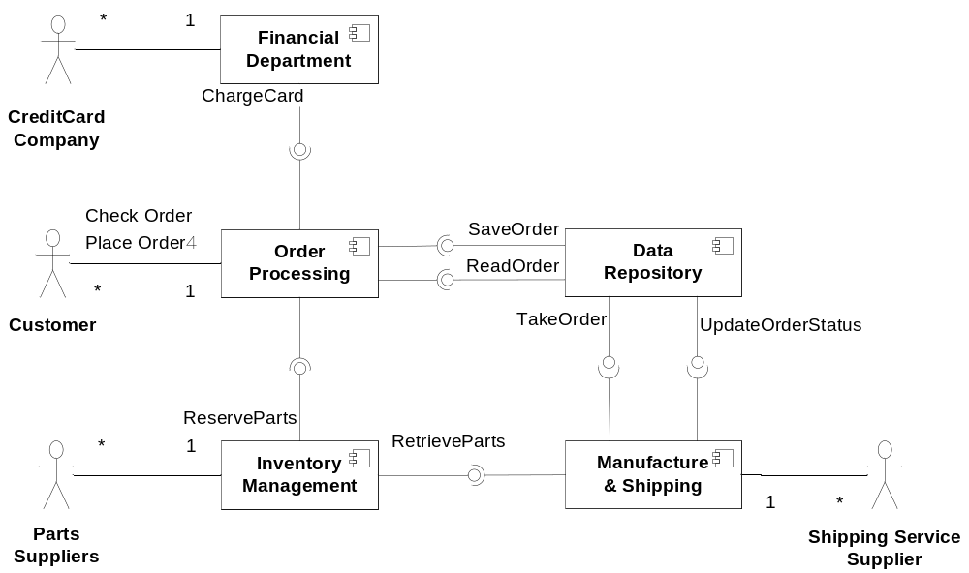
CBA Design
Notes:
1.5 MIN
ILLUSTRATE THE DIAGRAM

Slide 46
Is The Design Complete?
Req 1 (customer web portal)
  mapped to the Order Processing component.
Req 2 (insertion of product configuration)
  not satisfied by the architecture design.
  System analysts and software architects suggest removing this requirement.
  The argument is:
    to achieve Req 2, a specific product description language has to be defined and the corresponding language interpreter has to be implemented. Since OCVS does not release more than 20 products per year, there is really no need to build a product description language and interpretation system. A more convenient way is to insert product configuration modules into the order processing system manually by system engineer.
Notes:
1.5 min

Slide 47
Is the Design Complete?
Req 3 (computer assisted manufacture system)
  Mapped to the Manufacture & Shipping component.
Req 4 (smart inventory management)
  Mapped to the Inventory Management component.
Req 5
  Reflected in the design of the overall structure where the Data Repository component takes the charge of maintaining live data.
Notes:
1.5 min

Slide 48
Is the Design Complete?
expandability
  can be solved by manual addition of product configuration modules into the Order Processing component (not as good as the product description language solution, but much less costly).
Time efficiency and availability can be achieved through replication of components, e.g., Order Processing and Data Repository components.
modifiability
  Not handled well
  When internal data representations of customer profile or order details are changed, Data Repository and other correlated components have to be modified.
Notes:
1.5 min
30 min now

Slide 49
Order Processing Component
Similar to Order Processing System (OPS)
Which architecture style to use?
  MVC
    Good for separating presentation and business logic
  Component Based Architecture
    Good for functional division
Notes:
1 min

Slide 50
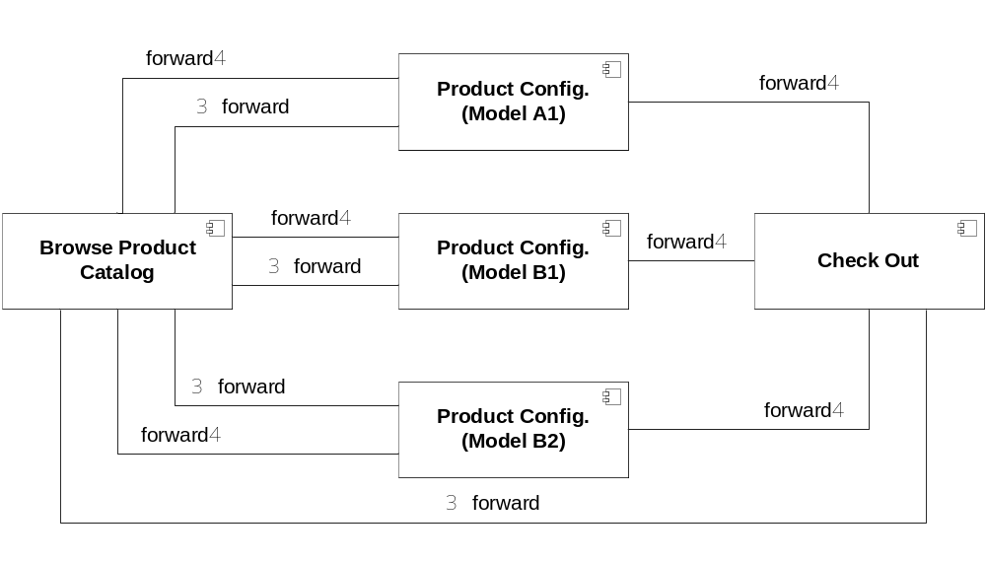
Architecture of OPC
Notes:
1 min
Explain each componetn is a set of JSP pages and java servlet

Slide 51
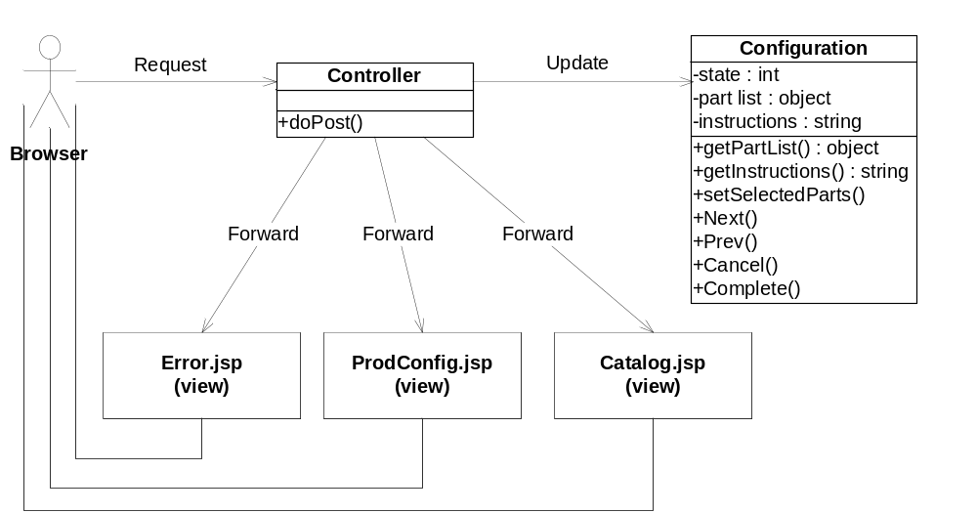
Drill Down: Product Configuration
Notes:
1 min

Slide 52
Why separate Controller and Configuration
Controller handles the details
  E.g., HTTP request parameters
Configuration class handles the business logic
Notes:
1 min

Slide 53
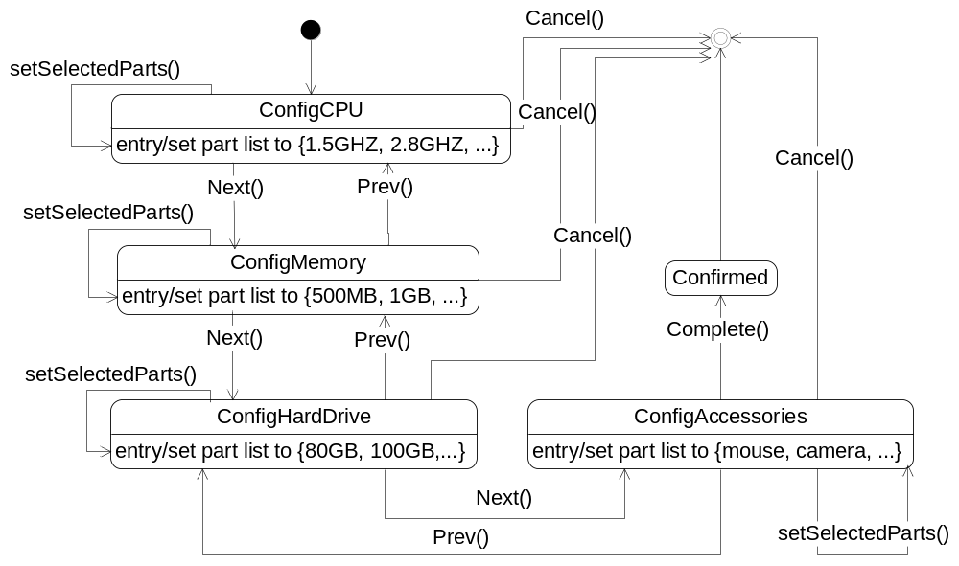
Drill Down: State Diagram
Notes:
1 min

Slide 54
Inventory Management
Requirements
  Manage all parts (CPU, disk, ...)
  Allows reservation for an order
  Interacts with manufacturing component to check out parts
  Routinely checks stock, generates order to suppliers
Needed components
  Backend DB
  Controller which interacts with others
  Satellite computers (barcode scanners) by workers
Notes:
1.5 min

Slide 55
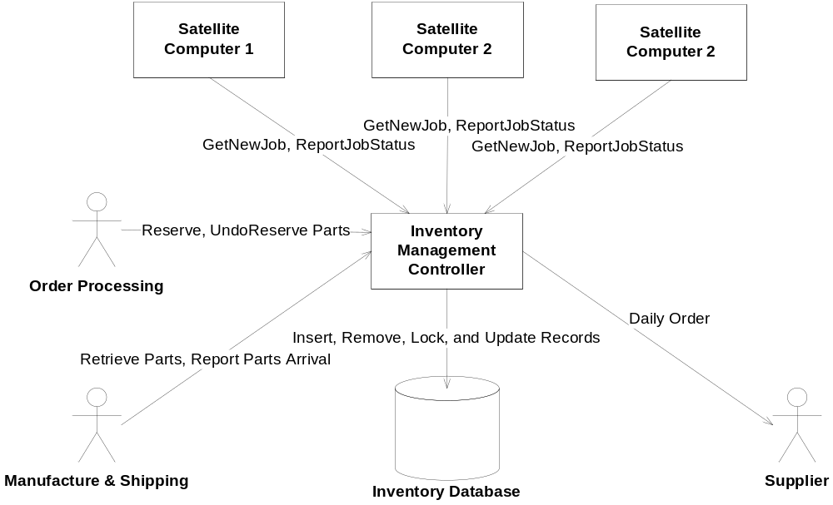
Architecture Selection
Which style?
  Data Repository + Client-Server (for satalite computers)
Notes:
1 min

Slide 56
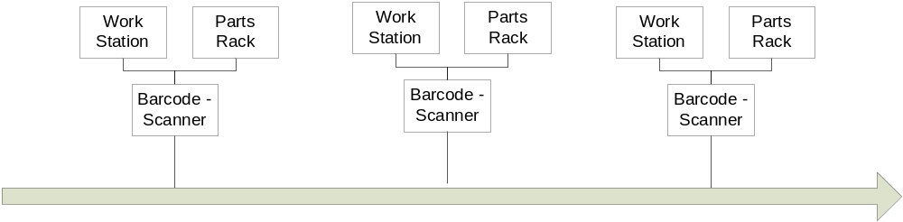
Manufacturing Department
Assembly Line
  Maximize unit efficiency
Notes:
1 min

Slide 57
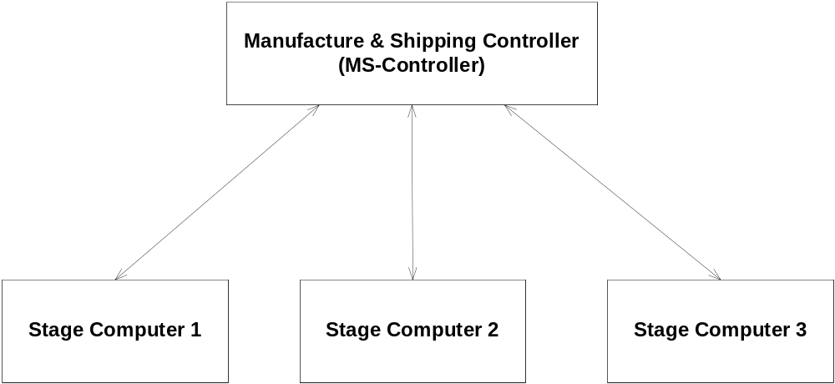
Architecture Style Selection
Which Style?
  Client Server
Notes:
0.5 min

Slide 58
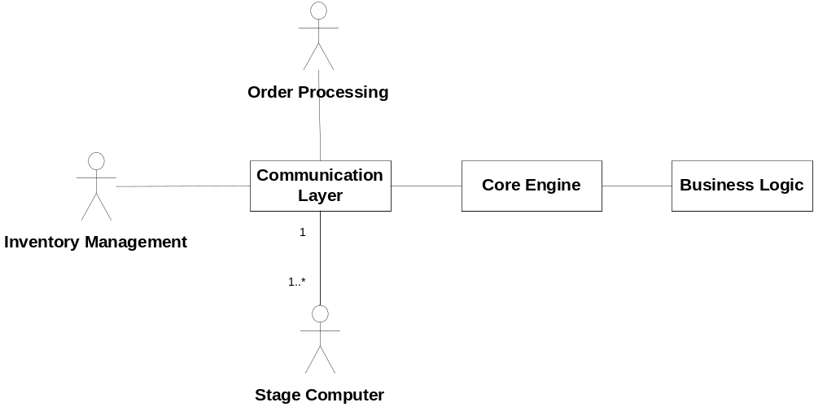
Design of Manufacturing and Shipping Controller
Requirements
  Interact with Inventory for smooth supply-chain
  Manage all stage computers for coordinating process
Architecture Selection: Layered Style
Benefits of separating them?
Notes:
1.5 min

Slide 59
Design of Core-Engine Module?
Architecture Selection?
  Event-Based!
Assembly Line Started
  Retrieve list of orders of the day.
  Send requests to inventory for parts
Parts delivered at one stage
  Based on part code, find the order which uses it and update the information.
  When all parts ready, triggers the all parts ready event.
Notes:
2 min

Slide 60
Design of Core Engine
All parts ready for an order
  Schedule job to one of assembly lines
  Consult business logic about split of manufacture process
  Map “logical stages” to physical stages
Chassis arrived at one stage
  Send job details to the stage computer
Parts malfunction
  Send instruction: “Pull the chassis off line ...”
  Send emergency parts retrieval requests
Notes:
2 min

Slide 61
Summary
Take the solution that works best even if it’s a mixed solution!
Notes:
0.5 min
45 min now

