Slide 1
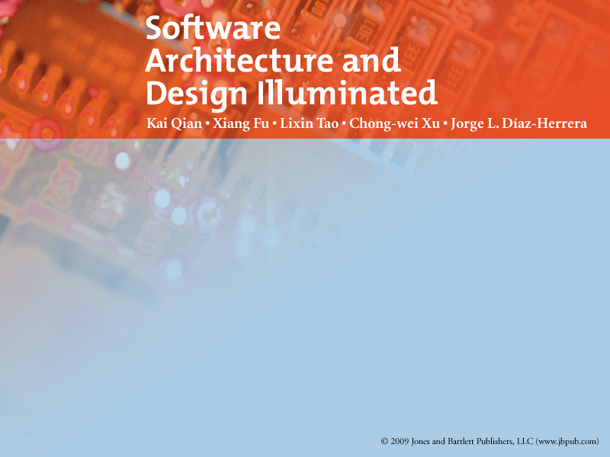
Chapter 1
INTRODUCTION TO SOFTWARE ARCHITECTURE

Slide 2

Objectives
Introduce the relationship between software requirements and architecture
Introduce the relationship between architectural styles and architecture
Introduce the elements of software architecture
Describe quality attributes trade-off analysis

Slide 3
Software Architecture
Definitions
  IEEE Std 1471
    the system architecture as “the fundamental organization of a system
      embodied in
        its components,
        their relationships to each other, and to the environment
        the principles guiding its design and evolution.
  Shaw and Garlan (1996)
    software architecture as the description of
      elements that comprise a system,
      the interactions and patterns of these elements,
      the principles that guide their composition
      the constraints on these elements.

Slide 4
Software Architecture
Architects use various design strategies in software construction
  To divide and conquer the complexities of a problem domain
  To solve the problem.
A good software design
  Reduces risks in software production,
  Coordinates development teams to work together orderly
  Makes the system traceable for implementation and testing
  Leads to software products have higher quality attributes.

Slide 5
Software Architecture…
The input of software design
  Software Requirements Specification (SRS).
    is the result of requirement analysis
      functional and non-functional requirements that must be met by the software system.

Slide 6
Software Architecture…
The output of software design
  Software Design Description (SDD).
    Includes
      the software architecture or high-level design
      the detailed design of the system.
    The blueprint for the implementation phase.
    Describes
      the components of a system
      the modules that comprise each component
      the detailed information of each module, such as
        Data attributes
        Operations
        Algorithms.
  =>The system is then implemented using programming language, debugging, testing, and maintenance.

Slide 7
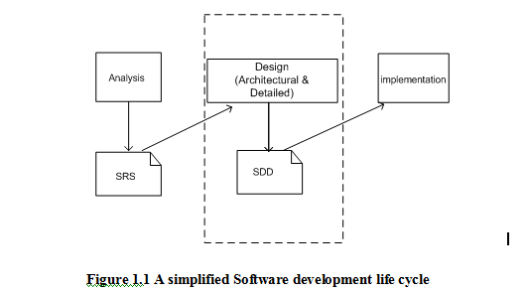

Slide 8
Software Architecture…
Sample outline of SDD based on IEEE Std 1016.
  Design overview, purpose, scope
  Decomposition description
    Module
    Data
    Process
  Dependency and connection description
    between modules, data, processes
  Attributes
  User interface description
  Detailed design
    module and data

Slide 9
Software Architecture…
Software design stage can be split into 2 steps
  Architectural design step
    we describe
      user accessible components
      the interconnections among them
        visible to stakeholders
  Detailed design step.
    we specify
      The internal details of each component
      Might introduce new invisible components
        to the stakeholders.

Slide 10
Software Architecture
Bridging Requirements and Implementation
  Software architecture plays a very important role in software development.
The architectural design
  embodies earliest decisions
    that have a decisive impact on the ultimate success of the software product.

Slide 11
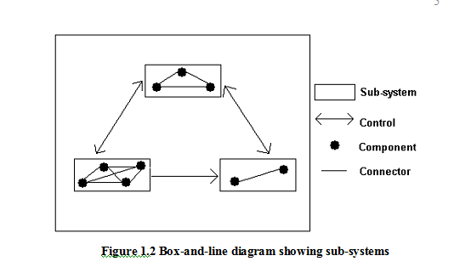
Software Architecture

Slide 12
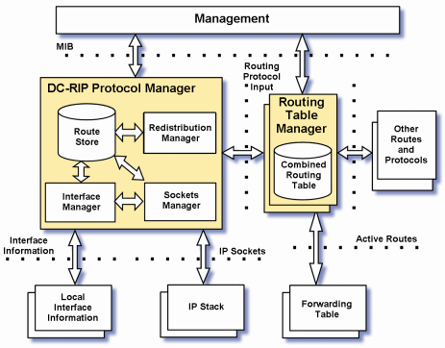
Software Architecture

Slide 13
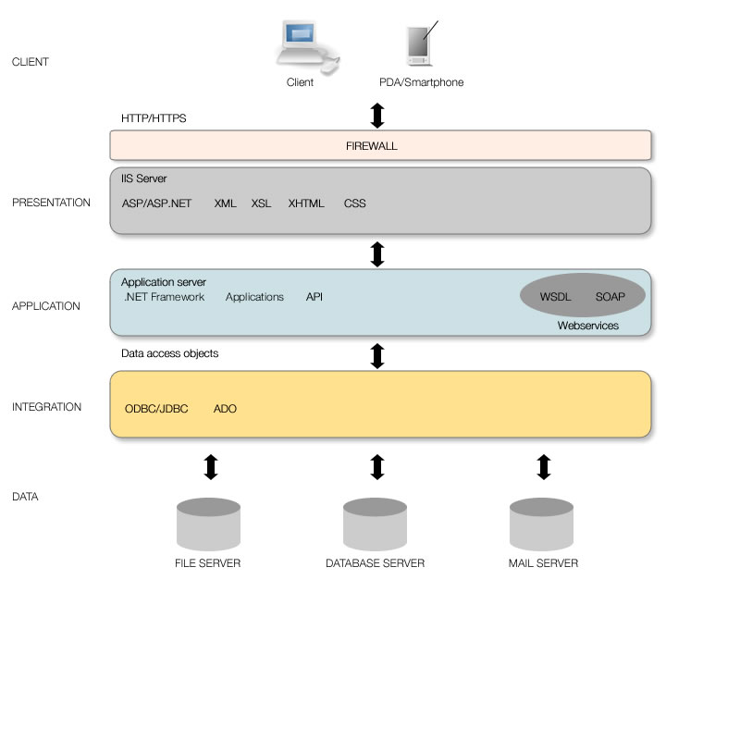
Software Architecture

Slide 14
Architectural Styles
Abstracts the common properties of a family of similar designs.
Also known as “architecture pattern”
contains a set of
  rules, constraints, and patterns of how to structure a system into a set of
    elements and connectors.
Governs the overall structure design pattern of
  constituent element types and their runtime interaction of flow control and data transfer.

Slide 15
Architectural Styles
Key components of an architectural style are:
  Elements
    that perform functions required by a system
  Connectors
    that enable communication, coordination, and cooperation among elements
  Constraints
    that define how elements can be integrated to form the system
  Attributes
    that describe the advantages and disadvantages of the chosen structure

Slide 16
Architectural Styles
In this course, we will discuss about:
  Batch Sequence, Pipe & Filter, Process Control (Data Flow)
  Repository, Blackboard (Data Centered)
  Object-Oriented
  Layered, Virtual Machine, Main/Subroutine (Hierarchy)
  Multi-tier, Client/Server (Distributed)
  Event-Based, Buffered Messaging (Asynchronous Communication)
  MVC, PAC (Presentation-Abstraction-Control, ) (Interaction Oriented)

Slide 17
Software architect’s tasks
Perform
  System static partitioning
  System decomposition into sub-systems and communications between sub-systems.
    A software element can be
      configured, delivered, developed, deployed and is replaceable in future.
    Each element has its interface
      that encapsulates details and provides loose coupling with other elements or sub-systems.

Slide 18
Software architect’s tasks
Establish dynamic control relationships
  between different sub-systems in terms of
    Data flow
    Control flow orchestration
    Message dispatching.
Consider and evaluate
  alternative architecture styles for the problem at hand.
Perform trade-off analysis on quality attributes and other non-functional requirements
  during the selection of architecture styles.
The most important jobs
  To map the software requirements specification to the software architecture
  To guarantee that the software architecture satisfies
    functional and non-functional requirements.

Slide 19
Quality Attributes
Are closely related to architectural styles.
  Each architectural style
    supports some quality features.
    has its advantages, disadvantages and potential risks.
      Choosing the right architectural style to satisfy
        required quality attributes is also very important in addition to function satisfaction.
Are identified in the requirement analysis process.
An architectural style encapsulates tradeoffs among many conflicting quality attributes.

Slide 20
Quality Attributes
List of sample quality attributes:
Performance
Reliability
Portability
Usability
Security
Testability
Maintainability
Availability
Flexibility
Interoperability
Scalability.
Time to market
Cost
Life time

Slide 21
Quality Attributes
Classifications
  Implementation attributes
    not observable at runtime
  Runtime attributes
    observable at runtime
  Business attributes

Slide 22
Implementation attributes
Interoperability:
  Refers to the universal accessibility and
  The ability to exchange data with internal components and the outside world.
  It needs loose dependency of infrastructure.
Maintainability & extensibility:
  Refers to the ability to modify the system and extend it conveniently.
Testability:
  Refers to the degree
    to which the system facilitates the establishment of test cases.
  Usually requires a complete set of documentation accompanied with system design and implementation.

Slide 23
Implementation attributes
Portability:
  Refers to the level of independence of the system on software and hardware platforms.
    Systems developed using high-level programming languages usually have good portability.
    Ex : Java
      most Java programs need only be compiled once and can run everywhere.
Scalability:
  Refers to the ability to adapt to an increase of user requests volume.
  It disfavors bottlenecks in system design.

Slide 24
Implementation attributes
Flexibility:
  Refers to the ease of modification of a system to cater for different environment or problems
    for which the system is originally not designed.
  Ex : Systems developed using the component based architecture or the service-oriented architecture usually possess this property.

Slide 25
Runtime attributes
Availability:
  Refers to the ability of a system to be available 24x7.
    Availability can be achieved via replication and careful design to cope with failures of hardware, software, or the network
Security:
  Refers to the ability to cope with malicious attacks from outside or inside of the system.
    Security can be improved by installing firewalls and establishing authentication and authorization processes, and using SSL and encryption.

Slide 26
Runtime attributes
Performance
  Refers to increasing efficiencies such as
    Response time
    Throughput
    Generally resource utilization
    -> which most of the time conflict with each other.
Usability
  Refers to the level of “satisfaction” from a human perspective in using the system.
    Includes
      completeness
      Correctness
      Compatibility
      more critically user friendliness.

Slide 27
Business attributes
Time to market
  Refers to the time it takes from requirement analysis to the date product is released.
Cost
  Refers to expense of building, maintaining, and operating the system.
Lifetime
  Refers to the period of time that the product is “alive” before retirement.

Slide 28
Quality attributes trade-off
Tradeoff between space and time.
  Ex: to increase the time efficiency of a hash table means to decrease its space efficiency.
Tradeoff between reliability and performance.
  Ex: Java programs are well protected against buffer overflow due to its security measures such as boundary check on arrays.
    Such reliability features come at the cost of time efficiency, compared with the simpler and faster C language which provides the “dangerous” yet efficient pointers.

Slide 29
Quality attributes trade-off
Tradeoff between scalability and performance.
  Ex: one typical approach to increase the scalability of a service is to replicate servers. To ensure consistency of all servers (e.g., to make sure that each server has the same logically consistent data), performance of the whole service is sacrificed.

Slide 30
Software Architecture Design Guidelines
Think of what to do before thinking of how to do it.
Functional and non-functional requirements should be identified, verified, and validated before architectural and detailed design.
Using an abstract architectural design of a system to communicate with stakeholders helps avoid overhauling the system design in later stages of the software development cycle.

Slide 31
Software Architecture Design Guidelines
Think of abstract design before thinking of concrete design.
Always start with an abstract design that specifies interfaces of components and abstract data types.
Use multiple levels of abstraction if necessary.
Make all implementation decisions depend on the abstract interfaces instead of concrete ones because those are more stable – they are the contracts between service providers and services requesters so they are defined at the early stages of software development cycle.

Slide 32
Software Architecture Design Guidelines
Think of non-functional requirements earlier.
When we map functional requirements to an architectural design, we should consider non-functional requirements as well.
Communicate with stakeholders and document their preferences of quality attributes.
It is not possible to find a design that meets all quality attributes.
Balance the quality attributes, and consider heterogeneous architecture styles when necessary.

Slide 33
Software Architecture Design Guidelines
Think of software reusability and extensibility as much as possible.
For most software systems, it is very likely that new functionalities will be added after they are deployed.
In addition, we need to consider how to reuse existing software components to increase the reliability and cost-effectiveness of new systems.
Always try hard to make software extensible in the future.

Slide 34
Software Architecture Design Guidelines
Tolerate refinement of design.
Never expect to have software design completely perfect within one step.
We may need to use prototyping and iteration to refine the software design.
Avoid ambiguous design and over-detailed design.
Ambiguous design lacks constraints and over-detailed design restricts implementation.

Slide 35
Try to promote high cohesion within each element and loose-coupling between elements.
A highly coherent sub-system, component, or module performs sole function only.
A similar concern is that each architectural style should show a very clear division between elements to guarantee loose-coupling.

Slide 36
Summary
Software architectural design has emerged as an important part of software development.
A software architecture specification consists of software elements, connections and collaborations among the elements, and desired software quality attributes.

Slide 37
An architectural style is a set of rules, constraints, or patterns that guide how to structure a system into a set of elements and connectors, and how to govern overall structure design patterns of constituent element types and their runtime interaction.
One specific architectural style may not be able to honor all quality attributes of the system.

Slide 38
There are always quality attribute tradeoffs between different styles.
Hence how to keep a balance on quality attributes is an important design issue.

