Slide 1

Chapter 2 Software Architectural Design Space

Slide 2

Objectives
• Introduce major perspectives and structures for a software architecture
• Introduce major element and connector types of a software architecture
• Introduce the iterative refinement process for software architectural design

Slide 3
Introduction
Architectural design space
  Design alternatives that can
    support functional and non-functional requirement specifications
Major challenge
  how to produce “agile” software architectures that
    can be easily adapted to their changing environments without major re-engineering
Notes:
1.5 min

Slide 4
Introduction …
In a software architecture
  Software elements
    Includes
      process
      object
      instance of software component, service
    could be deployed on different hardware or software platforms
    could be developed in different languages or on different software frameworks

Slide 5
Introduction …
In a software architecture
  Connectors
    local method invocation
    remote method invocation
    service call
    messaging

Slide 6
Introduction …
Major recent changes:
  Software-component-based software engineering and software frameworks
    have greatly enhanced the level of complexity encapsulation
    Ex : like Java EE and .NET
  Web services and service-oriented architectures have
    more flexible connector implementation technologies and software architecture varieties

Slide 7
Types of Software Structures
A software architecture can be described with various software structures, each from a different perspective
  Static (source code) structure
  Dynamic structure
  Deployment structure
  Management structure
Different structures
  use different elements and connectors,
  have different performance attributes

Slide 8
Static (Source Code) Structure
At software development time, the main software elements are
  source code modules or files
    Has assigned functional and non-functional attributes
The connectors at this level are in the form of module dependency
  Module A is connected to module B
    if and only if A needs to invoke some methods in module B

Slide 9
Static (Source Code) Structure …
Static connectors have attributes including
  Direction
    If module A invokes a method of module B
      then there is a unidirectional connector from module A to module B.
  Synchronization.
    A method invocation can be synchronous or asynchronous.
  Sequence.
    Some connectors must be used in a particular sequence.

Slide 10
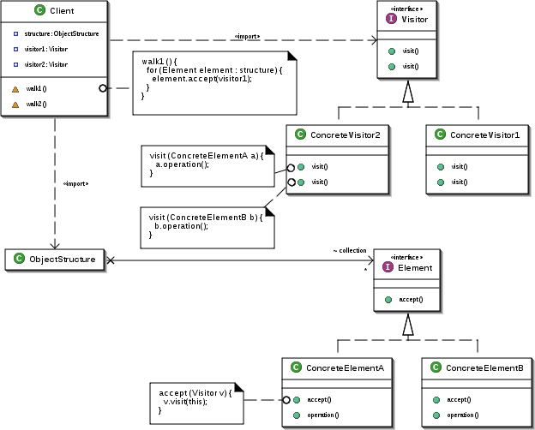
Static (Source Code) Structure …

Slide 11
Static Deployment Structure
At software deployment time, the software elements are
  the executable version of the project modules and files
Several source code modules
  may be packaged into the same deployment unit
The connectors are basically the same as those for the source module structures

Slide 12
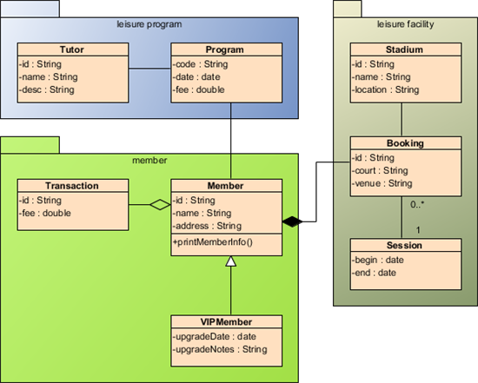
Static Deployment Structure

Slide 13
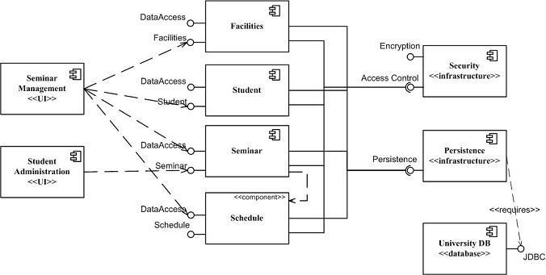
Static Deployment Structure

Slide 14
Managing Static Structural Representations
Static Structural play a critical role
Systems are developed incrementally
  increases the need for tight control of this structure in the physical software element
Managing static structural representations involves
  dealing with layers of abstraction and levels of refinements
    showing visibility and encapsulation, respectively

Slide 15
Managing Static Structural Representations …
Two kinds of static hierarchical relations
  A linear client-server relation
    is formed when a component provides primitive abstractions to another component;
      in this sense, components can refer to abstractions that once defined can be used throughout the entire design (at all levels).
  A tree-like hierarchy of refinement relations
    defined between an abstraction (i.e., a component) and its implementation,
      by the recursive division of components into sub-components

Slide 16
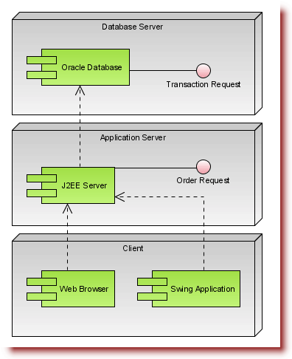
Managing Static Structural Representations …

Slide 17
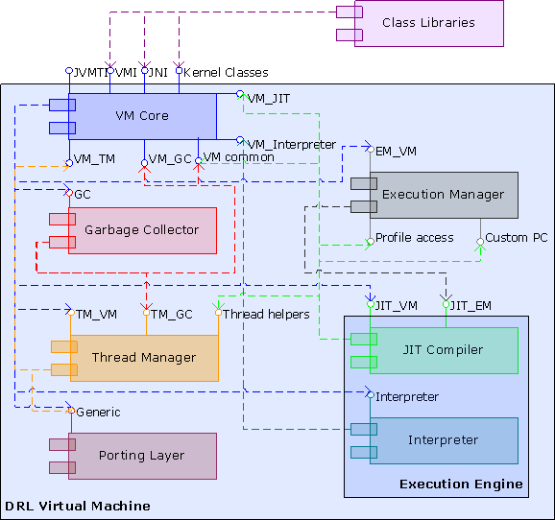
Managing Static Structural Representations …

Slide 18
Software Management Structure
A large software project
  is normally designed and implemented by several project teams,
    each having its well-defined responsibilities at specific Software Development Life Cycle process stages
In this structure, each element consists of
  specific manipulation (design, implementation, debugging, etc.) of specific code units
    assigned to the same project team,
Also often used for project resource allocation

Slide 19
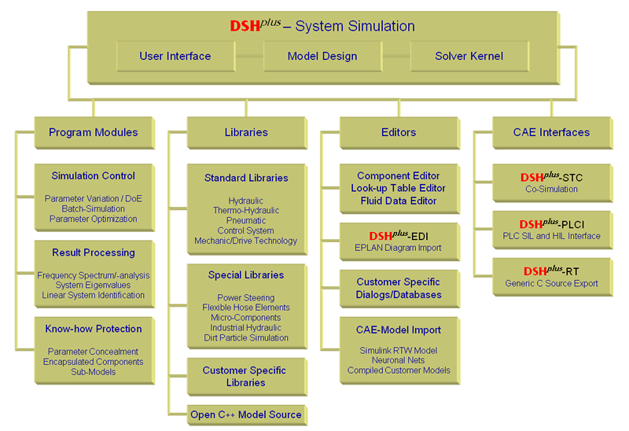
Software Management Structure

Slide 20
Software Runtime Structure
At runtime elements are
  threads,
  processes,
  functional units,
  and data units
These elements may run on
  the same computer or
  multiple computers across a network

Slide 21
Software Runtime Structure
The same element in a code structure can implement or support multiple runtime elements
  In a client-server application, the same client module may run on many client computers
Several code structure elements may implement or support a single runtime element
  Many threads may run multiple methods from different classes that may be packaged in different code units

Slide 22
Software Runtime Structure …
Runtime connectors inherit attributes
  from their source-code structure counterparts, with a few extra attributes
    Multiplicity.
      One element can be connected to multiple other elements if it needs to invoke methods of multiple elements at runtime
    Distance and connection media
    Universally invokable.
      with this attribute set to true, it allows any external software system can invoke the method at the connector’s target, no matter what
        hardware/ software platforms that they run on
        what programming languages or software frameworks that they are developed in
    Self-descriptive.
      With this attribute set to true. It allows external software systems invoke its target method without the pre-installation of any software specific for the method

Slide 23
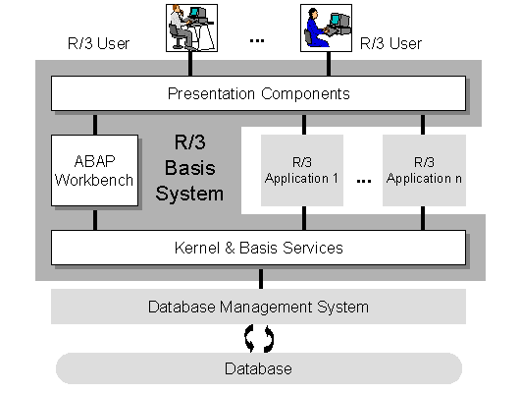
Software Runtime Structure …

Slide 24
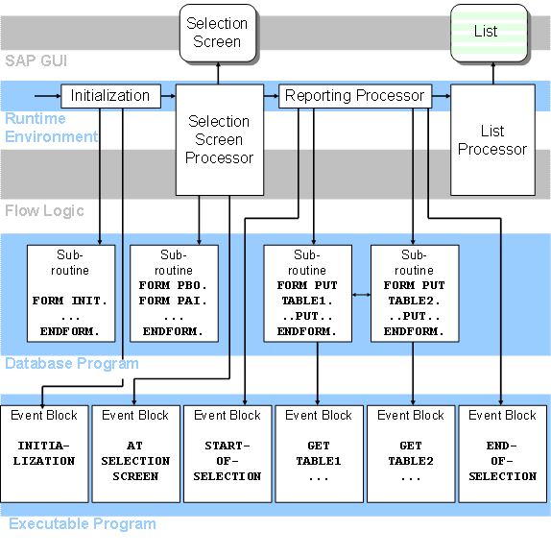
Software Runtime Structure …

Slide 25
Software Elements
The elements of a software architecture
  are usually refined through multiple transformation steps based on
    the element attributes
    the project requirement specification
Based on the function assignment, each software element may have different
  synchronization
    Multiplicity, reentrant, …
  performance constraints
    Scalability, response time, throughput…

Slide 26
Guidelines for Mapping Runtime Elements
If an element is reentrant
  it can be implemented by a thread or a process
If an element is
  not reentrant and
  multiple threads or processes may need to communicate with it
  -> it must be run on separate threads or processes so they can be thread-safe
If an element has
  high multiplicity and
  its performance is important to the global system performance,
  -> an application server should be used for its implementation

Slide 27
Guidelines for Mapping Runtime Elements …
If there are heavy computations
  in the elements for deployment at a particular location
    a cluster of processors
      should be considered for added CPU data processing power
If an element is assigned
  complex
  but well-defined functions similar to those of some commercial off-the-shelf software components and
  the performance of this element is not critical
  -> then it is more cost-effective to use an existing software component to implement the element’s functions

Slide 28
Guidelines for Mapping Runtime Elements …
A complex element can be expanded
  into a sub-system with its own elements and connectors
A complex element can be transformed into
  a sequence of
    vertical layered elements
      if each layer provides a virtual machine or interface to its immediate upper layer element and each layered element hides away some low-level system details from the upper layers
    horizontally tiered elements
      if the business logic can be achieved by processing data with a sequence of discrete processing stages and these processing stages can be implemented by tiered elements with well-defined interfaces and balanced workloads

Slide 29
Software Connectors
The connectors of a software architecture should be
  refined within the design process
Connector refinement is heavily influenced by
  a project’s deployment environment
In the most abstract form a connector
  just indicates the necessity during system execution time for one of the elements
    to send a message to another element and potentially get some return message

Slide 30
Guidelines for Mapping Software Connectors …
During the refinement of the software architecture
  If the two elements are mapped to a single process,
    the connector could be mapped to a local method invocation
  If the two elements are mapped to two different processes on the same computer
    then the connector could be mapped to a local message queue or a pipe
  If the two elements are mapped to two different computers,
    then remote method invocation or Web service invocation could be used
      for the architectural refinement for the corresponding connector between them

Slide 31
Software Connector Classification
Based on connector’s synchronization mode
  blocking
    allows one of its incident elements to send a request (method call or message) to another
    wait for a response (method return value or message),
    the element will be blocked from further execution until it receives a response
  non-blocking
    allows one of its incident elements to send a request (method call or message) to another and
    continue its execution without waiting for a response

Slide 32
Software Connector Classification …
Based on the connector’s initiator
  An initiator is an incident element of a connector that can make a request to its partner
  one-initiator connectors
    allows one of its two incident elements to make a request to the other element, but not the another way around
  two-initiator connectors
    allows either of its two incident elements to make a request to the other element
      For a system to support callback between its two sub-systems, the two sub-systems must be connected by a two-initiator connector

Slide 33
Software Connector Classification …
Based on connector’s information carrier
  Variable
    for elements in the same process
  Environment resource
    for elements in different processes of the same system
  Method
    Local invocation
    Remote invocation

Slide 34
Software Connector Classification …
Based on connector’s information carrier …
  Message
    An example message system,
      consisting of a message sender module and a message receiver module connected by a network,
      is used to implement a one-initiator connector for sub-system 1 to send messages/requests to sub-system 2
    A message format must be defined so both the message sender and the message receiver can understand the messages
    a protocol must be adopted to decide the proper handshaking and synchronization between the two parties
message system
Message
sender
network
Message
receiver
Sub-system 1
Sub-system 2

Slide 35
Software Connector Classification …
Based on connector’s implementation type
  Signature-based
    The method’s name indicates an operation, and the parameters carry argument values for the execution of the operation
    If we assign one or more parameters of a method also to indicate operation types, then the connector can be used to implement protocols
  Protocol-based
    A protocol-based connector can implement multiple operation types with a single binding signature

Slide 36
Software Connector Classification …
Based on connector’s active time
  Programmed
    A method call will be made at a time specified at programming time
  Event-driven
    One element will function as an event source
    All elements that need be notified of the event will register as listeners of the event source
    When the event happens, all the registered listener elements will be notified for potential reaction
      Method callback can be considered as a special case of this event-driven mechanism

Slide 37
Software Connector Classification …
Based on connector span
  Local
    The incident elements are located in the same processor
  Networked
    Normally implemented with the proxy design pattern to support object-oriented programming paradigm in a distributed environment
Sub-system 1
Same interface
Sub-system 2
Message
sender
network
Message
receiver
Proxy
Skeleton
message system

Slide 38
Software Connector Classification …
Based on connector fan-out
  “1-1”
    for connecting two elements only
  “1-*”
    for connecting one element with variable elements of the same type
      A web server and the web browsers are connected with a 1-* connector
      So are the server and clients in a client-server architecture

Slide 39
Software Connector Classification …
Based on connector environment
  Homogeneous
    The incident elements of a homogeneous connector are implemented with the same programming language and software framework and run on the same operating system
  Heterogeneous
    The incident elements of a heterogeneous connector may be implemented with different programming languages or software frameworks and may run on different operating systems

Slide 40
Software Connector Classification …
Based on connector environment …
  Heterogeneous …
    CORBA, Web services and messaging are typical implementation technologies for heterogeneous connectors
    Heterogeneous connectors are usually implemented with the broker design pattern
    A message system could be implemented with the message sender and receiver modules implemented in different programming languages or on different platforms

Slide 41
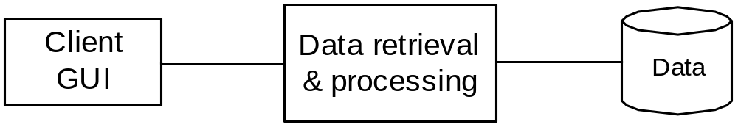
An Agile Example to Software Architecture Design
A standalone data presenter

Slide 42
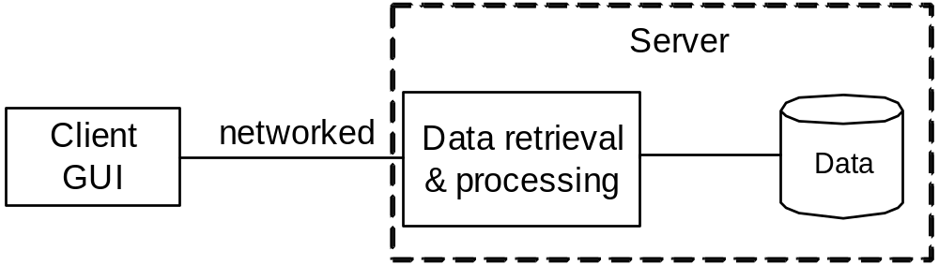
An Agile Example to Software Architecture Design …
Networked data presenter

Slide 43
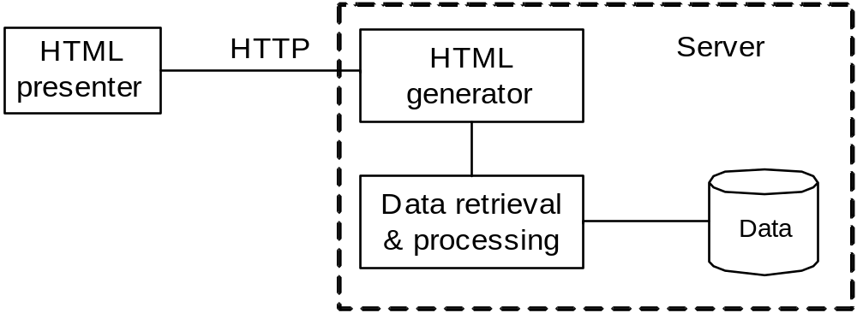
An Agile Example to Software Architecture Design …
HTML and HTTP based data presenter

Slide 44
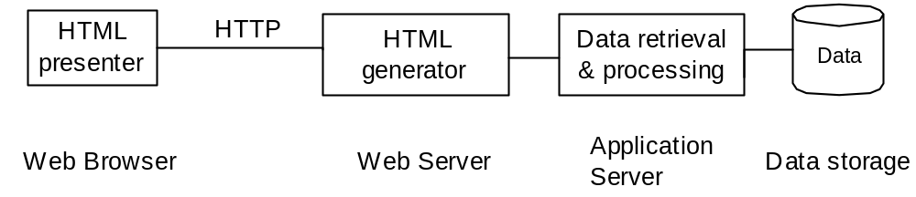
An Agile Example to Software Architecture Design …
The web architecture

Slide 45
Conclusion
Software architectures determine the overall structures of software systems and have great impact on their quality
Software architectures can be viewed from multiple perspectives
Each type of structure consists of elements and connectors as well as constraint attributes for both, the elements and the connectors; these are derived from the requirements specification
To minimize the impact of changing project requirements and to maximize design and implementation reuse, an architect should adopt an iterative process for the architecture design

