Slide 1
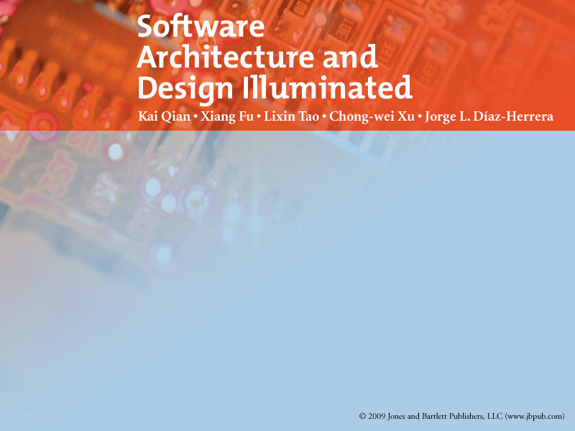
Chapter 3
Models for Software Architecture

Slide 2

Objectives
• Introduce concepts of the view models of software architecture
• Discuss the UML notations as modeling tools for software architecture specification

Slide 3
Agenda
Overview
4+1 View Model
UML for Software Architecture
  Structural Diagrams
  Behavioral Diagrams

Slide 4
Overview
Software architecture
  a high-level of abstraction of a software system by employing decomposition, composition, architectural styles, and quality attributes.
  Describe the collection of
    Components
    Connections
    Interactions between these components.
  Also specify the deployment configuration of all components and connections.
  Its design must conform to the functional and non-functional requirements of the software project.

Slide 5
Overview (cont)
Many effective ways to describe a software architecture
  formally
  informally.
To Describe the business concepts and processes:
  Box-and-line diagrams are often used.
    Descriptions of components and connectors
      Provide clarify understanding ( intuitive interpretation ).

Slide 6
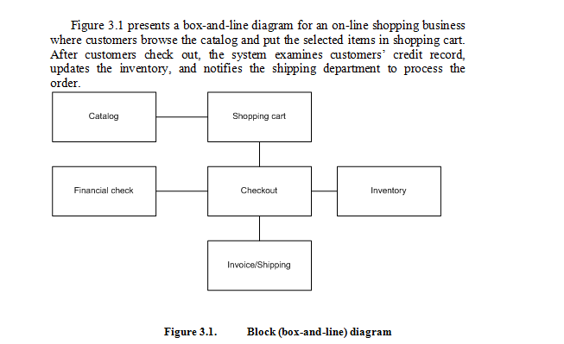

Slide 7
UML for Software Architecture
With a software-intensive system, the Unified Modeling Language (UML) is
  Is a graphical language for
    visualizing
    specifying
    constructing
    documenting the artifacts
  Offer a standard way to draw a system’s design ( system’s blueprints ),
  Including conceptual notions such as
    Business processes
    System functions
    Concrete designs such as
      programming language statements,
      database schemas, and
      reusable software components.

Slide 8
UML
a typical OO analysis and design notational tool
  provides many useful diagrams
    used to map requirement specifications to architectural designs
UML diagram could be group into 2 major categories:
  Structural (static)
    Class diagram, component diagram, deployment diagram, etc.
  Behavioral (dynamic)
    sequence diagram, collaboration diagram, activity diagram, etc.
      With object collaboration, interaction, activity, and concurrency notation.

Slide 9
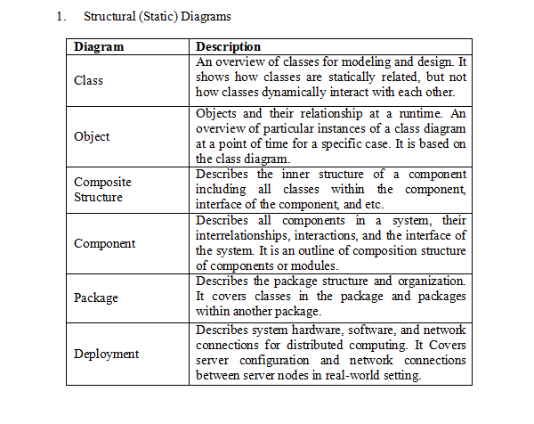

Slide 10
Class Diagram
Provides a static view of the system.
  Captures the vocabulary of the designed system.
Is a foundation diagram and most frequently used.
Derived from
  Use case diagrams
  Text analysis on the given problem domain.
System analysts and system designers will created it and iteratively refined

Slide 11
Class Diagram
Describe each individual class with its type, interface, properties, and methods.
Also specify : the accessibility (visibility) of each attribute and operation.
  Popular accessibility modifiers
    Private
    Public
    Protected
    Default
A class interface ( method(s) )
  Provides the behaviors the class support.

Slide 12
Relationships among classes:
  Inheritance
  Aggregation
  Association
For each relationship, multiplicities between classes can be denoted
  one to one
  one to many
  many to many mappings.
In UML, multiplicity notations
  1 = one instance
  0 = no instance
  0..1 -> zero or one instance
  1..* -> at least one instance.

Slide 13
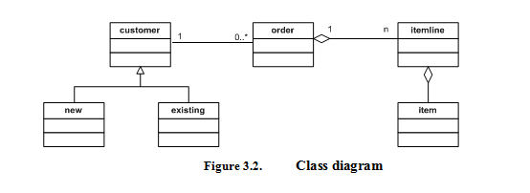

Slide 14
Object Diagram
Objects are the instances of classes.
Describe a sample subset of objects in the system at a point of time.
Shows a snapshot of class instance connection and interaction.
Derived from the corresponding class diagram and is a concrete example of the class diagram at runtime.
Below behavioral diagrams can make references to the object diagram.
  sequence diagram
  communication diagram
  interaction diagram

Slide 15
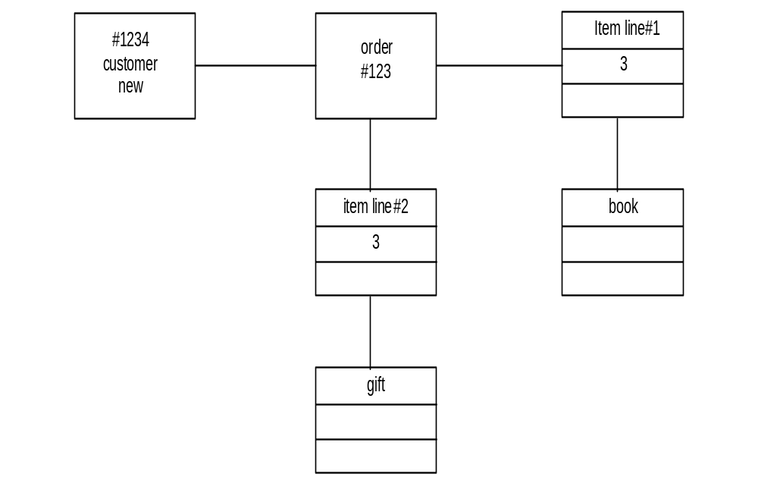

Slide 16
Composite Structure Diagram
Used to describe the composition of
  Interconnected elements
  The collaboration of runtime instances.
Basic notations
  collaboration (represented using a dashed eclipse)
  structured class (represented using a rectangle box).
Each structure class may have an annotation
  Indicates its “role” in the collaboration.

Slide 17
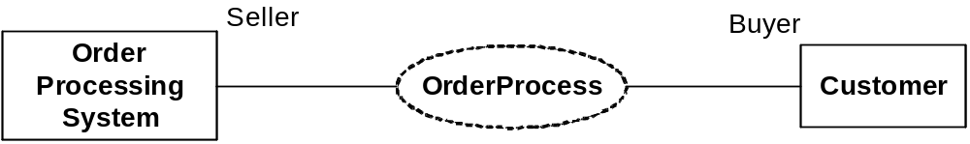
Simple Composite Structure

Slide 18
Component diagram
A component
  a deployable reusable building block for software design and development.
  Ex:
    a JavaBean component is deployed in jar file
    EJB component is deployed in ear file
    .NET component is deployed in .dll file.
Has interface to
  Expose its services
  Hides its implementations.

Slide 19
A lollipop shape of a component
  Represents an implemented interface.
A cup shape
  Represents the required interface must be provided by some other components.
Some of the components may exist and be available in house or on the market.
Other components are designed and developed by the designers and developers of the current project.

Slide 20
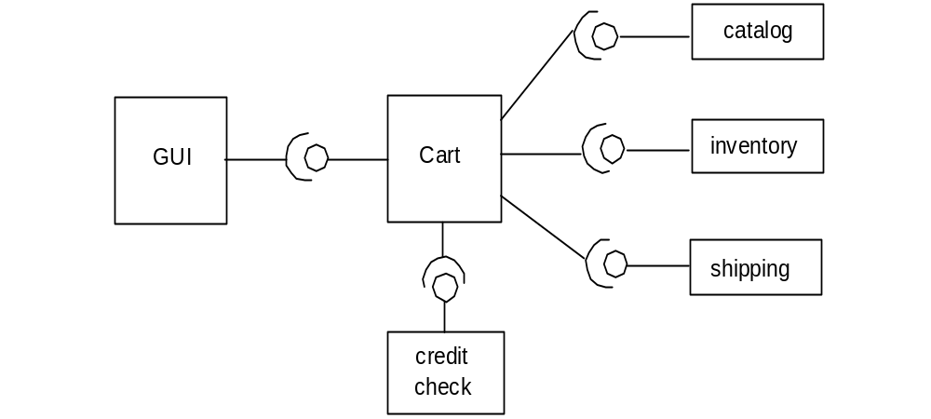

Slide 21
Package Diagram
Is represented by a tabbed folder
  Indicates where all included classes and sub packages reside.
  Ex:
    namespace in .NET
    packages in Java
Functionally related classes should be organized in the same package
  So that, easy to access each other within a default accessibility or visibility.
Organize related packages in a same parent package to build a class and package hierarchy Ex: .NET class library and Java API.

Slide 22
Package Diagram
Shows the dependency relationship between packages
  Due to this dependency, a change of one package may result in changes of other package.
Specify the contents of a package, i.e., the classes which constitute a package and their relationship.
Use of it in represent system structure
  Help reduce the dependency complexity
  Simplify relationships between groups of classes.

Slide 23
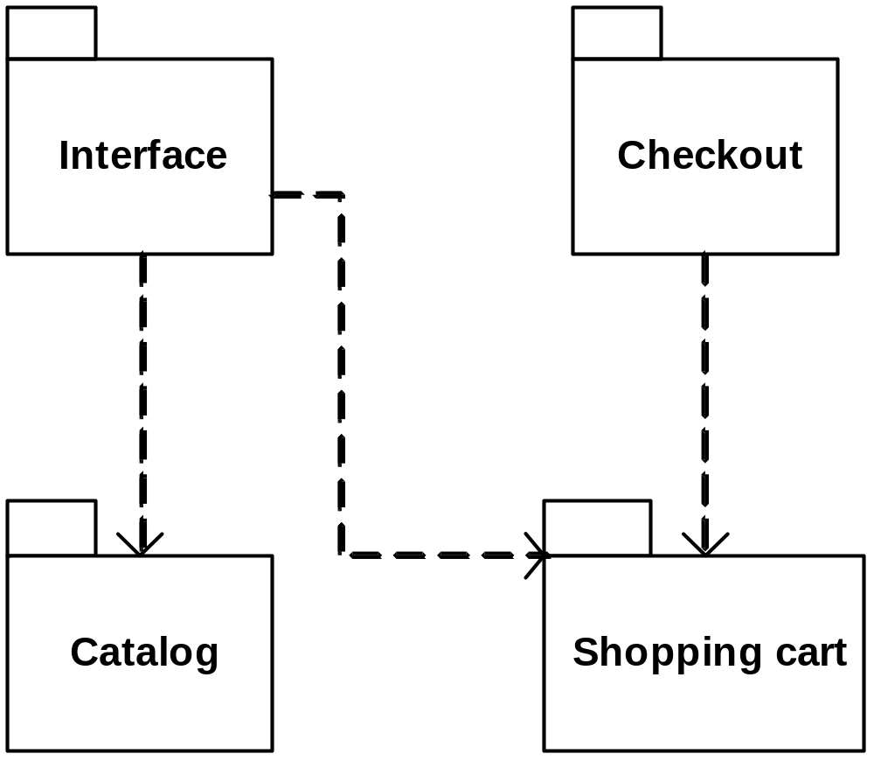
Package Diagram

Slide 24
Deployment Diagram
Describe the physical configuration of the software system
  deployed on hardware server nodes and the network between the nodes (defined as protocols).
Is Generated in the later phase of software development life cycle.
Component diagrams are the basis for the deployment diagram.
Is widely used to model and design distributed software systems.

Slide 25
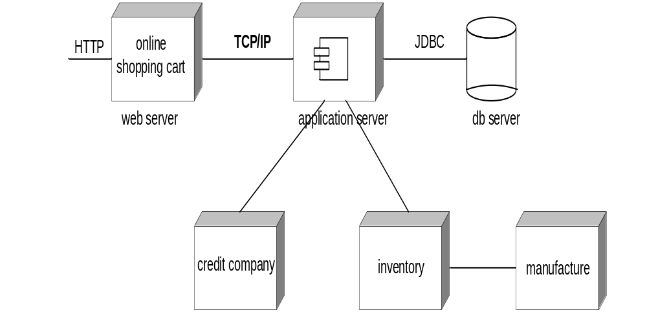

Slide 26
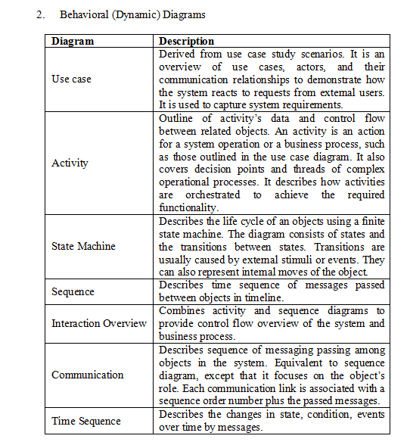

Slide 27
Use Case Diagram
Describe user requirements in terms of system functionality (use cases)
Consists
  Actors
  Use cases
  Links.

Slide 28
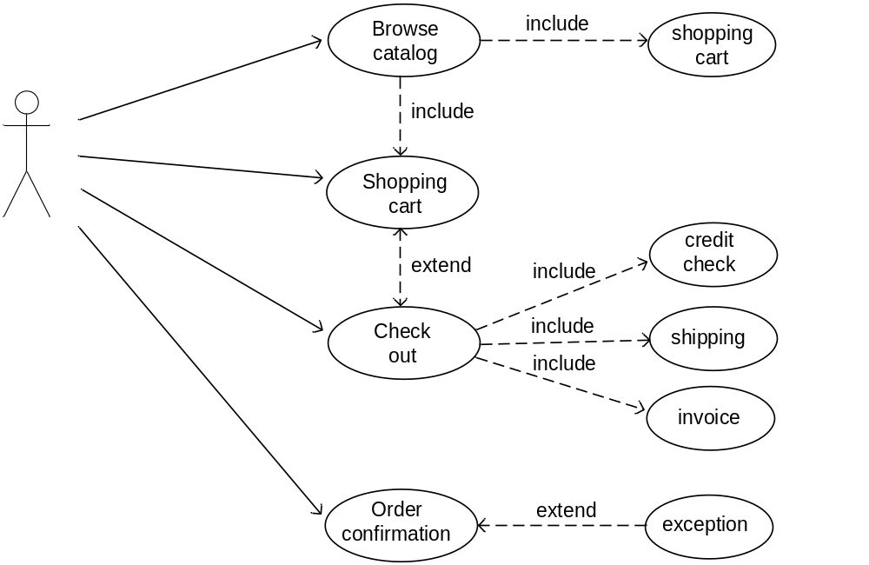

Slide 29
An actor
  is an external “user;”
    a human end user
    an application
    an external device
    or another system.
An use case
  Is a meaningful operational work scenario.
  Present a sequence of working steps to be carried out by classes
    in order to provide the required system functionality.
  Specified in a separate note including the pre and post conditions of the action in the sequence.

Slide 30
The (simple) connection link
  Shows the direction of actors using the use case.
An <<include>> link from one use case to another
  Is a dashed line with an arrow pointing to the reused use case.
  Indicates that the first use case reuses or includes the latter use case

Slide 31
An <<extend>> link
  shows a newly created optional use case from an existing use case.
  Covers alternative cases that may or may not necessarily take place.
  is also a dashed directed line with an arrow towards the extended use case.

Slide 32
Activity Diagram
Used to describe complex business processes
Involve
  Complex workflow,
  Decision making
  Concurrent executions
  Exception handling
  Process termination, etc.
Is a workflow-oriented diagram describing steps on a single process.

Slide 33
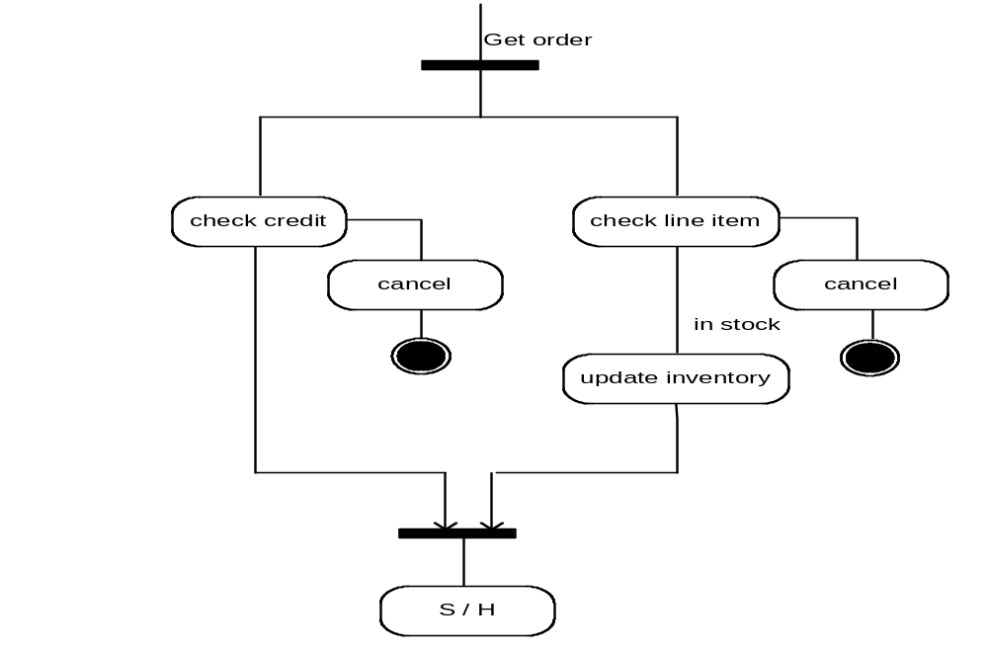
Activity Diagram

Slide 34
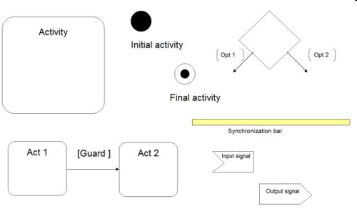
Activity Diagram

Slide 35
State Machine Diagram
Are widely used for
  embedded systems and device software analysis and design.
Is an event-oriented diagram
  Where the software elements in the system change their states in response to external or internal stimuli (such as time events or other system events).
Ideal for specifying the internal behavior of objects.
A state is a situation in which an object
  meets conditions,
  takes actions,
  and waits for new event.

Slide 36
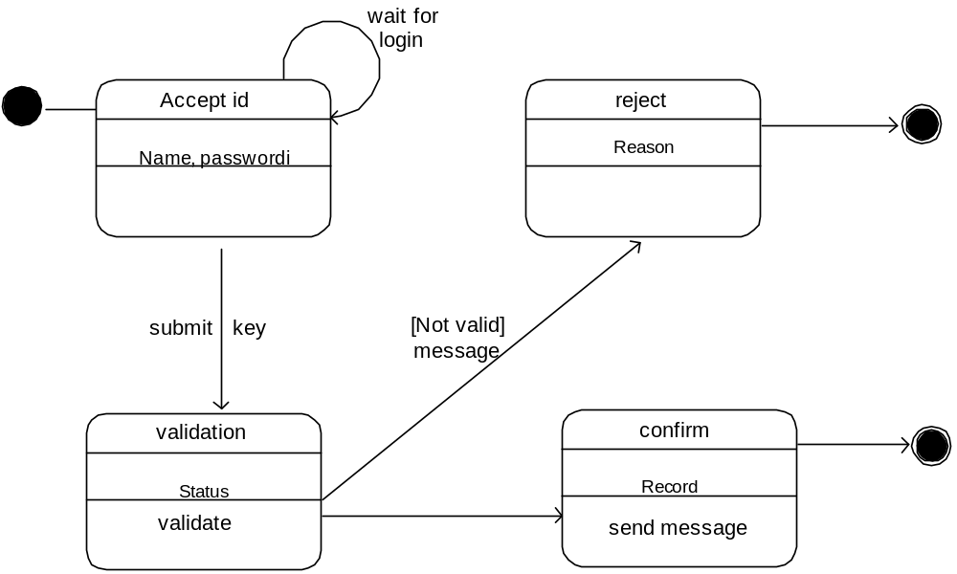
Fig State Machine Diagram

Slide 37
Interaction Overview Diagram
Describes the control flow of the interactions.
Is a variant of the Activity Diagram.
The nodes in a Interaction Overview Diagram
  represent either interactions reference to
    some existing diagrams (ref)
    interaction basic element (activity diagram (ad) or sequence diagram (sd)).
Is a high level abstraction of interaction overview description.

Slide 38
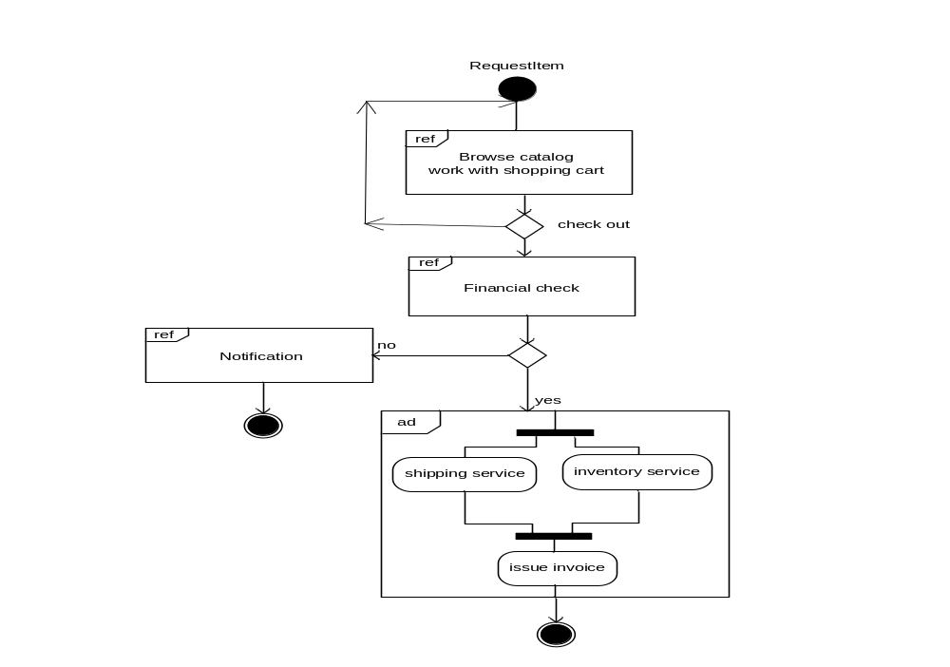

Slide 39
Sequence Diagram
Is one of the most important and most widely used UML diagrams for software system analysis and design.
Is a time-oriented interaction diagram
  showing the chronological sequence of messages between objects.
Usually, one sequence diagram corresponds to one use case.

Slide 40
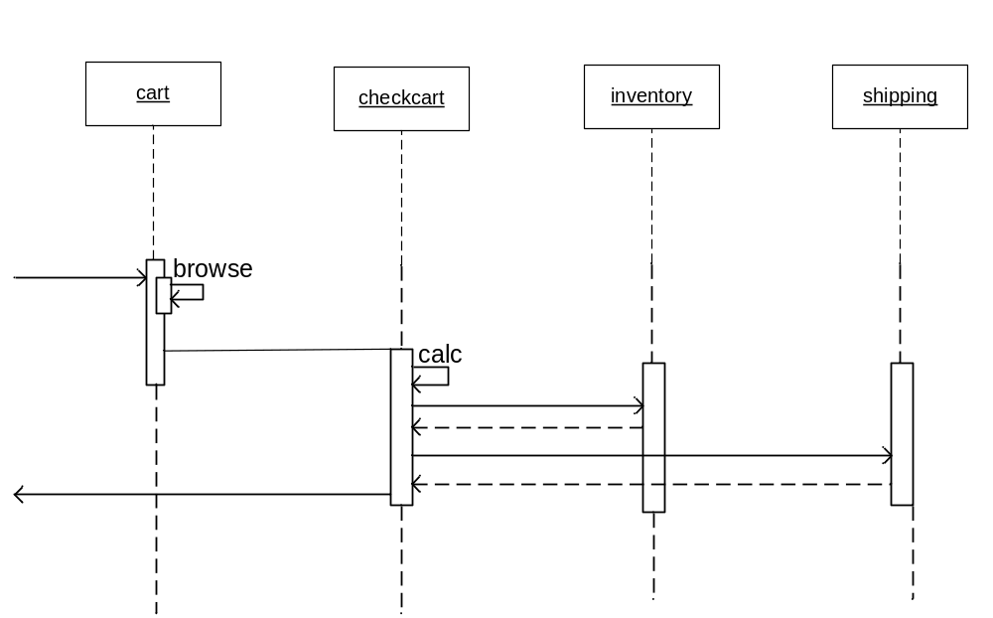

Slide 41
Communication or Collaboration Diagram
Is a message-oriented diagram describes
  Message passing sequence, flow control, object coordination, etc.
summarizes how objects in the system receive and send messages from/to other objects.
Is an extension of the static object diagram
  where the links between objects represent the association relationships.
Is equivalent to a sequence diagram
  i.e., a communication diagram can be converted to an equivalent sequence diagram and vice versa.

Slide 42
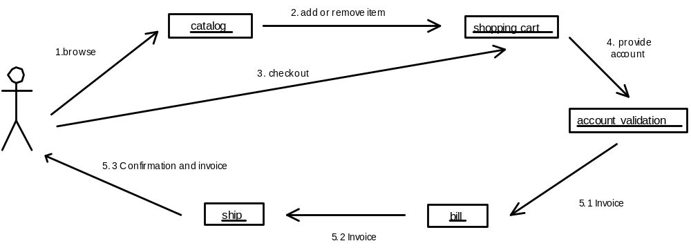
communication diagram

Slide 43
Timing Diagram
Is a new diagram in UML 2.0.
Combines the state diagram and time sequences
  to show the dynamic view of state change caused by external events over time.
Is often used in time-critical systems
  such as real time operating system, embedded system design, etc.

Slide 44
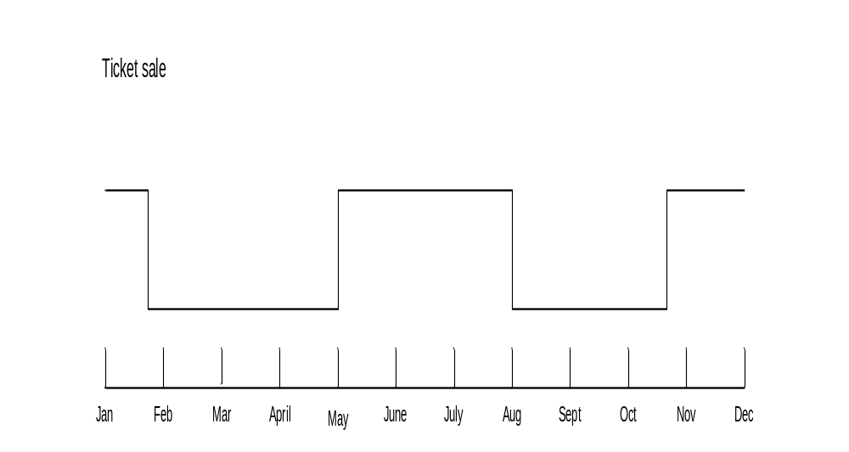

Slide 45
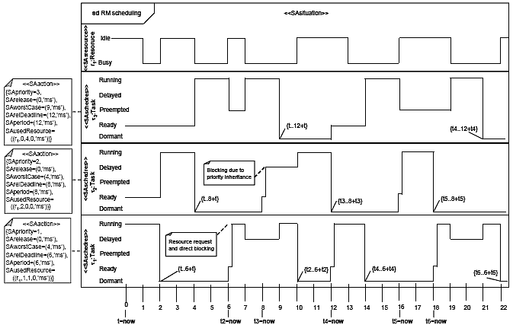

Slide 46
Architecture View Models
A model is
  a complete,
  simplified description of a system from a particular perspective or viewpoint.
There is no single view that can present all aspects of complex software to stakeholders.
Specific views models provide partial representations of the software architecture to a specific stakeholder such as
  system users
  the analyst/designer
  the developer/programmer
  the system integrator
  the system engineer, etc.

Slide 47
The 4+1 view model was originally introduced by Philippe Kruchten in 1995.
The model provides four essential views:
  the logical view
    Describe objects and their interactions;
  the process view
    System activities, their concurrency and synchronization
  the physical view
    The mapping of the software onto the hardware, server, and network configuration
  the development view
    Describes the software's static structure within a given development environment.

Slide 48
There is another view called the scenario view;
  describes the scenarios that capture the most important aspects of the functional requirements and that drive the system design and system validation.
The 4+1 view model is a multiple-view model that addresses different aspects and concerns of the system.
The 4+1 view model standardizes the software design documents and makes it easy to understand by all stakeholders.

Slide 49
The user interface (UI) view is an extend view.
  For end users of the software system,
  Describes the graphical interface to verify and validate the user interface requirements; these have significant impact on the system usability and other quality attributes.

Slide 50
The following diagram shows the extended
4 + 1 view model extended with our fifth view, the user interface view.
The scenario view is coherent with other four views, whereas the user interface view complies with the scenario view and is supported by the other four views.

Slide 51
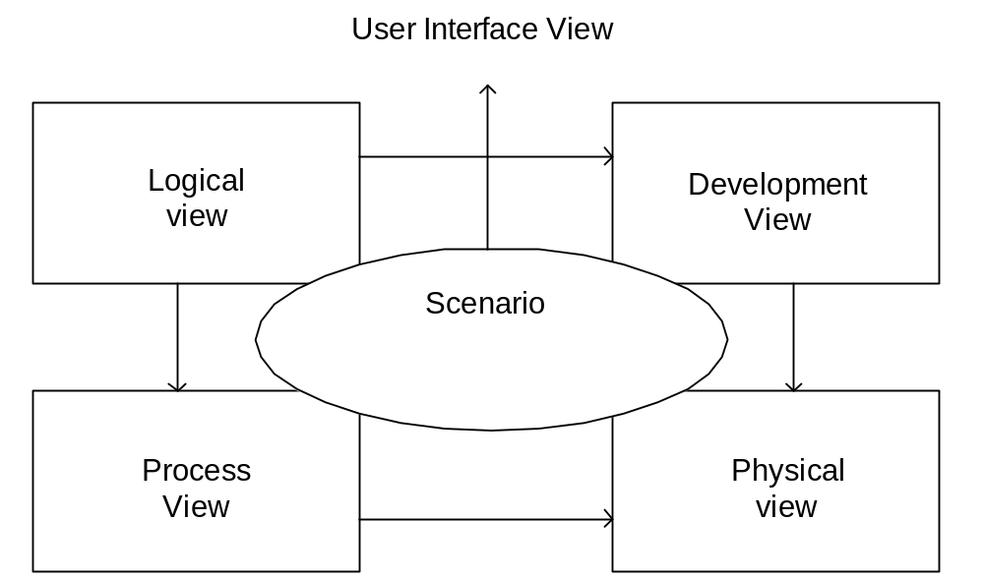

Slide 52
4+1 view Model
The “4+1” view model
  Another way
    to show different views of the functional and non-functional requirements
There are 5 views in the model
  the logical view
    Identify software modules and their boundaries, interfaces, external environment, usage scenarios, etc.
  the process view
    Addresses non-functional requirements such as module communication styles and performance issues at runtime.
  the development view
    Organizes the software units according to the actual file or directory structure
  the physical view
    Specify the deployment infrastructure in terms of software, hardware, and networking configurations, installation, and deployment for delivery purposes
  the user interface view

Slide 53
The scenario view
Describes the functionality of the system,
  i.e., how user will use the system and how the system provides services to the users.
A foundation for other 4 views and lets them work together seamlessly and coherently.
Helps designers discover architectural elements during design
Helps to validate the architectural design afterward.
Helps to make the software architecture consistent and validated against functional and non-functional requirements.

Slide 54
The Logical or Conceptual View
Based on
  Application domain entities necessary to implement the functional requirements.
Focuses on
  Functional requirements
  The main building blocks
  Key abstractions decomposing of the system.
An abstraction of the system's functional requirements.

Slide 55
Typically used for object-oriented modeling
  Emerges the static and dynamic system structures.
Specifies system decomposition into
  Conceptual entities (such as objects)
  Connection between them (such as associations).
Helps to understand the interactions between entities in the problem space domain.

Slide 56
Supported by
  UML static diagrams:
    class/object diagram
  UML dynamic diagrams:
    interaction overall diagram
    sequence diagram
    communication diagram
    state diagram
    activity diagram
The stakeholders of the logical view
  the end-user
  analysts
  designers.

Slide 57
The Development or Module View
Describes the software static organization of the system modules.
Derived from the logical view.
Addresses the sub-system decomposition and organizational issue.
In this view, the software is packaged and partitioned into small units
  program libraries
  sub-systems.

Slide 58
UML diagrams support this view:
  Package diagrams
  Component diagrams
The stakeholders of this view
  Programmers
  Software project manager.

Slide 59
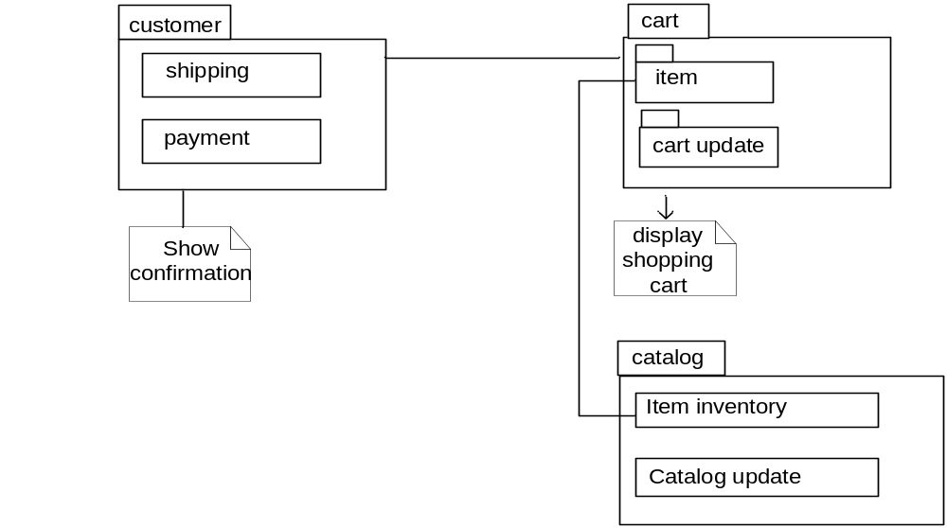
Figure shows a simple development view by a package diagram.

Slide 60
The Process View
Focuses on the dynamic aspects of the system,
  i.e., its execution time behavior.
Also derived from logical view.
An abstraction of processes or threads dealing with process synchronization and concurrency.
The stakeholders of this view are
  The developers
  Integrators.

Slide 61
a coordination view of the system's processes and the communications between them.
Maps functions, activities, and interactions onto runtime implementation
  with a focus on non-functional requirements as well as the implementation of the functional requirements.
The quality attributes are addressed here:
  Performance
  Scalability
  Concurrency
  Synchronization
  Distribution
  System throughput.
The UML support this view are :
  Activity diagrams
  Interaction overview diagram.

Slide 62
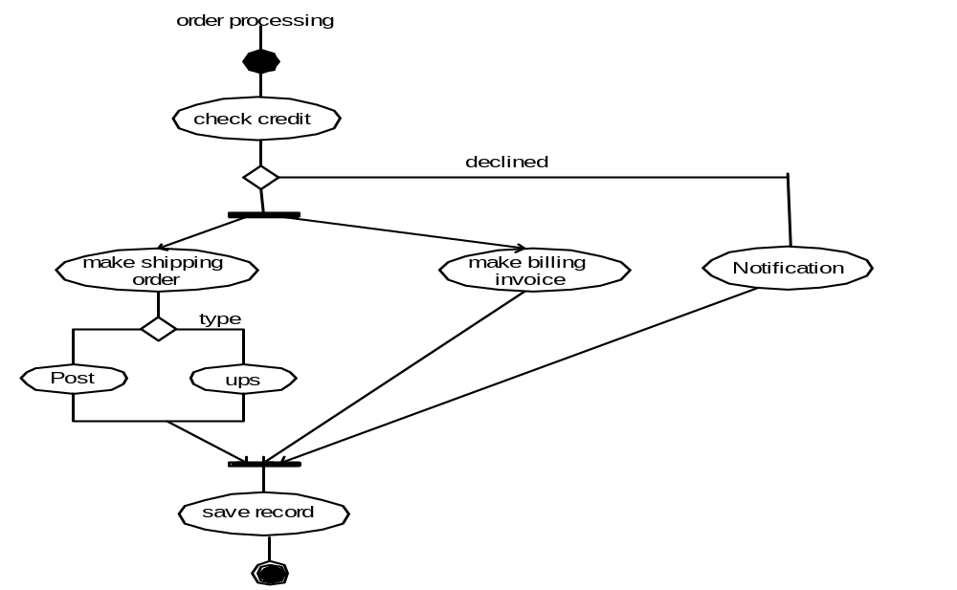
Activity Diagram in the Process View

Slide 63
The Physical View
Describes installation, configuration, and deployment of the software application.
Concerns with how to deliver the deployable system.
Shows the mapping of software onto hardware.
It is particularly of interest in
  Distributed systems
  Parallel systems
The stakeholders of this view are
  System installers
  System administrators
  System engineers
  Operators.

Slide 64
Also takes into account the system's nonfunctional requirements
  System availability
  Reliability (fault-tolerance)
  Throughput performance
  Scalability performance
  and Security.
Ex: software can be delivered in different hardware and networking layouts
  will result in significant differences in terms of these quality attributes.

Slide 65
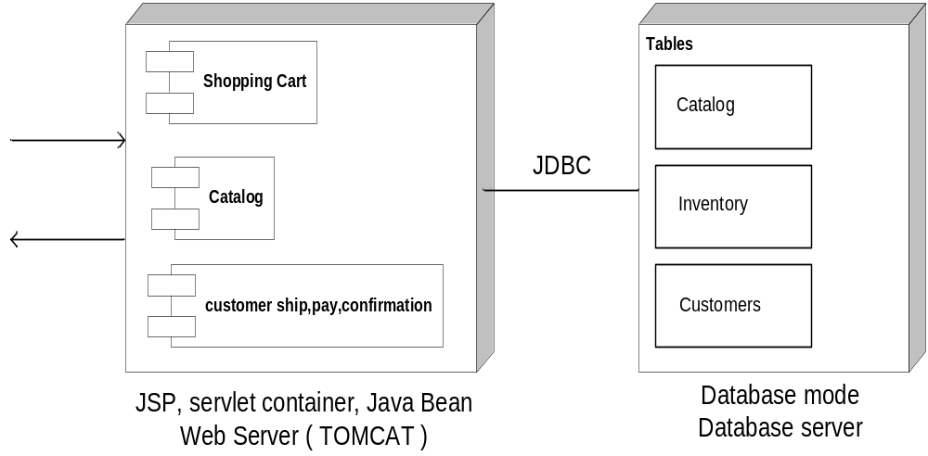
This deployment diagram shows that the order processing system is deployed on two servers.

Slide 66
The User Interface View
An extended view from scenarios view
Give user-computer clear interface view while hiding implementation details.
May be provided as a series of screen snapshots or a dynamic, interactive prototype demo.
Any modification on this view will have direct impact on the scenarios view.

Slide 67
4+1 View Summary
The view is an architecture verification technique for studying and documenting software architectural design.
Each view provides a window for the different aspects of the system.
It covers all aspects of a software architecture for all stakeholders.
The views are interconnected; thus, based on the scenarios view, we can start with logical view, and then move to development or process view and, finally go to physical view.
The user interface view is also established during this process.

