Slide 1

Chapter 5
DATA FLOW ARCHITECTURES

Slide 2
Objectives
Introduce the concepts of Data Flow architectures
Describe the Data Flow Architecture in UML
Discuss the application domains of the Data Flow architectural approach
• Discuss the benefits and limitations of the Data Flow architecture approach
• Demonstrate the Batch Sequential and Pipe & Filter architectures in OS and Java scripts

Slide 3
Overview
The data flow software architectural style
  is characterized by viewing the whole system as a series of transformations on successive sets of data, where data and operations on it are independent of each other.
The software system is decomposed into data processing elements
  where data directs and controls the order of data computation processing.
Each component in this architecture transforms its input data into corresponding output data.

Slide 4
The connection
  between the sub-system components
    may be implemented as I/O streams, I/O files, buffers, piped streams, or other types of connections.
Data can flow
  in a graph topology with cycles
  in a linear structure without cycles
  in a tree type structure.

Slide 5
The sub-systems are independent of each other
  One sub-system can be substituted by other sub-system
    without affecting the rest of the system as long as the new sub-system is compatible with the corresponding input and output data format.
Important property attributes of the data flow architecture.
  Modifiability and
  Reusability
  Because each sub-system does not need to know the identity of any other sub-system

Slide 6
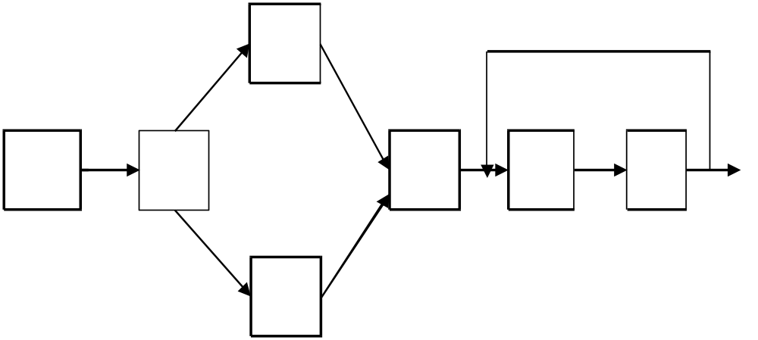
Block Diagram of Data Flow Architecture

Slide 7
We will discuss about 3 sub-categories in the data flow architectural styles:
  Batch Sequential
  Pipe & Filter
  Process Control

Slide 8
Batch Sequential
The batch sequential architectural style
  Represents a traditional data processing model
  widely used in 1950 - 1970.
RPG and COBOL are two typical programming languages working on this model.
In batch sequential architecture
  each data transformation sub-system or module
    Cannot start its process
      until its previous sub-system completes its computation.
Data flow carries a batch of data as a whole
  to move from one sub-system to another sub-system.

Slide 9
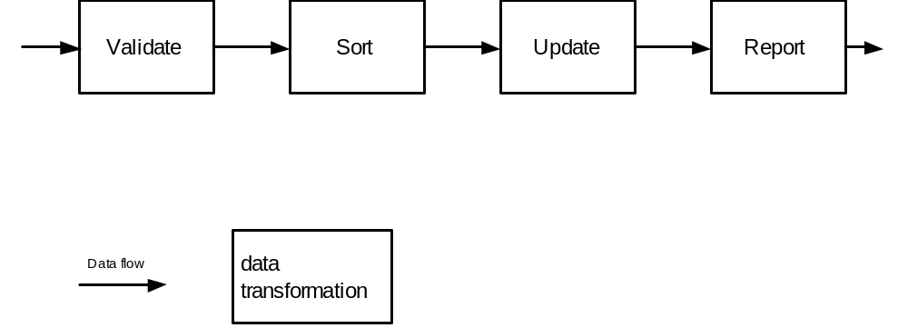
Batch Sequential Architecture

Slide 10
Batch Sequential Architecture
Typical applications are Business data processing such as banking and utility billing
A script is often used
  to make the batch sequence of the sub-systems in the system.

Slide 11
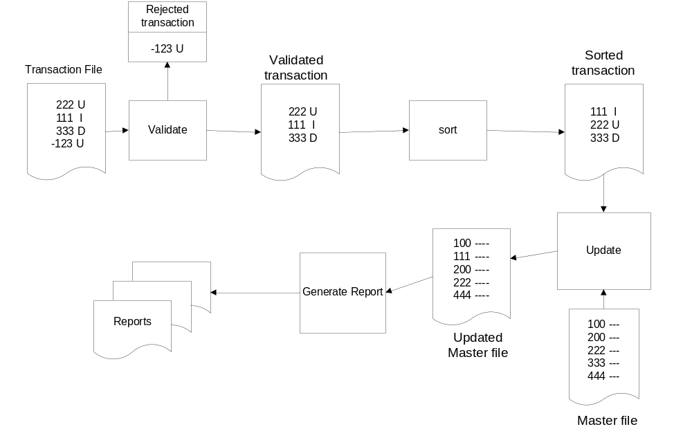
Batch Sequential in Business Data Processing

Slide 12
Batch Sequential Architecture
Applicable Design Domains
  Data are batched.
  Intermediate file is a sequential access file.
  Each sub-system reads related input files and writes output files.
Benefits:
  Simple divisions on sub-systems.
  Each sub-system can be a stand-alone program working on input data and producing output data.
Limitations:
  Implementation requires external control.
  Does no provide interactive interface.
  Concurrency is not supported and hence throughput remains low
  High latency.

Slide 13
Pipe & Filter Architecture
Is another type of data flow architecture where the flow is driven by data.
This architecture decomposes the whole system into components of
  Data source
  Filters
  Pipes
  Data sinks
The connections between components are data streams.
The particular property attribute is concurrent and incremented execution.

Slide 14
A Data stream
A data stream is a first-in-first-out buffer can be
  A stream of bytes
  A stream of characters
  A stream of records of XML
  Or any other type.
Most operating systems and programming languages provide a data stream mechanism
-> a very important tool for marshalling and unmarshalling in any distributed system.

Slide 15
A Filter
Is an independent data stream transformer
  reads data from its input data stream,
  transforms and processes it,
  writes the transformed data stream over a pipe for the next filter to process.
Does not need to wait for batched data as a whole.
    As soon as the data arrives through the connected pipe, the filter can start working right away.
Does not even know the identity of data upstream or data downstream.
  A filter is just working in a local incremental mode.

Slide 16
A Pipe
Moves data stream from one filter to another filter.
Can carry
  binary streams
  character streams.
An object-type data must be serialized to be able to go over a stream.
Is placed between two filters;
  these filters can run in separate threads of the same process as Java I/O streams.

Slide 17
Data transfer types
3 ways to make the data flow:
Push only (Write only)
A data source may pushes data in a downstream
A filter may push data in a downstream
Pull only (Read only)
A data sink may pull data from an upstream
A filter may pull data from an upstream
Pull/Push (Read/Write)
A filter may pull data from an upstream and push transformed data in a downstream

Slide 18
Filter types
An active filter
  Pulls in data and push out the transformed data (pull/push);
  Works with a passive pipe which provides read/write mechanisms for pulling and pushing.
  The pipe & filter mechanism in Unix adopts this mode.
  The PipedWriter and PipedReader pipe classes in Java are also passive pipes
A passive filter
  Lets connected pipes to push data in and pull data out.
  Works with active pipes that pull data out from a filter and push data into the next filter.
  Must provide the read/write mechanisms in this case. This is very similar to data flow architecture.

Slide 19
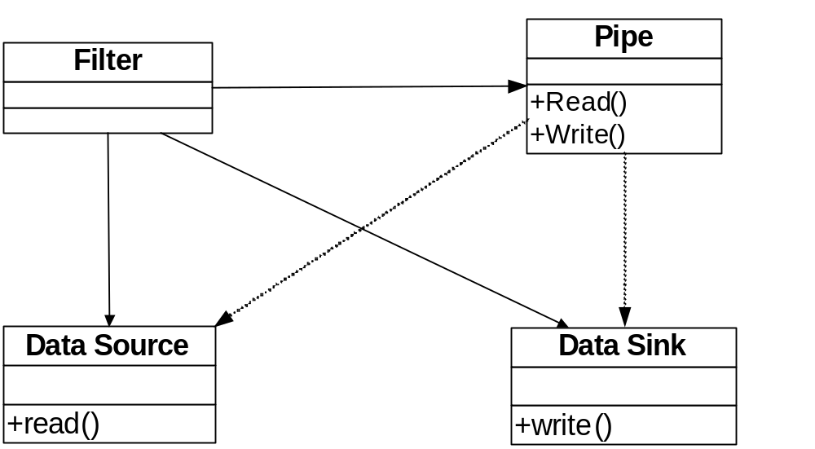
Pipe and Filter Class Diagram

Slide 20
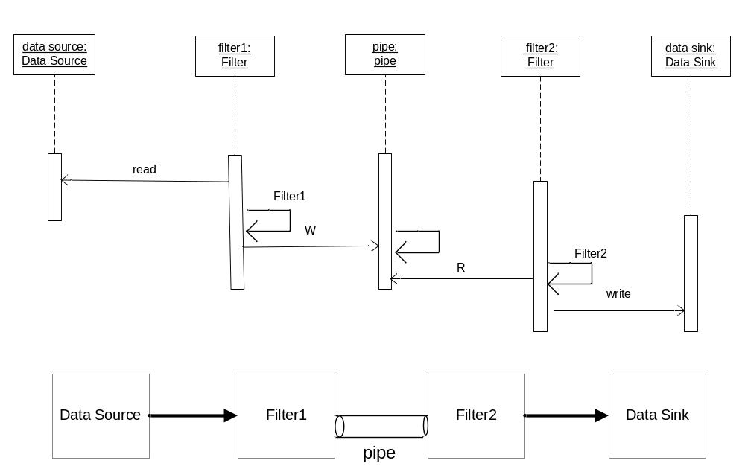
Pipe and Filter Block Diagram and Sequence Diagram

Slide 21
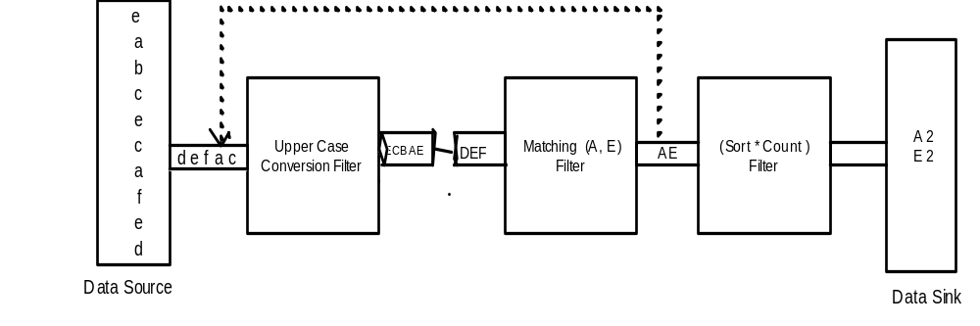
Fig Pipelined Pipe and Filter

Slide 22
The conversion filter converts all characters from lower case to upper case and the matching filter selects character “A” and “E” in the stream.
They are working concurrently; the matching filter can start its job before conversion completes its transformation of the whole input stream.

Slide 23
The sort and count filter counts the number of occurrences of “A” and “E” and sort them in alphabetical order.
It can take its input before the matching filter finishes the job but cannot output data until it gets all data in.

Slide 24
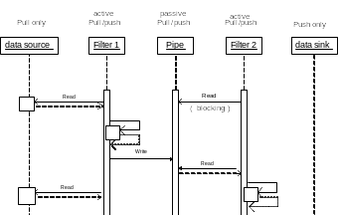
Pipe and Filter Sequence Diagram

Slide 25
Pipe & Filter in Unix
The pipe operator “|” moves the stdout from its predecessor to the stdin of its successor.
The successor can start data transformation over the data stream before the predecessor completes its transformation or processing.
For example, the pipeline of Unix commands reports the number of users who are logged on the system currently.
who | wc –l

Slide 26
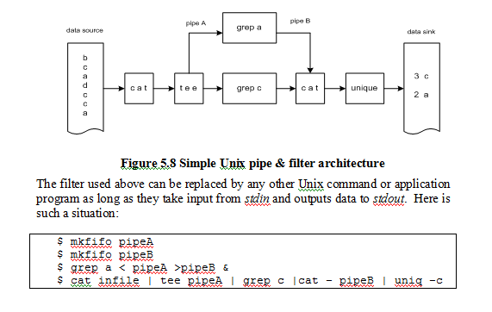

Slide 27
Pipe & Filter in Java
The Java API provides the PipedWriter and PipedReader classes in the java.io package
  allows for filters to push data into downstream or to pull data from the upstream.
Filters
  can run in separate threads
  can be synchronized in a parallel manner by PipedWriter and PipedReader.

Slide 28
Filter1.java:
package pf;
import java.io.*;
public class Filter1 extends Thread {
PipedWriter myPw;
public Filter1(PipedWriter pw) { myPw=pw; }
public void run() {
int j;
try {
for (int j = 1; j<100; j++) pw.write(j);
  pw.write(-1);
}
catch(Exception e){. . .}
}
}

Slide 29
Filter2.java:
package pf;
import java.io.*;
class Filter2 extends Thread {
PipedReader myPr;
  public Filter2(PipedReader pr) { myPr = pr; }
public void run() {
int j;
try {
while (myPr.read()!= -1){ . . . }
}
catch(Exception e){. . .}
}
}

Slide 30
Contd…..
pipeFilter.java:
import pf.*;
import java.io.*;
public class pipeFilter {
public static void main(String[] args) {
try {
PipedWriter pw = new PipedWriter();
PipedReader pr = new PipedReader(pw);
Filter1 f1 = new Filter1(pw);
Filter2 f2 = new Filter2(pr);
f2.start();
f1.start();
}
catch(Exception e){ . . . }
}
}

Slide 31
The pipeFilter Java main program runs two threads in addition to itself: Filter1 and Filter2.
They are connected by a synchronized pipe (PipedWriter and PipedReader).
Filter1 writes to the pipe and Filter2 reads from the pipe. Do we need to start Filter1 before starting Filter2? The answer is No.
You can see that the main program actually starts Filter2 before Filter1.
It works perfectly. This example demonstrates that the order of filters in the sequence is not important as long as the synchronization is taken care of.

Slide 32
Pipe & Filter Architecture
Applicable Design Domain
  Whenever the system can be broken into a series of processing steps over data streams
    in each step filters consume and move data incrementally.
  Whenever the data format on the data streams is
    simple and stable,
    and easy to be adapted if it is necessary.
  Whenever there is significant work
    Which can be pipelined to gain increased performance
  Suitable for producer/consumer type of problems.

Slide 33
Pipe & Filter Architecture
Benefits of Pipe & Filter
  Concurrency: High overall throughput for excessive data processing
  Reusability: Encapsulation of filters makes it easy to plug and play and to substitute.
  Modifiability: Low coupling between filters, less impact from adding new filters and modifying the implementation of any existing filters as long as the I/O interfaces are unchanged.
  Simplicity: Clear division between any two filters connected by a pipe.
  Flexibility: It supports both sequential and parallel execution.

Slide 34
Pipe & Filter Architecture
Limitations of Pipe & Filter
  Not suitable for dynamic interactions.
  Low Common Denominator
    Is required for data transmission in the ASCII formats
      since filters may need to handle data streams in different formats such as record type or XML type rather than character type.
  Overhead of data transformation among filters such as parsing repeated in two consecutive filters.
  Difficult to configure a P&F system dynamically.

Slide 35
Process-Control Architecture
Is suitable for the embedded system software design
  where the system is manipulated by a process control variable data.
Decomposes the whole system into
  sub-systems (modules) and
  connections between sub-systems.
2 types of sub-systems:
  executor processing unit for changing process control variables
  controller unit for calculating the amounts of the changes.

Slide 36
A process control system must have the following process control data:
Controlled variable: target controlled variable such as speed in a cruise control system or the temperature in an auto H/A system. It has a set point which is the goal to reach. The controlled variable data should be measured by sensors as a feedback reference to re-calculate manipulated variables.
Input variable: measured input data such as the temperature of return air in a temperature control system.
Manipulated variable: can be adjusted by the controller.

Slide 37
The input variables and manipulated variables are applied to the execution processor which results in a controlled variable.
The set point and controlled variables are the input data to the controller, the difference of the controlled variable value from the set point value is used to get a new manipulated value.
Cars cruise-control systems and building temperature control systems are good examples of this process control software architecture type of applications.

Slide 38
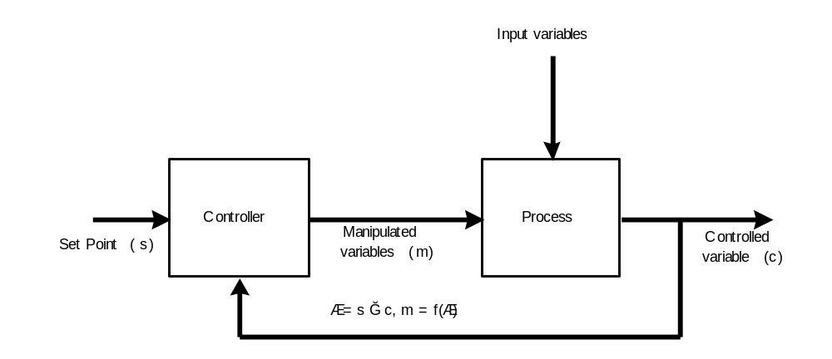
Data Flow in the Process Control Architecture.

Slide 39
Process Control Architecture
Applicable Domains
  Embedded software system involving continuing actions.
  The system needs to maintain an output data at a stable level.
  The system can have a set point which is the goal the system will reach and stay at that level.

Slide 40
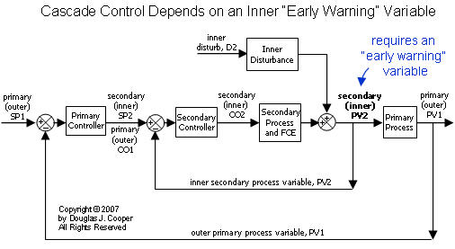

Slide 41
Benefits ( loop-back architecture )
  Better solution to the control system where no precise formula can be used to decide the manipulated variable.
  The software can be completely embedded in the devices.

Slide 42
Summary
The data flow architecture decomposes a system into a fixed sequence of transformations and computations.
  There is no direct interaction between any two consecutive sub-systems except for the exchange of data through data flow links.
  There is no data sharing among sub-systems in data flow architecture.
  It is not suitable for interactive business processing.
3 types of data flow architectures were discussed.
  Reading and writing I/O files drive the data flow in batch sequential architecture; its control flow is thus explicit.
  The batch sequential architecture may cause bottlenecks because it requires batched data as input and output.
  The pipe & filter is an incremental data transformation processing model and runs concurrently.
  The data flow and the control flow in pipe & filter are implicit.
  The process control architecture is another type of data flow architecture where the data is neither batched sequential nor pipelined streamed.
  The mechanism to drive the data flow comes from a set of variables that controls the process execution.

Slide 43
The design guidelines for a data flow based software system is listed here:
Decompose the system into series of process steps; each step takes the output of its previous step.
Define the output and input data formats for each step.
Define the data transformation in each step.
Design pipelines if concurrency is necessary.

