Slide 1

Chapter 6
DATA CENTERED
SOFTWARE ARCHITECTURE

Slide 2
Objectives
• Introduce the concepts of data centered software architecture
• Describe the repository and blackboard architectures
• Discuss applicable domains for data centered software architecture
• Discuss the benefits and limitations of data centered software architecture
• Discuss the data centered architecture when incorporated with other architectures

Slide 3
Agenda
Centralized data store
  Overview
  Repository Architecture Style
  Blackboard Architecture Style

Slide 4
Overview
The architecture is characterized by a centralized data store
  Shared by all surrounding software components.
The system is decomposed into 2 major partitions:
  Data store
  Independent software component or agents.
The connections between the data module and the software components
  Implemented by
    explicit method invocation
    implicit method invocation.

Slide 5
2 categories of data centered architecture
  Repository
  Blackboard
  Which is differentiated by the flow control strategy.
In the repository architecture
  The data store is passive
  Clients are active
    may access the repository
      Interactively
      By a batch transaction request.
  => Clients control the logic flow.

Slide 6
In the blackboard architecture
  The data store is active
  Clients are passive
  => the flow of logic is determined by the current data status in the data store.
The clients are called
  Knowledge sources
  Listeners
  Subscribers.

Slide 7
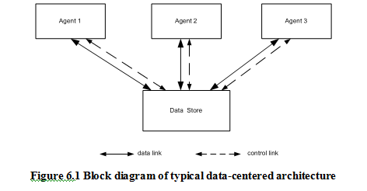

Slide 8
Repository Architecture Style
Is a data centered architecture
  supports user interaction for data processing (as opposed to the batch sequential transaction processing discussed earlier).
The software component agents control
  the computation
  flow of logic of the system.

Slide 9
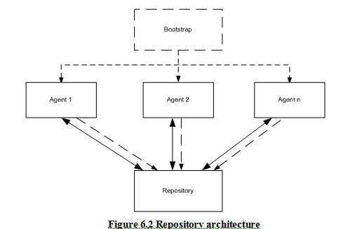

Slide 10
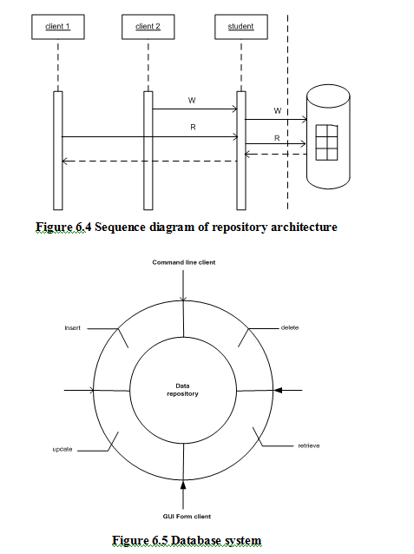

Slide 11
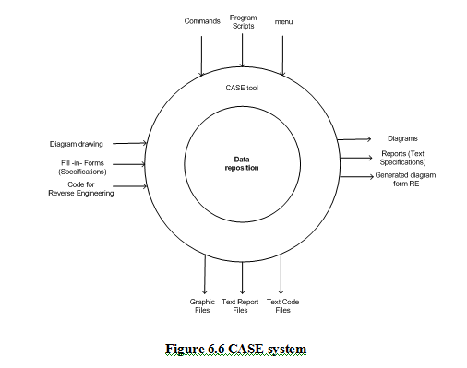

Slide 12
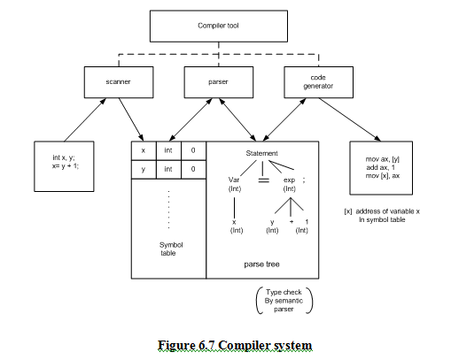

Slide 13
Repository Architecture
Applicable Domain:
  Suitable for large complex information systems
    Where many software component clients need to access it in different ways.
  Data transactions to drive the control flow of computation.
Benefits:
  Data integrity
    easy to backup and restore.
  System scalability and reusability of agents:
    easy to add new software components because they do not have direct communication with each other.
  Reduce the overhead of transient data between software components.

Slide 14
Limitations:
  Data store reliability and availability is a very important issue.
    Centralized repository is vulnerable to failure compared to distributed repository with data replication.
  High dependency between data structure of data store and its agents.
    The changes of data structure have significant impacts on its agents.
      The data evolution is more difficult and expensive.
  Overhead cost of moving data on network
    if data is distributed.

Slide 15
Blackboard Architecture Style
The idea is similar to the classroom blackboard setting used in solving problems without deterministic outcome.
Students and Teacher play the role of agents to make their contributions to the problem solving.
They all can work in parallel and very independently.
They will try their best to work together to find the best solution.

Slide 16
Blackboard Architecture Style
Is a data-directed and a partially data-driven architecture.
The whole system is decomposed into 2 major partitions.
  Blackboard
    Is used to store data.
  Knowledge sources
    Where the domain-specific knowledge is stored.
May be a third partition called the controller
  is used to initiate the blackboard and knowledge sources
  takes a bootstrap role and overall supervision control.

Slide 17
Blackboard Architecture Style
The connections between the blackboard sub-system and knowledge sources
  Basically implicit invocations from the blackboard to specific knowledge sources
    Are registered with the blackboard in advance.
  Can be implemented in publish/subscribe mode.
In blackboard, the data changes
  Trigger one or more matched knowledge source to continue processing is
  May be caused by
    new deduced information by some knowledge sources.
    hypotheses results by some knowledge sources.

Slide 18
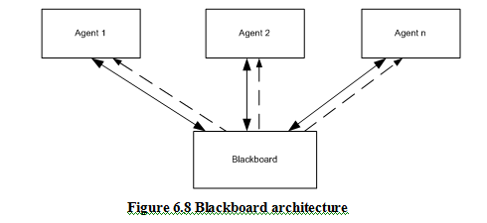

Slide 19
Blackboard Architecture Style
Many domain specific knowledge sources collaborate together to solve a complex problem such as
  Pattern recognition or
  Authentication in information security.
In blackboard, knowledge source
  Is relatively independent from other knowledge sources.
  Doesn’t need to interact with each other.
  Only needs to interact and respond to the blackboard sub-system.
  Only works on a specific aspect of the problem,
  Contributes a partial solution to the ultimate solution.

Slide 20
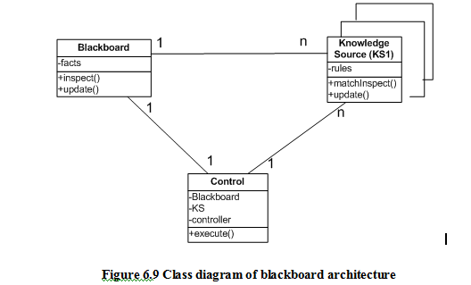

Slide 21
Blackboard Architecture Style
Ex:
  Let’s take a look at a well-known animal identification knowledge based system (KBS).
    The knowledge is represented in the format of production rules with condition and action parts.
    For each rule, if the condition is true then the action is taken.
    The action is to put new conclusion data in the data store, which is the blackboard.

Slide 22
Blackboard Architecture Style
Here is a set of rules:
R1: IF animal gives milk THEN animal is mammal
R2: IF animal eats meat THEN animal is carnivore
R3: IF animal is mammal AND animal is carnivore AND animal has tawny
color AND animal has black stripes THEN animal is tiger
Another example : weather forecasting.

Slide 23
Blackboard Architecture Style
Forward Reasoning.
  The forward reasoning starts with the initial state of data and proceeds towards a goal.
  It may reach the given goal or it may fail to reach the goal.
  If the goal is not given, the reasoning will come to a point where no more new facts can be derived that indicated that is the best result we can get.
Backward Reasoning
  The backward reasoning works in the opposite direction than the forward reasoning.

Slide 24
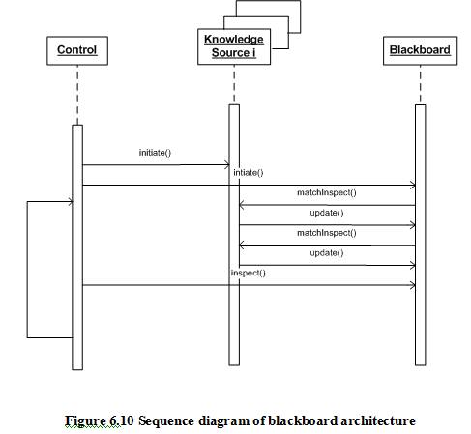

Slide 25
Blackboard Architecture Style
Applicable Domain
  Suitable for solving open-ended and complex problems
    artificial intelligence (AI) problems where no deterministic solutions exist.
  The problem spans multiple disciplines
    Each of them has complete different knowledge expertise and problem solving paradigms that co-operation is a must.
  Partial, or approximate solution is acceptable to the problems.
  Exhaustive searching is impossible and impractical
    Since it may take forever because
      available knowledge and
      even data and
      hypotheses may not complete or precisely accurate.

Slide 26
Blackboard Architecture Style
Benefits
  Scalability: easy to add new knowledge source or update existing knowledge source.
  Concurrency: all knowledge sources can work in parallel since they are very independent of each other.
  Supports experimentation for hypotheses.
  Reusability of knowledge source agents.

Slide 27
Blackboard Architecture Style
Limitations:
  Tight dependency between the blackboard and knowledge source
    the structure change of the blackboard may have a significant impact on all its agents.
  Difficult to make a decision when to terminate reasoning
    since only partial or approximated solutions are expected
  Synchronization of multiple agents is an issue.
    Since multiple agents are working and updating the shared data in the blackboard simultaneously,
      the preference or priority of executions of multiple agents must be coordinated.
  Debugging and testing of the system is a challenge.

Slide 28
Summary
The data centered repository architecture may be one of the most popular software architectures since most of software application needs to have a data repository.
Repositories are often used in layered architecture, client/server architecture, data tier in multi-tier architecture, and many other architecture designs.
The data store is passive in the repository architecture and agents control and trigger all operations on the data store. Agents of the data store in data centered repository architecture control the logic flow.

Slide 29
The data centered blackboard architecture is a knowledge-based architecture where the status of the data in the data store controls and triggers most of operations.
The data store is active in the blackboard software architecture.
The connection between the components in the blackboard architecture is implemented implicitly instead of explicit invocation in the repository systems.
There are many expert systems for pattern recognition, voice or speech recognition, or other similar systems with this architecture.

Slide 30
The set of facts is
F1: animal eats meat
F2: animal gives milk
F3: animal has black strips
F4: animal has tawny color
The goal is to recognize which animal it is.
The problem may ask you to approve a statement or get a best recognition in the animal category.

