Slide 1
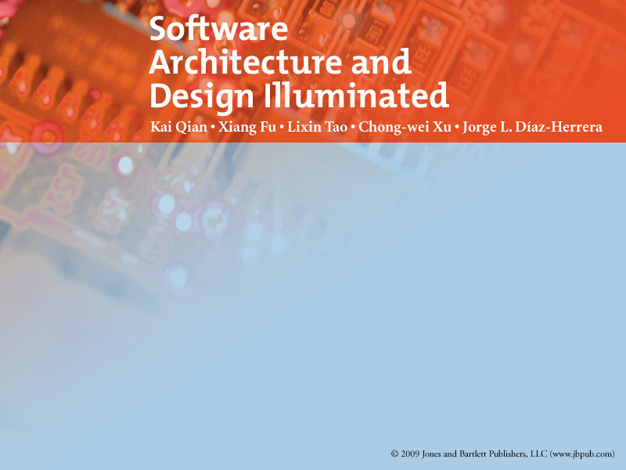
Chapter 7
HIERARCHICAL ARCHITECTURE

Slide 2
Objectives
• Introduce the concepts of hierarchical software architecture
• Describe the main-subroutine, master-slave, and layered architectures
• Discuss the application domains of hierarchical software architecture
• Discuss the benefits and limitations of hierarchical software architecture
• Demonstrate the hierarchical software architecture in OS scripts and Java

Slide 3
Agenda
Hierarchical Architecture
  Overview
  Characteristics
Main-Subroutine Architecture
Master-Slave Architecture
Layered Architecture
Virtual Machine

Slide 4
Overview
Viewing the whole system as a hierarchy structure.
The system is decomposed into logical modules (sub-systems) at different levels in the hierarchy.
A lower level module provides services to its adjacent upper level modules

Slide 5
Main-Subroutine Architecture
The purpose is to reuse the subroutines
  individual subroutines developed independently.
Data location
  In the classical procedural paradigm
    typically data are shared by related subroutines at the same level.
  With object orientation,
    the data is encapsulated in each individual object so that the information is protected.

Slide 6
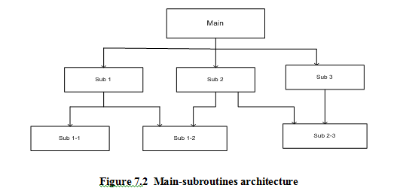
Main-Subroutine Characteristic

Slide 7
Main-Subroutine Characteristic
Using this style, a software system is decomposed into subroutines hierarchically
The hierarchy will be refined according to the desired functionality of the system.
Refinements are conducted vertically until
  The decomposed subroutine is simple enough to have its sole independent responsibility
  Whose functionality may be reused and shared by multiple callers.

Slide 8
Main-Subroutine Characteristic
Data is passed as parameters to subroutines from callers.
There are 2 different ways to pass on parameter data:
  Passed by reference where the subroutine may change the value of data referenced by the parameter.
  Passed by value where the subroutine only uses the passed data but cannot change it.

Slide 9
Main-Subroutine Characteristic
A Data Flow Diagram (DFD) is often used to model the software requirement
During the mapping from DFD to the Main-Subroutine architecture e need to find
  Transform flows
    incoming flow feeds data in an external format which is transformed into another format, and then the outgoing flow carries the data out.
  Transaction flows.
    evaluates incoming data and decides to follow one of many action paths.
Then separate the incoming path and all action paths, and classify each action path as transform or transaction flows.

Slide 10
Main-Subroutine Characteristic
A transform flow is mapped by a controlling module for incoming, transform and outgoing information processing.
A transaction center is located at the fork origin of action paths.

Slide 11
A
B
C
6
Action path
5
purchase
3
record
validate
return
Customer
7
1
2
Action path
Customer
Info
4
8

Slide 12
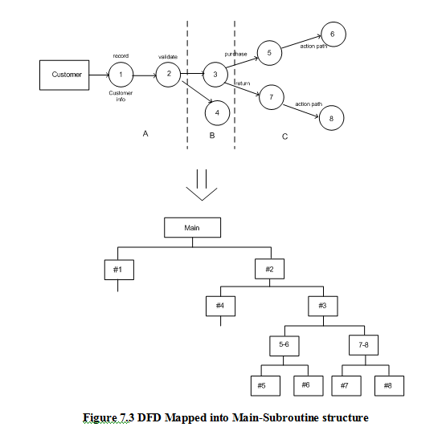

Slide 13
Main-Subroutine Characteristic
Benefits:
  Easy to decompose
    the system based on the definition of the tasks in a top-down refinement manner.
  This architecture can still be used in a sub-system of OO Design.
Limitations:
  Globally shared data in classical main-subroutines introduces vulnerabilities.
  Tight coupling may cause more ripple effects of changes

Slide 14
Master-Slave Architecture
Is a variant of the main-subroutine architecture style supports
  fault tolerance
  system reliability.
The master selects a particular service result among slaves by certain selection strategy.
The slaves may perform
  the same functional task by
    different algorithms
    different methods
  totally different functionality.

Slide 15
Master-Slave Architecture
Master
Slave
Slave
………..

Slide 16
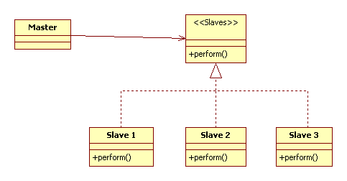
Master-Slave Architecture

Slide 17
Master-Slave Architecture
Applicable Design Domains :
  Used for the software system where the reliability is critical.
    due to the replication (redundancy) of servers.
  Also use the term master-slave or parent-child relationship in database schema design
    to specify the dependency of one entity on another.
    If the master node is deleted then the slave node does not have any reason to stay.

Slide 18
Layered Architecture
The system is decomposed into a number of higher and lower layers in a hierarchy
  Each layer consists of a group of related classes
    are encapsulated
      in package,
      in a deployed component
      or as a group of subroutines in the format of method library or header file.
  Each layer has its own sole responsibility

Slide 19
Layered Architecture
The interface of each layer encapsulates
  all detailed service implementations in
    the current layer and
    the interfaces of the layers below.
A request from higher layer to the layer below is made via
  method invocation
the response goes back up via
  method return.

Slide 20
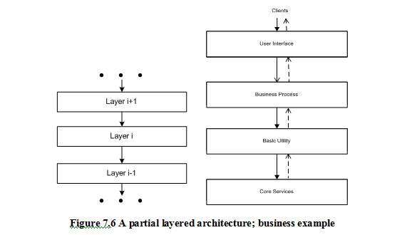
Layered Architecture

Slide 21
Layered Architecture
A simple software system may consist of two layers:
  Interaction Layer
  Processing Layer:
The Interaction layer provides
  User Interfaces to clients
  Takes requests
  Validates and Forwards request to processing layer for processing
  Responds to clients
The Processing layer
  Gets the forwarded requests
  Performs business logic process
  Accesses database
  Returns the results to its upper layer
  Lets upper layer respond to clients

Slide 22
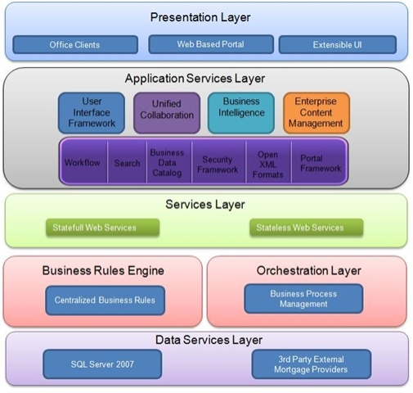

Slide 23
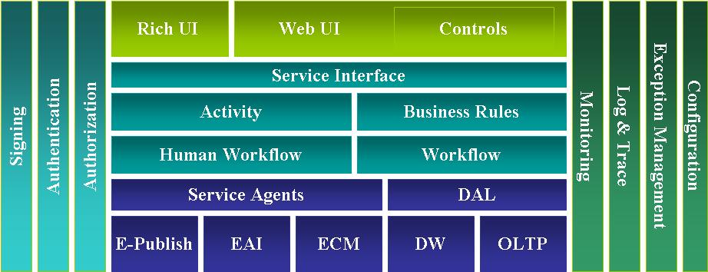

Slide 24
Layered Architecture
Applicable Design Domains
  Any system that can be divided
    Application specific portions
    Platform specific portions which provide generic services to the application of the system.
  Applications that have clean divisions between
    Core services
    Critical services
    User interface services, etc.
  Applications that have a number of classes that are closely related to each other
    can be grouped together into a package to provide the services to others.

Slide 25
Layered Architecture
Benefits:
  Incremental software development
    based on increasing levels of abstraction.
  Enhanced independence of upper layer to lower layer
    since there will be no impact from the changes of lower layer services as long as their interfaces remain unchanged.
  Enhanced flexibility
    interchangeability and reusability are enhanced due to the separation of the standard interface and its implementation.
  Component-based technology is a suitable technology to implement the layered architecture
    this makes the system much easier to allow for plug-and-play of new components.
  Promotion of portability
    Each layer can be an abstract machine deployed independently.

Slide 26
Layered Architecture
Limitations:
  Lower runtime performance: since
    a client’s request or a response to client must go through potentially several layers.
    overhead on the data organizing and buffering by each layer.
  Conflict of interlayer communication may cause deadlocks
  “bridging” may cause tight coupling.
    Ex : layer-i bridge to layer i+2,…
  Exceptions and error handling is an issue
    Since faults in one layer must propagate upwards to all calling layers.

Slide 27
Virtual machine
A virtual machine
  Is built up on an existing system
  Provides a virtual abstraction
    a set of attributes, and operations.
In most cases,
  A virtual machine separates a programming language or application environment from a execution platform.
a virtual machine looks like emulation software.

Slide 28
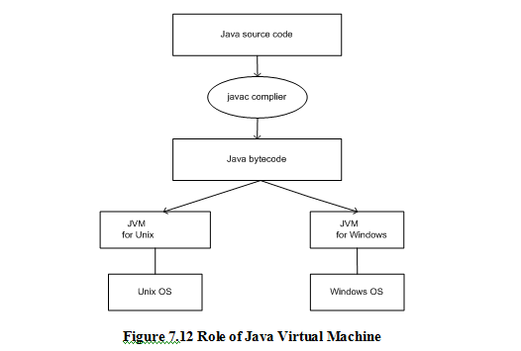

Slide 29
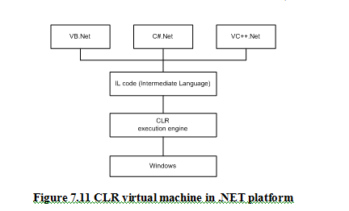

Slide 30
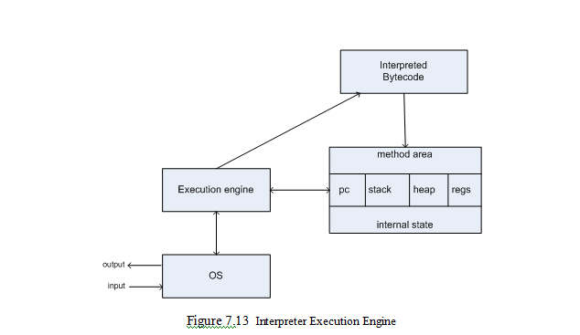

Slide 31
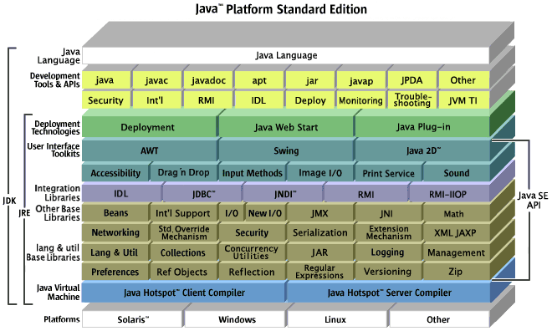

Slide 32
Virtual machine
Applicable Domain:
  Suitable for solving a problem by simulation or translation if there is no direct solution.
  Sample applications include
    Interpreters of microprogramming
    XML processing
    Script command language execution
    Rule-based system execution
    Smalltalk and Java interpreter typed programming language.

Slide 33
Virtual machine
Benefits:
  Portability and machine platform independency.
  Simplicity of software development.
  Simulation for disaster working model.
Limitations:
  Slow execution of the interpreter due to the interpreter nature.
  Additional overhead due to the new layer.

