Slide 1

Chapter 8
IMPLICIT ASYNCHRONOUS
COMMUNICATION SOFTWARE ARCHITECTURE

Slide 2
Objectives
• Introduce concepts of the asynchronous communication software architecture
• Describe the non-buffered event-based and buffered message-based architectures
• Discuss applicable domains
• Discuss the benefits and limitations of the asynchronous software architecture
• Discuss other related architectures

Slide 3
Implicit Asynchronous Comm.
Can be specified in 2 different modes:
  non-Buffered
  Buffered.
Refer some architecture that apply the
  publisher-subscriber patterns or
  producer-consumer patterns
    where the subscribers/consumers are interested in
      some events or
      messages issued by a publisher/producer.
Notes:
Ve tren bang de thao luan

Slide 4
Implicit Asynchronous Comm.
The message queue and message topic
  are typical buffered asynchronous architectures
  subscribers/consumers need to register their interests with
  the event/message is fired off
    when available on the buffered message queue or topic.
A message queue is
  a one-to-one or point-to-point architecture
    between message senders and message receivers;
A message topic is a one-to-many architecture
  between publishers and subscribers.

Slide 5
Non-Buffered Event-Based Implicit Invocations
Breaks the software system into 2 partitions:
  Event sources
  Event listeners.
The event registration process connects these two partitions.
There is no buffer available between these two parties.

Slide 6
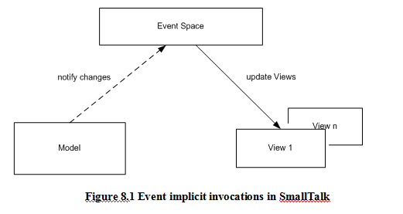

Slide 7
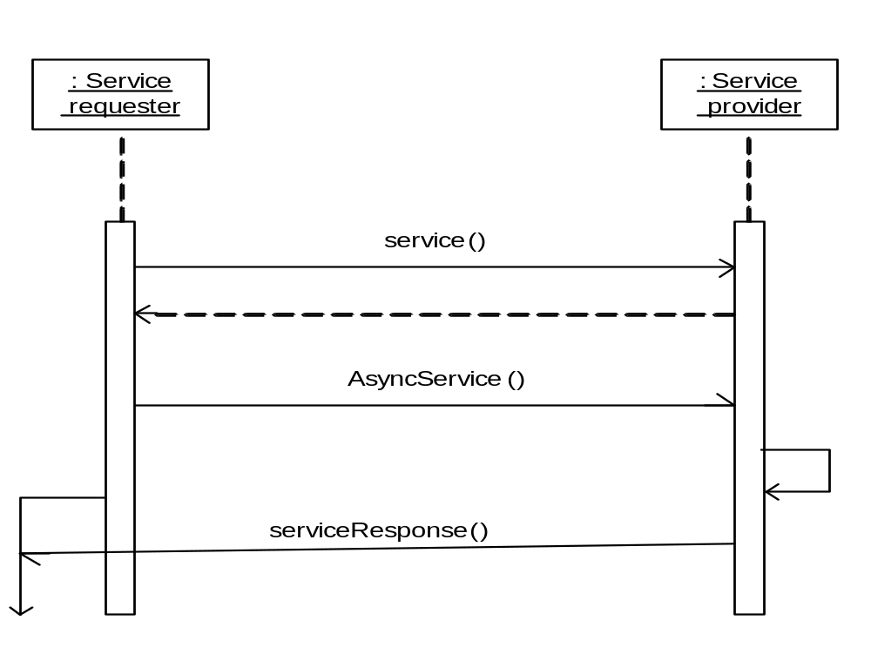

Slide 8
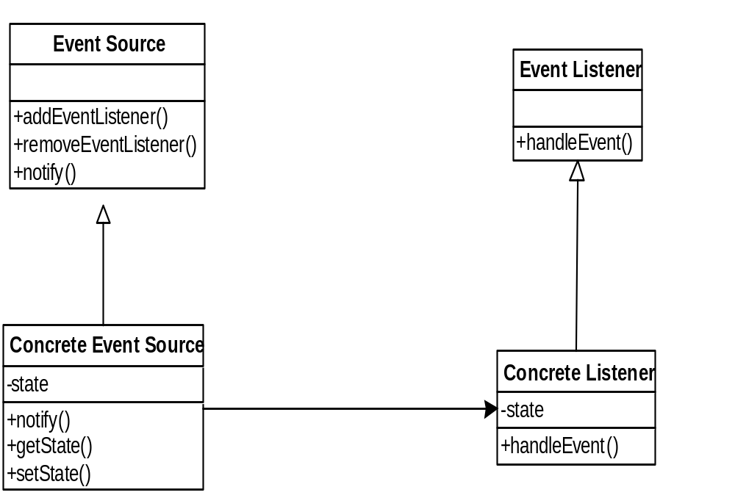
A typical event-based implicit invocation class diagram.

Slide 9
Non-Buffered Event-Based Implicit Invocations
The event source class must provide mechanisms to
  Register or Deregister event targets
  To notify event targets of the occurrence of the event.
Event targets must specify
  The action in the handleEvent() method to respond to incoming events.
Above the concrete classes are the interfaces for event source and event listener.

Slide 10
Non-Buffered Event-Based Implicit Invocations
Is a good solution for user interaction in a user interface application.
  Following are simple Java fragments that demonstrate how event sources and event targets (listeners) work together in an event-driven architecture for a user interface application.

Slide 11
package myEvent;
import java.applet.Applet;
import java.awt.*;
import java.awt.event.*;
public class Source extends Applet {
private TextField text1;
private Button button1;
private Target target; <- Target
// Source is the place where event is triggered
public void init() {
text1 = new TextField(20);
add(text1);
button1=new Button("Click Me");
add(button1);
target = new Target(button1,text1);
button1.addActionListener(target); <- Notice
}
}

Slide 12
The Target registers with the event source by the following statement button1.addActionListener(target)where target is an object of class Target.
The “Click Me” button is the event source.
If it is pressed it will fire off an AWT event of ActionEvent, which will be intercepted by an ActionListener that has registered for it.

Slide 13
In this case, the Target is the ActionListener where the actionPerformed()method specifies the event handling processing.
The greeting message of “Hello <user>” will be displayed in the text filed text1 where the <user> is the user name typed in the text field before the button is pushed.

Slide 14
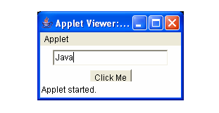

Slide 15
package myEvent;
import java.applet.Applet;
import java.awt.*;
import java.awt.event.*;
public class Target implements ActionListener {
  private Button button1;
  private TextField text1;

Slide 16
Contd…….
public Target(Button b,TextField t) {
button1 = b;
text1 = t;
}
// Target is the event listener
public void actionPerformed(ActionEvent event) {
String msg = new String("Hello");
if (event.getSource()==button1) {
text1.setText(msg + " " + text1.getText());
}
}
}

Slide 17
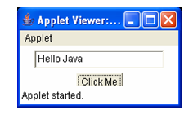

Slide 18
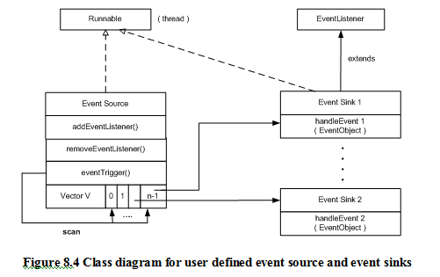

Slide 19
Non-Buffered Event-Driven Architecture
Applicable Domain
  Interactive GUI component communication
  Integrated Development Environment (IDE) tools.
  Applications that require loose coupling between components
    that need to notify or trigger other components to take actions upon asynchronous notifications.
  The implementation of state machines.
  When event handlings in the application are not predictable.

Slide 20
Non-Buffered Event-Driven Architecture
Benefits
  Framework availability:
    Many vendor APIs such as Java AWT and Swing components available.
  Reusability of components:
    Easy to plug-in new event handlers without affecting the rest of the system.
  System maintenance and evolution:
    Easy to update both of event sources and targets.
  Independency and flexible connectivity:
    Dynamic registration and deregistration can be done dynamically at run-time.
  Possibility of parallel execution of event handlings

Slide 21
Non-Buffered Event-Driven Architecture
Limitations:
  Difficult to test and debug the system
    Since it is hard to
      predict and verify responses and
      predict and verify the order of responses from the listeners.
  The event trigger cannot determine
    When the response finished
    The sequence of all responses.
  Tight coupling between event sources and their listeners
    More than in message queue based or message topic based implicit invocation.
    Data sharing and data passing in the event object forwarded from event sources to event listeners
      Make the coupling tighter
      Make somewhat hard to debug and test.
  Reliability and overhead of indirect invocations may be an issue.

Slide 22
Buffered Message-Based Software Architecture
Breaks the software system into 3 partitions:
  Message producers
  Message consumers
  Message service providers.
They are connected asynchronously by
  a message queue
  a message topic.
This architecture is also considered data-centric.

Slide 23
Buffered Message-Based Software Architecture
In a message-based system ( Fire & Forget system)
  a sender
    sends out a message and
    does not care much of the response from the receivers
    except for guaranteed message delivery
  Typically implemented as a Message-Oriented Middleware (MOM)
    providing a reliable message service on a distributed system.
Has been used for a long time.
  Messaging systems are used to build
    reliable, scalable, and flexible distributed applications supporting asynchronous communication.

Slide 24
Buffered Message-Based Software Architecture
Is a peer-to-peer client-server architecture.
The high degree of independency between components
  is one of its most important features.
Its high scalability, interoperability in heterogeneous networks, and reliability
  make the messaging system more popular.

Slide 25
Buffered Message-Based Software Architecture
What is a message?
  A structured data with
    a message id,
    message header,
    property, and
    a body.
  Ex : an XML document, Windows Message
What is messaging?
  a mechanism or technology that handles
    asynchronous message or
    synchronous message.
  -> delivery effectively and reliably

Slide 26
Buffered Message-Based Software Architecture
A messaging client can
  Produce message
  Send messages to other clients
  Also consume messages from other clients.
Each client must register with
  a messaging destination (a specific queue)
    in a connection session provided by a message service provider for
      Creating messages
      Sending messages
      Receiving messages
      Reading messages
      Validating messages
      Processing messages.

Slide 27
Point-to-Point Messaging (P2P)
The message queue architecture is a point-to-point structure between producer and consumer.
Is composed of
  Message queues
  Senders
  Receivers.
Each message is sent to a destination which is maintained by the consumer
Consumer clients extract messages from these queues.

Slide 28
Point-to-Point Messaging (P2P)
The queue retains all messages they received
  Until the messages are consumed
  Or until the messages expire.
Each message has only one consumer,
  i.e., the message will be “gone” once it is delivered.
A sender and a receiver of a message have
  no timing dependencies,
    The receiver can still get the message even
      it was not available when the sender sent the message.
Requires every message sent to the message queue
  must be processed successfully by a consumer.

Slide 29
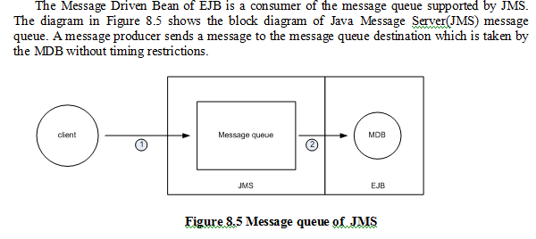

Slide 30
Publish-Subscribe Messaging (P&S)
Is a hub-like architecture
  publisher clients send messages to
    a message topic that
      acts like a bulletin board.
  Message topic publishers and subscribers
    are not aware of each other.
Difference between P&S from P2P
  Each topic message can have multiple consumers.
    The system delivers the messages to all its multiple subscribers.

Slide 31
Publish-Subscribe Messaging (P&S)
Have a timing coupling dependency.
  A message topic consumer
    must subscribe the topic
      before it is published
    unless subscription is a durable subscription
      which is able to receive any topic messages
        sent while the subscribers are not active or not ready yet.

Slide 32
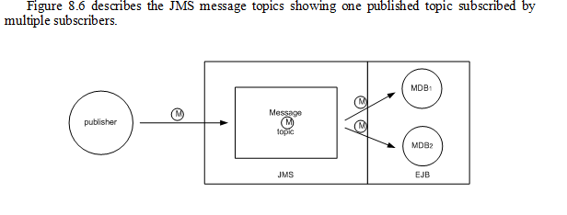

Slide 33
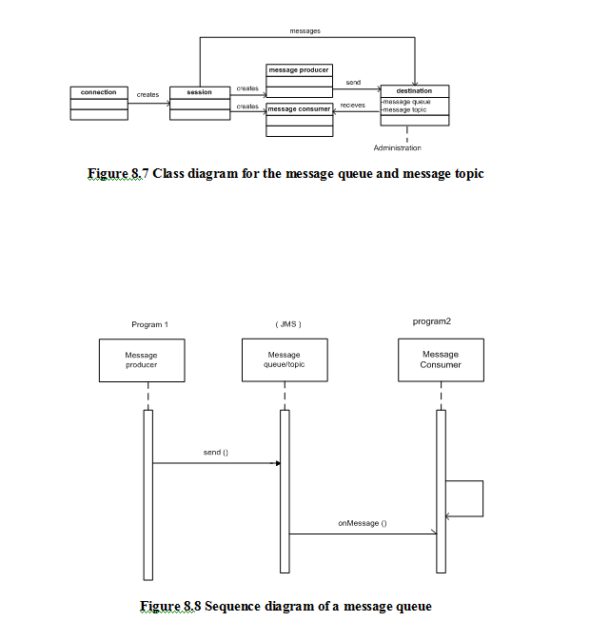

Slide 35
Message-Based Architecture
Applicable Domain:
  Where the communication between a producer and a receiver needs
    buffered message-based asynchronous implicit invocation for
      performance purpose
      distribution purpose
  Wants the components not to depend on information about other components' interfaces
    so that components can be easily replaced.
  Wants the application to run
    whether or not all other components are up and running simultaneously.
  The application business model allows a component to
    send information to another
    and to continue to operate on its own
      without waiting for an immediate response.

Slide 36
Message-Based Architecture
Benefits:
  Providing high degree of anonymity
    between message producer and consumer.
      The message consumer does not know
        who produced the message (user independence)
        where the producer lives on the network (location independence).
        when the message was produced (time independence).
  Supporting for concurrency
    among consumers
    between producer and consumers.

Slide 37
Message-Based Architecture
Benefits:
  Providing scalability and reliability of message delivery;
    Reliability mechanisms include
      Control level setting of message acknowledgement
      Message persistence setting without loss
      Message priority level setting
      Message expiration setting
  Supporting batch processing.
  Supporting loose coupling
    between message producers and consumers
    between legacy systems and modern systems for integration development.

Slide 38
Message-Based Architecture
Limitations:
  Capacity limit of message queue.
    This is not an inherent limitation
    but an implementation issue that can be eased
      if the queue is implemented as a dynamic data structure
        e.g., linked lists.
    However, there is an absolute limit based on available memory.
  Difficult to determine the numbers of agents
    needed to satisfy the loose couplings between agents.
  Complexity development
    caused by the complete separation of presentation and abstraction by control in each agent
      since communications between agents only take place between the control of agents.
  Increased complexity of the system design and implementation

Slide 39
Summary
Implicit invocation architectures break the system into two parties.
One [party a publisher, sender, producer, source, or any other titles for event or message announcement, and the other has subscriber, receiver, consumer, target, or any other title with the same meaning for registering their interest and handling the events or messages as the case may be.
The communication between these two parties can be synchronous or asynchronous in a one-to-one (message queue), one-to-many (message topic, event-based), or many-to-one (event-based) mode.

Slide 40
Thus, the implicit invocation architectural style has its invariants based on whether the event source or message sender know what components are interested in such event or message; whether they care how the event target or message receiver will handle the event or message; and whether the two parties (source and target) are loosely connected.

Slide 41
This architectural style is commonly used in user interface design, e-commerce application design, and other distributed transactional business applications where the system involve many pairs of producer-consumer models that are loosely and asynchronously connected.
The coupling between the sender and the receiver in message-based implicit invocation connected system is even looser than the event-based connected system because there is no time constraints dependency.

Slide 42
A message receiver can still receive messages even if it is not running at the time the message was sent.
In an event-based invocation system the event handler must be ready in order to be able to intercept an event and take an action upon that event.
This architectural style is commonly used in the connection between the Model sub-system and the View sub-system in an MVC or PAC architecture.

