Slide 1
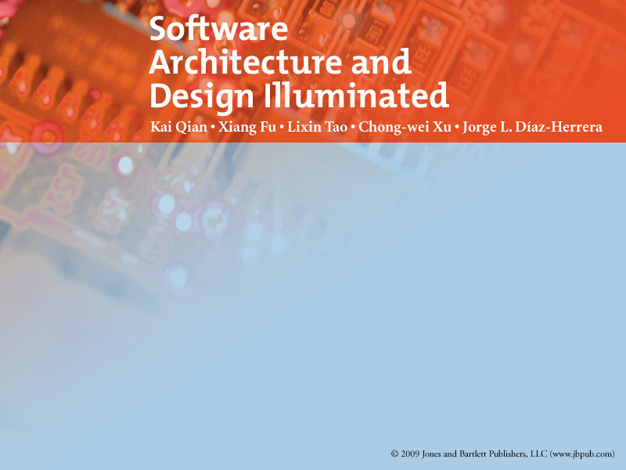
Chapter 9
INTERACTION ORIENTED SOFTWARE ARCHITECTURES

Slide 2
Objectives
• Introduce concepts of interaction-oriented software architectures.
• Describe the MVC and PAC architectural styles.
• Discuss the applicable domains of interaction-oriented software architectures.
• Discuss the benefits and limitations of the interaction-oriented software architecture style.
• Discuss other related architectures.

Slide 3
INTERACTION ORIENTED SOFTWARE ARCHITECTURES
Decomposes the system into 3 major partitions
  Data module
  Control module
  View presentation module
Each module has its own responsibilities.
  The data module provides
    The data abstraction
    All core business logic on data processing.
  The view presentation module is responsible for
    Visual or audio data output presentation
    May also provide user input interface as well when necessary.

Slide 4
INTERACTION ORIENTED SOFTWARE ARCHITECTURES
  The control module determines the flow of control involving
    View selections
    Communications between modules
    Job dispatching
    Certain data initialization and system configuration actions.
The key point is “the separation of user interactions from data abstraction and business data processing”.
  Since there may be many view presentations in different formats
    Multiple views may be supported for the same data set.
  Even for a specific view presentation, the interfaces or views may need to change often
    Loose coupling between data abstractions and its presentations is helpful.

Slide 5
INTERACTION ORIENTED SOFTWARE ARCHITECTURES
The loose coupling connections can be implemented in different ways
  explicit method invocation
  implicit registration/notification method invocation.
All 3 modules may be fully connected.
We will discuss about 2 major styles categories of interaction-oriented architectures
  Presentation-Abstraction-Control (PAC) architecture
  Model-View-Controller (MVC) architecture.

Slide 6
Both of MVC and PAC are used for interactive applications such as
  Web online applications
  Distributed applications with multiple tasks and user interactions.
They are different in their flow of control and organization.
  PAC
    is an agent based hierarchical architecture
  MVC
    does not have a clear hierarchical structure
    all three modules are connected together.

Slide 7
Model-View-Controller (MVC)
MVC programming is the application of this 3-way factoring
  Objects of different classes take over the operations related to the application domain (the model)
  The display of the application's state (the view)
  The user interaction with the model and the view (The controller)

Slide 8
Model-View-Controller (MVC)
Models is
  the domain-specific software simulation
  or implementation of the application's central structure.
Views deal with everything graphical
  Request data from their model
  And display the data
Controllers contain the interface between
  Associated models
  Associated views
  and the input devices (e.g., keyboard, pointing device, time).

Slide 9
MVC-I
The MVC-I is a simple version of MVC architecture
The system is simply decomposed into 2 sub-systems
  The Controller-View
    takes care of input and output processing and their interfaces
    takes appropriate action upon the changes on the model
  The Model.
    copes with all core functionality and the data.
    notifies the Controller-View module of any data changes so that any graphics data display will be changed accordingly
The Controller-View module registers with the Model module.

Slide 10
MVC-I
The connection between the Controller-View and the Model
  Can be designed in a pattern of subscribe-notify
    the Controller-View subscribes to the Model
    the Model notifies the Controller-View of any changes.
  Note: the Controller-View is an observer of the data in the Model module.

Slide 11
MVC-I
DB
View - Controller
Model

Slide 12
MVC-I Example
A simple GUI example designed in MVC-I.
  The View has a GUI interface with two text fields
    the user to enter a new number in one of the text field
    the accumulated summation is displayed in the other text field.
  The summation is held in the Model module.
  Model provides all business logics including all getter and setter methods.

Slide 13
MVC-I Example
  Whenever the data in the Model is updated
    The Model will notify the registered GUI components of changes
    Then the GUI components will update their displays.
  -> This is why we say that the data in the Model of MVC architecture is active.

Slide 14
public class ViewController extends JFrame implements
ActionListener {
Model myModel; <- Model
JTextField myInput; <- View’s element
JTextField mySum; <- View’s element
JPanel content;
public ViewController(Model model) {
myModel = model;
myInput = new JTextField(5);
mySum = new JTextField(15);

Slide 15
content = new JPanel();
content.add(myInput);
content.add(mySum);
setContentPane(content);
myInput.addActionListener(this);
}
public void update() {
mySum.setText(" " + myModel.getSum());
}
public void actionPerformed(ActionEvent e) {
try {
myModel.add(myInput.getText());
} catch (Exception ex) { ... }
}
}

Slide 16
public class Model {
int sum;
Vector listeners;
public Model() {
sum = 0;
listeners = new Vector();
}
public void attach(ViewController vc) {
listeners.addElement(vc);
}
public void notifyVC() {
for (int i = 0; i < listeners.size(); i++) {
ViewController vc =(ViewController) vc.update();
}
}
public void add(String st) {
sum += Integer.parseInteger(st);
notifyVC();
}
public int getSum() {
return sum;
}
}

Slide 17
public class MVC1{
public static void main(String[] args) {
Model myModel = new Model();
ViewController vc =
new ViewController(myModel);
myModel.attach(vc);
vc.setTitle("my MVC-I");
vc.setVisible(true);
}
}

Slide 18
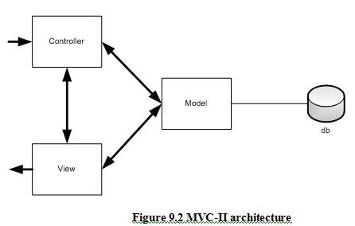
MVC-II

Slide 19
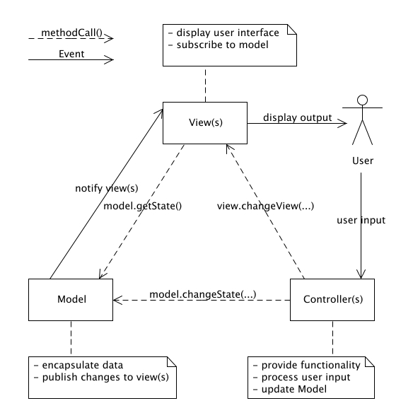

Slide 20
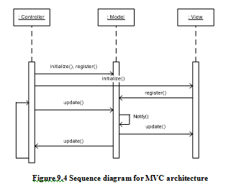

Slide 21
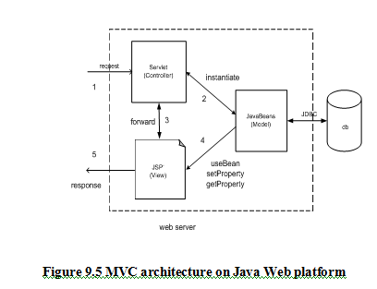

Slide 22
MVC architecture:
Applicable domain
  Suitable for interactive applications
    Multiple views are needed for a single data model
    The interfaces are prone to data changes frequently.
    There are clear divisions between controller, view, and data modules
      so that different professionals can be assigned to work on different aspects of such applications concurrently.

Slide 23
MVC Architecture
Benefits
  Many MVC vendor framework toolkits available.
  Multiple views synchronized with same data model
  Easy to plug-in new or change interface views
    thus allowing updating the interface views with new technologies without overhang the rest of the system.
  Very effective for developments
    if Graphics expertise professionals, programming professionals, and data base development professionals are working in a team in a designed project.

Slide 24
MVC Architecture
Limitations
  Does not fit well agent-oriented applications such as
    Interactive mobile
    Robotics applications.
  Any data model change expensive.
    Multiple pairs of controllers and views based on the same data model
  In some cases the division between the View and the Controller is not clear

Slide 25
Presentation-Abstraction-Control (PAC)
Similar to MVC but with some important differences.
  The PAC was developed from MVC to support the application requirement of multiple agents in addition to interactive requirements.
  In PAC, the system is decomposed into a hierarchy of many cooperating agents.
    Each agent has 3 components
      Presentation
      Abstraction
      Control

Slide 26
Presentation
Abstraction
Controller

Slide 27
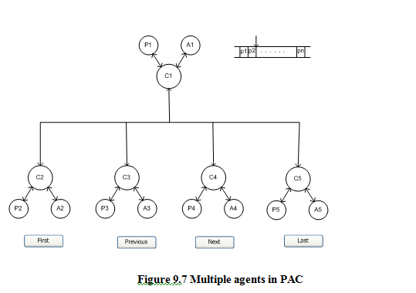

Slide 28
The Control component in each agent
  is in charge of communications with other agents.
The top-level agent provides
  core data and business logics.
The bottom level agents
  provide detailed specific data and presentations.
A middle level agent play
  a role of coordinator of low-level agents.
There are no direct connections between
  Abstraction component
  Presentation component

Slide 29
Very suitable for any distributed system where
  all the agents are
    distantly distributed
  each of them has its own functionalities with
    data and
    interactive interface.
  all agents need to communicate with other agents in a well-structured manner.
also used in applications with rich GUI components where
  each of them keeps
    its own current data and
    Its interactive interface and
    needs to communicate with other components.

Slide 30
Components are required if necessary
  For some middle level agents
    the interactive presentations are not required
  The control component is required for all agents
    because this is the only way for an agent to talk to another agent.

Slide 31
The Control component is
  a mediator
    between the Presentation component and the Abstraction component within the agent,
  a bridge
    between the agent itself and other agents as well.
The Presentation component and the Abstraction component are loosely coupled.
The Presentation component is responsible for both
  data input and
  data output in GUI interfaces where the data come from the Abstraction component.
The Abstraction component is responsible for
  providing logical data concepts and services
  encapsulating all detailed data manipulation.

Slide 32
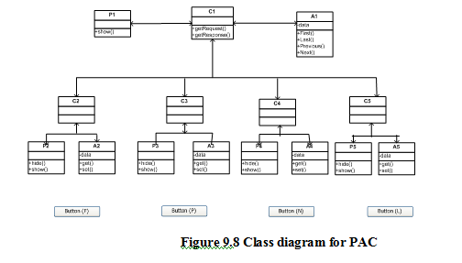

Slide 33
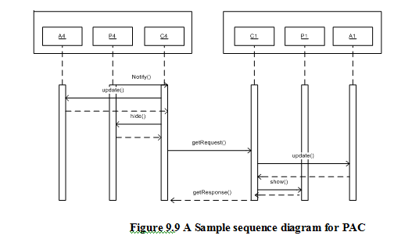

Slide 34
PAC architecture:
Applicable domain
  Suitable for an interactive system
    Where the system can be divided into many cooperating agents in a hierarchical manner.
    Each agent has its own specific assigned job.
  Suitable when the coupling among the agents is expected to be loose
    so that changes on an agent does not affect others.

Slide 35
PAC architecture
Benefits
  Support of multi-tasking and multi-viewing.
  Support agent reusability and extensibility.
  Easy to plug-in new agent or replace an existing one.
  Support for concurrency where
    multiple agents are running in parallel in
      different threads or
      different devices or
      computers.

Slide 36
PAC Architecture
Limitations:
  Overhead due to the control bridge
    between presentation and abstraction and the communication of controls among agents.
  Difficult to determine the right number of the agents
    due to the loose coupling and high independence between agents
  Complete separation of presentation and abstraction
    by control in each agent generate development complexity since communications between agents only take place between the controls of agents.

