Slide 1
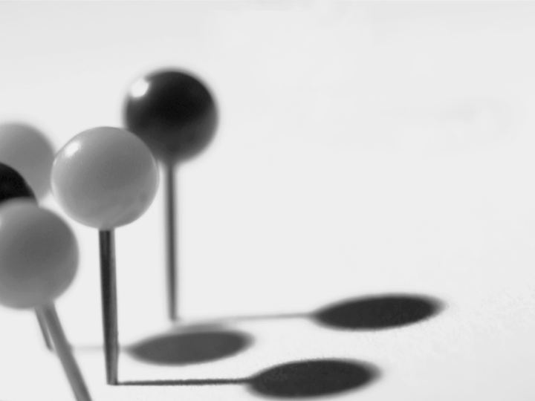

Fast and Robust Ellipse Detection
A Novel Multi-Population Genetic Algorithm
J Yao, N Kharma et al.
Computational Intelligence Lab
Electrical & Computer Eng. Dept.
Concordia University
Montréal, Québec, Canada
July 2006

Slide 2
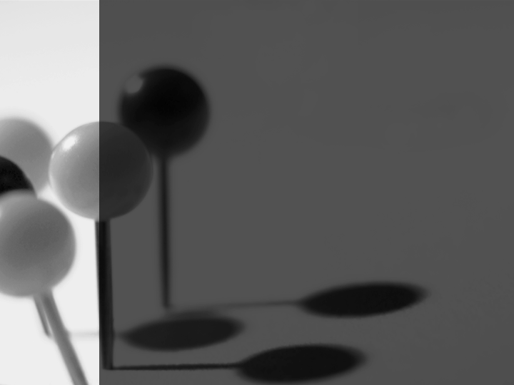
Criteria
(A) The result is an improvement over a patented invention
(B) The result is equal to or better than a result that was accepted as a new scientific result at the time when it was published in a peer-reviewed scientific journal.
Multi-population GA
≥
1. Hough Transform Family
Randomized Hough Transform
2. Multi-Population Genetic Algorithm
≥
3. Comparison
Classical Hough Transform
4. Summary

Slide 3
Agenda
1. Hough Transform Family

Slide 4
Hough Transform Family
Hough Transform
Generalized Hough
Transform²
U.S. Patent
3,069,654¹
Hough and P.V.C., 1962
Duda and Hart, 1972
Xu et. al., 1990
Randomized Hough
Transform³

Slide 5
Randomized Hough Transform = RHT
Improvements over standard
Hough Transform (McLaughlin, 1998)
Accuracy
Speed
Memory
False
positive

Slide 6
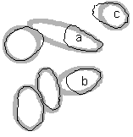

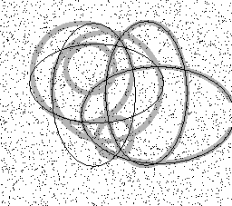
RHT?!
Coarse Approximation
False Positive
Inaccuracy

Slide 7
Agenda
1. Hough Transform Family
2. Multiple Population Genetic Algorithm

Slide 8
Multi-Population GA = MPGA
Essence of
Clustering
Exploitation
Multiple
population
Bi-objective
MPGA
Diversification
Multi-modality
Specialized
Mutation
Enhancement

Slide 9
MPGA vs. RHT
RHT
MPGA
  Progressively
  enhanced
Sampling
  Independent
  Blind
  Heuristic
  Directed
Accumulative
Blind
Search
  Little noise
  Few targets
High noise
Multiple targets
Suitable
Search

Slide 10
Agenda
1. Hough Transform Family
2. Multiple Population Genetic Algorithm
3. Comparison*
* Yao, et. al., 2005

Slide 11
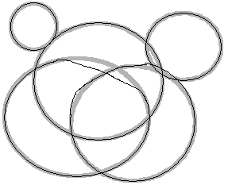
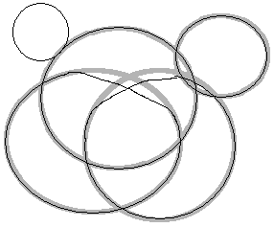
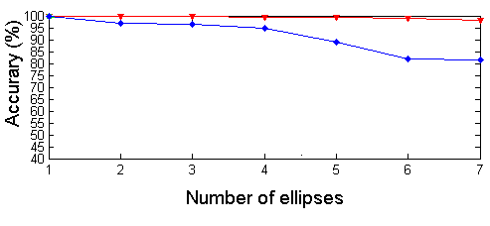
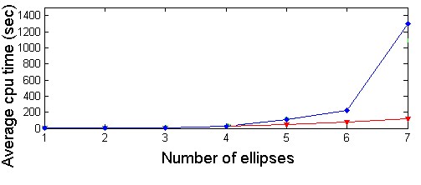

Detection of Multiple Ellipses
MPGA
RHT

Slide 12
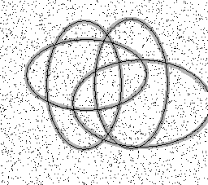
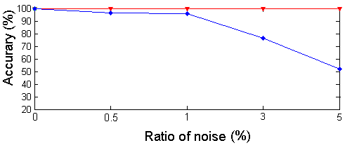
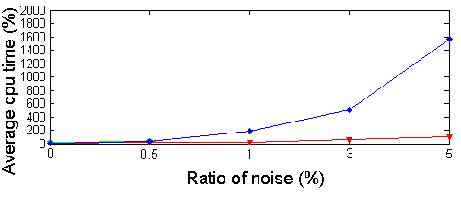
The Effect of Noise I
MPGA
RHT

Slide 13
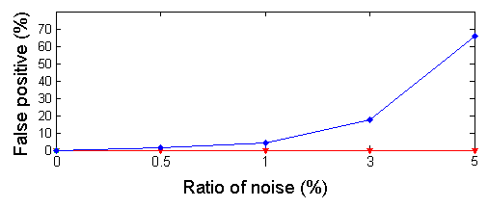
The Effect of Noise II

Slide 14




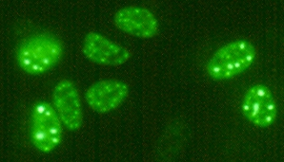
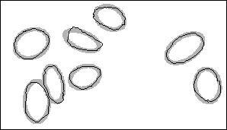
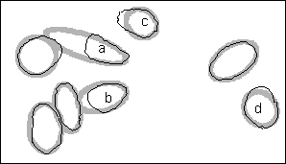
Results on Real World Images
Handwritten Characters
MPGA
RHT Returns False Positives
Road
Signs
MPGA
RHT Misses Smaller Ellipses
Microscopic Images
MPGA
RHT Provides
Coarse Approximation

Slide 15
Real World Images - Statistics
 | MPGA | RHT
Accuracy (%) | 92.761 | 64.387
Average CPU Time (sec) | 134.58 | 809.73
False Positive (%) | 6.9048 | 18.633

Slide 16
Agenda
1. Hough Transform Family
2. Multi-Population Genetic Algorithm
3. Comparison
4. Summary

Slide 17
Summary
Accuracy
Robustness
Efficiency
-- MPGA
Better than classical…
-- RHT
Oldest…
-- classical HT

Slide 18
References
Hough and P.V.C., Methods and Means for Recognizing Complex Patterns, U.S. Patent 3,069,654, 1962.
Duda, R. O. and P. E. Hart, "Use of the Hough Transformation to Detect Lines and Curves in Pictures," Comm. ACM, Vol. 15, pp. 11-15, 1972.
McLaughlin, R. A., “Randomized Hough Transform: Improved ellipse detection with comparison”, Pattern Recognition Letters 19 (3-4), 299-305, 1998.
L. Xu, E. Oja, and P. Kultanen. Anew curve detection method: Randomized Hough Transform (RHT). Pattern Recognition Letters, 11:331-338, 5 1990.
Yao, J., Kharma, N., and Grogono, P, "A multi-population genetic algorithm for robust and fast ellipse detection", Pattern Analysis & Applications, Volume 8, Issue 1 - 2, Sep 2005, pp. 149-162.

