Slide 1
Color Segmentation: Color Spaces and Illumination
Mohan Sridharan
University of Birmingham
mzs@cs.bham.ac.uk

Slide 2
Talk Outline
Color segmentation: a simple outline.
Color Spaces:
  RGB family (RGB, CMY).
  YCbCr.
  HSV.
  LAB.
Illumination:
  The effect on segmentation.
  Representation.
  Adapting to change.

Slide 3
Talk Outline
Color segmentation: a simple outline.
Color Spaces:
  RGB family (RGB, CMY).
  YCbCr.
  HSV.
  LAB.
Illumination:
  The effect on segmentation.
  Representation.
  Adapting to change.

Slide 4

Sample Video – Input

Slide 5
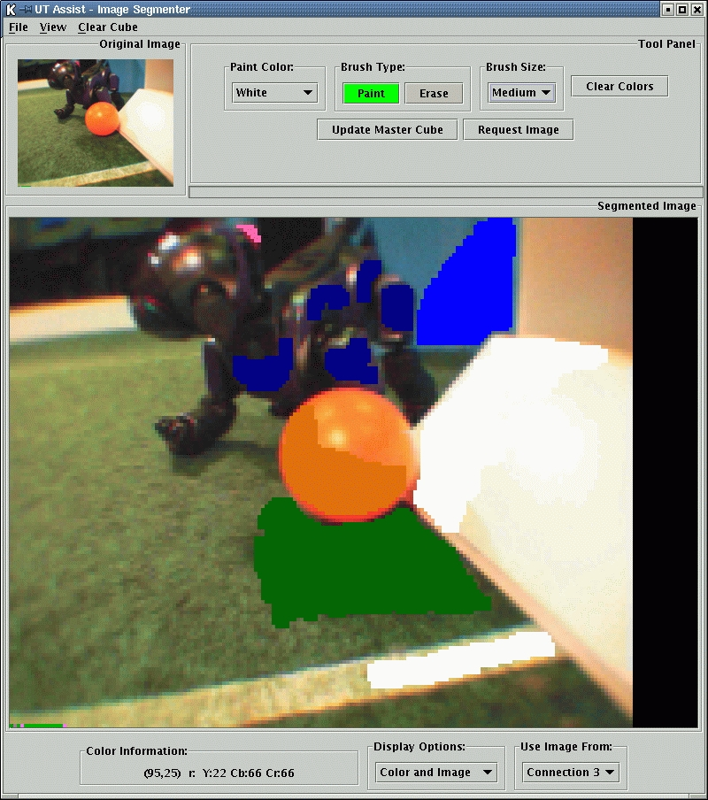
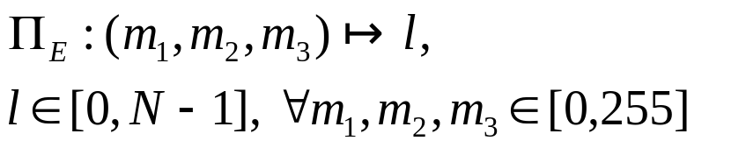
Color Segmentation – Calibration
Assign color labels to 256*256*256 possible combinations: Color Map.
Hand-label discrete colors in image regions – offline processing.
Locally Weighted average – Color map generalization.

Slide 6
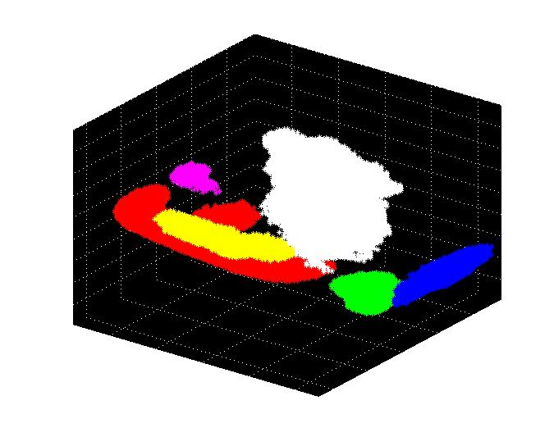
Sample Color Map
Y
Cr Cb

Slide 7

Sample Video – Objects Superimposed

Slide 8
Talk Outline
Color segmentation: a simple outline.
Color Spaces:
  RGB family (RGB, CMY).
  YCbCr.
  HSV.
  LAB.
Illumination:
  The effect on segmentation.
  Representation.
  Adapting to change.

Slide 9
Color Spaces – What and Why?
Means of representing colors.
Means of distinguishing between colors.
Different color spaces for different applications.
Visually appealing ☺

Slide 10
Color Space – RGB, CMY
RGB:
  Most common – graphics and displays.
  Additive and Device Dependent.
  Color perception not absolute.
CMY:
  Common – graphics and printers.
  Subtractive and Device Dependent.
  C = 1-R, M = 1-G, Y = 1-B.
  Color perception not absolute.

Slide 11
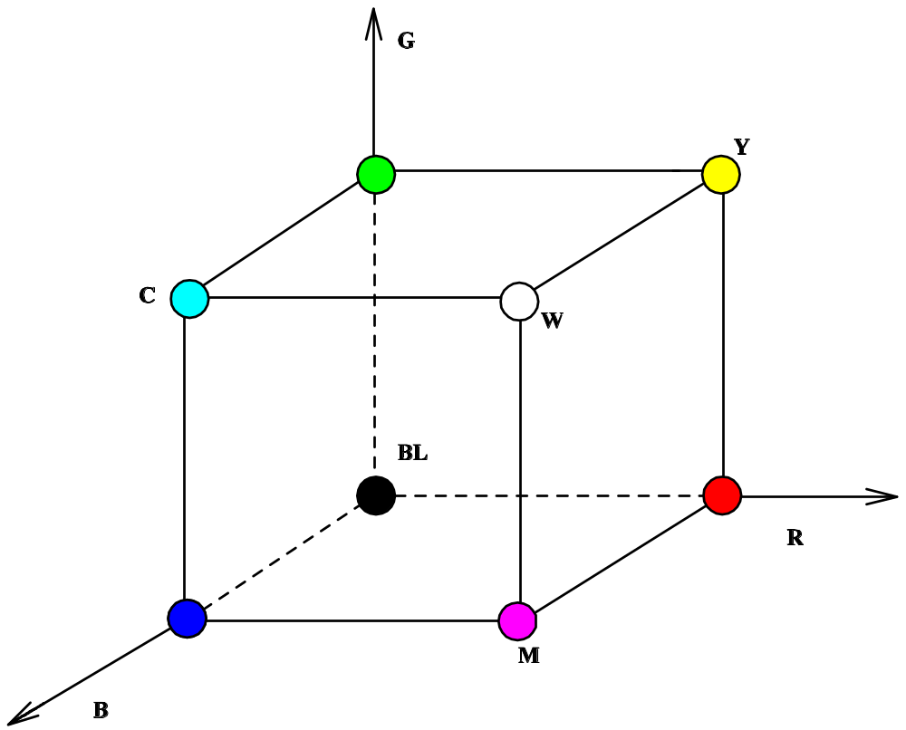
Color Space – RGB, CMY

Slide 12
Color Space – Normalized RGB (rgb)
Normalize individual components of RGB.
  r = R / (R+G+B)
  g = G / (R+G+B)
  b = B / (R+G+B)
Provides some robustness to illumination changes.
Used extensively for human skin, face detection.

Slide 13
Color Space – YCbCr
Video systems, television.
Device Dependent.
Color perception not absolute.
Separate luminance from color components.
  Y = Luminance.
  Cb = Difference from B (blue).
  Cr = Difference from R (red).

Slide 14

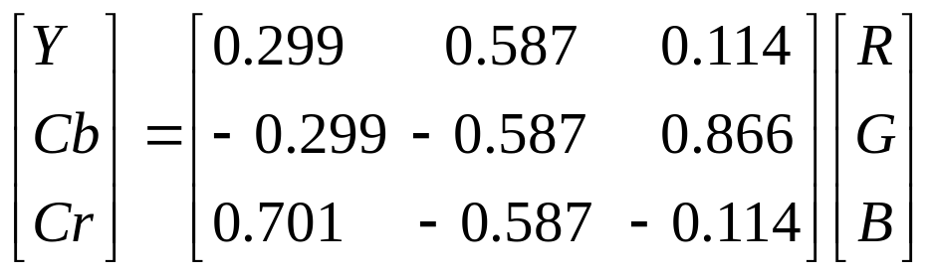
YCbCr in RGB – Video
RGB to YCbCr: Linear Transformation.

Slide 15
Color Space – HSV
Common among artists.
Based on artistic perception.
Hue, Saturation and Value.
  Hue = tint of color.
  Value = brightness of color.
  Saturation = strength of color.
Easy to visualize colors.

Slide 16
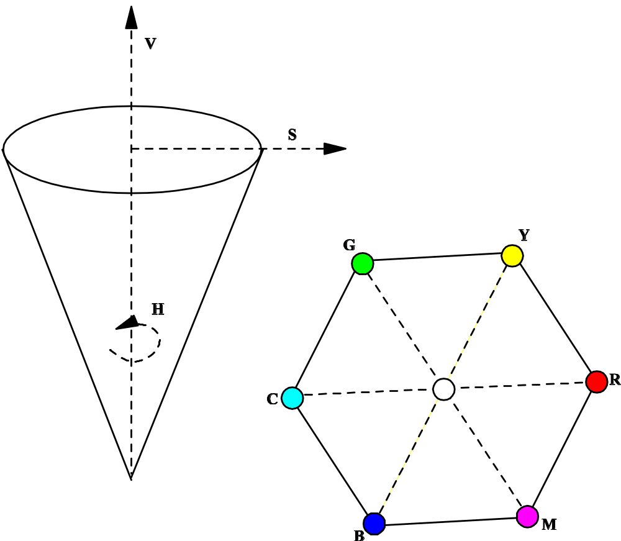
Color Space – HSV
Notes:
Describe the organization of colors, especially the separation of hue – hexagonal top view – from the saturation and value.

Slide 17
Color Space – LAB
Perceptually motivated.
Absolute color space:
  Colors are abstract and unambiguous.
Geometric distance proportional to perceptual distance.
Darker colors clustered together, brighter ones well separated.
More robust to illumination changes.

Slide 18
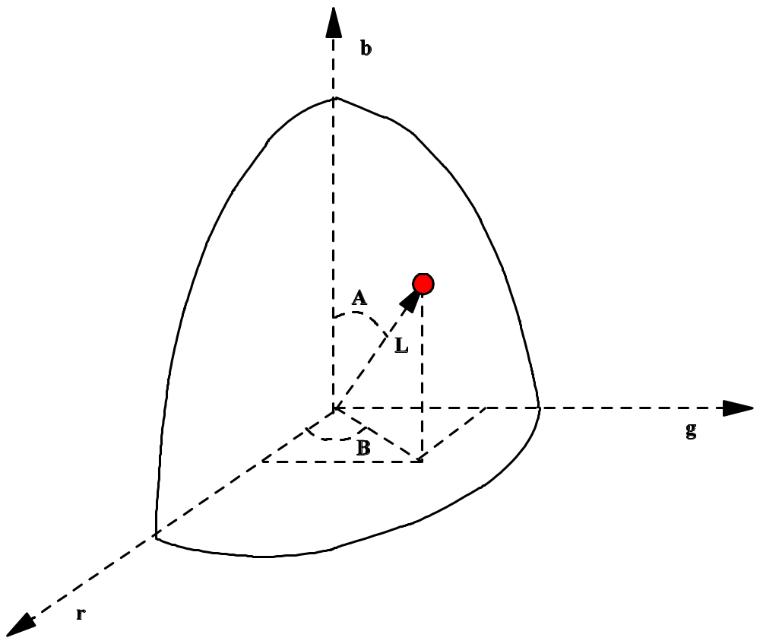
Color Space – LAB
Notes:
Explain general transformation from RGB to LAB to show that it is actually a spherical coordinate system…

Slide 19
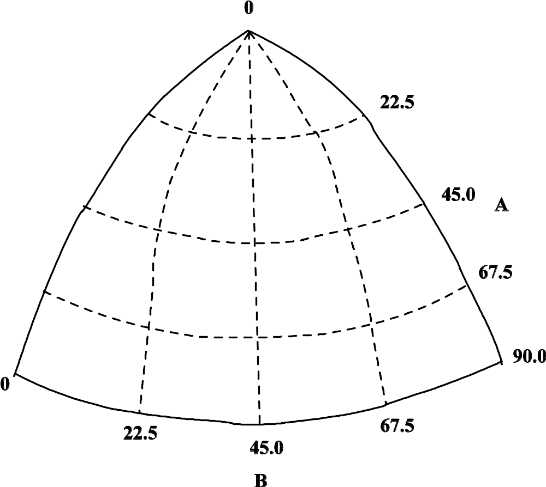
Color Space – a slice of LAB
Notes:
Describe the organization of the cells to show how darker colors are grouped together and brighter colors are spread out – distances similar to the perceived distance in the human visual system.

Slide 20
Color Spaces – Summary
Several Color spaces available.
Each has advantages and disadvantages.
Select color space based on requirements and application.

Slide 21
Talk Outline
Color segmentation: a simple outline.
Color Spaces:
  RGB family (RGB, CMY).
  YCbCr.
  HSV.
  LAB.
Illumination:
  The effect on segmentation.
  Representation.
  Adapting to change.

Slide 22
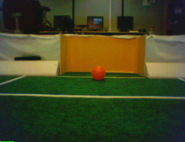
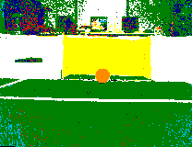
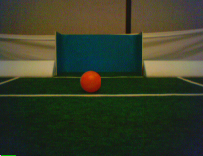
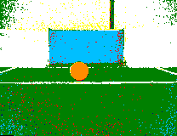
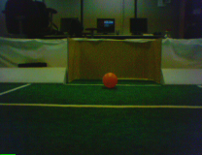
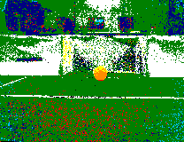
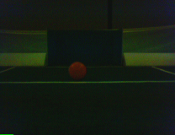
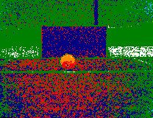
Illumination Sensitivity – Problem
Trained under one illumination:
Under different illumination:

Slide 23
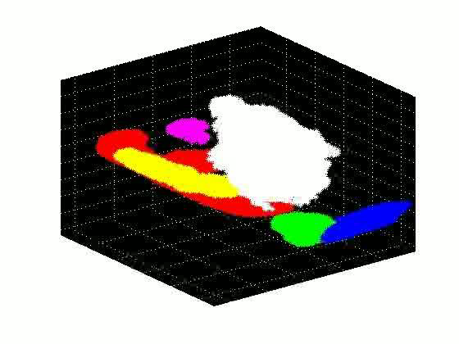
Illumination Sensitivity – Video

Slide 24
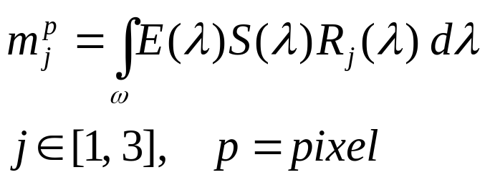
Illumination – overview
Sensor response depends on:
  scene illuminant, surface reflectance of objects, spectral response of the sensor.
Measure all three factors ahead of time for a given scene and set of illuminants.
Robots frequently have to work in new situations:
  Robot can learn useful representations.

Slide 25
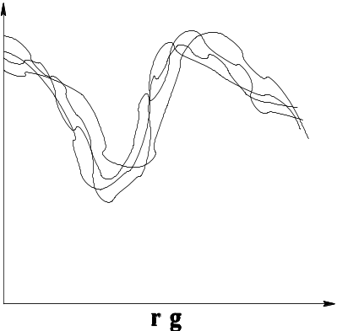
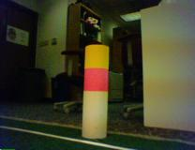
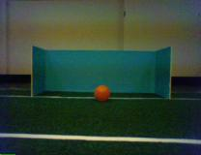
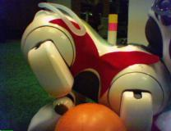
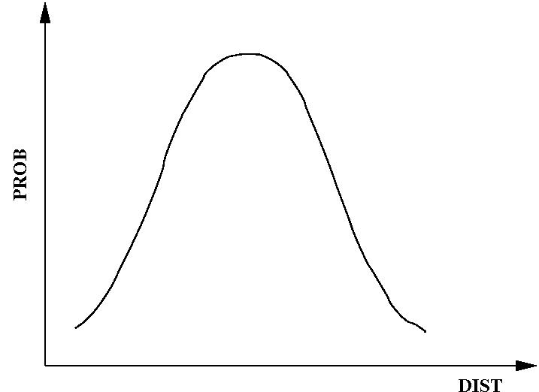
Illumination Representation
Color Map.
Distributions in color space.
Distribution of distances between color space distributions.

Slide 26
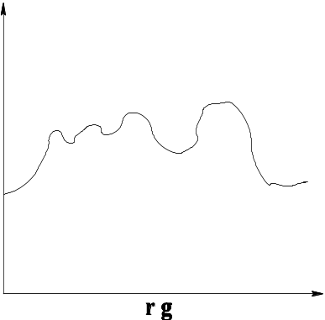
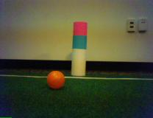
Major Illumination Changes - Approach
Periodically generate test image distribution.
Compute average distance between test distribution and known distributions D_{avg}.

Slide 27

Major Illumination changes – Video

Slide 28
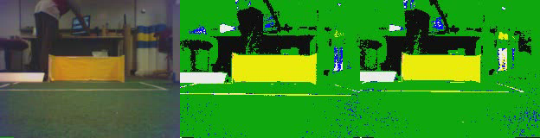
Minor Illumination changes – Video

Slide 29
To Summarize…
Color segmentation important sub-task of vision.
Color spaces: choice depends on applications and requirements.
Illumination effects color labels: humans adapt readily, but robots still need some help…

Slide 30
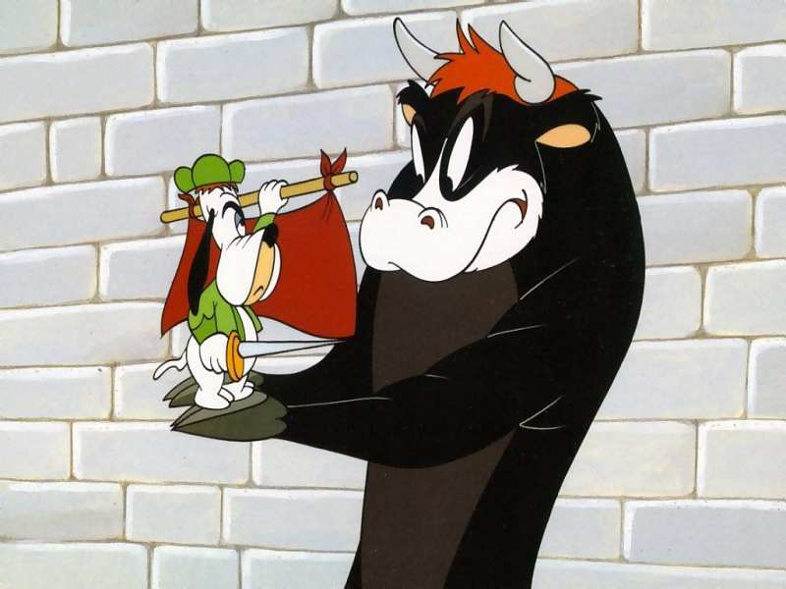
That’s all folks ☺

