Slide 1
An Analysis of the Sentiments of the Covid-19 and its Impacts on Economy
SICSS 2020 Group Project

Slide 2
Authors
Fatim Diabagate
Shruti Kulkarni
Matthew Martin
Julian Posada
Dan Xu
Baturay Yurtbay

Slide 3
Introduction
The COVID-19 pandemic is not only a health crisis, but an economic one as well
Governments are introducing measures to promote public health such as social distancing and closing of non-essential businesses. These measures help slow the spread of the pandemic but also have a negative consequence on the greater economy, including increasing unemployment, negatively impacting individual’s income and savings etc.
In democratic societies, it is important that leaders understand not just the public health and economic impacts of their policies, but also the public’s sentiment towards them. Effective democratic policies require popular support in order to be sustainable in the long-term.
Traditional methods of measuring public sentiment involve survey techniques that are expensive and do not reflect real-time changes in the population (which can change rapidly from day to day).
Our research seeks to find new means of measuring public sentiment related to COVID-19 and governmental response. In particular, we propose using a sentiment analysis of Twitter data related to COVID-19 and other policy-related keywords (such as governmental actors in different geographic regions)

Slide 4
Research Questions
Does Twitter sentiment correlate with traditional survey methods that measure public approval of governmental action related to COVID?
Looking at Leger surveys will examine this
What is the relationship between sentiment on Twitter related to COVID and the greater economy ie.economic indicators (unemployment rate, hiring probability, layoff rates, job mobility)?
Can we find proper keywords that indicate discussion about particular economic-related topics?
A topic analysis will examine this
How does this relationship differ across different countries, especially how it relates to # deaths, infections, lockdown strategies, etc.
Can we find proper keywords that indicate discussion about particular geographic areas and policies relevant to those areas?
A topic analysis will examine this

Slide 5
Methods
Topic Analysis
Sentiment analysis
Survey methods
COVID 19 Infection rates
Labor market indicators (forthcoming)

Slide 6
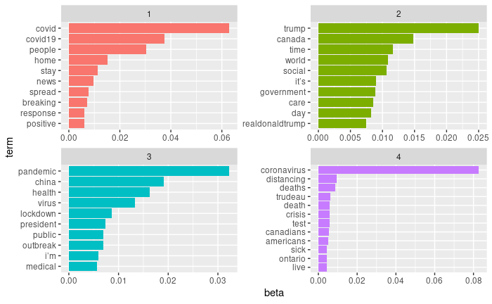
Topic analysis

Slide 7
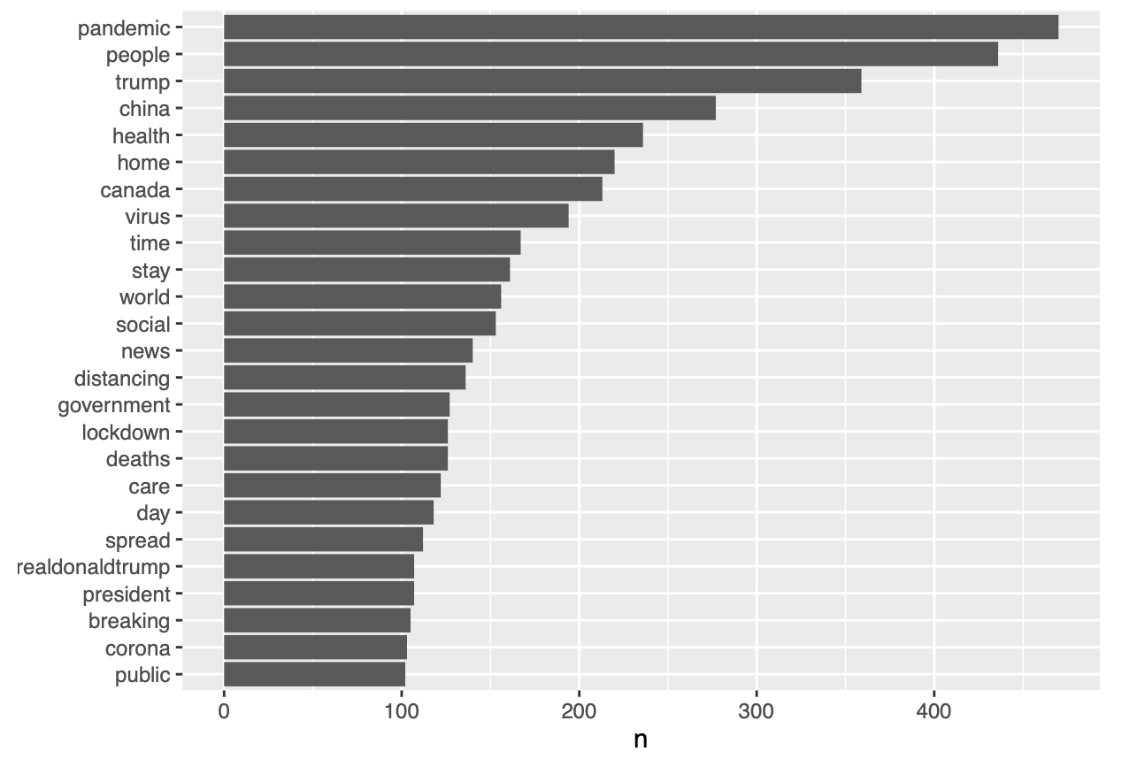
Most frequent words
Frequent topics:
‘Trump’, ‘U.S’
‘Trudeau’, ‘Canada’

Slide 8
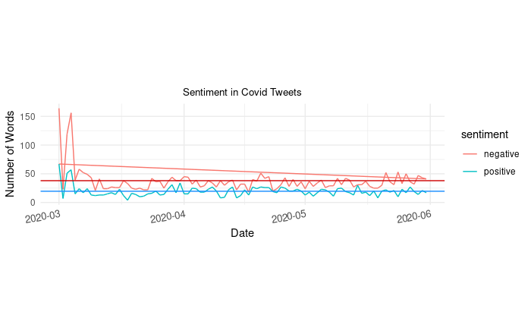
Sentiment

Slide 9
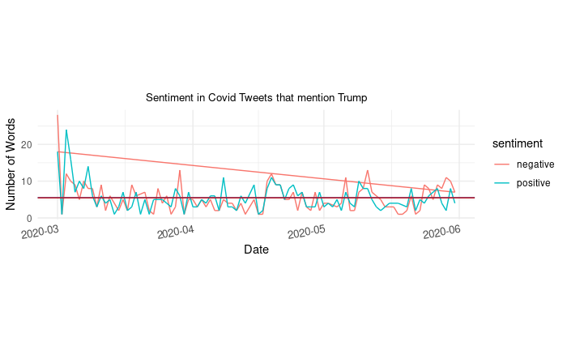
Sentiment Analysis

Slide 10
Survey Data: Leger COVID-19 Surveys
Are you personally afraid of contracting the COVID-19 (Coronavirus)?
Do you believe that the Canadian government are doing enough to protect Canadians from the risk posed by the coronavirus?
Do you believe that the COVID-19 pandemic is a real threat or is it being blown out of proportion?
At the moment, is the current crisis having a direct impact on you financially, when it comes to the following?
To this day, are you satisfied or not with the measures put in place to fight the COVID-19 (Coronavirus) pandemic by the following?
Which of the following best describes when you think your life will return to a normal schedule, following the Coronavirus global pandemic?
Notes:
https://leger360.com/surveys/concerns-about-covid-19-march-24-2020/

Slide 11
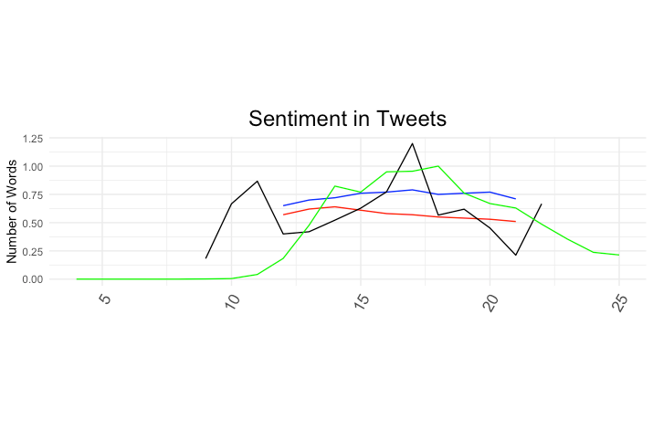
Canadians talking about ‘Canada’ or ‘Trudeau’, and COVID
Black = ratio of positive/negative tweets,
blue = survey approve,
red = survey fear,
green = number of COVID cases

Slide 12
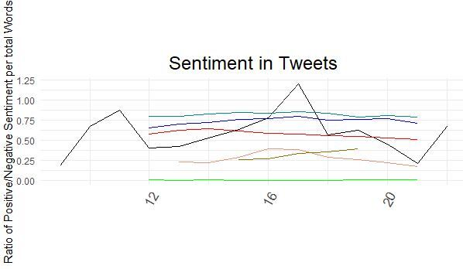
Canadians talking about ‘Canada’ or ‘Trudeau’, and COVID
Black = tweet positivity
Green = proportion of people already exposed
Pink= worst now
Cyan = satisfied with measures at province
Gold = percentage that do not commit with measures

Slide 13
Correlations
Spearman correlations were conducted between twitter sentiment (ratio of positive words / negative words) aggregated by week, and survey data of Canadian opinion towards various topics, measured weekly
tweet positivity and approval of measures at federal level
r = 0.81
tweets positivity and approval of measures from provincial gov
r = 0.75
tweet positivity and proportion that was exposed to the virus
r = -0.59
tweets positivity and proportion of people that think the pandemic is currently at its worst stage (being optimistic for future)
r =0.89
tweets positivity and proportion of people that do not commit with measures in place
r = -0.5
tweets positivity and proportion of people that think the pandemic threat is blown out of proportion
r=- 0.8
tweets positivity and cases of COVID
r = .33

Slide 14
Discussion
Twitter sentiment appears to be predictive of public attitudes regarding the government response to COVID
Shortcoming: small sample of weekly survey data (N = 10) limits generalizability
Future work: replicate results with USA, provincial data, different countries- Labor market indicators
Future work: more sophisticated multivariate statistical analysis, time-series

