Slide 1

Understanding Mixed Models Through Simulations A primer on power simulation
Julian Quandt
Wu Vienna University of Economics and Business
Slides and Code @ https://short.wu.ac.at/gz76

Slide 2
A few words before we start
First, I know the slides contain a lot of text – this is mainly so you can look at them later and still understand them without me talking through them. You don’t have to read everything as I am also going to explain it.
Full explanation of power simulation for mixed models beyond the scope of this talk
I wrote a rather long 4-part tutorial on power simulation, that contains the examples from his talk + many other details, so if you enjoy today’s talk, consider having a look
The focus of the tutorials is understanding simulation bottom-up, with using as little R packages as possible. IMO this gives a deeper understanding than using packages / functions on a high level of abstraction. That said, if your focus is on running power simulation with as little effort as possible, have a look at faux or simR instead - both are great and easier to use than simulating from scratch.
Today’s talk: How can simulations in R help us to understand mixed-effects models?
Why are simulations a useful tool
How to simulate mixed models from scratch
Understanding convergence warnings through simulations
If we have time: simulating random correlations, simulating binomial responses, residual variance decomposition, simulating level-2 nested data.

Slide 3
Part I
Prelude: Why simulations are useful

Slide 4
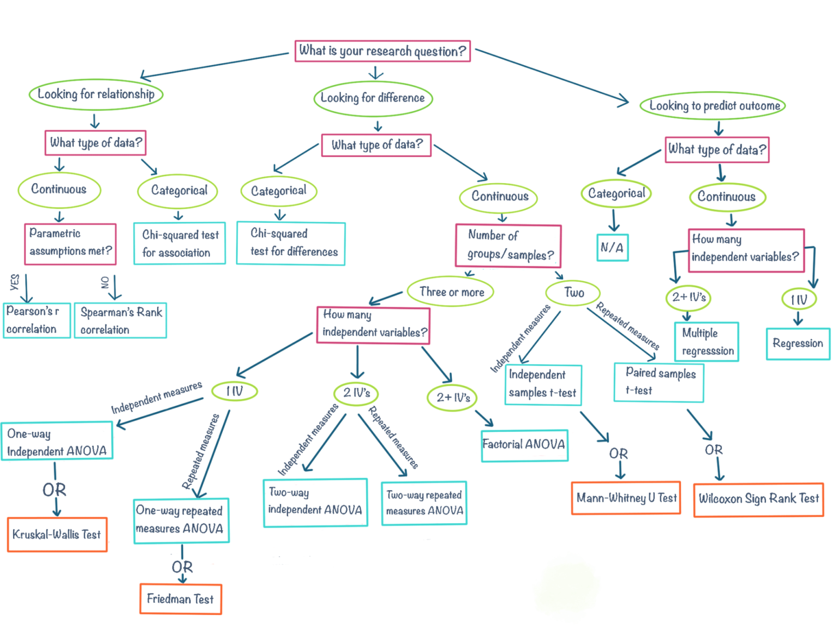
The garden of statistical analyses
Notes:
If you learned statistics anything like me, it probably looked like this, where you learned lots and lots of different analyses and were looking for which analysis would be the right one to apply to the data that you had.
If you had two groups, it’s a t-test, more groups, it’s ANOVA, non-normality → Kruskall-Wallis Test
In my opinion this approach to learning statistics is a little bit like the “Chinese Room” thought experiment, where a person is locked in a room and translates Chinese into English by looking up each Chinese character in a very long instruction manual without ever understanding what they are doing.
In other words, such an approach to statistics can, for some people, feel like a black box that does not really allow us, or at least require us, to understand the internal workings of statistical analyses.

Slide 5

Statistical analyses as linear models
$$Y= β_{0}+β_{1}∗X+∈$$
Check out this great overview by Kristoffer Lindeløv
Notes:
Interestingly, however, there is an alternative to this approach to statistics. Specifically, all the analyses shown in this graph can simply be expressed as a linear model
To me, who is not trained as a statistician, this was very surprising when I first learned that its possible for all these tests.
While this might seem like only an interesting side-note I think this insight can really change the way we approach statistical models.
Treating statistical analyses as variations of linear models allows us to approach statistics from a bottom-up perspective, where we start with a data-generating process in mind, and then just develop our predictions, power analysis and statistical tests from there.

Slide 6
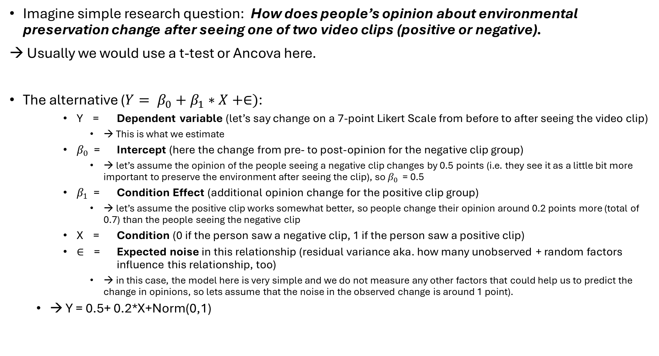
Two approaches to power analysis
Imagine simple research question: How does people’s opinion about environmental preservation change after seeing one of two video clips (positive or negative).
→ Usually we would use a t-test or Ancova here.
The alternative ($Y= β_{0}+β_{1}∗X+∈)$:
Y = Dependent variable (let’s say change on a 7-point Likert Scale from before to after seeing the video clip)
→ This is what we estimate
$β_{0}$ = Intercept (here the change from pre- to post-opinion for the negative clip group)
→ let’s assume the opinion of the people seeing a negative clip changes by 0.5 points (i.e. they see it as a little bit more important to preserve the environment after seeing the clip), so $β_{0}$ = 0.5
$β_{1}$ = Condition Effect (additional opinion change for the positive clip group)
→ let’s assume the positive clip works somewhat better, so people change their opinion around 0.2 points more (total of 0.7) than the people seeing the negative clip
X = Condition (0 if the person saw a negative clip, 1 if the person saw a positive clip)
$∈$ = Expected noise in this relationship (residual variance aka. how many unobserved + random factors influence this relationship, too)
→ in this case, the model here is very simple and we do not measure any other factors that could help us to predict the change in opinions, so lets assume that the noise in the observed change is around 1 point).
→ Y = 0.5+ 0.2*X+Norm(0,1)

Slide 7
Let’s try this in R

Slide 8
Summary of the simulation approach
We can use the linear model to simulate data
We come up with parameter values that we expect
We make a design matrix, that contains all the information that we need to calculate the dependent variable.
We add the dependent variable to the design matrix, and run the analysis on the simulated scores
→ If we repeat this like 1000 times and save the p-value for each simulation, we get the power of the test

Slide 9
Part II
Simulating Mixed-Effects Models

Slide 10
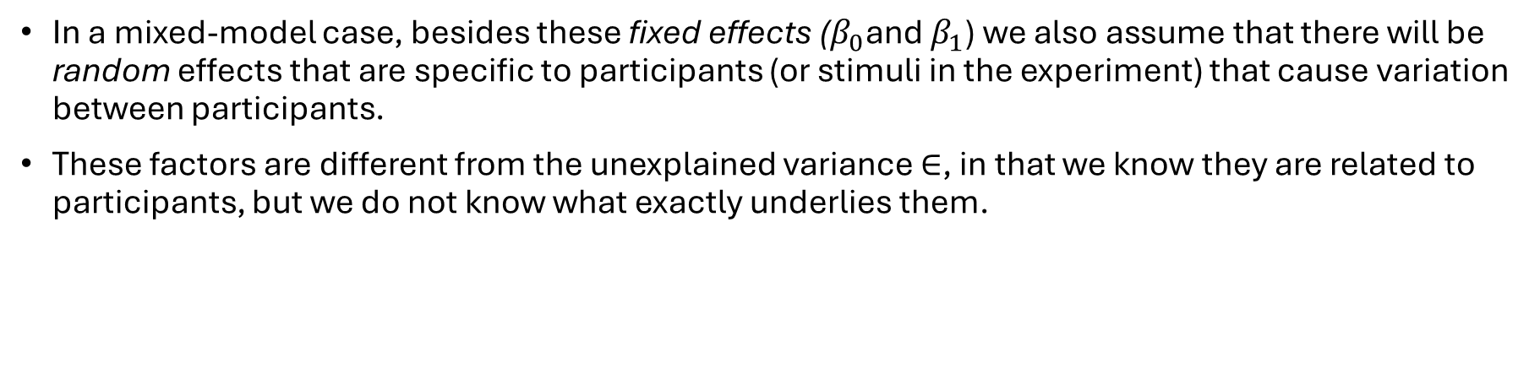
Extending the linear model with random effects
$$Y= β_{0}+β_{1}∗X+∈$$
DV
Overall mean
Treatment-specific adjustment
To overall mean
Unexplained Variance / Prediction Error
In a mixed-model case, besides these fixed effects ($β_{0}$and $β_{1}$) we also assume that there will be random effects that are specific to participants (or stimuli in the experiment) that cause variation between participants.
These factors are different from the unexplained variance $∈$, in that we know they are related to participants, but we do not know what exactly underlies them.
Notes:
As mentioned, all standard statistical models are in fact linear models and mixed models are no exception to this.

Slide 11
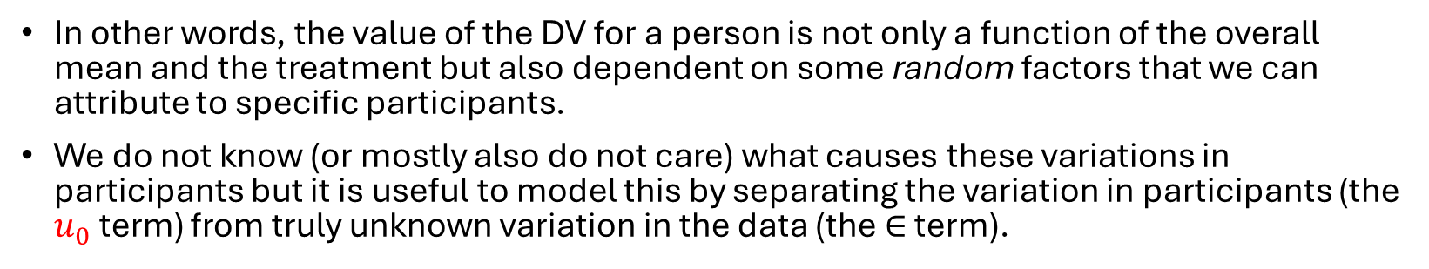
Extending the linear model with random effects
$$Y= β_{0}+u_{0}+β_{1}∗X+∈$$
DV
Overall mean
Treatment-specific adjustment
To overall mean
Unexplained Variance / Prediction Error
Participant-specific adjustment to overall mean
Random Intercept
In other words, the value of the DV for a person is not only a function of the overall mean and the treatment but also dependent on some random factors that we can attribute to specific participants.
We do not know (or mostly also do not care) what causes these variations in participants but it is useful to model this by separating the variation in participants (the $u_{0}$ term) from truly unknown variation in the data (the $∈$ term).
Notes:
As mentioned, all standard statistical models are in fact linear models and mixed models are no exception to this.

Slide 12
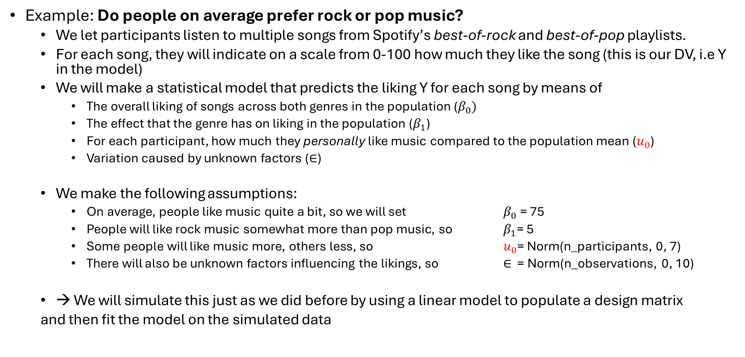
Extending the linear model with random effects
Example: Do people on average prefer rock or pop music?
We let participants listen to multiple songs from Spotify’s best-of-rock and best-of-pop playlists.
For each song, they will indicate on a scale from 0-100 how much they like the song (this is our DV, i.e Y in the model)
We will make a statistical model that predicts the liking Y for each song by means of
The overall liking of songs across both genres in the population ($β_{0})$
The effect that the genre has on liking in the population ($β_{1}$)
For each participant, how much they personally like music compared to the population mean ($u_{0}$)
Variation caused by unknown factors ($∈$)
We make the following assumptions:
On average, people like music quite a bit, so we will set $β_{0}$ = 75
People will like rock music somewhat more than pop music, so $β_{1}$= 5
Some people will like music more, others less, so $u_{0}$= Norm(n_participants, 0, 7)
There will also be unknown factors influencing the likings, so $∈$ = Norm(n_observations, 0, 10)
→ We will simulate this just as we did before by using a linear model to populate a design matrix
and then fit the model on the simulated data

Slide 13
Let’s try this in R

Slide 14
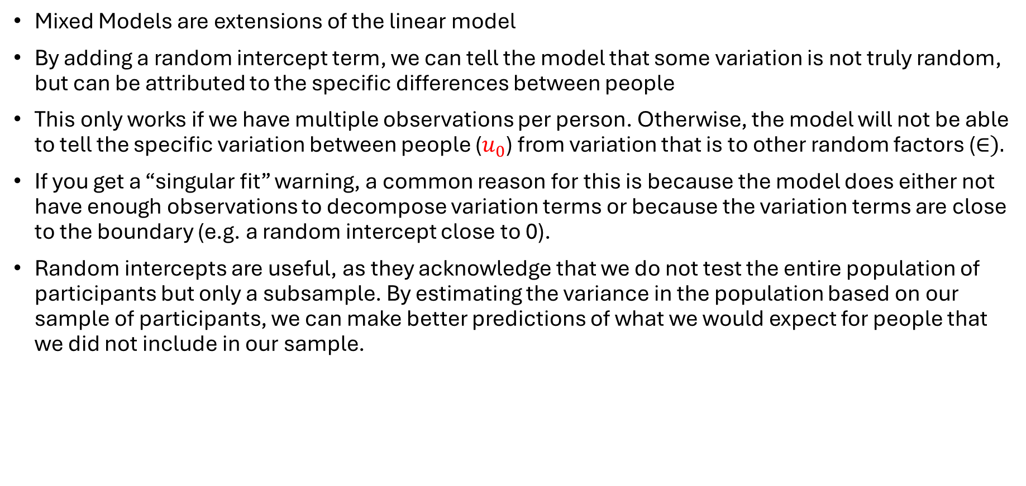
Interim Summary
Mixed Models are extensions of the linear model
By adding a random intercept term, we can tell the model that some variation is not truly random, but can be attributed to the specific differences between people
This only works if we have multiple observations per person. Otherwise, the model will not be able to tell the specific variation between people ($u_{0}$) from variation that is to other random factors ($∈).$
If you get a “singular fit” warning, a common reason for this is because the model does either not have enough observations to decompose variation terms or because the variation terms are close to the boundary (e.g. a random intercept close to 0).
Random intercepts are useful, as they acknowledge that we do not test the entire population of participants but only a subsample. By estimating the variance in the population based on our sample of participants, we can make better predictions of what we would expect for people that we did not include in our sample.

Slide 15

Extending the linear model with random effects
So far, we assume that no matter how much a person likes music in general, they will always like rock somewhat more than pop. However, it is likely that this differs among people.
There might be people who like music a lot in general (high $u_{0}$) but whether a specific song is pop or rock matters less to them.
There might also be people, for whom it matters more than 5 points, i.e. they also might like music on average but that is only because they LOVE rock songs, but strongly dislike pop songs.

Slide 16
Extending the linear model with random effects
$$Y= β_{0}+u_{0}+(β_{1}+u_{1})∗X+∈$$
Music ratings
(0-100)
Population music liking
Population genre effect
Unexplained Variance / Prediction Error
Participant-specific adjustment to music liking
Random Intercept
Participant specific adjustment to genre effect (how much a specific participant prefers rock over pop music)
Random slope for participants over genre
Notes:
As mentioned, all standard statistical models are in fact linear models and mixed models are no exception to this.

Slide 17
Let’s try this in R

Slide 18
Interim Summary
By adding random slopes to a model, we can account for our treatment / or experimental conditions, affecting different people differently.
This only works if we have multiple observations per participant per condition. If this is the case, it is always advisable to at least try and add this random effect to the model, as otherwise we might increase the risk of false positive conclusions (Type I errors) while also potentially sacrificing statistical power of our test.
For more information see this paper and these standard operating procedures on fitting mixed models

Slide 19
Extending the linear model with random effects
So far, we assume that each song is equally likely to be liked or disliked. However, it is more likely that:
Some songs will be universally liked more (the “hits” in each genre) while some songs will be liked less.
→ we can add these assumptions as random effects to the model, too.

Slide 20
Extending the linear model with random effects
$$Y= β_{0}+u_{0}+w_{0}+(β_{1}+u_{1})∗X+∈$$
Music ratings (0-100)
Population music liking
Population genre effect
Unexplained Variance / Prediction Error
Participant-specific adjustment to music liking
Random Intercept for participants
Participant specific adjustment to genre effect (how much a specific participant prefers rock over pop music)
Random slope for participants over genre
Song-specific adjustment to music liking
Random Intercept for songs
Notes:
As mentioned, all standard statistical models are in fact linear models and mixed models are no exception to this.

Slide 21
Let’s try this in R

Slide 22
Interim Summary
Random effects cannot only be estimated across people, but also stimuli.
This can be an important addition to a model, as we usually do not use the entire set of possible stimuli in the model. Here, for instance, we do not have people listen to all possible rock and pop songs, so it is useful to have an estimate for how much songs differ in terms of how much they are liked. This helps us make better predictions for songs that we did not include in the sample.

Slide 23
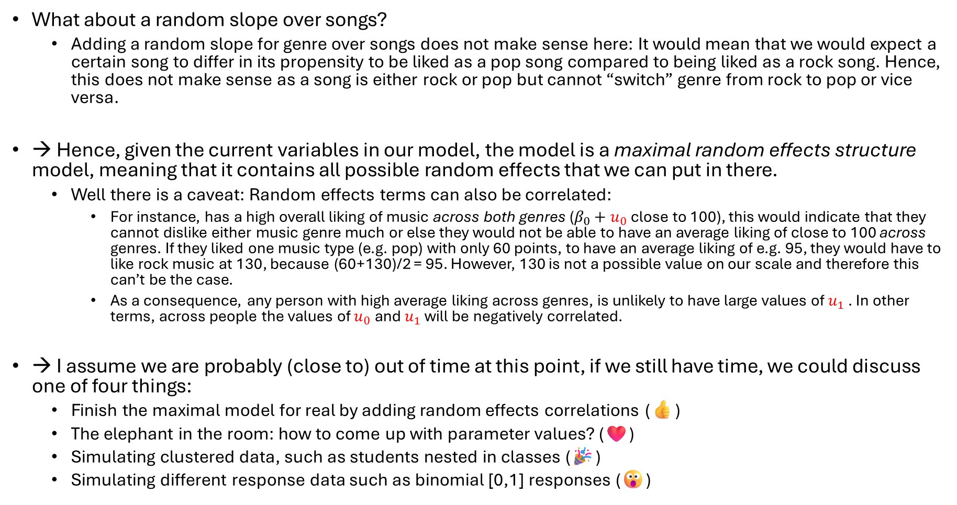
Extending the linear model with random effects
What about a random slope over songs?
Adding a random slope for genre over songs does not make sense here: It would mean that we would expect a certain song to differ in its propensity to be liked as a pop song compared to being liked as a rock song. Hence, this does not make sense as a song is either rock or pop but cannot “switch” genre from rock to pop or vice versa.
→ Hence, given the current variables in our model, the model is a maximal random effects structure model, meaning that it contains all possible random effects that we can put in there.
Well there is a caveat: Random effects terms can also be correlated:
For instance, has a high overall liking of music across both genres ($β_{0}+u_{0}$ close to 100), this would indicate that they cannot dislike either music genre much or else they would not be able to have an average liking of close to 100 across genres. If they liked one music type (e.g. pop) with only 60 points, to have an average liking of e.g. 95, they would have to like rock music at 130, because (60+130)/2 = 95. However, 130 is not a possible value on our scale and therefore this can’t be the case.
As a consequence, any person with high average liking across genres, is unlikely to have large values of $u_{1}$ . In other terms, across people the values of $u_{0}$ and $u_{1}$ will be negatively correlated.
→ I assume we are probably (close to) out of time at this point, if we still have time, we could discuss one of four things:
Finish the maximal model for real by adding random effects correlations (👍)
The elephant in the room: how to come up with parameter values? (❤️)
Simulating clustered data, such as students nested in classes (🎉)
Simulating different response data such as binomial [0,1] responses (😮)
Notes:
Check time here

Slide 24
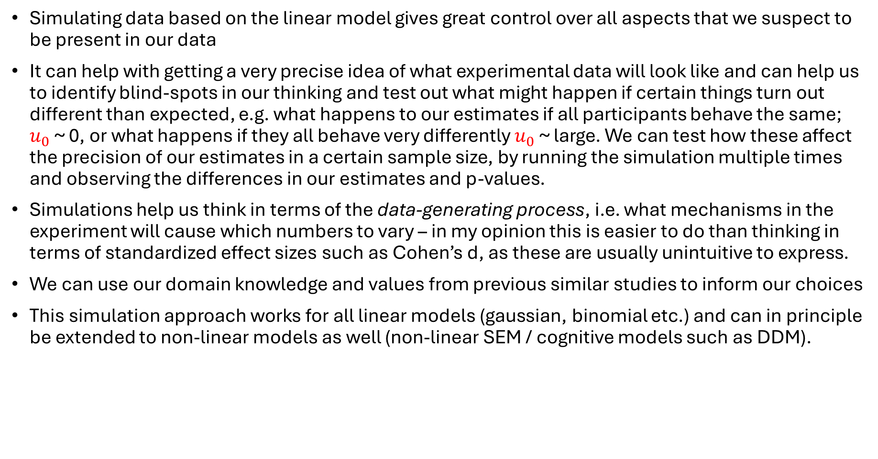
Conclusion
Simulating data based on the linear model gives great control over all aspects that we suspect to be present in our data
It can help with getting a very precise idea of what experimental data will look like and can help us to identify blind-spots in our thinking and test out what might happen if certain things turn out different than expected, e.g. what happens to our estimates if all participants behave the same; $u_{0}$ ~ 0, or what happens if they all behave very differently $u_{0}$ ~ large. We can test how these affect the precision of our estimates in a certain sample size, by running the simulation multiple times and observing the differences in our estimates and p-values.
Simulations help us think in terms of the data-generating process, i.e. what mechanisms in the experiment will cause which numbers to vary – in my opinion this is easier to do than thinking in terms of standardized effect sizes such as Cohen’s d, as these are usually unintuitive to express.
We can use our domain knowledge and values from previous similar studies to inform our choices
This simulation approach works for all linear models (gaussian, binomial etc.) and can in principle be extended to non-linear models as well (non-linear SEM / cognitive models such as DDM).
Notes:
Check time here

